Slide 1


Maths
Measurement
Year One
Maths | Year 4 | Measurement | Solving Time Problems | Lesson 1 of 4: Time Problems Involving Hours and Minutes

Slide 3
Aim
I can solve problems that involve converting units of time (hours
and minutes).
Success Criteria
I can convert from hours and minutes to minutes.
I can convert from minutes to hours and minutes.
I can solve problems that involve converting from hours and minutes to minutes and minutes to hours and minutes.

Slide 4

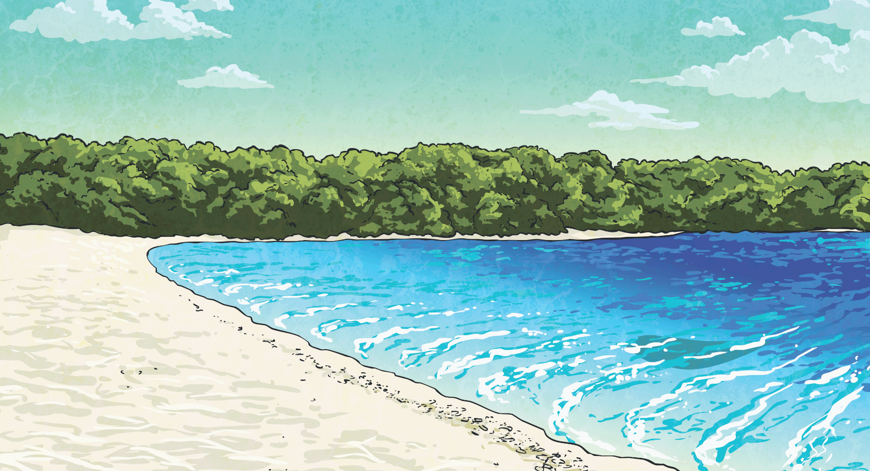
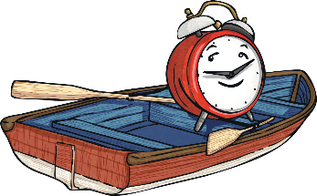
Comparing Time Units
Use the correct symbol (<, > or =) to compare these times:
>
<
=
125 seconds
>
1 minute
50 seconds

Slide 5
Comparing Time Units
Use the correct symbol (<, > or =) to compare these times:
>
<
=
2 minutes
20 seconds
<
150 seconds

Slide 6
Comparing Time Units
Use the correct symbol (<, > or =) to compare these times:
>
<
=
1 hour 15 minutes
=
75 minutes

Slide 7
Comparing Time Units
Use the correct symbol (<, > or =) to compare these times:
>
<
=
500 seconds
<
9 minutes

Slide 8
Comparing Time Units
Use the correct symbol (<, > or =) to compare these times:
>
<
=
1000 seconds
<
20 minutes

Slide 9
Comparing Time Units
Use the correct symbol (<, > or =) to compare these times:
>
<
=
2 hours
10 minutes
>
100 minutes
=
1 hour 40 minutes

Slide 10

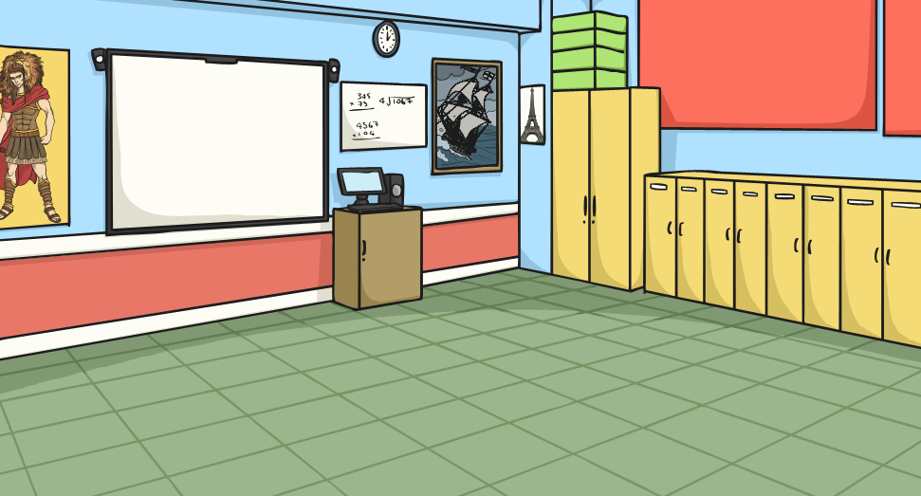
Comparing Time Units
Order these times from the longest time to the shortest time:
500 seconds
3 minutes
50 seconds
1 hour 5 minutes
30 minutes
2 hours
25 minutes
395 seconds
1
2 hours
25 minutes
2
1 hour 5 minutes
3
30 minutes
4
500 seconds
5
395 seconds
6
3 minutes
50 seconds

Slide 11

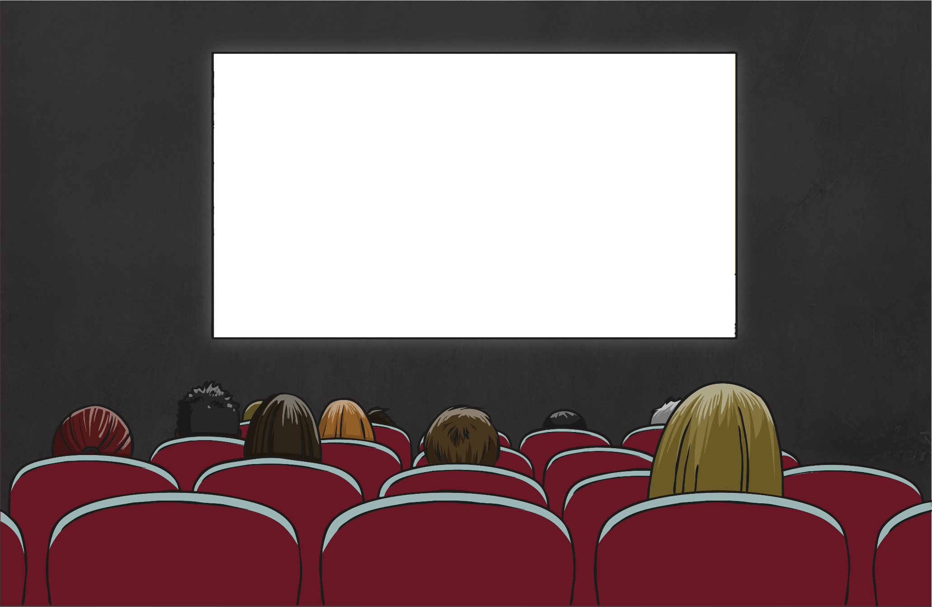
How Long Is That Film?
Now we have converted all the films into the same unit, it is easier to sort
them in order of length. This is the order from shortest to longest:
Convert the times to show them in minutes and in hours and minutes.
Here are the times for some popular films:
Film | Length in Hours and Minutes | Minutes
Toy Zone | 1h 21m
Timbo and the Golden Lion | 2h 32m
Scalliwags |  | 91m
Frozen World |  | 102m
Finding Billy | 1h 37m
Horses in the Wild |  | 178m
Film | Length in Hours and Minutes | Minutes
Toy Zone | 1h 21m | 81m
Scalliwags | 1h 31m | 91m
Finding Billy | 1h 37m | 97m
Frozen World | 1h 42m | 102m
Timbo and the Golden Lion | 2h 32m | 152m
Horses in the Wild | 2h 58m | 178m
1
81m
2
152m
3
1h 31m
4
1h 42m
5
97m
6
2h 58m

Slide 12
How Long Is That Film?
We can now work out how much longer one film is than another:
Film | Length in Hours and Minutes | Minutes
Toy Zone | 1h 21m | 81m
Scalliwags | 1h 31m | 91m
Finding Billy | 1h 37m | 97m
Frozen World | 1h 42m | 102m
Timbo and the Golden Lion | 2h 32m | 152m
Horses in the Wild | 2h 58m | 178m
How much longer is Timbo and the Golden Lion than Toy Zone?
152 – 81 =
71 minutes

Slide 13
How Long Is That Film?
Can you solve this problem? Write the answer on a whiteboard.
Film | Length in Hours and Minutes | Minutes
Toy Zone | 1h 21m | 81m
Scalliwags | 1h 31m | 91m
Finding Billy | 1h 37m | 97m
Frozen World | 1h 42m | 102m
Timbo and the Golden Lion | 2h 32m | 152m
Horses in the Wild | 2h 58m | 178m
How much longer is Frozen World
than Scalliwags?
102 – 91 =
11 minutes
How much longer is Horses in the Wild than Finding Billy?
178 – 97 =
81 minutes

Slide 14

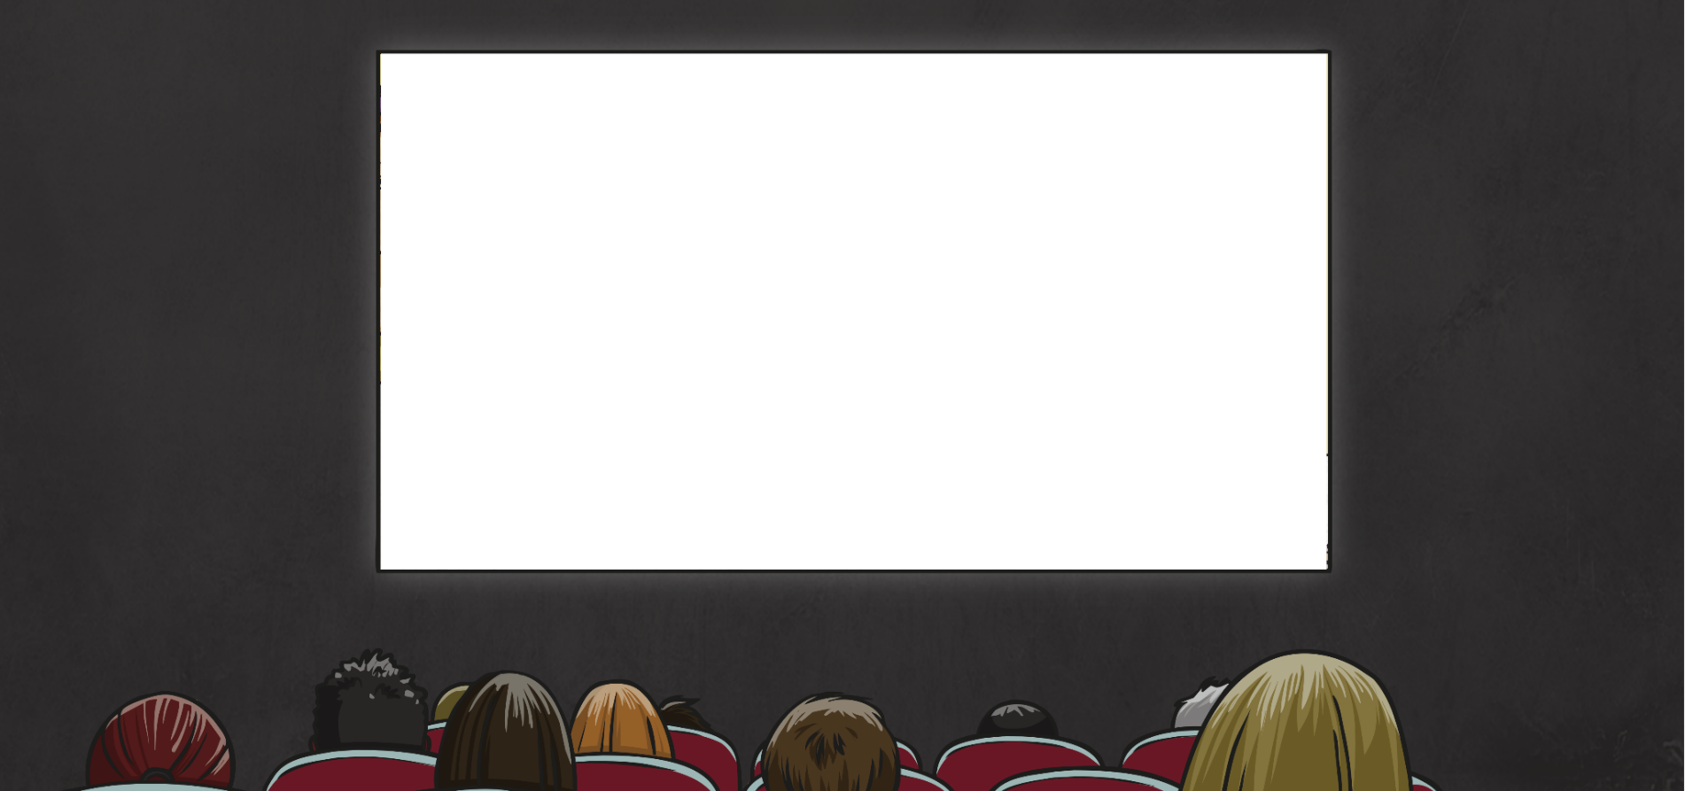
What Time Does It End?
If Scalliwags (length: 1h 31m or 91m) starts at 3 p.m., what time will it end?
Is it best to use hours and minutes or minutes to work this out?
You could work this out on a number line using hours and minutes.
+ 1 hour
+ 31 minutes
Start:
3 p.m.
4 p.m.
4:31 p.m.

Slide 15
What Time Does It End?
If Finding Billy (length: 1h 37m or 97m) starts at 4:30 p.m.,
what time will it end?
+ 1 hour
+ 30 minutes
+ 7 minutes
Start:
4:30 p.m.
5:30 p.m.
6:00 p.m.
6:07 p.m.

Slide 16
What Time Does It End?
If Horses in the Wild (length: 2h 58m or 178m) starts at 11:00 p.m.,
what time will it end?
+ 2 hours
+ 58 minutes
Start:
11:00 a.m.
1:00 p.m.
1:58 p.m.

Slide 17

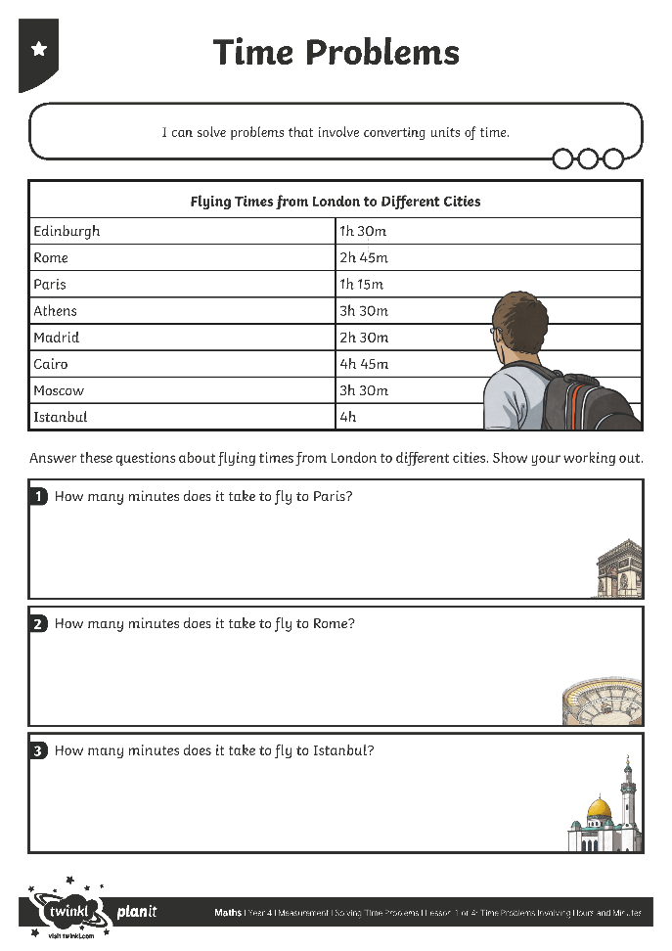
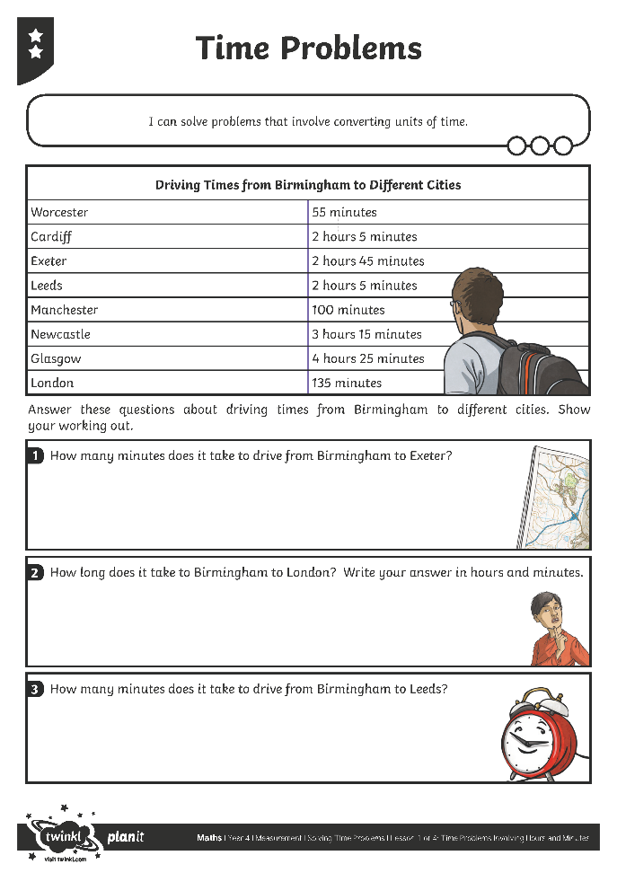

Time Problems
Use your mastery skills to complete this activity sheet.

Slide 18

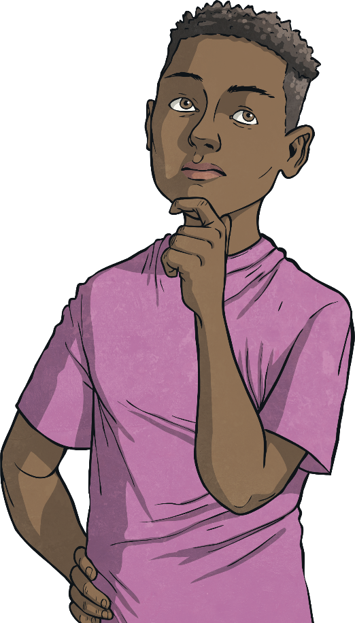
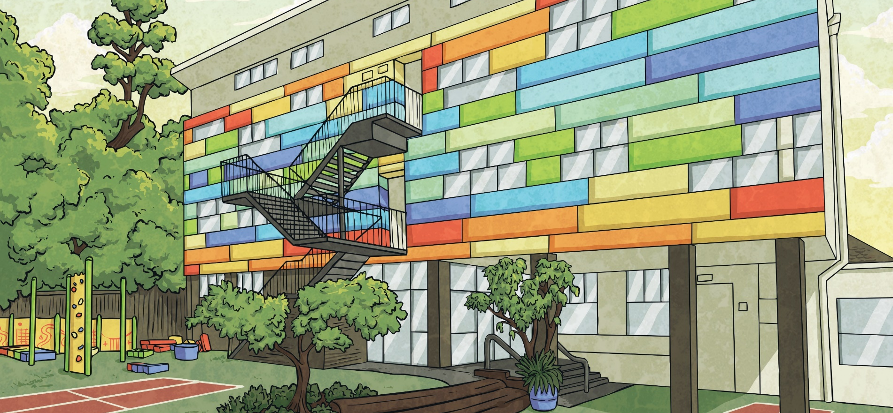
Plan the Activities
At Starlight Holiday Club, there are a variety of activities for children to choose from. Daniel is planning how he will spend his time. Some of the activities have a particular start time, so he needs to bear this in mind. His session starts at 9 a.m. and ends at 1 p.m.
Activity | Start Time (if there is one) | Length of Activity
Drawing |  | 45 minutes
Football skills | 10:00 a.m. | 1 hour
Sweet making |  | 30 minutes
Dance lesson | 11:15 a.m. | 50 minutes
Pottery |  | 40 minutes
Photography | 10:30 a.m. | 1 hour
Watching a film | 11:00 a.m. | 90 minutes
Puppet making |  | 25 minutes
Your task is to plan a morning of activities for Daniel. Decide how you will record the activities he chooses.

Slide 19

Aim
I can solve problems that involve converting units of time (hours
and minutes).
Success Criteria
I can convert from hours and minutes to minutes.
I can convert from minutes to hours and minutes.
I can solve problems that involve converting from hours and minutes to minutes and minutes to hours and minutes.

