Slide 1
National Curriculum Objective
L.O: To reflect objects in the first quadrant

Slide 2
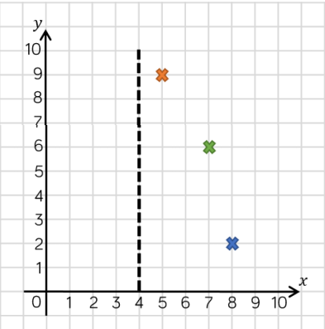
L.O: To reflect objects in the first quadrant
The dotted line is the line of reflection. (reflective vertex)
You need to count carefully to make sure there is the same distance on either side of the mirror line.
I have reflected the blue cross for you.

Slide 3

Reflection with Coordinates
Diving
Jermaine wants to reflect the blue rectangle in the mirror line.
Draw the reflected shape.
The reflected shape is shown in green.
10
9
8
7
6
5
4
3
2
1
0
0
0
1
2
3
4
5
6
7
8
9
10

Slide 4

Reflection with Coordinates
Deeper
You could focus on one vertex at a time, counting the distance from the mirror line and repeating this distance across the mirror line, plotting the points as you go to show the reflected shape.
You could focus on one vertex at a time, counting the distance from the mirror line and repeating this distance across the mirror line, plotting the points as you go to show the reflected shape.
How could you reflect the shape if you didn’t have a mirror to hand?
10
9
8
7
6
5
4
3
2
1
0
0
0
1
2
3
4
5
6
7
8
9
10

Slide 5
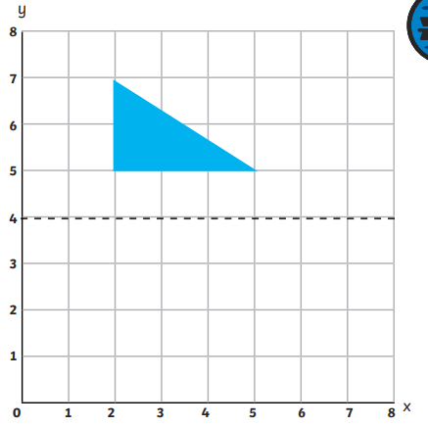
L.O: To reflect objects in the first quadrant
Remember to reflect one vertex (point) at a time and then use a ruler to join the points.

Slide 6
L.O: To reflect objects in the first quadrant
Remember to reflect one vertex (point) at a time and then use a ruler to join the points.
Don’t just move the shape – remember that the dotted line is a mirror!

Slide 7
L.O: To reflect objects in the first quadrant
Now have a go at your activity sheet. The first four questions are fluency based and then you are challenged further with some reasoning.
It might help you to check your answers with a mirror if you have one.

