Slide 1
L.O: To recognise parallel and perpendicular lines

Slide 2
L.O: To recognise parallel and perpendicular lines
Perpendicular lines are at right angles to each other.
There are 90° between 2 perpendicular lines
Where you spot a right angle, you spot a pair of perpendicular lines!

Slide 3
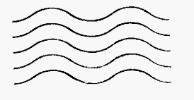


L.O: To recognise parallel and perpendicular lines
Parallel lines always stay the same distance from each other (like train tracks)
Parallel lines can be straight or wavy.

Slide 4
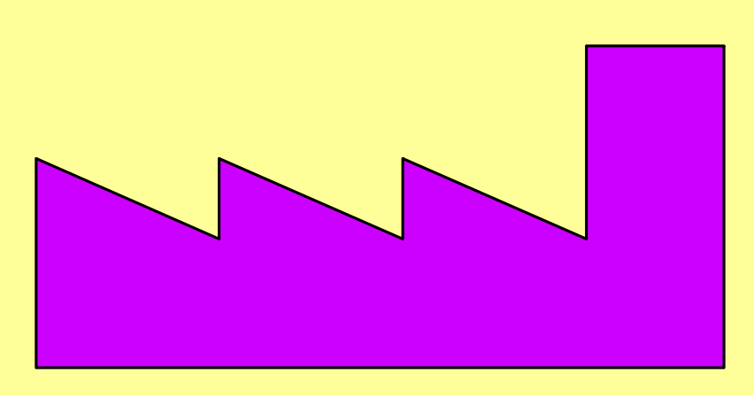
L.O: To recognise parallel and perpendicular lines
Here are 2 sets of perpendicular lines.
Can you spot 2 more sets?

Slide 5
L.O: To recognise parallel and perpendicular lines

Slide 6
L.O: To recognise parallel and perpendicular lines
Which lines are parallel to each other?

Slide 7
L.O: To recognise parallel and perpendicular lines

Slide 8
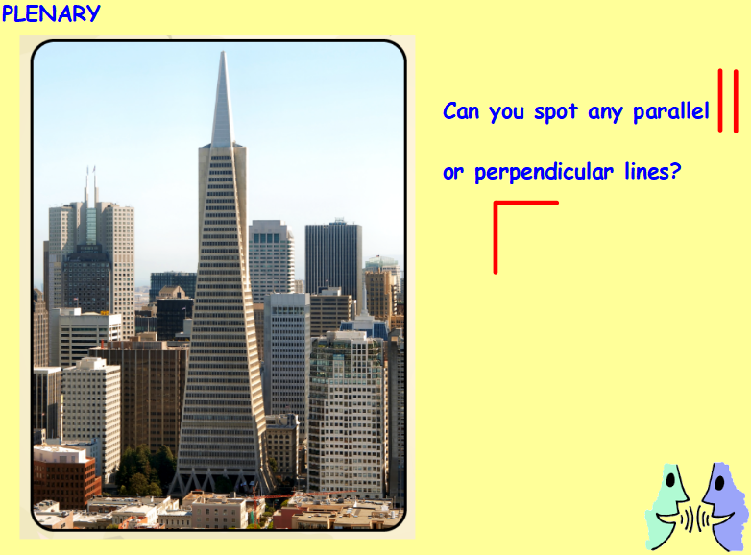

Slide 9
L.O: To recognise horizontal, diagonal and vertical lines
Use a ruler to draw the lines.
a) Draw a horizontal line 5 cm long.
b) Draw a line that is not horizontal or vertical.
c) Draw a vertical line 5 cm long.

Slide 10
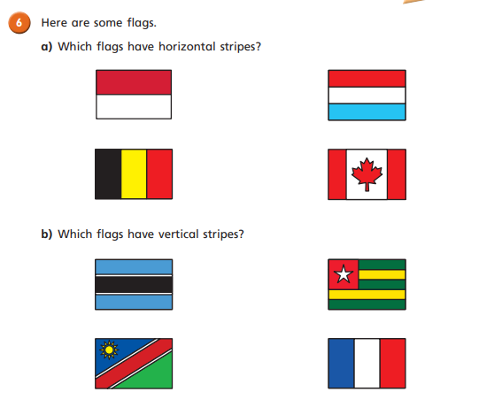

Slide 11
