Slide 1
L.O: To recognise horizontal, vertical and diagonal lines

Slide 2
L.O: To recognise horizontal, diagonal and vertical lines

Slide 3
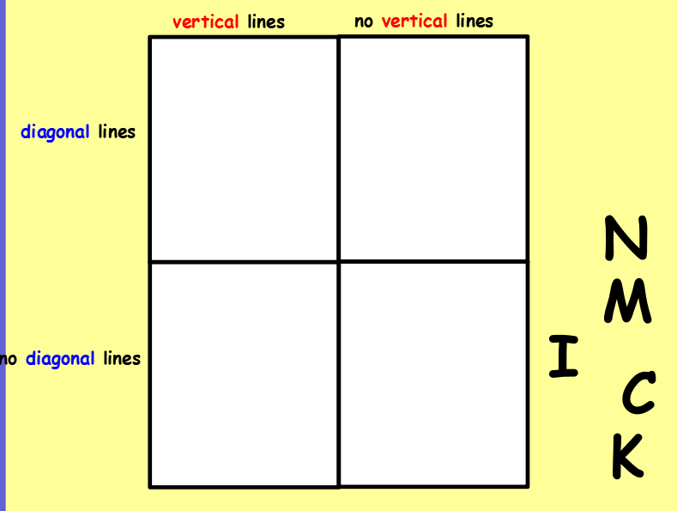
L.O: To recognise horizontal, diagonal and vertical lines
Where would you put these shapes on the carroll diagram?
Answers on the next slide

Slide 4
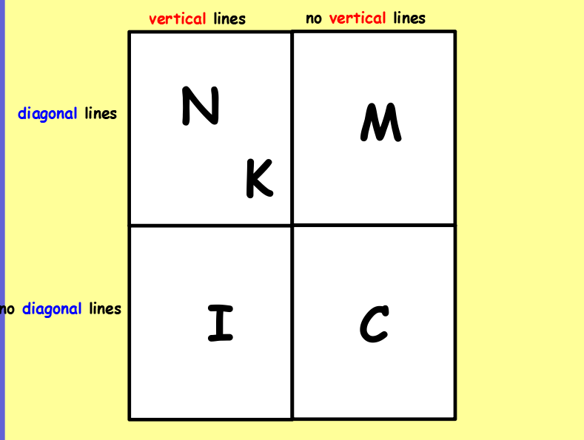

Slide 5
L.O: To recognise horizontal, diagonal and vertical lines
Use a ruler to draw the lines.
a) Draw a horizontal line 5 cm long.
b) Draw a line that is not horizontal or vertical.
c) Draw a vertical line 5 cm long.

Slide 6
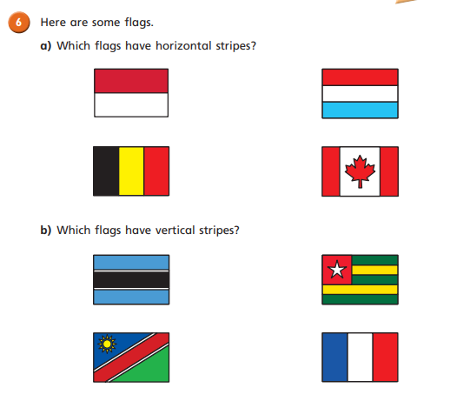

Slide 7
