Slide 1
L.O: To compare angles

Slide 2
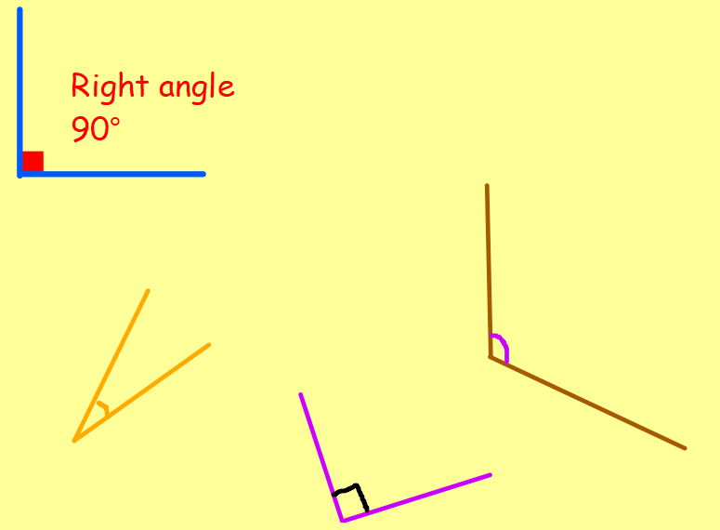
L.O: To compare angles
Are these angles bigger or smaller than a right angle?
You can use your angle checker to check!

Slide 3
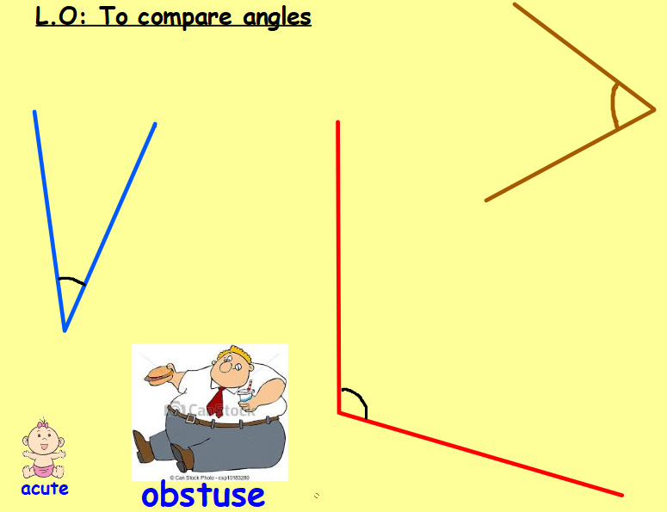
Remember that smaller than a right angle is called acute (think of a cute baby)
Bigger than a right angle is called obtuse.

