Slide 1


Maths
Measurement
Year One
Maths | Year 4 | Measurement | Telling the Time 12-Hour and 24-Hour | Lesson 4 of 4: 24-Hour to 12-Hour (Numbers and Words)

Slide 3
Aim
I can convert 24-hour times to 12-hour times.
Success Criteria
I can convert 24-hour times to 12-hour times, using a.m. for times up to 12:00.
I can convert 24-hour times to 12-hour times, using p.m. for times after 12:00.
I can change digital times which use a.m. and p.m. to times using numbers and words.
I can use in the morning, in the afternoon and in the evening in place of a.m. and p.m.

Slide 4
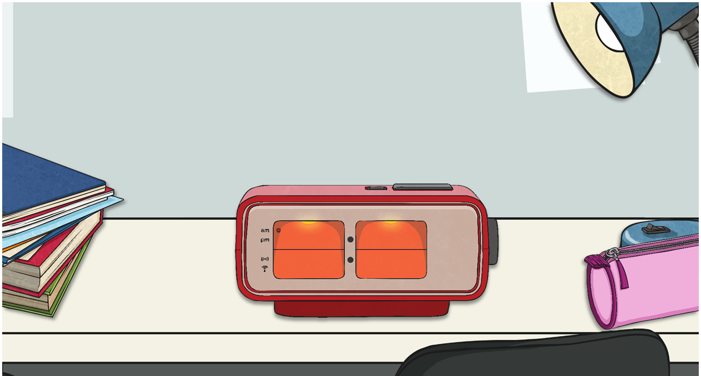


Digital to Analogue
When you see the digital time, convert it to numbers and words:
17 minutes past 3

Slide 5



Digital to Analogue
When you see the digital time, convert it to numbers and words:
4 minutes past 12

Slide 6


Digital to Analogue
When you see the digital time, convert it to numbers and words:
25 minutes to 9

Slide 7
Digital to Analogue
When you see the digital time, convert it to numbers and words:
20 minutes to 12

Slide 8
Digital to Analogue
When you see the digital time, convert it to numbers and words:
18 minutes past 4

Slide 9
Digital to Analogue
When you see the digital time, convert it to numbers and words:
17 minutes to 12

Slide 10

Digital to Analogue
When you see the digital time, convert it to numbers and words:
2 minutes to 10

Slide 11
Digital to Analogue
When you see the digital time, convert it to numbers and words:
28 minutes past 8

Slide 12

Digital to Analogue
When you see the digital time, convert it to numbers and words:
24 minutes to 11

Slide 13
Digital to Analogue
When you see the digital time, convert it to numbers and words:
11 minutes to 8

Slide 14

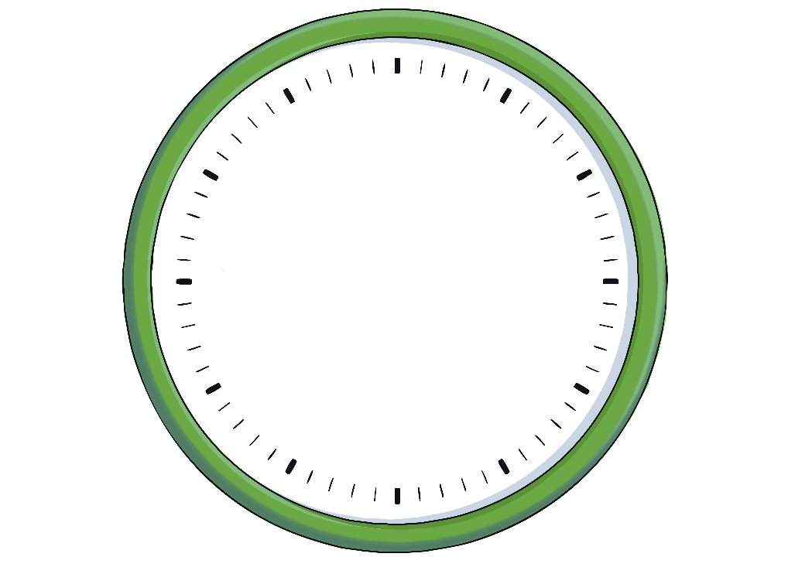

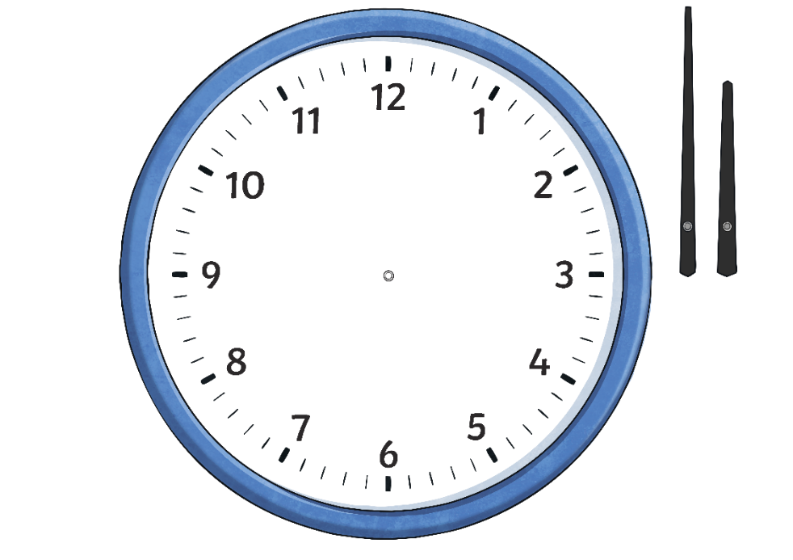
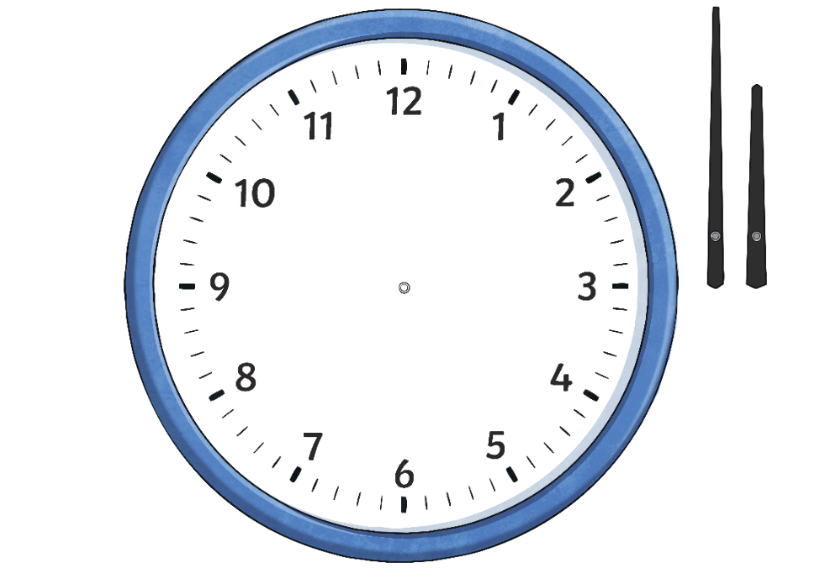
12- and 24-Hour Time
On a 12-hour clock, when the hour hand has gone all the way round the clock once, we start counting again from 1. We use a.m. and p.m. to tell the difference between times before 12 p.m. and after 12 p.m.
On a 24-hour clock, when the hour hand has gone all the way round the clock once, we keep counting all the way up to 24. We do not need to use a.m. or p.m.
00
23
13
11
12
22
1
14
10
2
21
9
3
15
23:00
04:00
05:00
06:00
07:00
08:00
09:00
10:00
11:00
12:00
13:00
14:00
16:00
17:00
18:00
19:00
20:00
22:00
00:00
01:00
02:00
03:00
00:00
15:00
21:00
8
4
20
7
5
16
11:00 p.m.
4:00 a.m.
5:00 a.m.
6:00 a.m.
7:00 a.m.
8:00 a.m.
9:00 a.m.
10:00 a.m.
11:00 a.m.
12:00 p.m.
1:00 p.m.
2:00 p.m.
4:00 p.m.
5:00 p.m.
6:00 p.m.
7:00 p.m.
8:00 p.m.
10:00 p.m.
12:00 a.m.
1:00 a.m.
2:00 a.m.
3:00 a.m.
12:00 a.m.
3:00 p.m.
9:00 p.m.
6
19
17
18

Slide 15

Converting 12-Hour Times
to 24-Hour Times
Let’s recap on changing 12-hour times into 24-hour times.
Can you remember how to change a 12-hour a.m. time into 24-hour time?
7:15 a.m.
We do not need to write a.m. or p.m. in 24-hour time.
07
15
__:__
We write the hour before the colon. If the hour is a smaller number than 10, we write a 0 to fill the gap.
We write the minutes after the colon.

Slide 16
Converting 12-Hour Times
to 24-Hour Times
Let’s recap on changing 12-hour times into 24-hour times.
Can you remember how to change a 12-hour p.m. time into 24-hour time?
2:30 p.m.
We do not need to write a.m. or p.m. in 24-hour time.
14
30
__:__
Add 12 to the p.m. hour to find the 24-hour time. We write the hour before the colon.
We write the minutes after the colon.

Slide 17

Converting 12-Hour Times
to 24-Hour Times
Try to match the equivalent 12-hour and 24-hour times.
8:45 a.m.
6:45 p.m.
6:45 a.m.
8:45 p.m.
18:45
20:45
08:45
06:45
ANSWER

Slide 18

Converting 12-Hour Times
to 24-Hour Times
When you know how to change 12-hour times to 24-hour times, it is easy to change 24-hour times to 12-hour times. You just do it the other way round!
If the hours are less than 12, this means it is before midday. All you need to do is remove the 0 and add a.m. to the end.
06:30
6:30 a.m.

Slide 19
Converting 12-Hour Times
to 24-Hour Times
If the hours are greater than 12, this means it is after midday. To change it to a 12-hour time, subtract 12 from the hours and add p.m. to the end.
19:10
7:10 p.m.

Slide 20
Converting 12-Hour Times
to 24-Hour Times
Can you write each 24-hour time as a 12-hour time?
09:00
9:00 a.m.

Slide 21
Converting 12-Hour Times
to 24-Hour Times
Can you write each 24-hour time as a 12-hour time?
22:10
10:10 p.m.

Slide 22
Converting 12-Hour Times
to 24-Hour Times
Can you write each 24-hour time as a 12-hour time?
01:05
1:05 a.m.

Slide 23
Converting 12-Hour Times
to 24-Hour Times
Can you write each 24-hour time as a 12-hour time?
13:30
1:30 p.m.

Slide 24
Converting 12-Hour Times
to 24-Hour Times
Can you write each 24-hour time as a 12-hour time?
07:00
7:00 a.m.

Slide 25
Converting 12-Hour Times
to 24-Hour Times
Can you write each 24-hour time as a 12-hour time?
18:40
6:40 p.m.

Slide 26
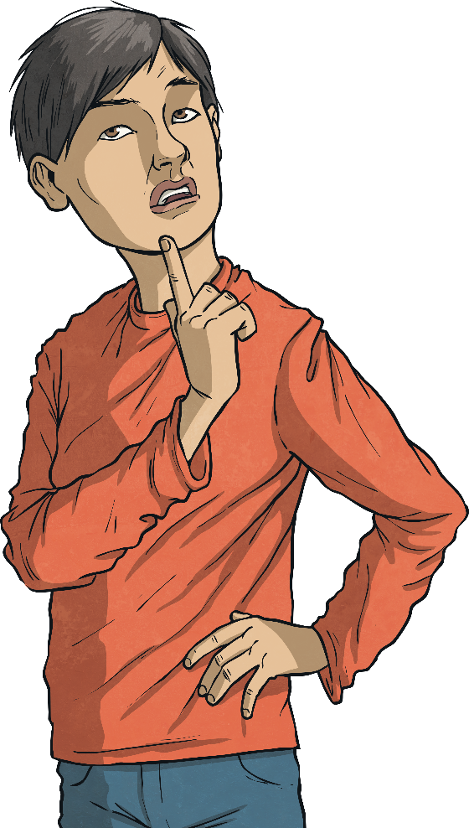
Time for a Change!
Change each 24-hour time to a 12-hour time using a.m. or p.m. Then change it to words and numbers using 'in the morning', 'in the afternoon' or 'in the evening’.
05:40
18:25
5:40 a.m.
6:25 p.m.
20 to 6 in the morning
25 past 6 in the evening

Slide 27
Time for a Change!
Change each 24-hour time to a 12-hour time using a.m. or p.m. Then change it to words and numbers using 'in the morning', 'in the afternoon' or 'in the evening’.
11:35
20:18
11:35 a.m.
8:18 p.m.
25 to 12 in the morning
18 minutes past 8 in the evening

Slide 28
Time for a Change!
Change each 24-hour time to a 12-hour time using a.m. or p.m. Then change it to words and numbers using 'in the morning', 'in the afternoon' or 'in the evening’.
03:42
15:26
3:42 a.m.
3:26 p.m.
18 minutes to 4 in the morning
26 minutes past 3 in the afternoon

Slide 29
Time for a Change!
Change each 24-hour time to a 12-hour time using a.m. or p.m. Then change it to words and numbers using 'in the morning', 'in the afternoon' or 'in the evening’.
07:39
23:17
7:39 a.m.
11:17 p.m.
21 minutes to 8 in the morning
17 minutes past 11 in the evening

Slide 30

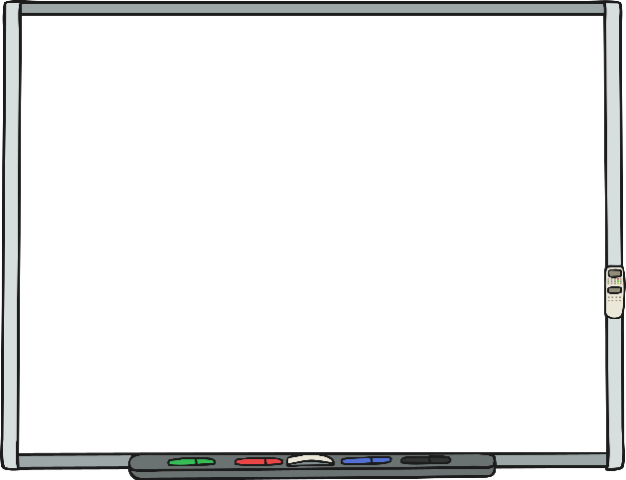
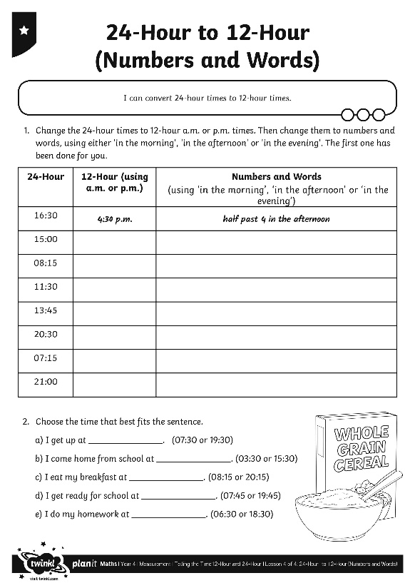
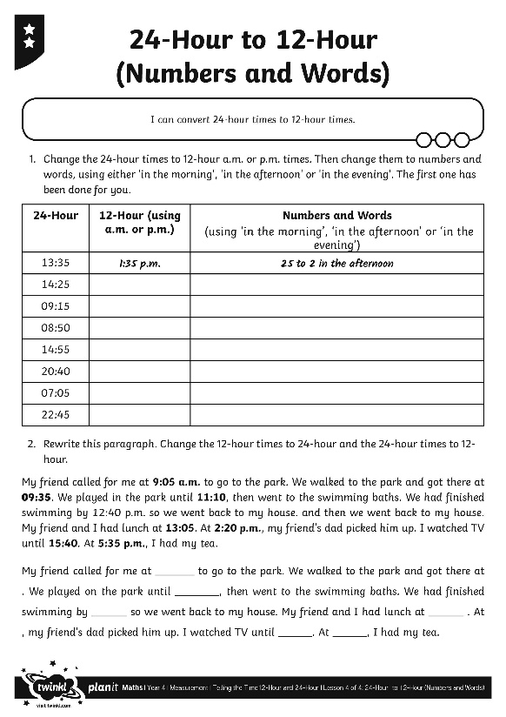

24-Hour to 12-Hour
(Numbers and Words)
Use your super time skills to complete the activity sheet.

Slide 31
Rewrite It
Rewrite this paragraph on the My Day Sheet. Where you see a 24-hour time, change it to words and numbers using either ‘in the morning’, ‘in the afternoon’ or ‘in the evening’. The first time has been written for you.
At half past 7 in the morning, I woke up. I went downstairs and had my breakfast at 07:45. At 08:35, I left the house and walked to school. After the register at 09:05, we went into assembly, which lasted until 09:27. We had maths first and playtime was at 10:30. It was raining, so we had to come back into class at 10:38. The bell for lunch went at 12:15. At 12:37, my class were called into the dining hall to have our lunch. Afternoon classes began at 12:55. School finished at 15:15 and I arrived home at 15:39. I watched TV until 16:18 and then I did my homework. We ate our evening meal at 17:48 and I stayed up until 20:30. I fell asleep at 20:54.

Slide 32

Rewrite It
At half past 7 in the morning, I woke up. I went downstairs and had my breakfast at quarter to 8 in the morning. At 25 to 9 in the morning, I left the house and walked to school. After the register at 5 past 9 in the morning,,we went into assembly, which lasted until 27 minutes past 9 in the morning. We had maths first and playtime was at half past 10 in the morning. It was raining, so we had to come back into class at 22 minutes to 11 in the morning. The bell for lunch went at quarter past 12 in the afternoon. At 23 minutes to 1 in the afternoon, my class were called into the dining hall to have our lunch. Afternoon classes began at 5 to 1 in the afternoon. School finished at quarter past 3 in the afternoon and I arrived home at 21 minutes to 4 in the afternoon. I watched TV until 18 minutes past 4 in the afternoon and then I did my homework. We ate our evening meal at 12 minutes to 6 in the evening and I stayed up until half past 8 in the evening. I fell asleep at 6 minutes to 9 in the evening.
How does this paragraph sound?
Is this the best way to write the time in this type of paragraph?

Slide 33

Aim
I can convert 24-hour times to 12-hour times.
Success Criteria
I can convert 24-hour times to 12-hour times, using a.m. for times up to 12:00.
I can convert 24-hour times to 12-hour times, using p.m. for times after 12:00.
I can change digital times which use a.m. and p.m. to times using numbers and words.
I can use in the morning, in the afternoon and in the evening in place of a.m. and p.m.

