Slide 1


Year 4 – Summer Block 3 – Time – Analogue to Digital – 12 Hour
About This Resource:
It includes a starter activity and an example of each question from the Varied Fluency and Reasoning and Problem Solving resources also provided in this pack. You can choose to work through all examples provided or a selection of them depending on the needs of your child.
National Curriculum Objectives:
Mathematics Year 4: (4M4b) Read, write and convert time between analogue and digital 12- and 24-hour clocks
© Classroom Secrets Limited 2018

Slide 2
Year 4 – Summer Block 3 – Time
Step 3: Analogue to
Digital – 12 hour
© Classroom Secrets Limited 2018

Slide 3
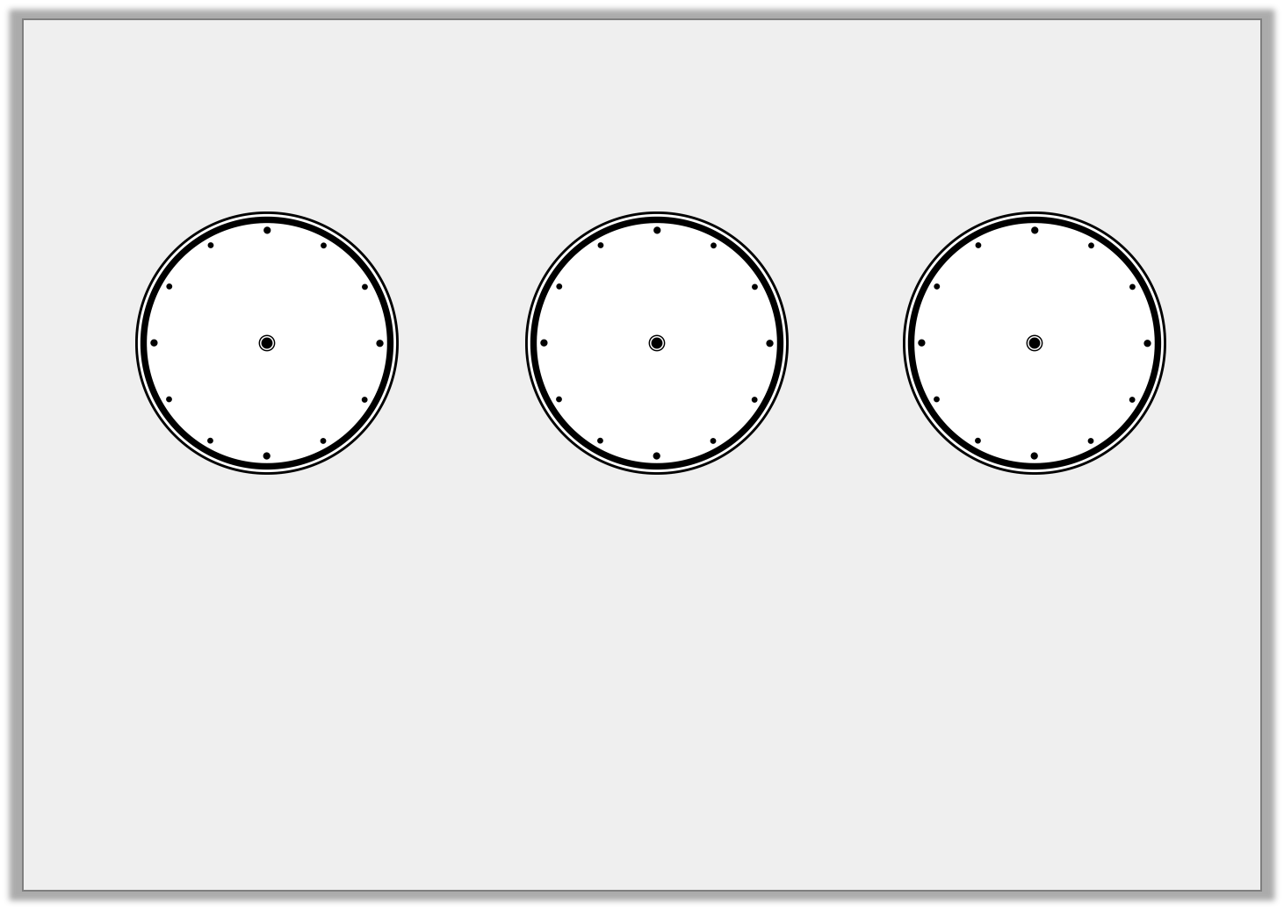
Introduction
Match the times.
9:17
12:21
3:46
© Classroom Secrets Limited 2018

Slide 4
Introduction
Match the times.
9:17
12:21
3:46
© Classroom Secrets Limited 2018

Slide 5
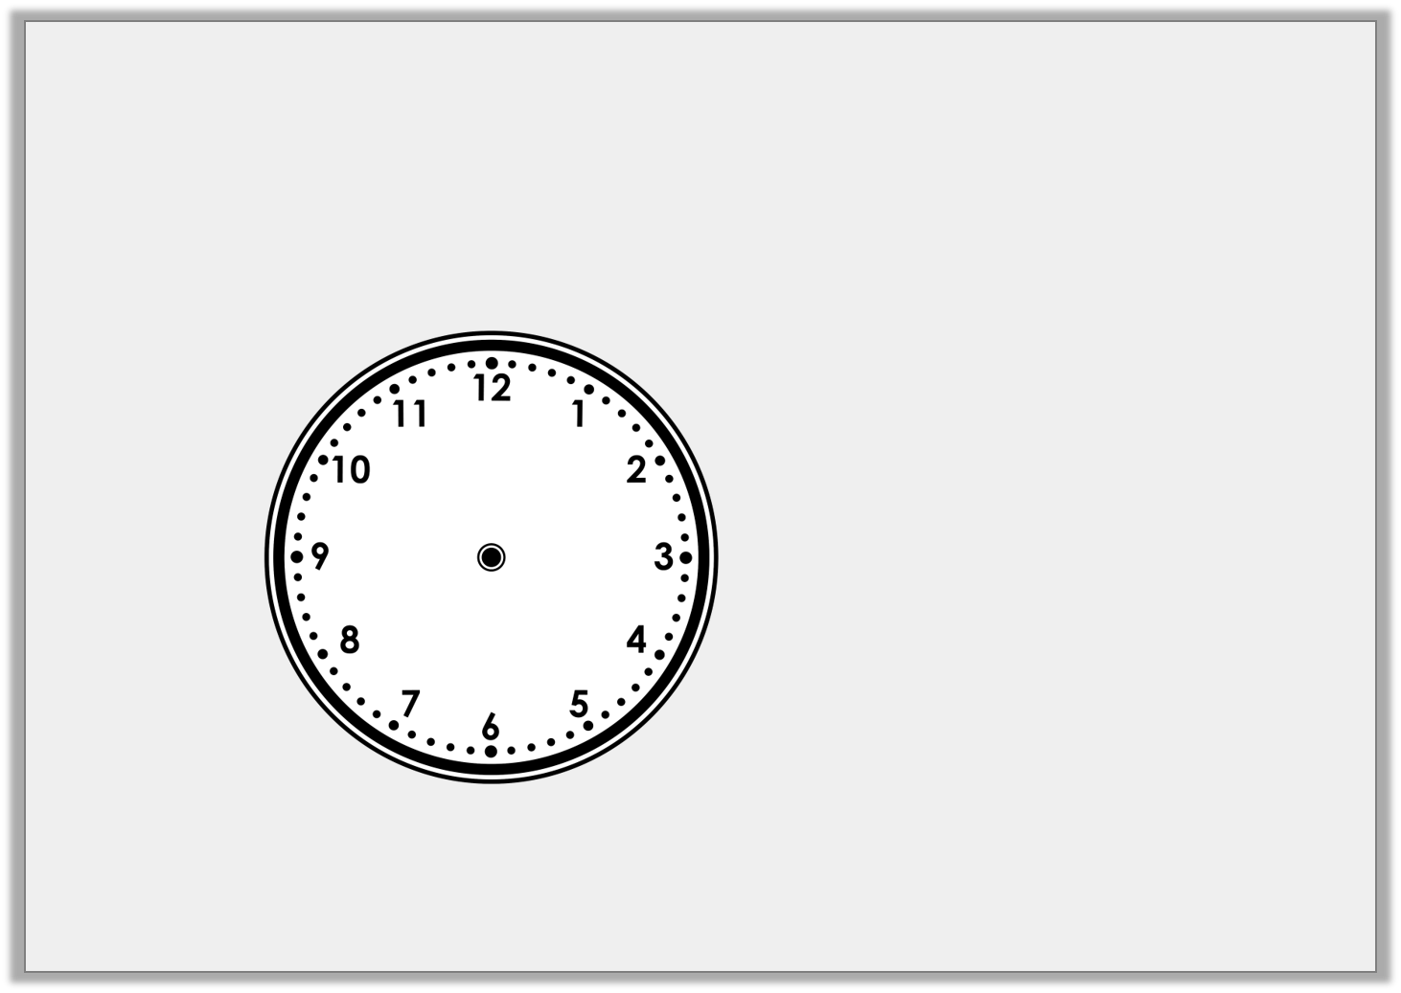
Varied Fluency 1
Convert this to digital time.
:
© Classroom Secrets Limited 2018

Slide 6
Varied Fluency 1
Convert this to digital time.
04:55
© Classroom Secrets Limited 2018

Slide 7
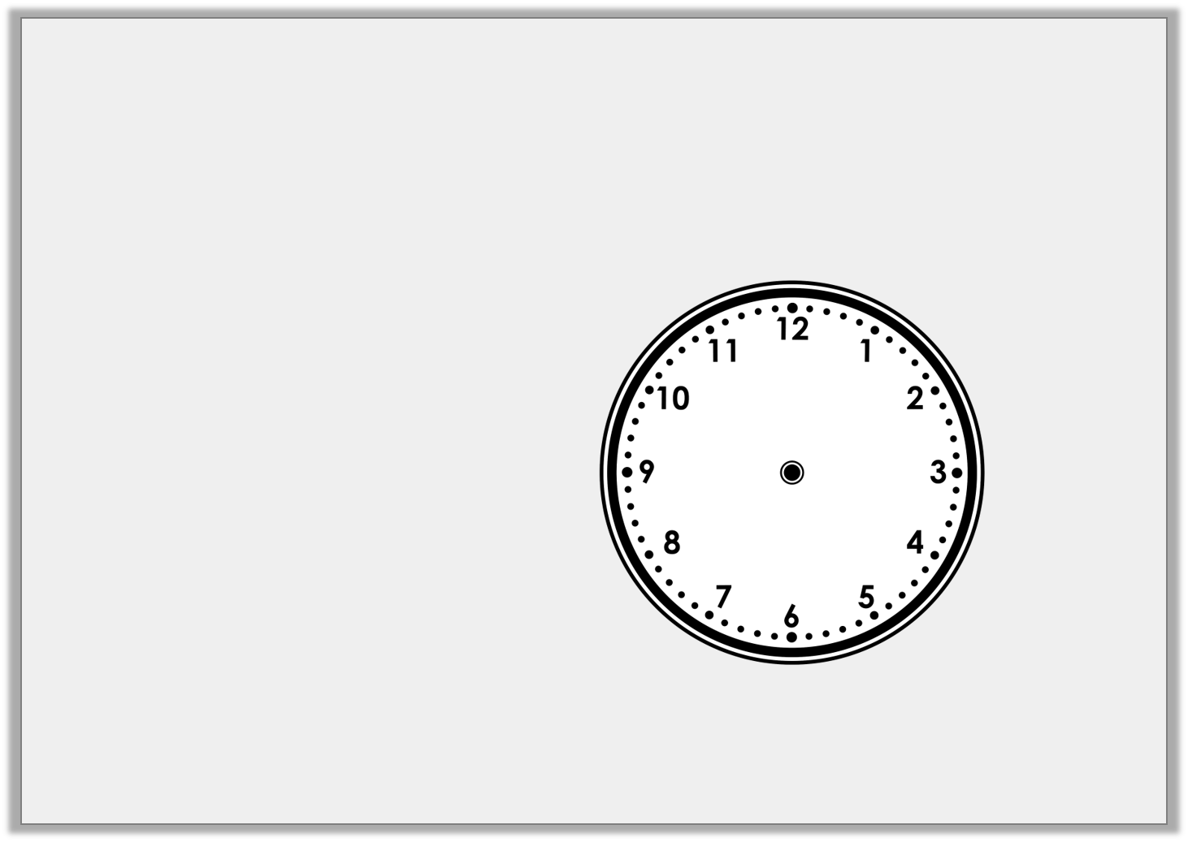
Varied Fluency 2
Draw the hands on the clock face to represent the digital time.
12:19
© Classroom Secrets Limited 2018

Slide 8
Varied Fluency 2
Draw the hands on the clock face to represent the digital time.
12:19
© Classroom Secrets Limited 2018

Slide 9
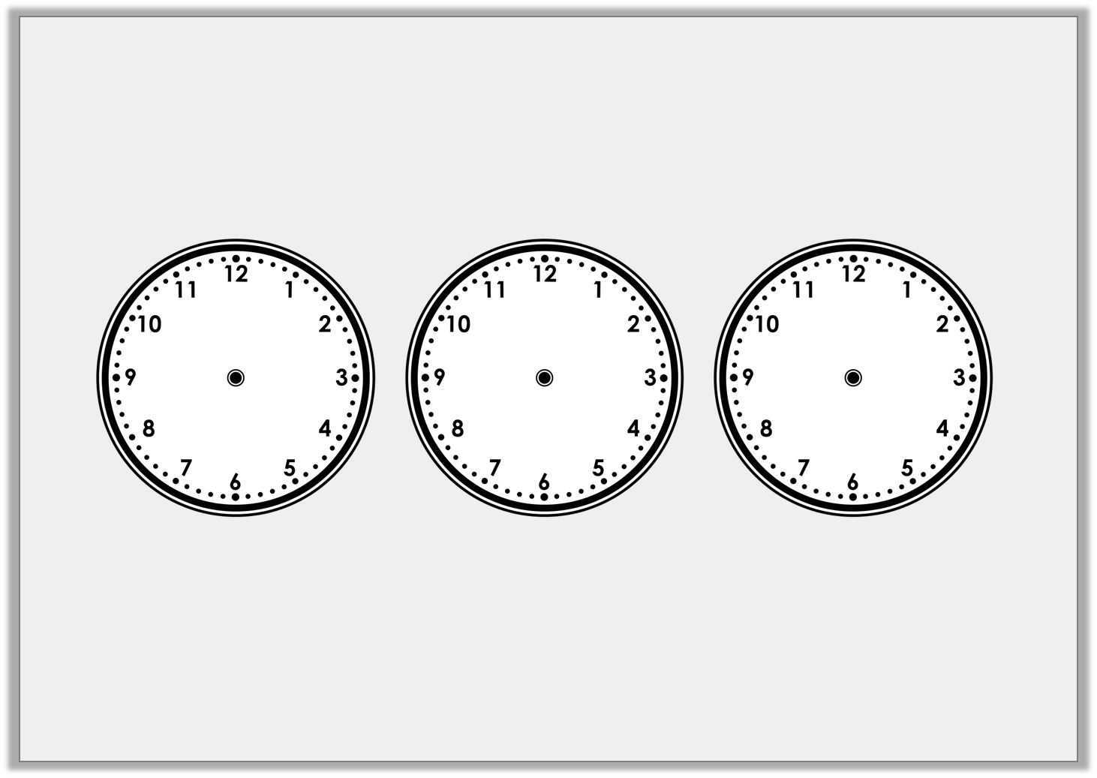
Varied Fluency 3
Convert these AM times to digital and order them from earliest to latest.
:
:
:
© Classroom Secrets Limited 2018

Slide 10
Varied Fluency 3
Convert these AM times to digital and order them from earliest to latest.
01:30am
05:44am
07:15am
© Classroom Secrets Limited 2018

Slide 11
Varied Fluency 4
What would the digital time be if it was 14 minutes later than the time shown on the clock?
:
© Classroom Secrets Limited 2018

Slide 12
Varied Fluency 4
What would the digital time be if it was 14 minutes later than the time shown on the clock?
04:55
© Classroom Secrets Limited 2018

Slide 13

Reasoning 1
Grayson arrives at the dog show at the time shown on the analogue clock. He thinks he’s on time to watch agility.
Is he correct? Explain why.
Event | Start Time
Agility | 10:33am
Best in show | 10:52am
Obedience | 11:16am
© Classroom Secrets Limited 2018

Slide 14
Reasoning 1
Grayson arrives at the dog show at the time shown on the analogue clock. He thinks he’s on time to watch agility.
Is he correct? Explain why.
Grayson is on time to watch the agility as…
Event | Start Time
Agility | 10:33am
Best in show | 10:52am
Obedience | 11:16am
© Classroom Secrets Limited 2018

Slide 15
Reasoning 1
Grayson arrives at the dog show at the time shown on the analogue clock. He thinks he’s on time to watch agility.
Is he correct? Explain why.
Grayson is on time to watch the agility as he is 10 minutes early.
Event | Start Time
Agility | 10:33am
Best in show | 10:52am
Obedience | 11:16am
© Classroom Secrets Limited 2018

Slide 16
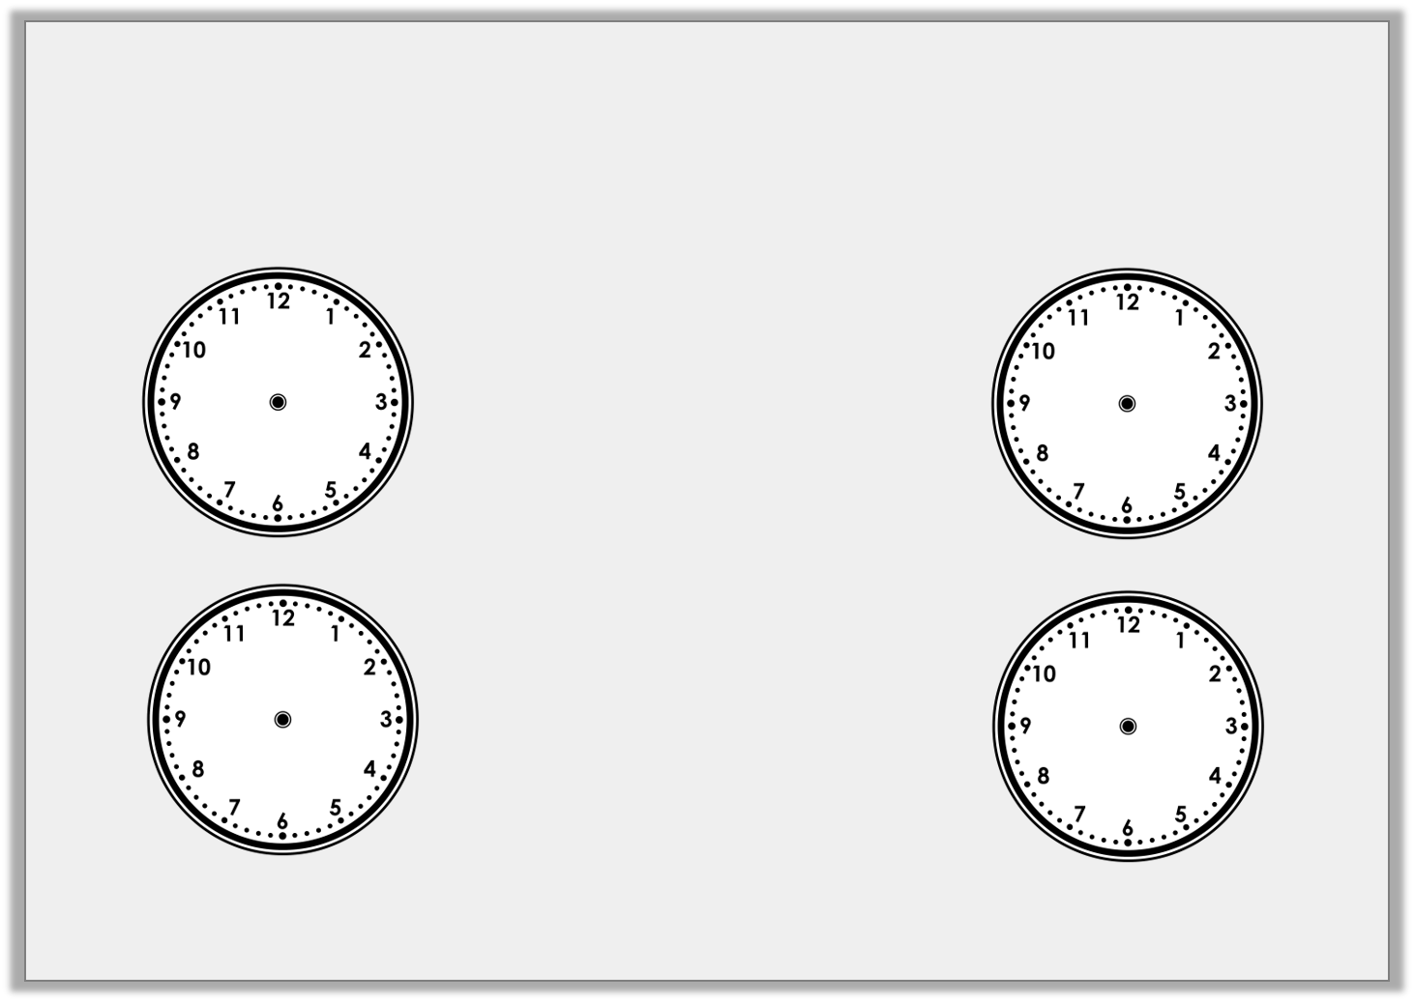
Problem Solving 1
Which is the earliest and latest time?
am
pm
06:22am
06:18am
10:24pm
09:59pm
pm
am
© Classroom Secrets Limited 2018

Slide 17
Problem Solving 1
Which is the earliest and latest time?
am
pm
earliest
06:22am
06:18am
10:24pm
09:59pm
latest
pm
am
© Classroom Secrets Limited 2018

Slide 18
Problem Solving 2
These clocks both show the same time.
What could the missing minute hand and hour be?
:53
© Classroom Secrets Limited 2018

Slide 19
Problem Solving 2
These clocks both show the same time.
What could the missing minute hand and hour be?
06:53
© Classroom Secrets Limited 2018

Slide 20
Now you have got 2 tasks to do; Activity 1 and Activity 2.
Activity 1 is fluency
Activity 2 is reasoning and problem solving
You must do Activity 1 and then Activity 2.
There are 3 levels to both activities and you can decide whether you will do the 1 star, 2 star or 3 star sheet.
If you are very confident, you may want to do the 3 star Activity 1 sheet and then all three of the reasoning and problem solving questions. It is up to the adults to decide which sheet you need to do.
© Classroom Secrets Limited 2018

