Slide 1


Maths
Measurement
Year One
Maths | Year 4 | Measurement | Telling the Time 12-Hour and 24-Hour | Lesson 1 of 4: Telling the Time Minute Intervals

Slide 3
Aim
I can tell the time to minute intervals.
Success Criteria
I can count single minutes in a clockwise direction to read a clock showing minute intervals past the hour.
I can count single minutes in an anti-clockwise direction to read a clock showing minute intervals to the hour.
I can set time on a clock showing minute intervals past the hour.
I can set time on a clock showing minute intervals to the hour.

Slide 4
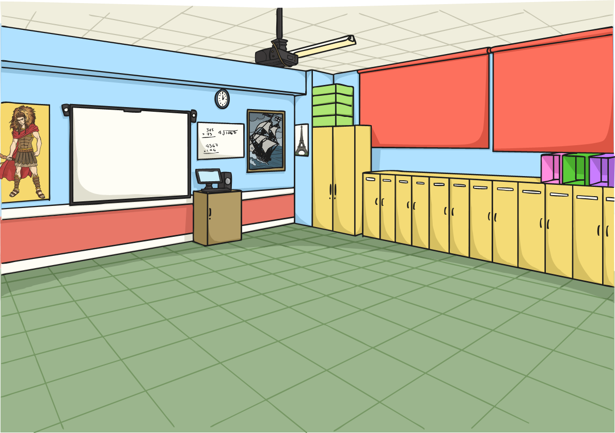
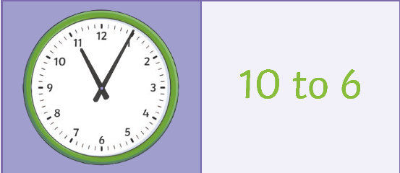
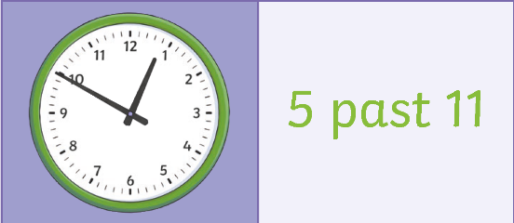
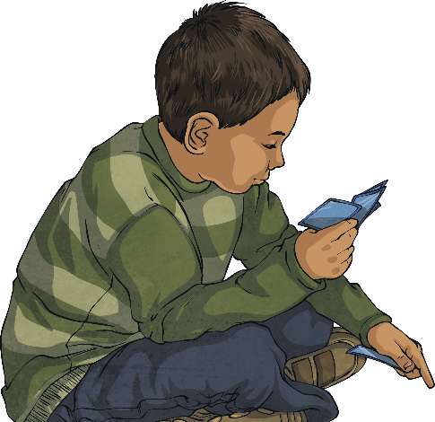
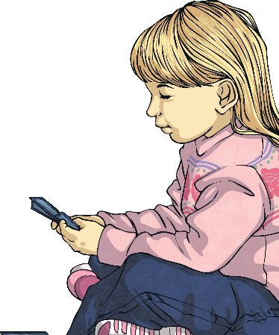
Dominoes:
Tell the Time in Five-Minute Intervals
You can also play this as a matching game if you are working alone.
With a partner, shuffle the dominoes cards.
Place the cards face down in front of you.
Each person takes three cards.
Turn one of the cards that are left over.
Take turns to try to match the times on either end.
If you can’t place one of your cards, take another card.
The first person to get rid of all their cards wins.
3.5cm

Slide 5

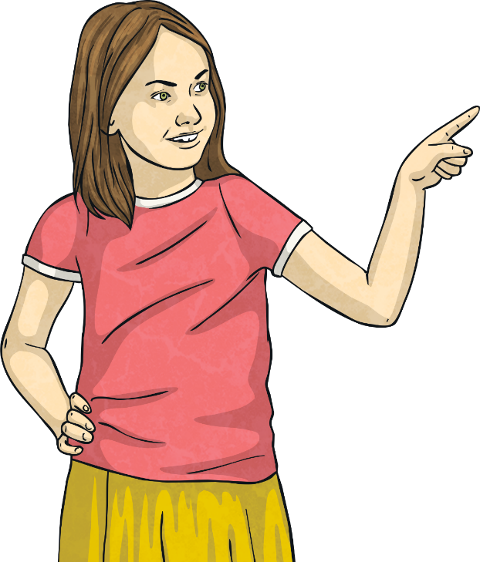

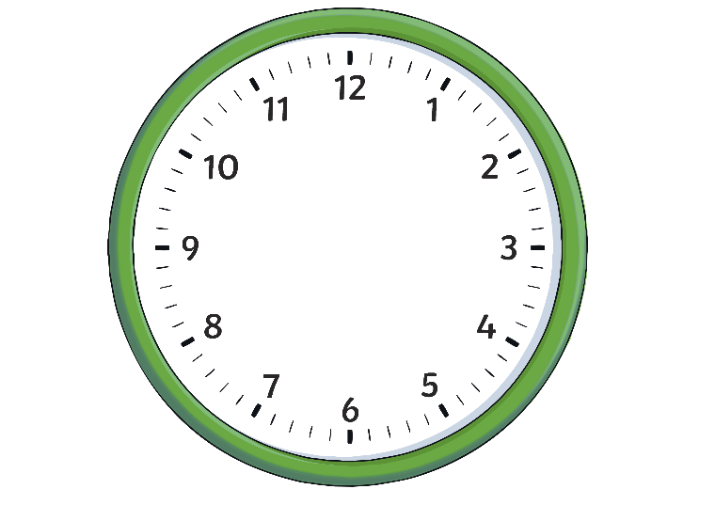
Telling the Time:
Minute Intervals Past the Hour
To find out five-minute intervals past the hour, we count around the clock in a clockwise direction in fives. Between the five-minute intervals, we count single minutes:
5
10
15
20
25
30

Slide 6
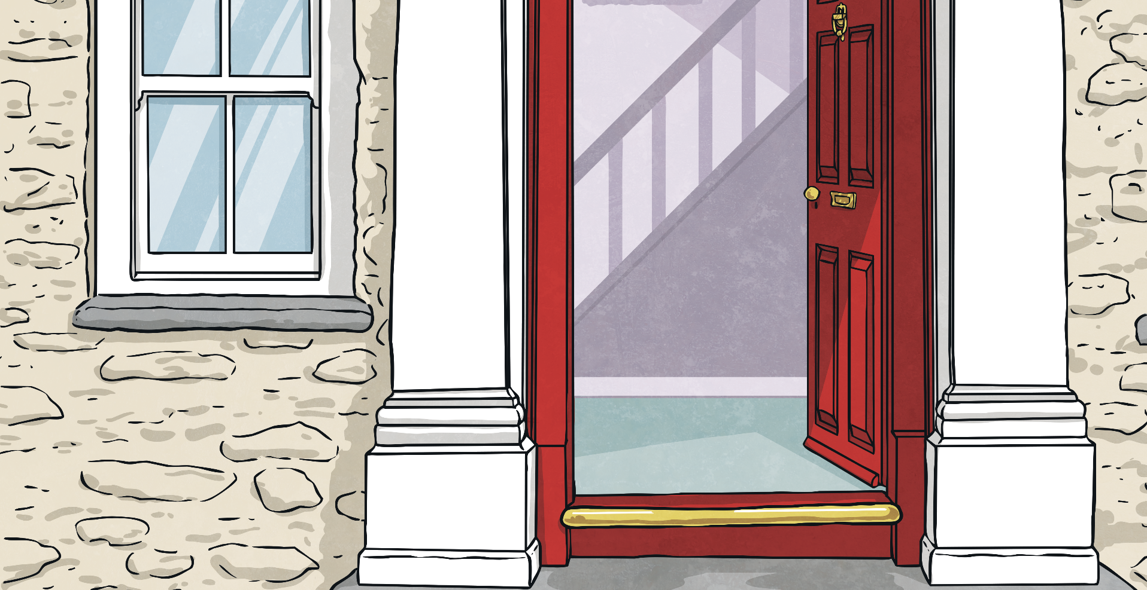
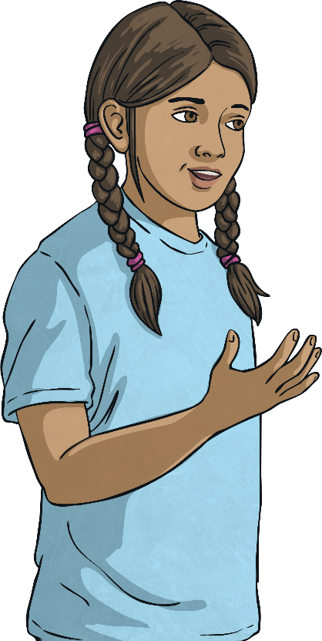
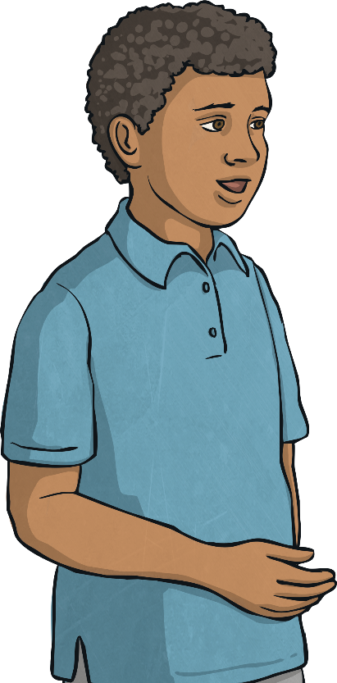
Telling the Time:
Minute Intervals Past the Hour
Sometimes, it is sufficient to use five-minute intervals when telling the time. For example, if you were meeting a friend, five-minute intervals are enough.
However, sometimes it is vital to use minute intervals. For example, when catching a train you need to use the exact time.
I’ll meet you at 20 past 11.
My train is 22 minutes past 10 - I mustn’t be late!

Slide 7

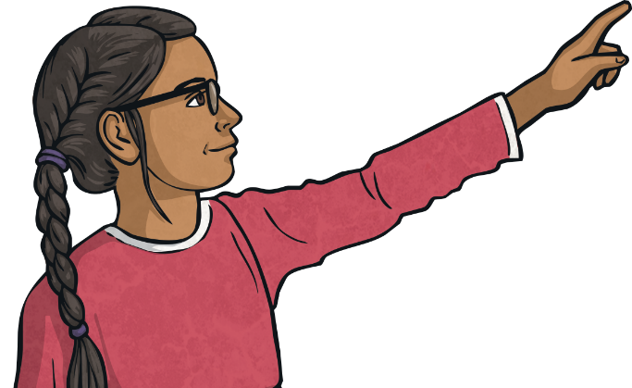
Telling the Time:
Minute Intervals Past the Hour
5
Now let's look at the minutes. On this clock, the big hand is one minute after the 4. Count in 5s to the 4 and then count on in 1s to the minute hand. How many minutes have you counted?
10
What hour is shown
on the clock?
15
20
20 + 1 = 21
It is 21 minutes past the hour.

Slide 8
Telling the Time:
Minute Intervals Past the Hour
5
Now let's look at the minutes. On this clock, the big hand is one minute before the 2. Count in 5s to the 2 and then count back in 1s to the minute hand. How many minutes have you counted?
10
What hour is shown
on the clock?
10 - 1 = 9
It is 9 minutes past the hour.

Slide 9

Telling the Time:
Minute Intervals Past the Hour
Write the time shown on these clocks:
5
5
10
10
15
15
20
20
25
25
30
30
24 minutes past 2
11 minutes past 9

Slide 10
Telling the Time:
Minute Intervals Past the Hour
Write the time shown on these clocks:
5
5
10
10
15
15
20
20
25
25
30
30
6 minutes past 4
22 minutes past 1

Slide 11
Telling the Time:
Minute Intervals Past the Hour
Write the time shown on these clocks:
5
5
10
10
15
15
20
20
25
25
30
30
28 minutes past 2
2 minutes past 10

Slide 12
Telling the Time:
Minute Intervals Past the Hour
Set your clock to show these times:
19 minutes past 6
18 minutes past 6

Slide 13
Telling the Time:
Minute Intervals Past the Hour
Set your clock to show these times:
4 minutes past 4
23 minutes past 10

Slide 14
Telling the Time:
Minute Intervals Past the Hour
Set your clock to show these times:
14 minutes past 1
9 minutes past 8

Slide 15
Telling the Time:
Minute Intervals to the Hour
To find out five-minute intervals to the hour, we count around the clock in fives in an anticlockwise direction. Between the five-minute intervals, we count single minutes:
5
10
15
20
25

Slide 16

Telling the Time:
Minute Intervals to the Hour
5
Now let's look at the minutes. On this clock, the big hand is four minutes before the 9. Count in 5s to the 9 and then count on in 1s to the minute hand. How many minutes have you counted?
10
What hour is shown
on the clock?
15
15 + 4 = 19
It is 19 minutes to the hour.

Slide 17
Telling the Time:
Minute Intervals to the Hour
5
Now let's look at the minutes. On this clock, the big hand is one minute before the 11. Count in 5s to the 11 and then count on in 1s to the minute hand. How many minutes have you counted?
What hour is shown
on the clock?
5 + 1 = 6
It is 19 minutes to the hour.

Slide 18
Telling the Time:
Minute Intervals to the Hour
Write the time shown on these clocks:
5
5
10
10
15
15
20
20
25
25
23 minutes to 4
17 minutes to 12

Slide 19
Telling the Time:
Minute Intervals to the Hour
Write the time shown on these clocks:
9 minutes to 6
19 minutes to 9

Slide 20
Telling the Time:
Minute Intervals to the Hour
Write the time shown on these clocks:
28 minutes to 11
1 minute to 4

Slide 21
Telling the Time:
Minute Intervals to the Hour
Set your clock to show these times:
13 minutes to 9
21 minutes to 11

Slide 22
Telling the Time:
Minute Intervals to the Hour
Set your clock to show these times:
4 minutes to 6
26 minutes to 8

Slide 23
Telling the Time:
Minute Intervals to the Hour
Set your clock to show these times:
19 minutes to 2
12 minutes to 8

Slide 24
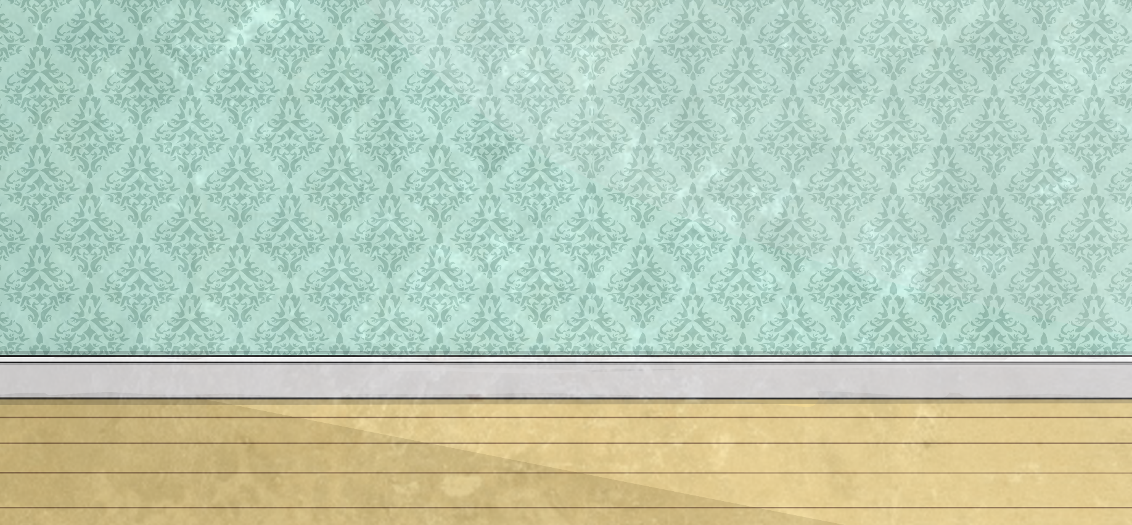
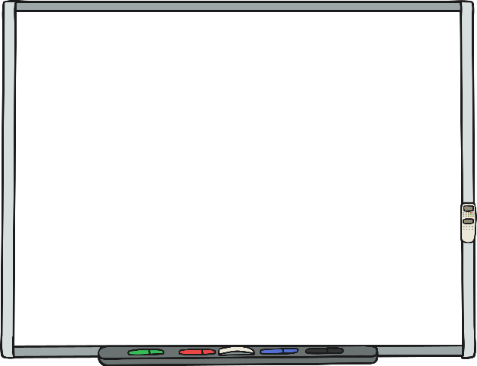
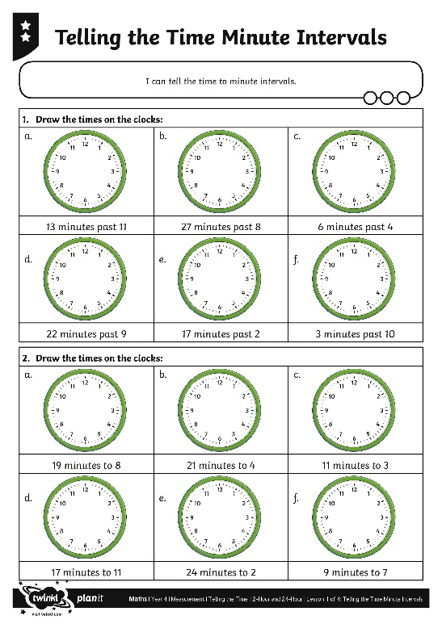
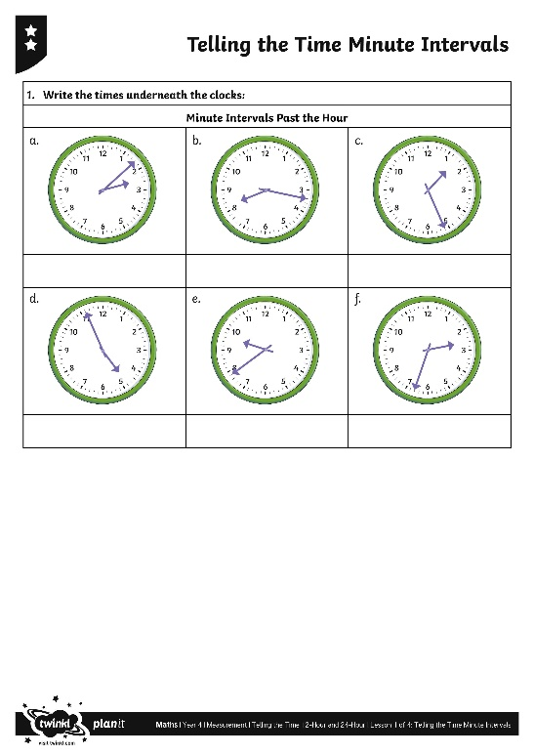

Telling the Time
Minute Intervals
Use your fabulous skills of telling the time to complete the Telling the Time Minute Intervals Activity Sheet.

Slide 25
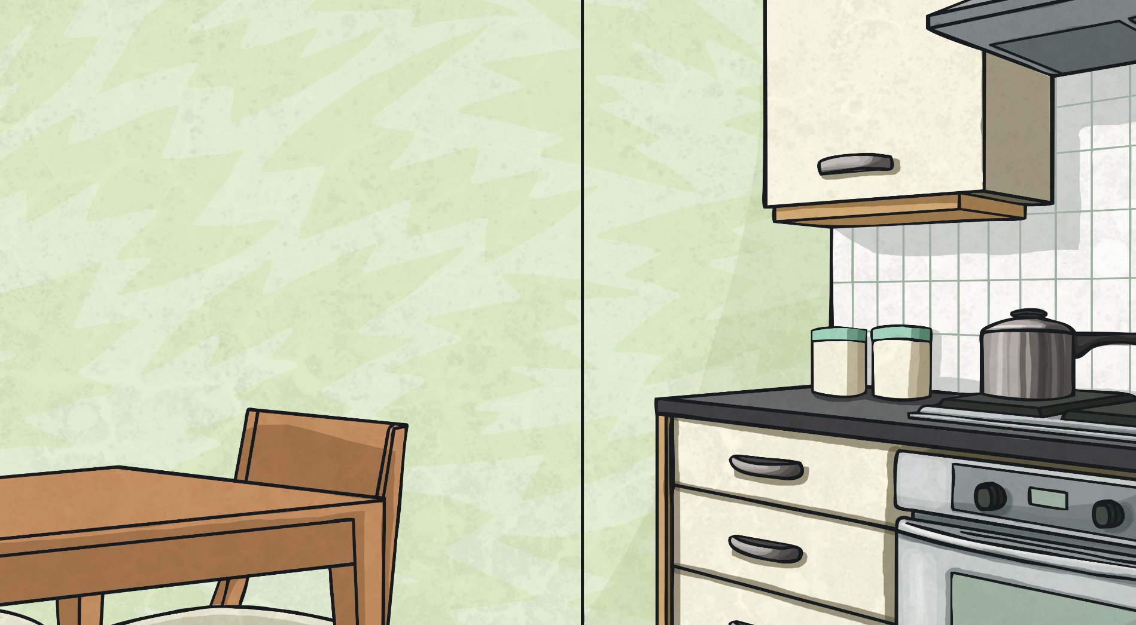

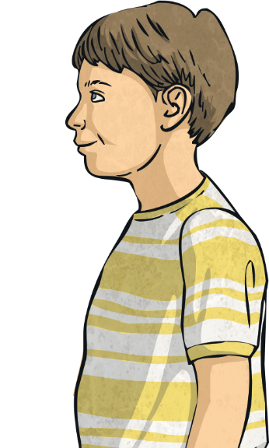
What’s the Time?
Set your clock or write on paper to show the answer to this problem:
It is 13 minutes past 5. In five minutes, we need to leave home to go to the park. What time will we leave home?
18 minutes past 5.

Slide 26

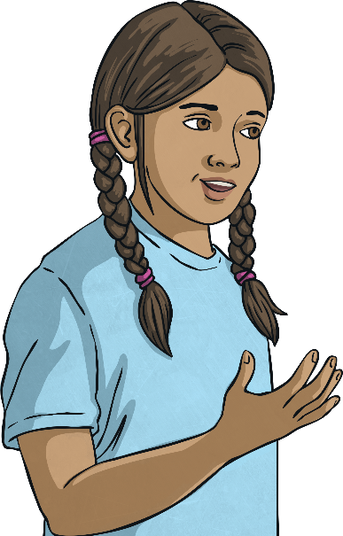
What’s the Time?
Set your clock or write on paper to show the answer to this problem :
20 minutes ago, we arrived home. It is now 23 minutes past 10. What time did we arrive home?
3 minutes past 10.

Slide 27

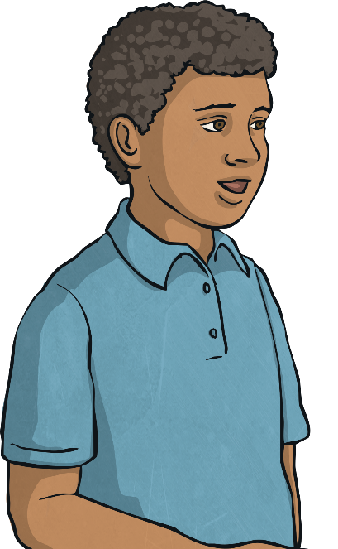
What’s the Time?
Set your clock or write on paper to show the answer to this problem :
It’s 11 minutes to 12. My lunch will be ready in 16 minutes. What time will lunch be ready?
5 minutes past 12.

Slide 28

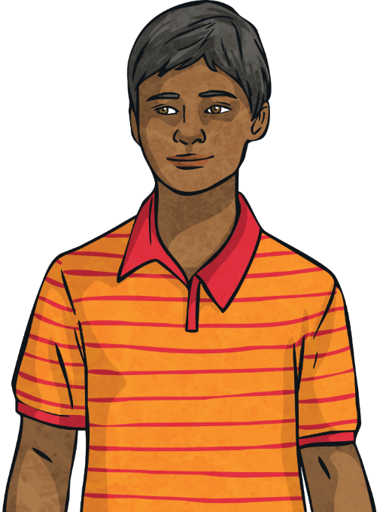
What’s the Time?
Set your clock or write on paper to show the answer to this problem :
My watch says it is 13 minutes to 5. The watch is 20 minutes slow. What is the correct time?
7 minutes past 5.

Slide 29

Aim
I can tell the time to minute intervals.
Success Criteria
I can count single minutes in a clockwise direction to read a clock showing minute intervals past the hour.
I can count single minutes in an anti-clockwise direction to read a clock showing minute intervals to the hour.
I can set time on a clock showing minute intervals past the hour.
I can set time on a clock showing minute intervals to the hour.

