Slide 2



Diving into Mastery Guidance for Educators
Each activity sheet is split into three sections, diving, deeper and deepest, which are represented by the following icons:
These carefully designed activities take your children through a learning journey, initially ensuring they are fluent with the key concept being taught; then applying this to a range of reasoning and problem-solving activities.
These sheets might not necessarily be used in a linear way. Some children might begin at the ‘Deeper’ section and in fact, others may ‘dive straight in’ to the ‘Deepest’ section if they have already mastered the skill and are applying this to show their depth of understanding.
Diving
Deeper
Deepest

Slide 3
Aim
Solve problems involving converting from hours to minutes; minutes to seconds; years to months; weeks to days.

Slide 4

Years, Months, Weeks and Days
Diving
Select the correct number to complete the sentence.
One number will not be needed.
There are years in a decade.
6
30
There are days in June.
104
There are months in half a year.
10
There are weeks in 2 years.
52

Slide 5

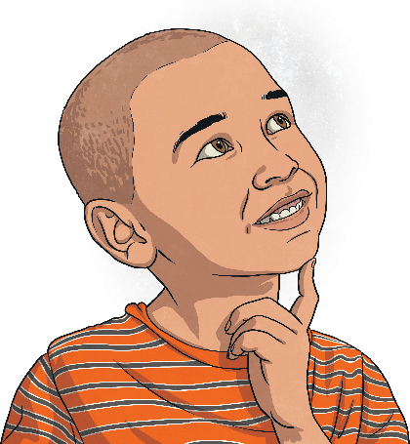
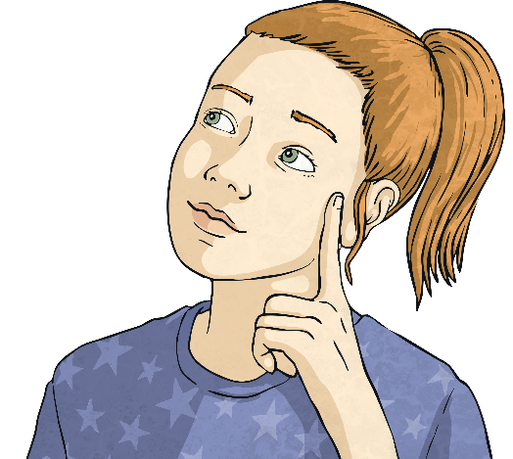
Years, Months, Weeks and Days
Diving
Put these in order from shortest to longest length of time.
3 weeks
36 hours
Number of days in July
shortest
longest

Slide 6
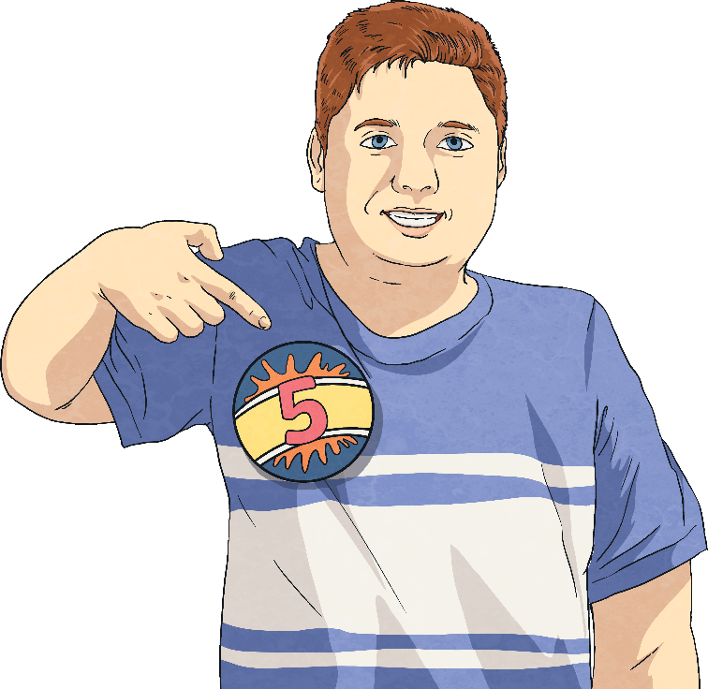
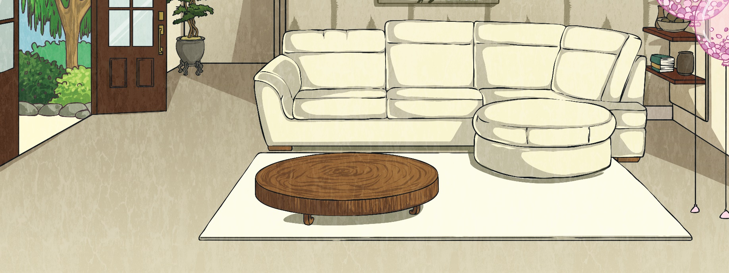

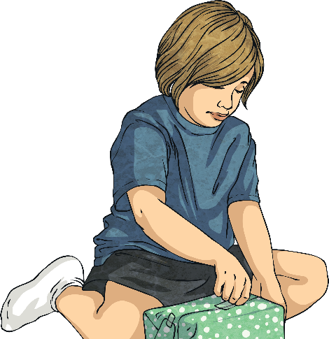

Years, Months, Weeks and Days
Diving
Harry’s birthday is in June. His brother’s birthday is 5 months before his. What month is his brother’s birthday?
January
February
March
April
May
June

Slide 7
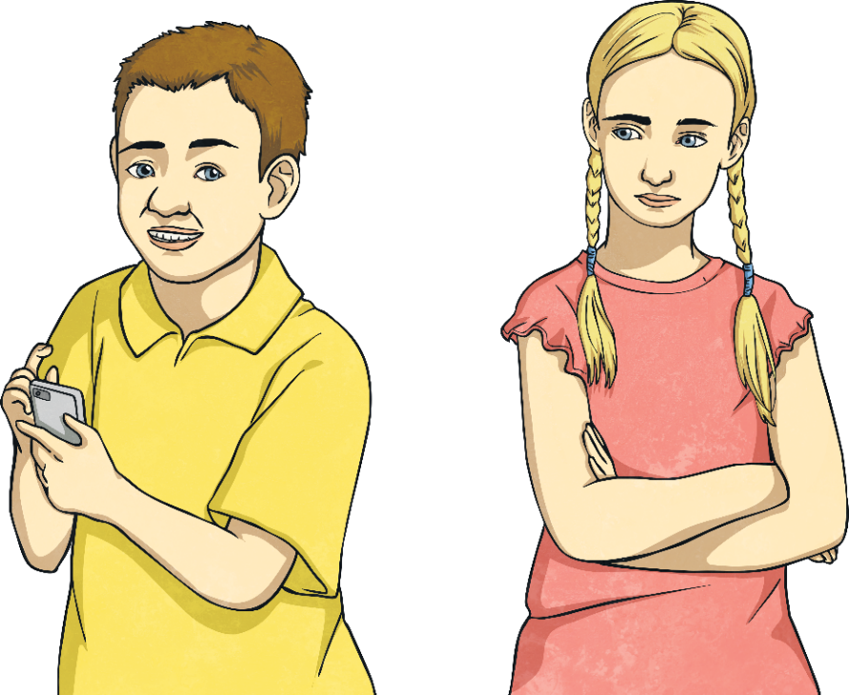
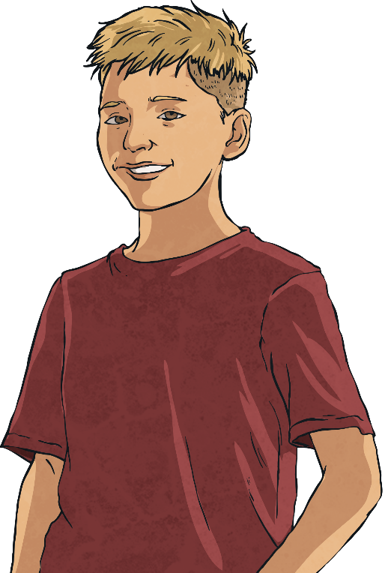
Years, Months, Weeks and Days
Diving
Who is the eldest? How can you prove it?
Jamie
3 years
and 9 months
Joy
208 weeks
Franco
50 months
Franco –
50 months is 4 years and 2 months.
Joy –
208 weeks is 4 years.
Franco is the eldest.

Slide 8
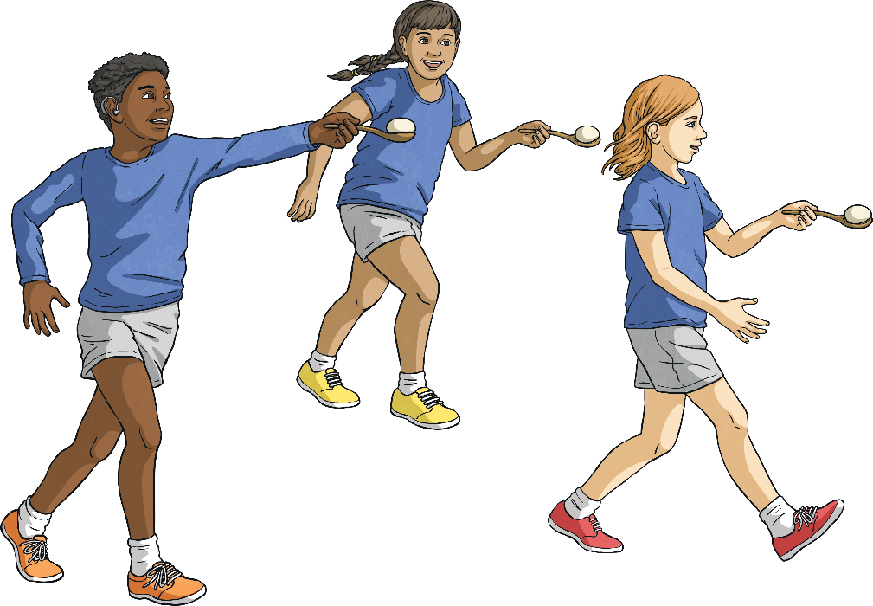
Years, Months, Weeks and Days
Deeper
Today is the 23rd May. Summer Sports Day is in 5 weeks time.
What date will this be?
May 2020
S | M | T | W | T | F | S
 |  |  |  |  | 1 | 2
3 | 4 | 5 | 6 | 7 | 8 | 9
10 | 11 | 12 | 13 | 14 | 15 | 16
17 | 18 | 19 | 20 | 21 | 22 | 23
24 | 25 | 26 | 27 | 28 | 29 | 30
31
June 2020
S | M | T | W | T | F | S
 | 1 | 2 | 3 | 4 | 5 | 6
7 | 8 | 9 | 10 | 11 | 12 | 13
14 | 15 | 16 | 17 | 18 | 19 | 20
21 | 22 | 23 | 24 | 25 | 26 | 27
28 | 29 | 30

Slide 9
Years, Months, Weeks and Days
Deeper
Three children are talking about when their birthdays are.
If today is 10th July, work out when each birthday is.
Jack
July 2020
S | M | T | W | T | F | S
 |  |  | 1 | 2 | 3 | 4
5 | 6 | 7 | 8 | 9 | 10 | 11
12 | 13 | 14 | 15 | 16 | 17 | 18
19 | 20 | 21 | 22 | 23 | 24 | 25
26 | 27 | 28 | 29 | 30 | 31
June 2020
S | M | T | W | T | F | S
 | 1 | 2 | 3 | 4 | 5 | 6
7 | 8 | 9 | 10 | 11 | 12 | 13
14 | 15 | 16 | 17 | 18 | 19 | 20
21 | 22 | 23 | 24 | 25 | 26 | 27
28 | 29 | 30
My birthday is
in 2 weeks time.
24th July
Pablo
My birthday is 20 days
before Siannise.
6th June
June 2020
S | M | T | W | T | F | S
 | 1 | 2 | 3 | 4 | 5 | 6
7 | 8 | 9 | 10 | 11 | 12 | 13
14 | 15 | 16 | 17 | 18 | 19 | 20
21 | 22 | 23 | 24 | 25 | 26 | 27
28 | 29 | 30
July 2020
S | M | T | W | T | F | S
 |  |  | 1 | 2 | 3 | 4
5 | 6 | 7 | 8 | 9 | 10 | 11
12 | 13 | 14 | 15 | 16 | 17 | 18
19 | 20 | 21 | 22 | 23 | 24 | 25
26 | 27 | 28 | 29 | 30 | 31
Siannise
My birthday was
2 weeks ago.
26th June

Slide 10

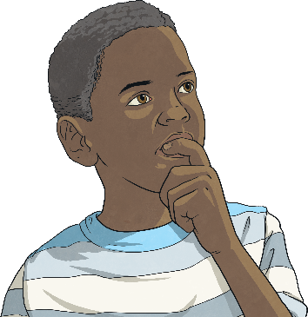
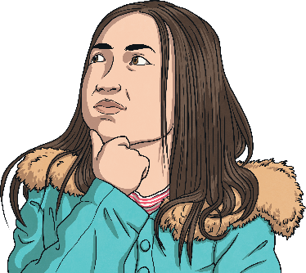
Years, Months, Weeks and Days
Deepest
Which sets of 3 consecutive months have exactly 92 days?
March, April and May 31 + 30 + 31 = 92
May, June and July 31 + 30 + 31 = 92
June, July and August 30 + 31 + 31 = 92
July, August and September 31 + 31 + 30 = 92
August, September and October 31 + 30 + 31 = 92
October, November and December 31 + 30 + 31 = 92
November, December and January 30 + 31 + 31 = 92
2020 is a leap year. Name 3 other leap years that will happen after 2050.
Possible answers are 2052, 2056, 2060 and 2064.
They will need to be a multiple of 4 to be a leap year.

Slide 11
Years, Months, Weeks and Days
Deepest
Complete these statements to make them true. Explain how you know.
2
36 hours < days
days > 4 weeks
30
This must be more than 1 and a half days.
24 + 12 = 36.
This must be more than 28.
4 × 7 = 28
100
600
16
40
2 years > weeks > days
months < 2 years < months
This must be less than 104.
52 × 2 = 104
This must be less than 730.
365 x 2 = 730
This must less than 24.
2 × 12 = 24
This must be more than 24.
12 × 2 = 24

Slide 12
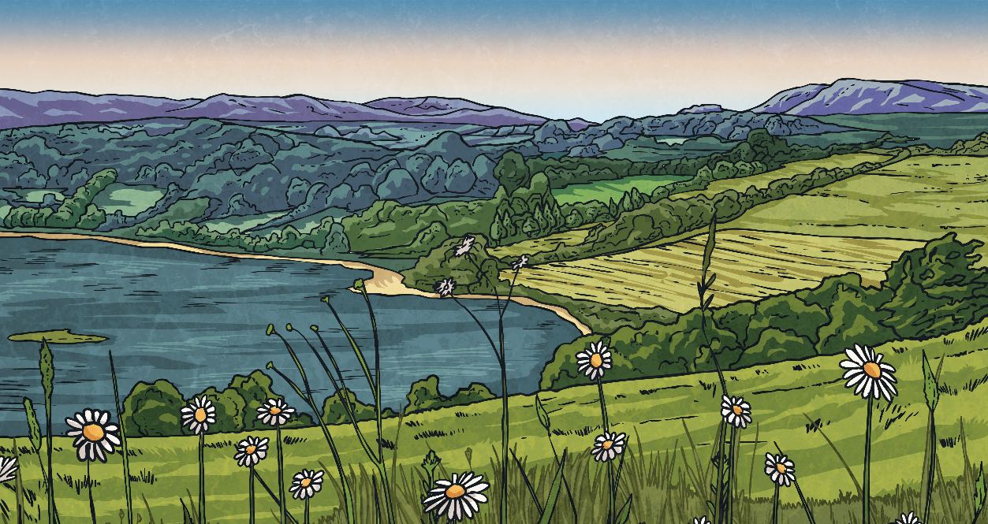

Years, Months, Weeks and Days
Deepest
Investigate:
How many days of this year have there been so far up to today’s date.
Days in the Month
Thirty days in September,
April, June and November;
February has twenty-eight.
All the rest have thirty-one.
Except in a Leap Year,
that’s the time
When February has twenty-nine.

Slide 13
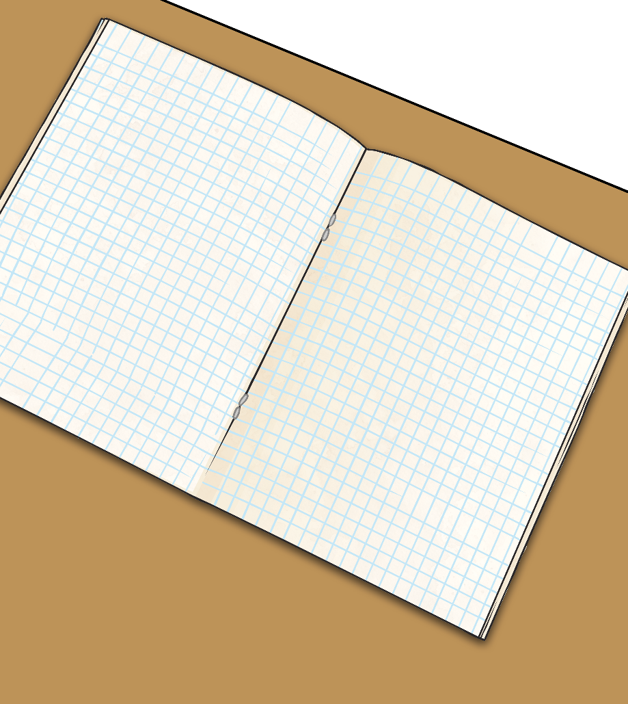
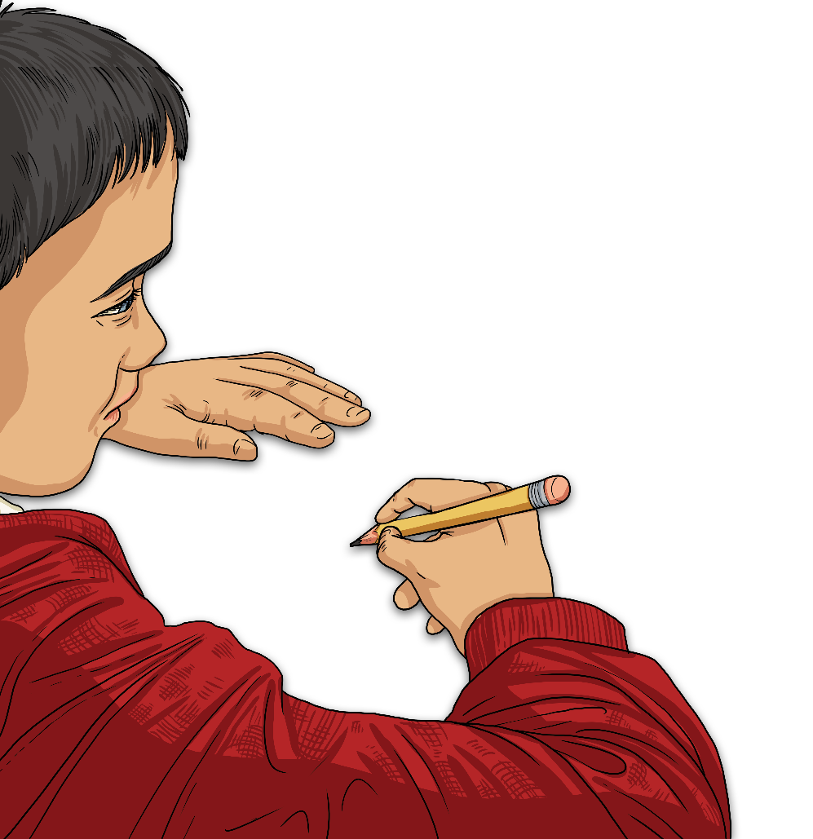
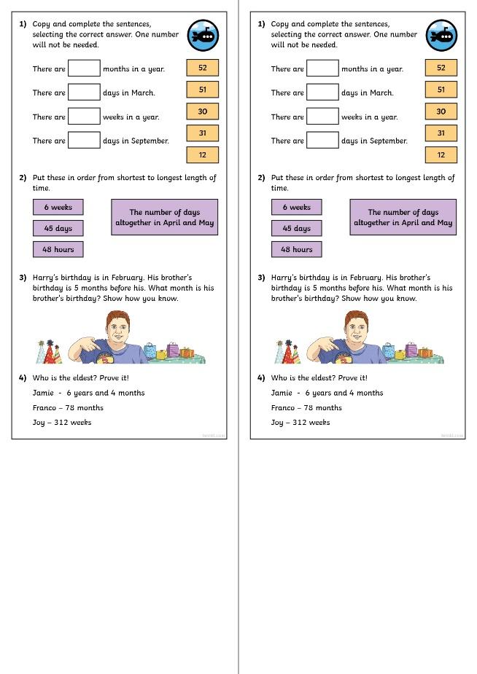
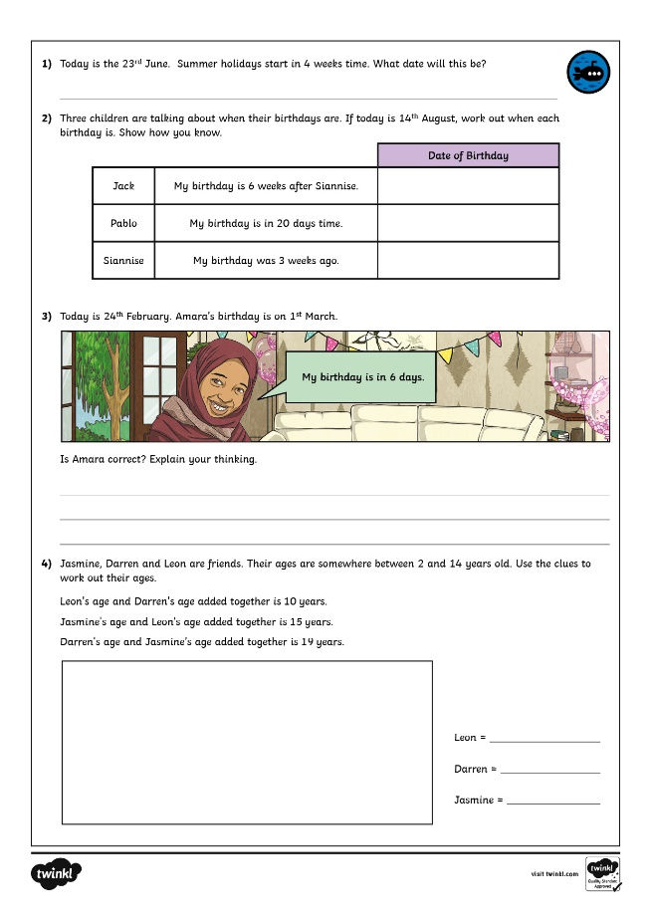
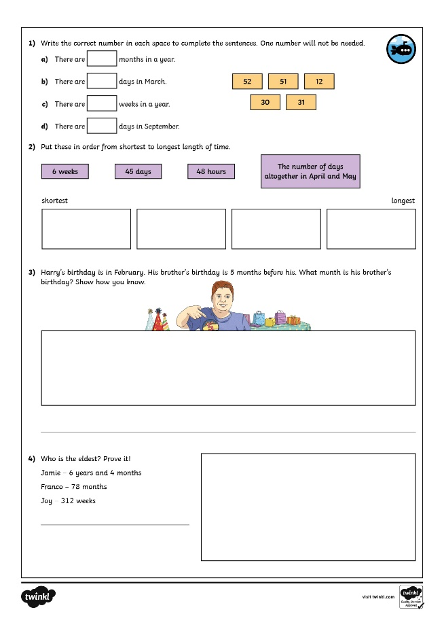
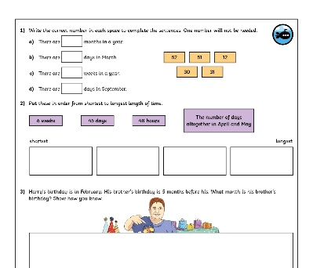
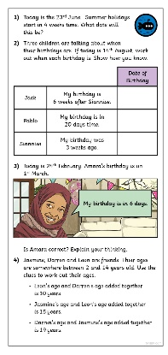
Years, Months, Weeks and Days
Dive in by completing your own activity!

