Slide 2



Diving into Mastery Guidance for Educators
Each activity sheet is split into three sections, diving, deeper and deepest, which are represented by the following icons:
These carefully designed activities take your children through a learning journey, initially ensuring they are fluent with the key concept being taught; then applying this to a range of reasoning and problem-solving activities.
These sheets might not necessarily be used in a linear way. Some children might begin at the ‘Deeper’ section and in fact, others may ‘dive straight in’ to the ‘Deepest’ section if they have already mastered the skill and are applying this to show their depth of understanding.
Diving
Deeper
Deepest

Slide 3
Aim
Solve problems involving converting from hours to minutes; minutes to seconds; years to months; weeks to days.

Slide 4
Hours, Minutes and Seconds
Diving
Complete the table.
1 hour 20 minutes | = | minutes
1 hour 5 minutes | = | minutes
1 hour 35 minutes | = | minutes
hour minutes | = | 105 minutes
hours minutes | = | 150 minutes
hours minutes | = | 200 minutes
80
65
95
1
45
2
30
3
20

Slide 5
Hours, Minutes and Seconds
Diving
Use <, > or = to make the statements correct.
2 hours 24 minutes | = | 150 minutes
85 seconds | = | 1 minute 25 seconds
3 hours | = | 170 minutes
250 minutes | = | 4 hours
3 minutes 5 seconds | = | 200 seconds
<
=
>
>
<

Slide 6

Hours, Minutes and Seconds
Deeper
Find the odd one odd in each group of times. Explain your reasoning.
a) | 2 minutes | 2 minutes 15 seconds | 125 seconds
1
4
The other times equal 135 seconds.
b) | 3 minutes | 3 minutes 3 seconds | 210 seconds
1
2
The other times equal 210 seconds.
c) | 4 minutes | 4 minutes 40 seconds | 280 seconds
3
4
The other times equal 280 seconds.

Slide 7

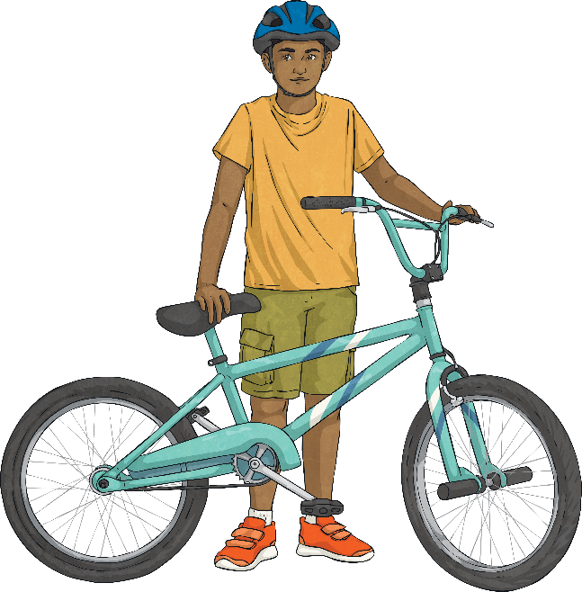
Hours, Minutes and Seconds
Deeper
Tessa rides her bike for 1 hour and 9 minutes.
69 minutes
Todd rides his bike for 70 minutes.
70 minutes
Thomas rides his bike for 1 and hours.
75 minutes
1
4
Thomas thinks he rode his bike for the longest time.
Is he correct? Explain your reasoning.
Thomas is correct as he rode for 75 minutes and Tessa and Todd rode for less.

Slide 8

Hours, Minutes and Seconds
Deepest
Three children took part in a sponsored walk to raise money for the NHS. Complete the missing information in the table.
Name | Average time per lap | Number of Laps | Total Time Walked
Aleesha | 2 minute 10 seconds | 10
Ben | 115 seconds | 12
Ed |  | 10 | 25 minutes
21 minutes 40 seconds
23 minutes
2 minutes 30 seconds
What was the difference in seconds between the person who walked for the longest time and the person who walked for the shortest time?
3 minutes
20 seconds =
200 seconds

Slide 9


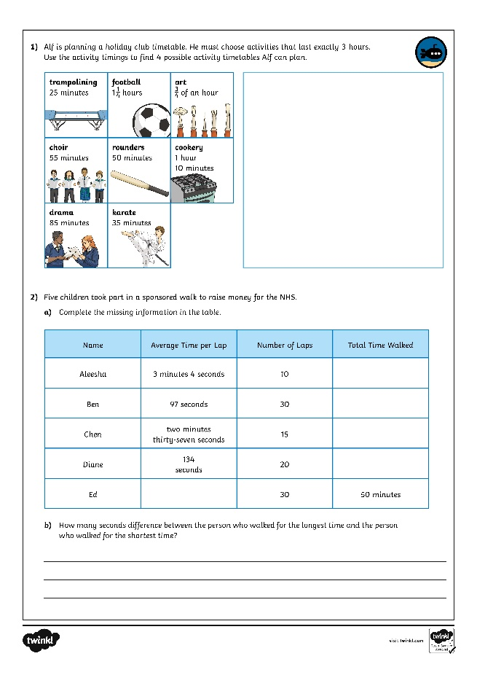
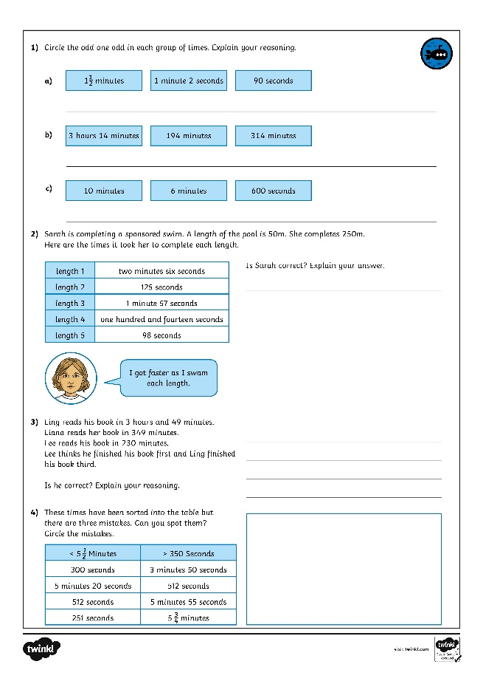
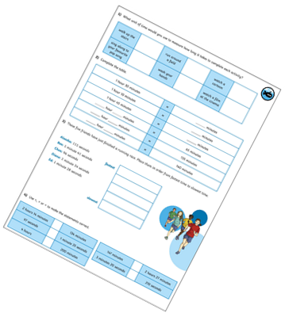
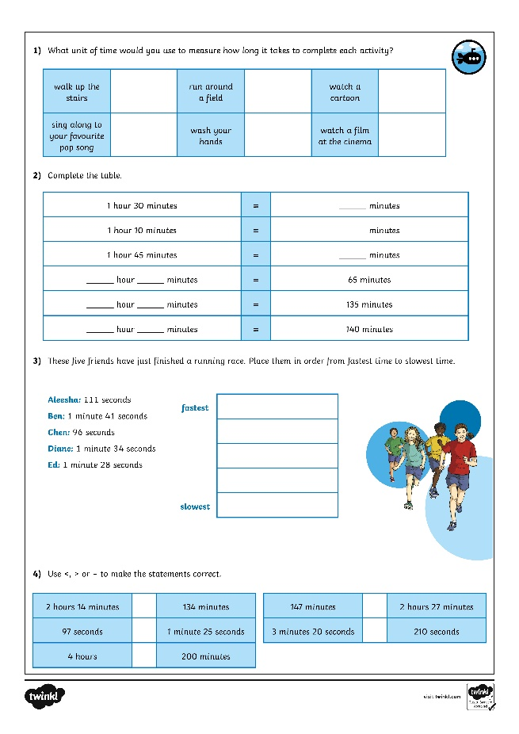
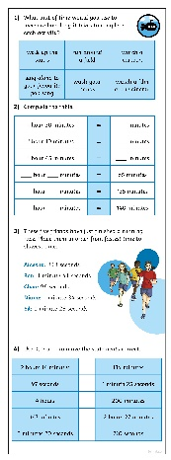
Hours, Minutes and Seconds
Dive in by completing your own activity!

