Slide 1
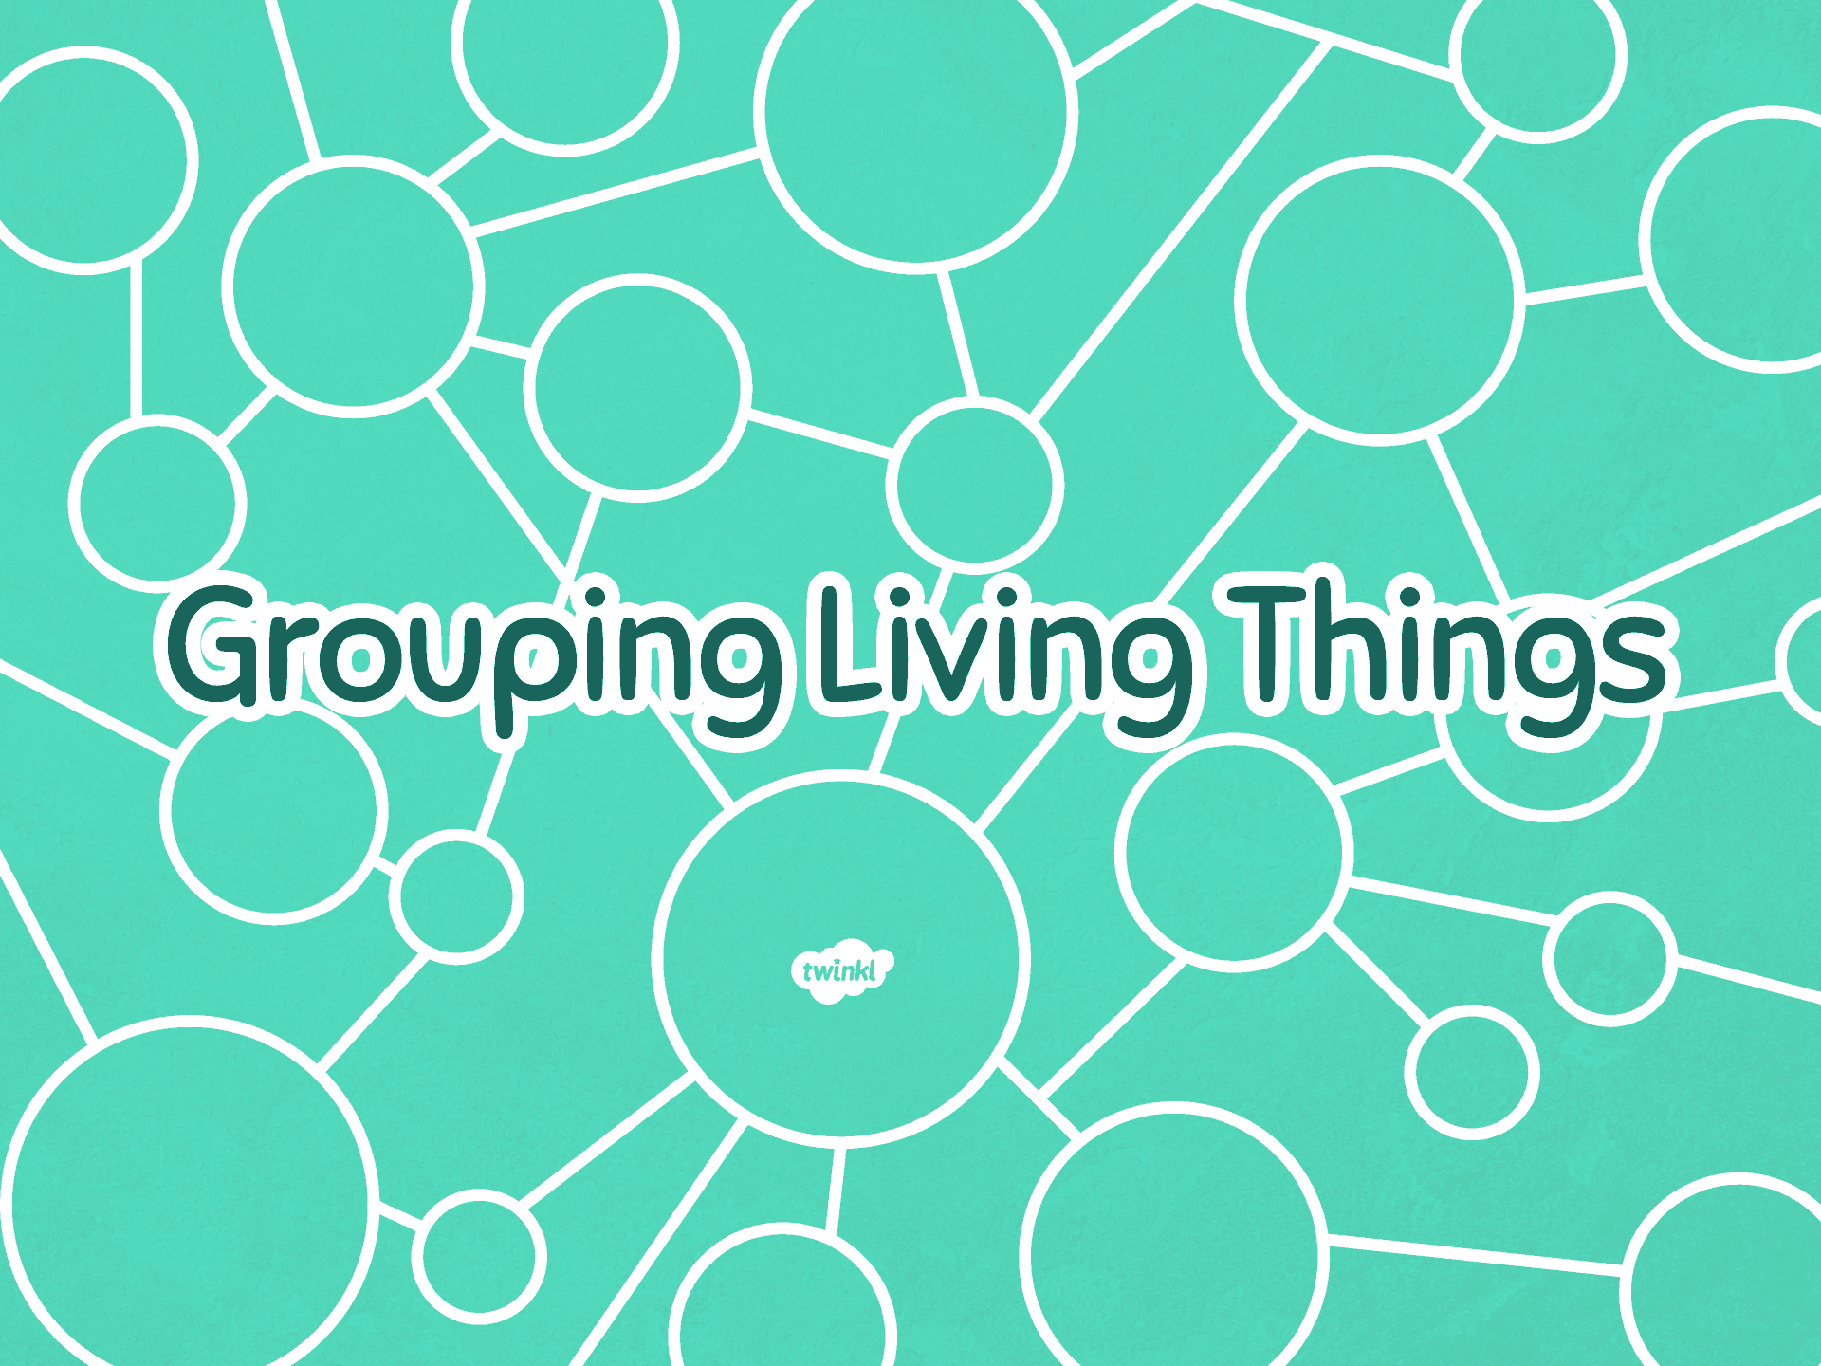

Slide 2

Aim
I can group living things in a range of ways.
I can use a range of methods to sort living things.
Success Criteria
I can sort living things into groups.
I can generate criteria to sort living things.
I can sort living things into a Venn diagram.
I can sort living things into a Carroll diagram.

Slide 3
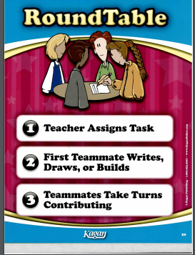
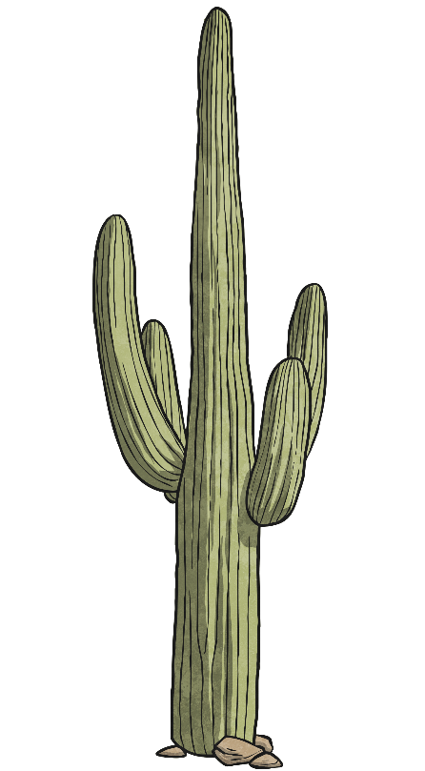
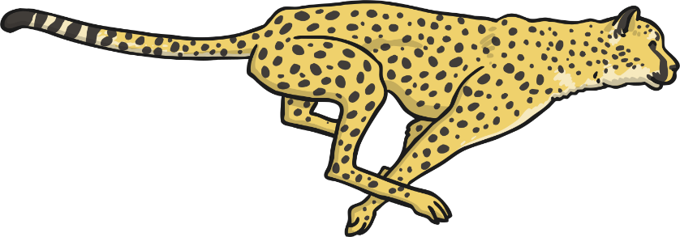
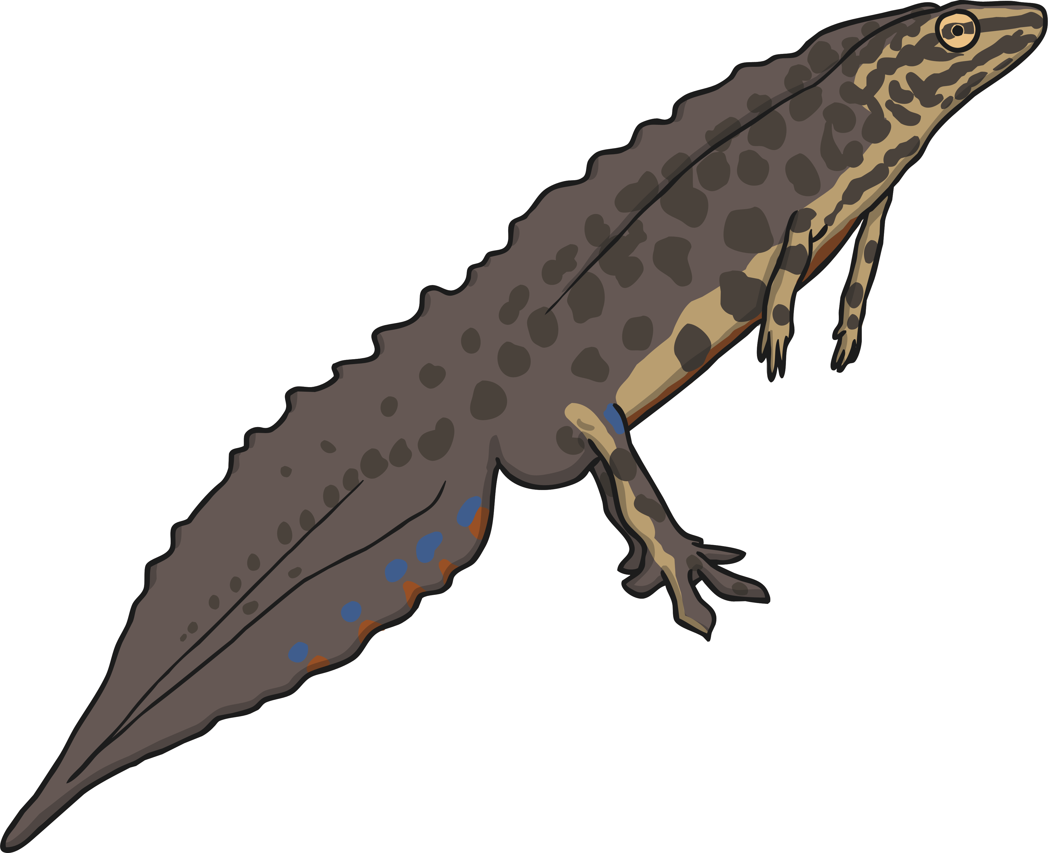
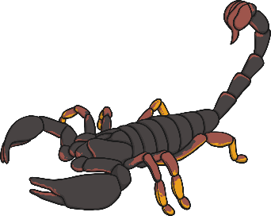
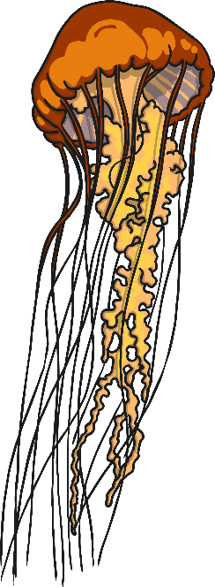
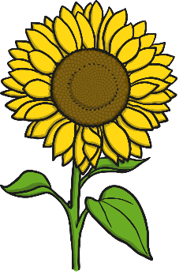
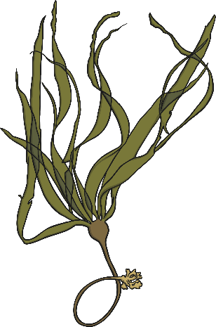
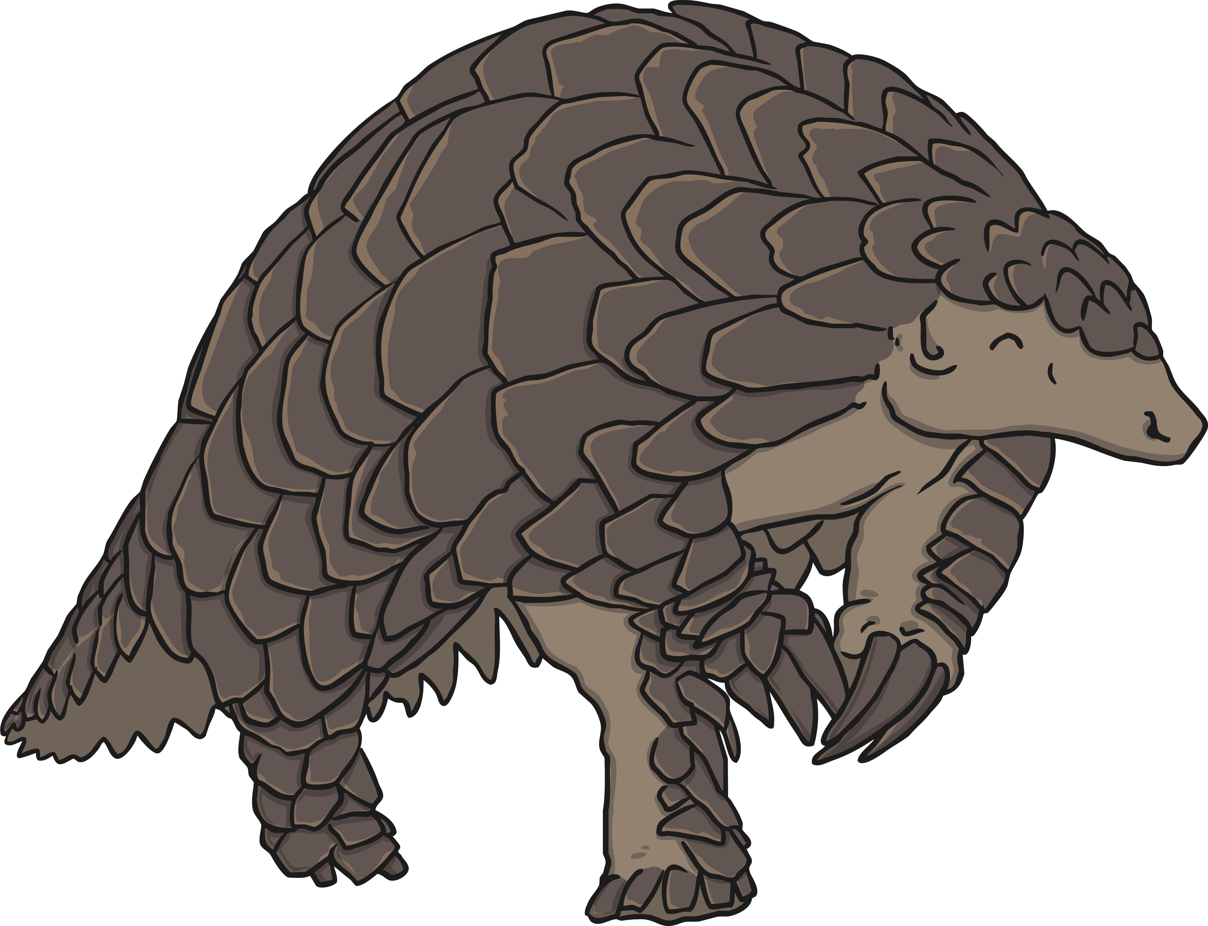
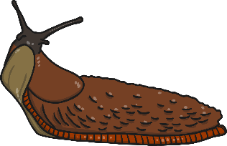
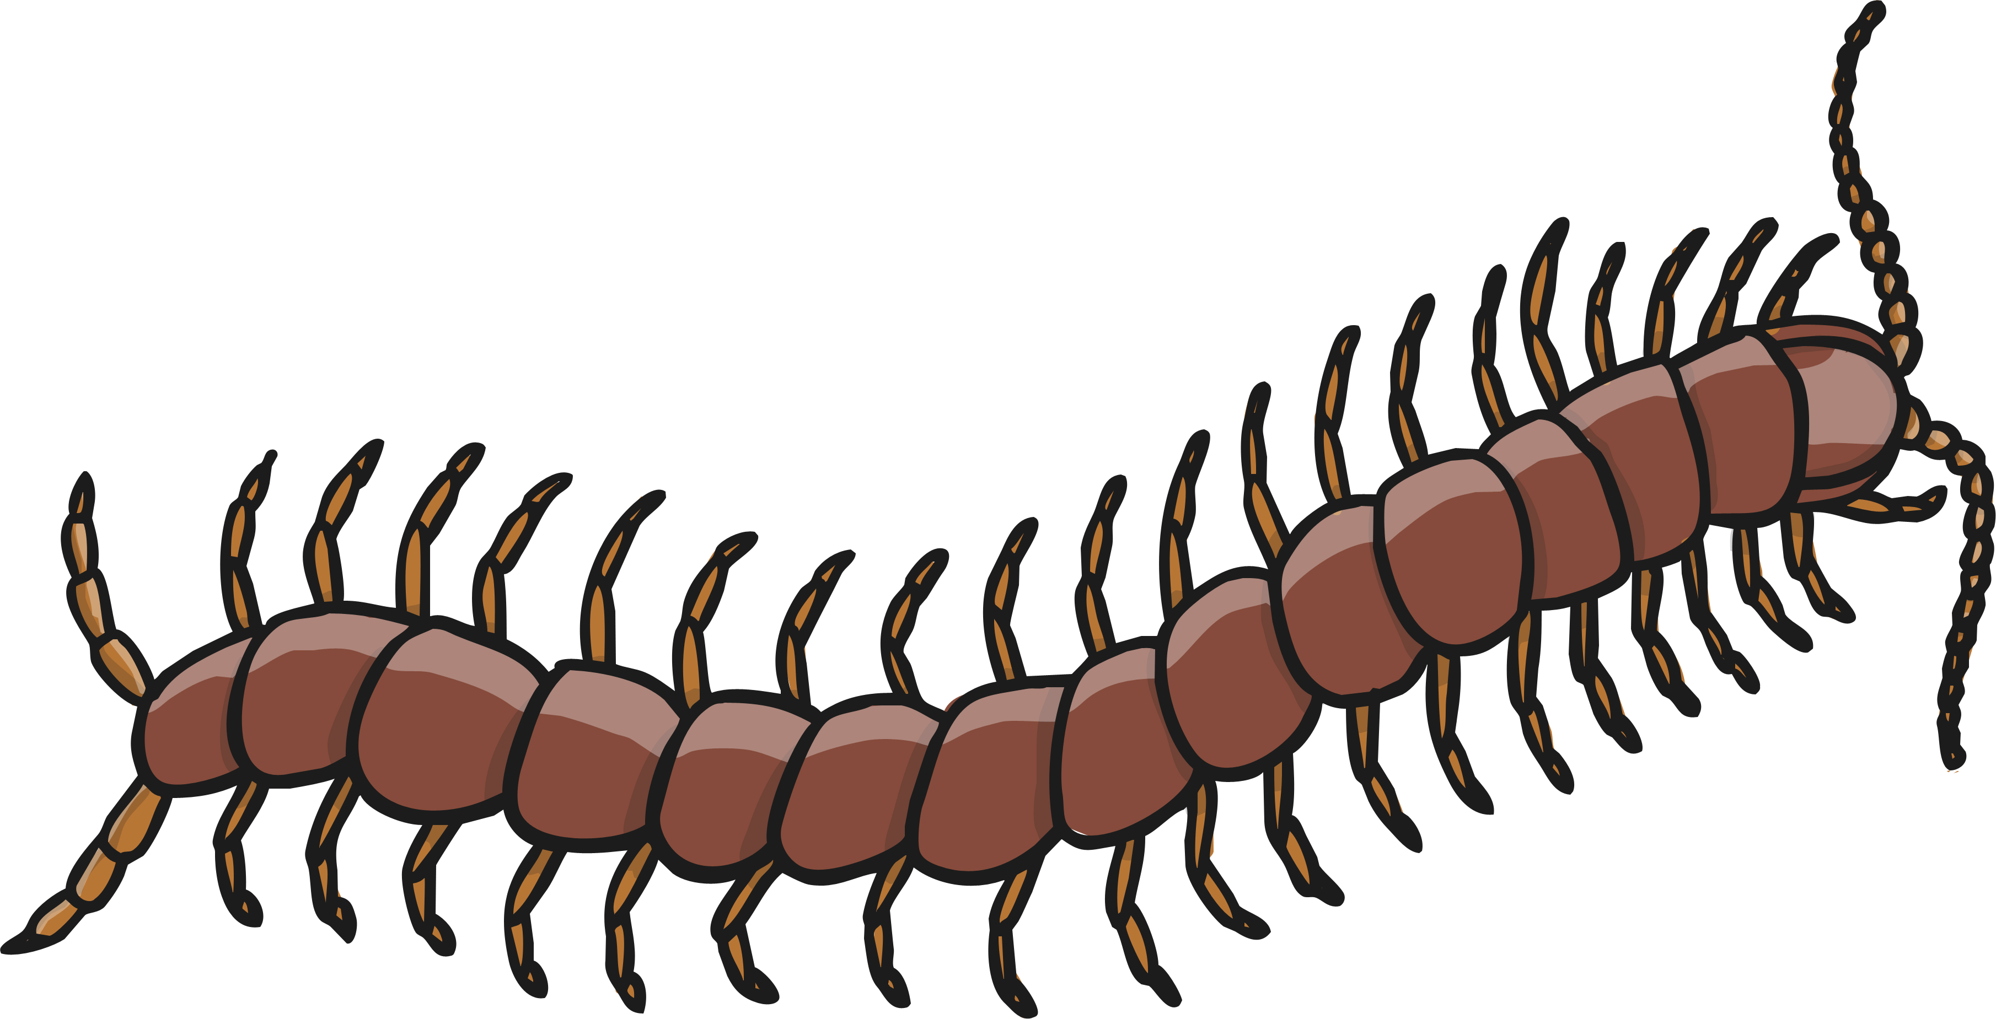
Life Processes
What do all these things have in common?

Slide 4

Life Processes
All of these images are of living things. Sometimes we call them ‘organisms’.
Even though they might be very different from each other, all of these organisms share certain characteristics. All living things do certain things to stay alive. These are called life processes.
All animals, including humans, do these things. Plants do too, although they do them in different ways.
We can remember life processes by thinking about Mrs Gren.

Slide 5
Life Processes
Movement
Respiration
Sensitivity
Growth
Reproduction
Excretion
Nutrition
MRS GREN

Slide 6
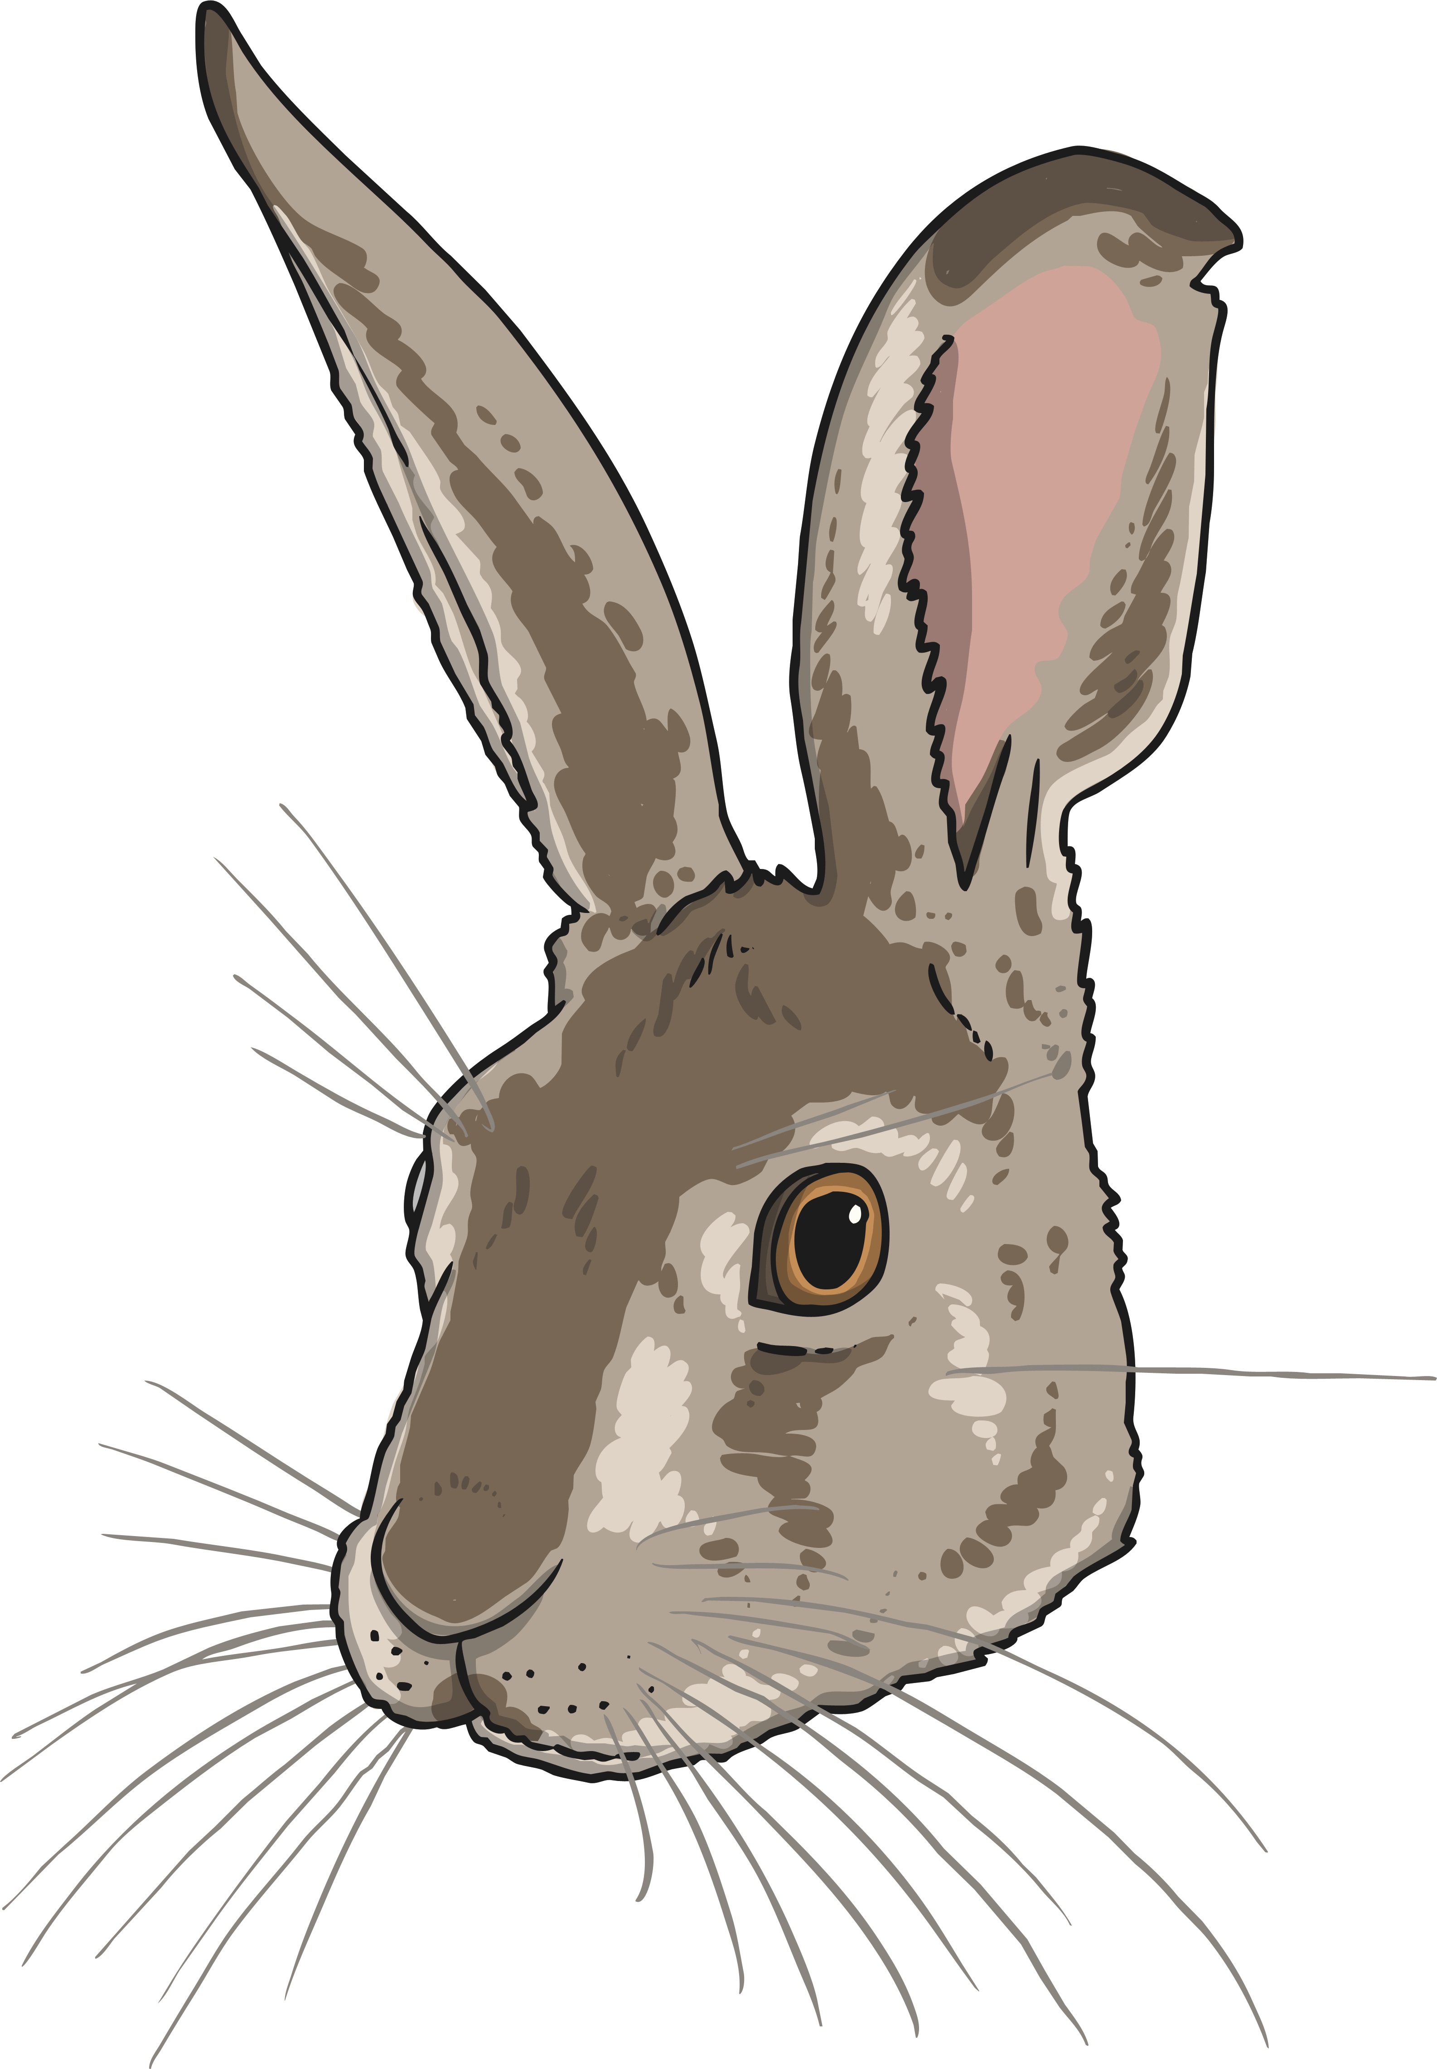

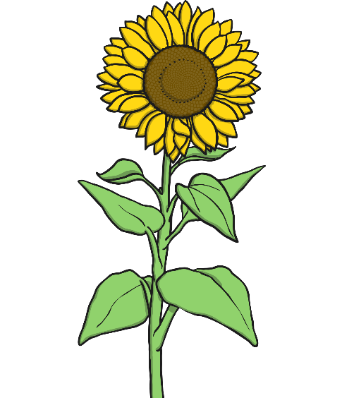
Life Processes
Movement
All living things move.
A hare runs to escape from danger.
Animals
move around
to get from
place to
place.
Plants grow and turn towards the light.
A sunflower moves to turn its face towards the sun.

Slide 7
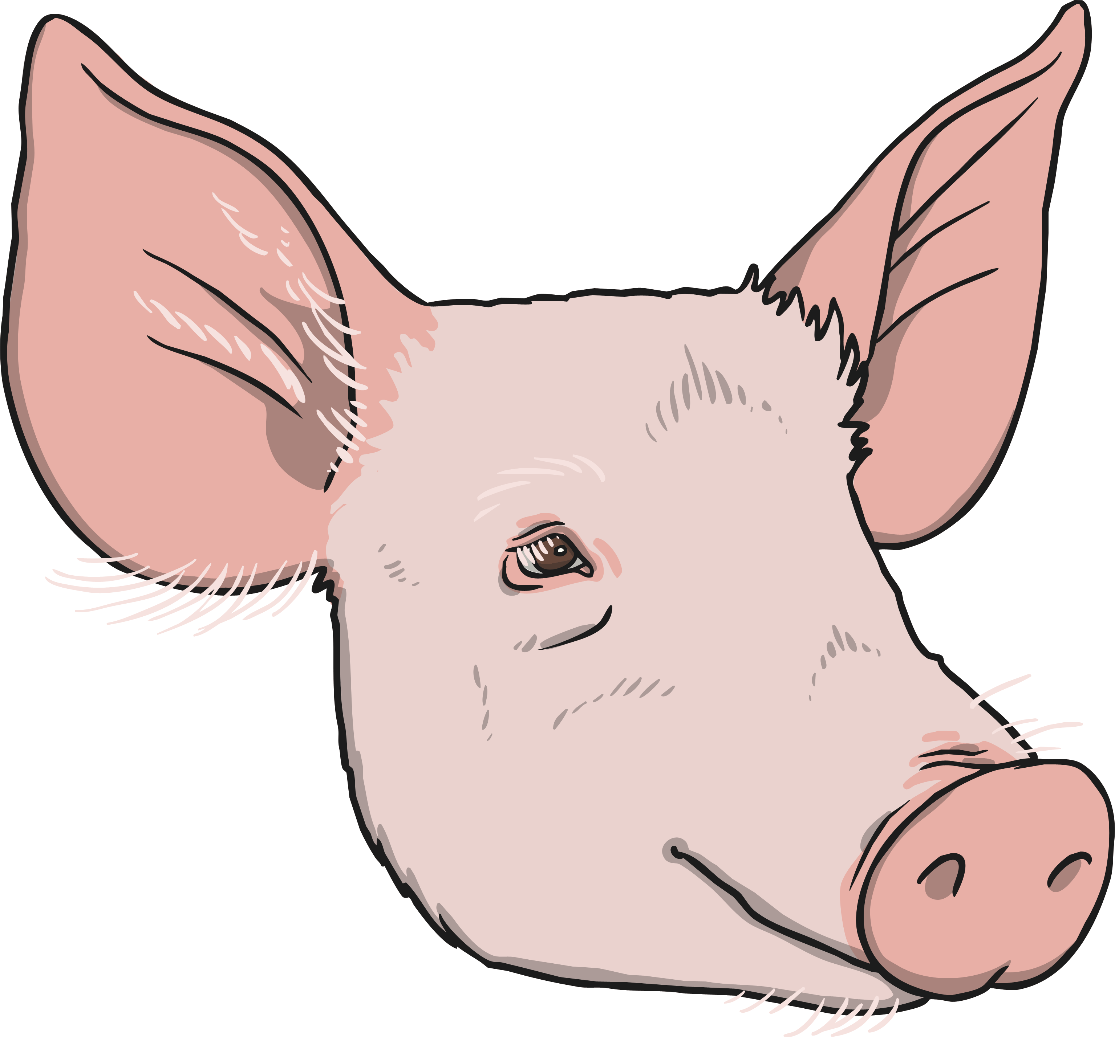

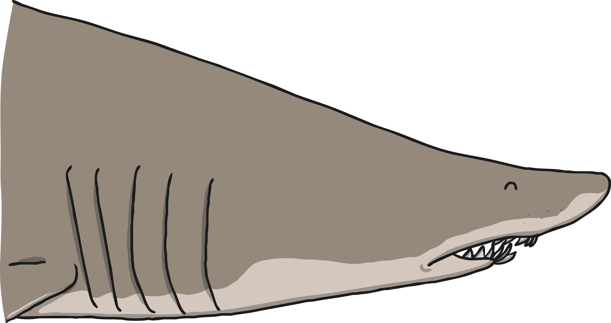

Life Processes
Respiration
Land animals breathe oxygen through their mouths or noses. Sea creatures breathe oxygen dissolved in the water through their gills. Both types of creature then use this oxygen in their
body for respiration.
All living things respire.
Plants and animals both use oxygen gas from the air to
turn their food into energy. This is called respiration.
Plants both respire and photosynthesise. While photosynthesis happens when the plant is in light, plants respire by taking in oxygen and giving out carbon dioxide during darkness.

Slide 8
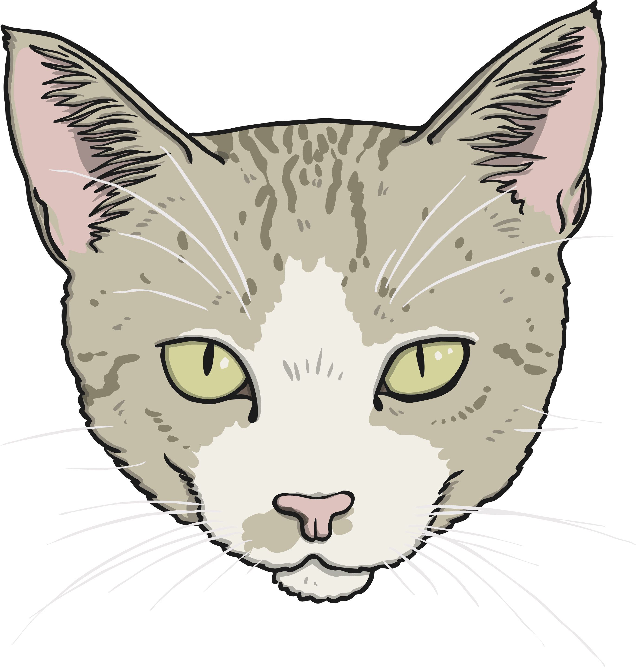

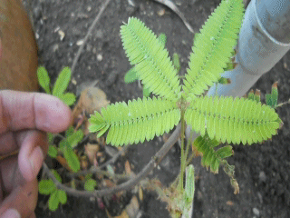
Life Processes
Sensitivity
Animals use their senses to see, hear, taste, touch and smell the world around them.
All living things are sensitive.
Every living thing can detect changes in their surroundings.
Plants can also detect changes in the environment. This mimosa plant curls up when you touch it!

Slide 9
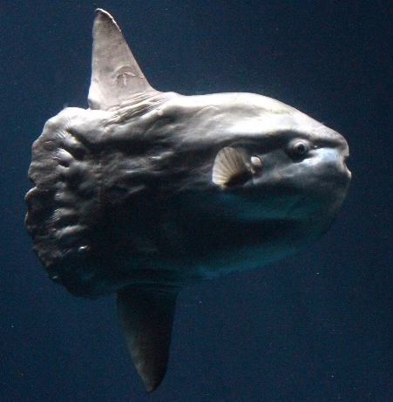

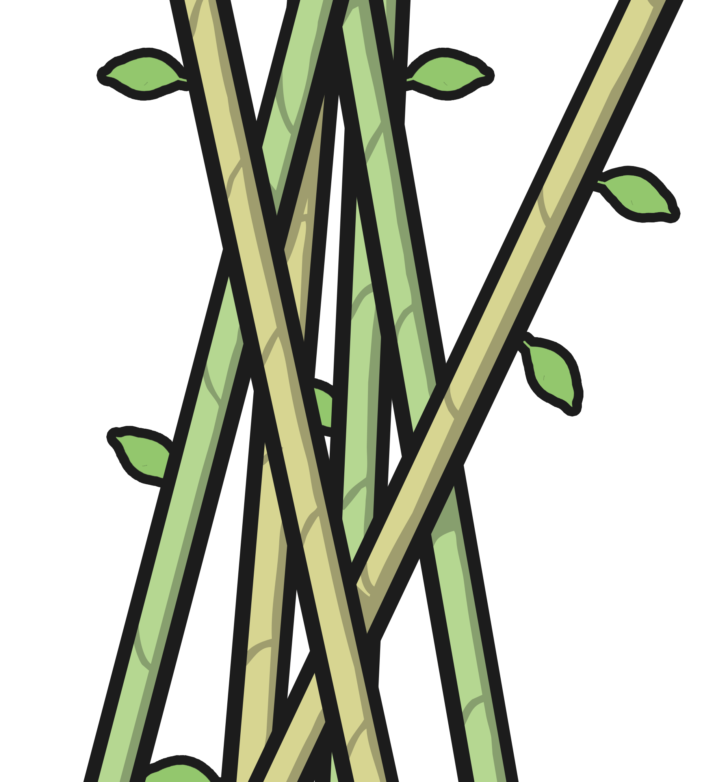
Life Processes
Growth
This ocean mola started life as an egg not much bigger than a full stop. It will grow to weigh about 1000 kg - this is the same size as a large bull!
All living things grow.
Animals grow from babies to adults.
Seeds grow into plants.
Bamboo can grow up to 3cm every hour.
Photo courtesy of sandipb (@flickr.com) - granted under creative commons licence - attribution

Slide 10
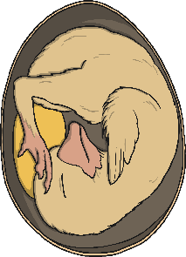
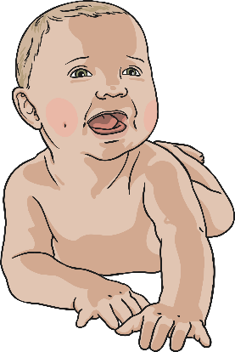
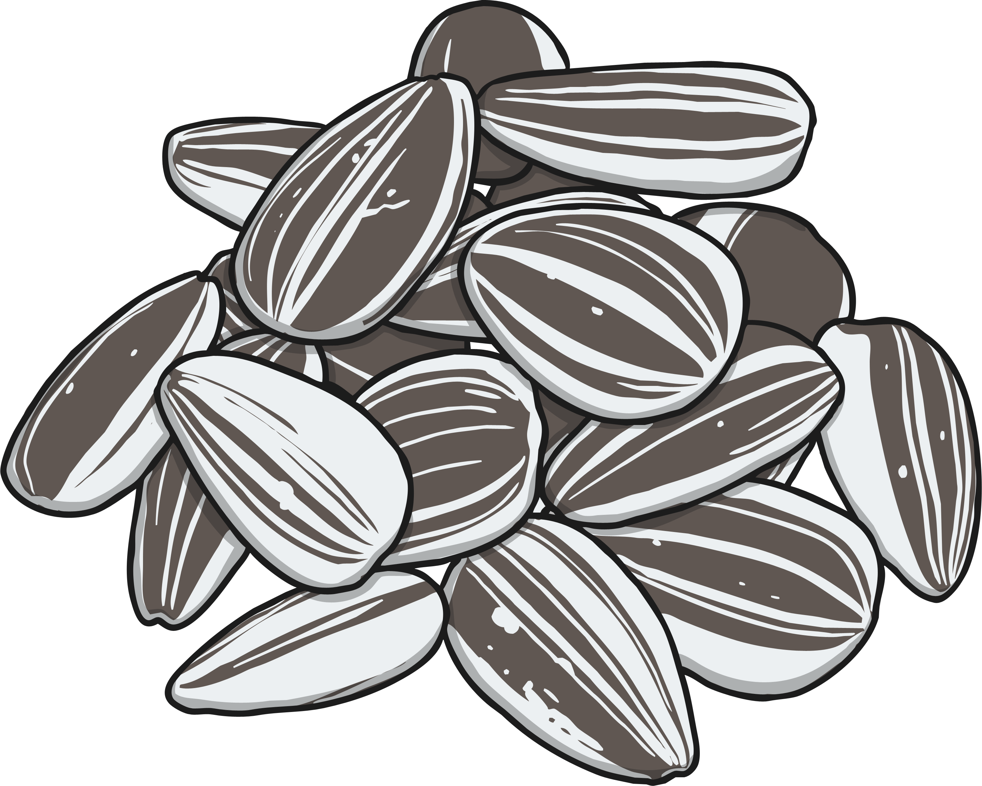
Life Processes
Reproduction
All living things reproduce.
Animals lay eggs or give birth to live young.
Animals have young.
Plants
produce seeds from which more plants grow.
Most plants reproduce by forming seeds.

Slide 11
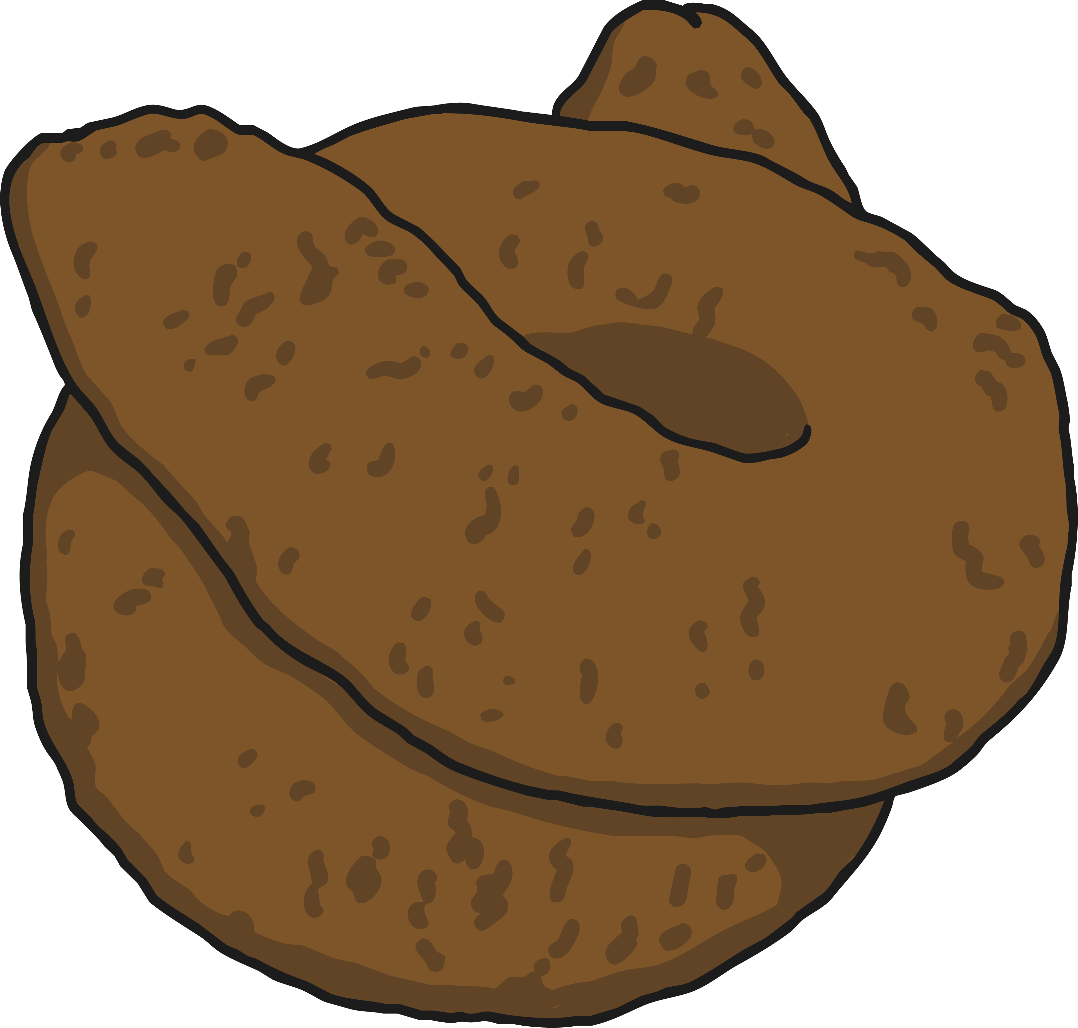
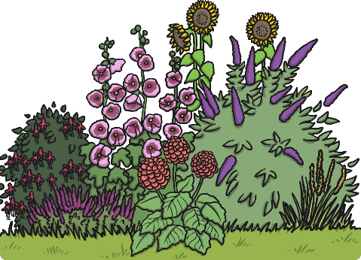
Life Processes
Excretion
All living things excrete.
Animals excrete waste through urine and faeces.
Waste products are removed from the body.
Both plants and animals have to get rid of excess gas and water.
Leftover gases and water leave plants from their leaves.

Slide 12
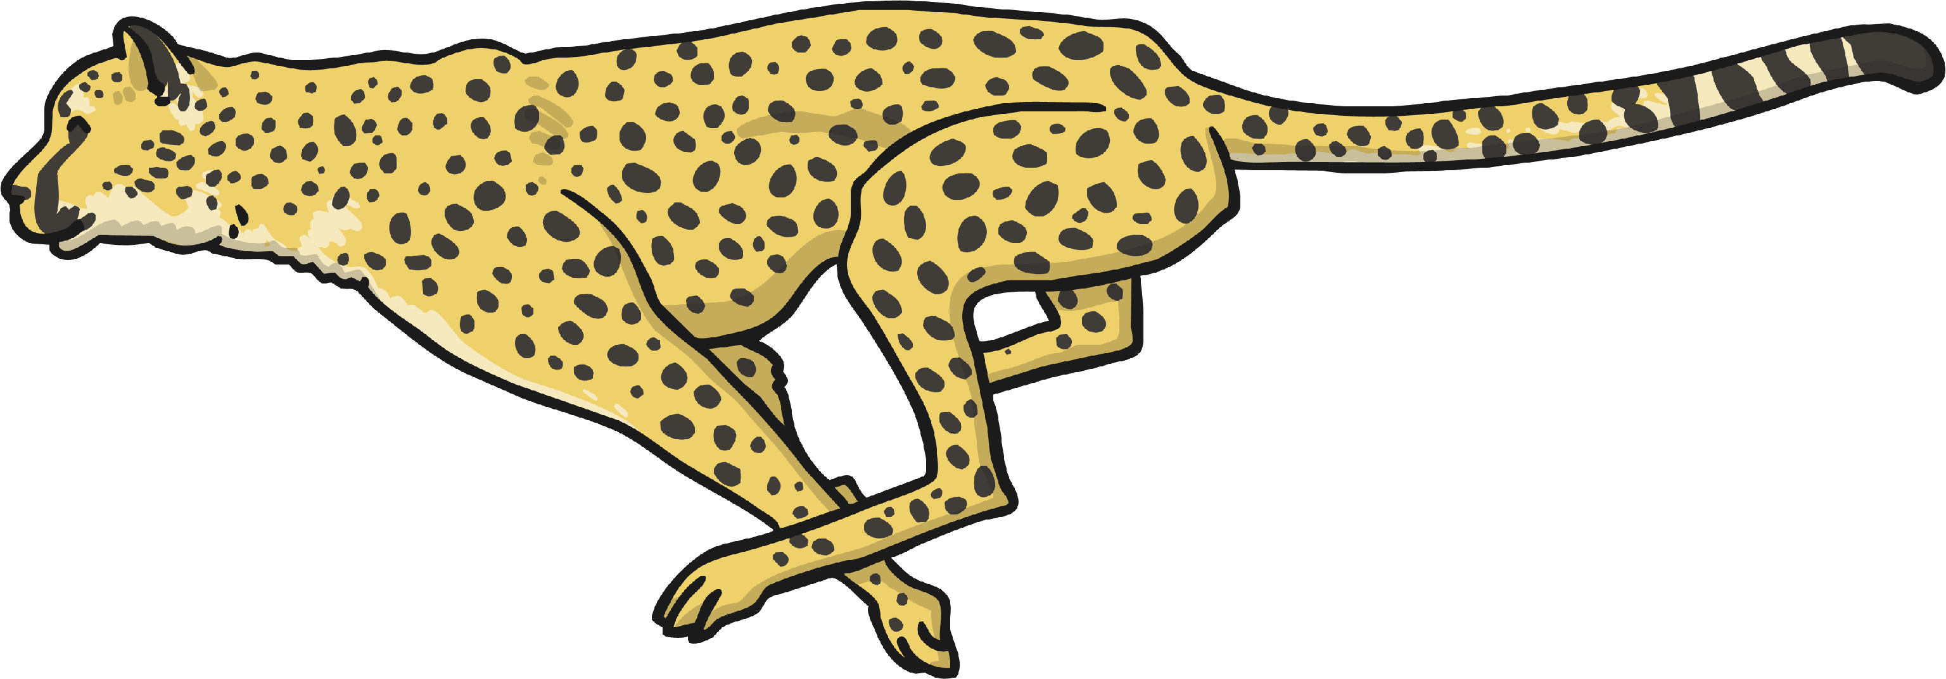
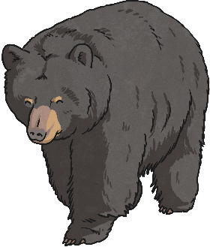
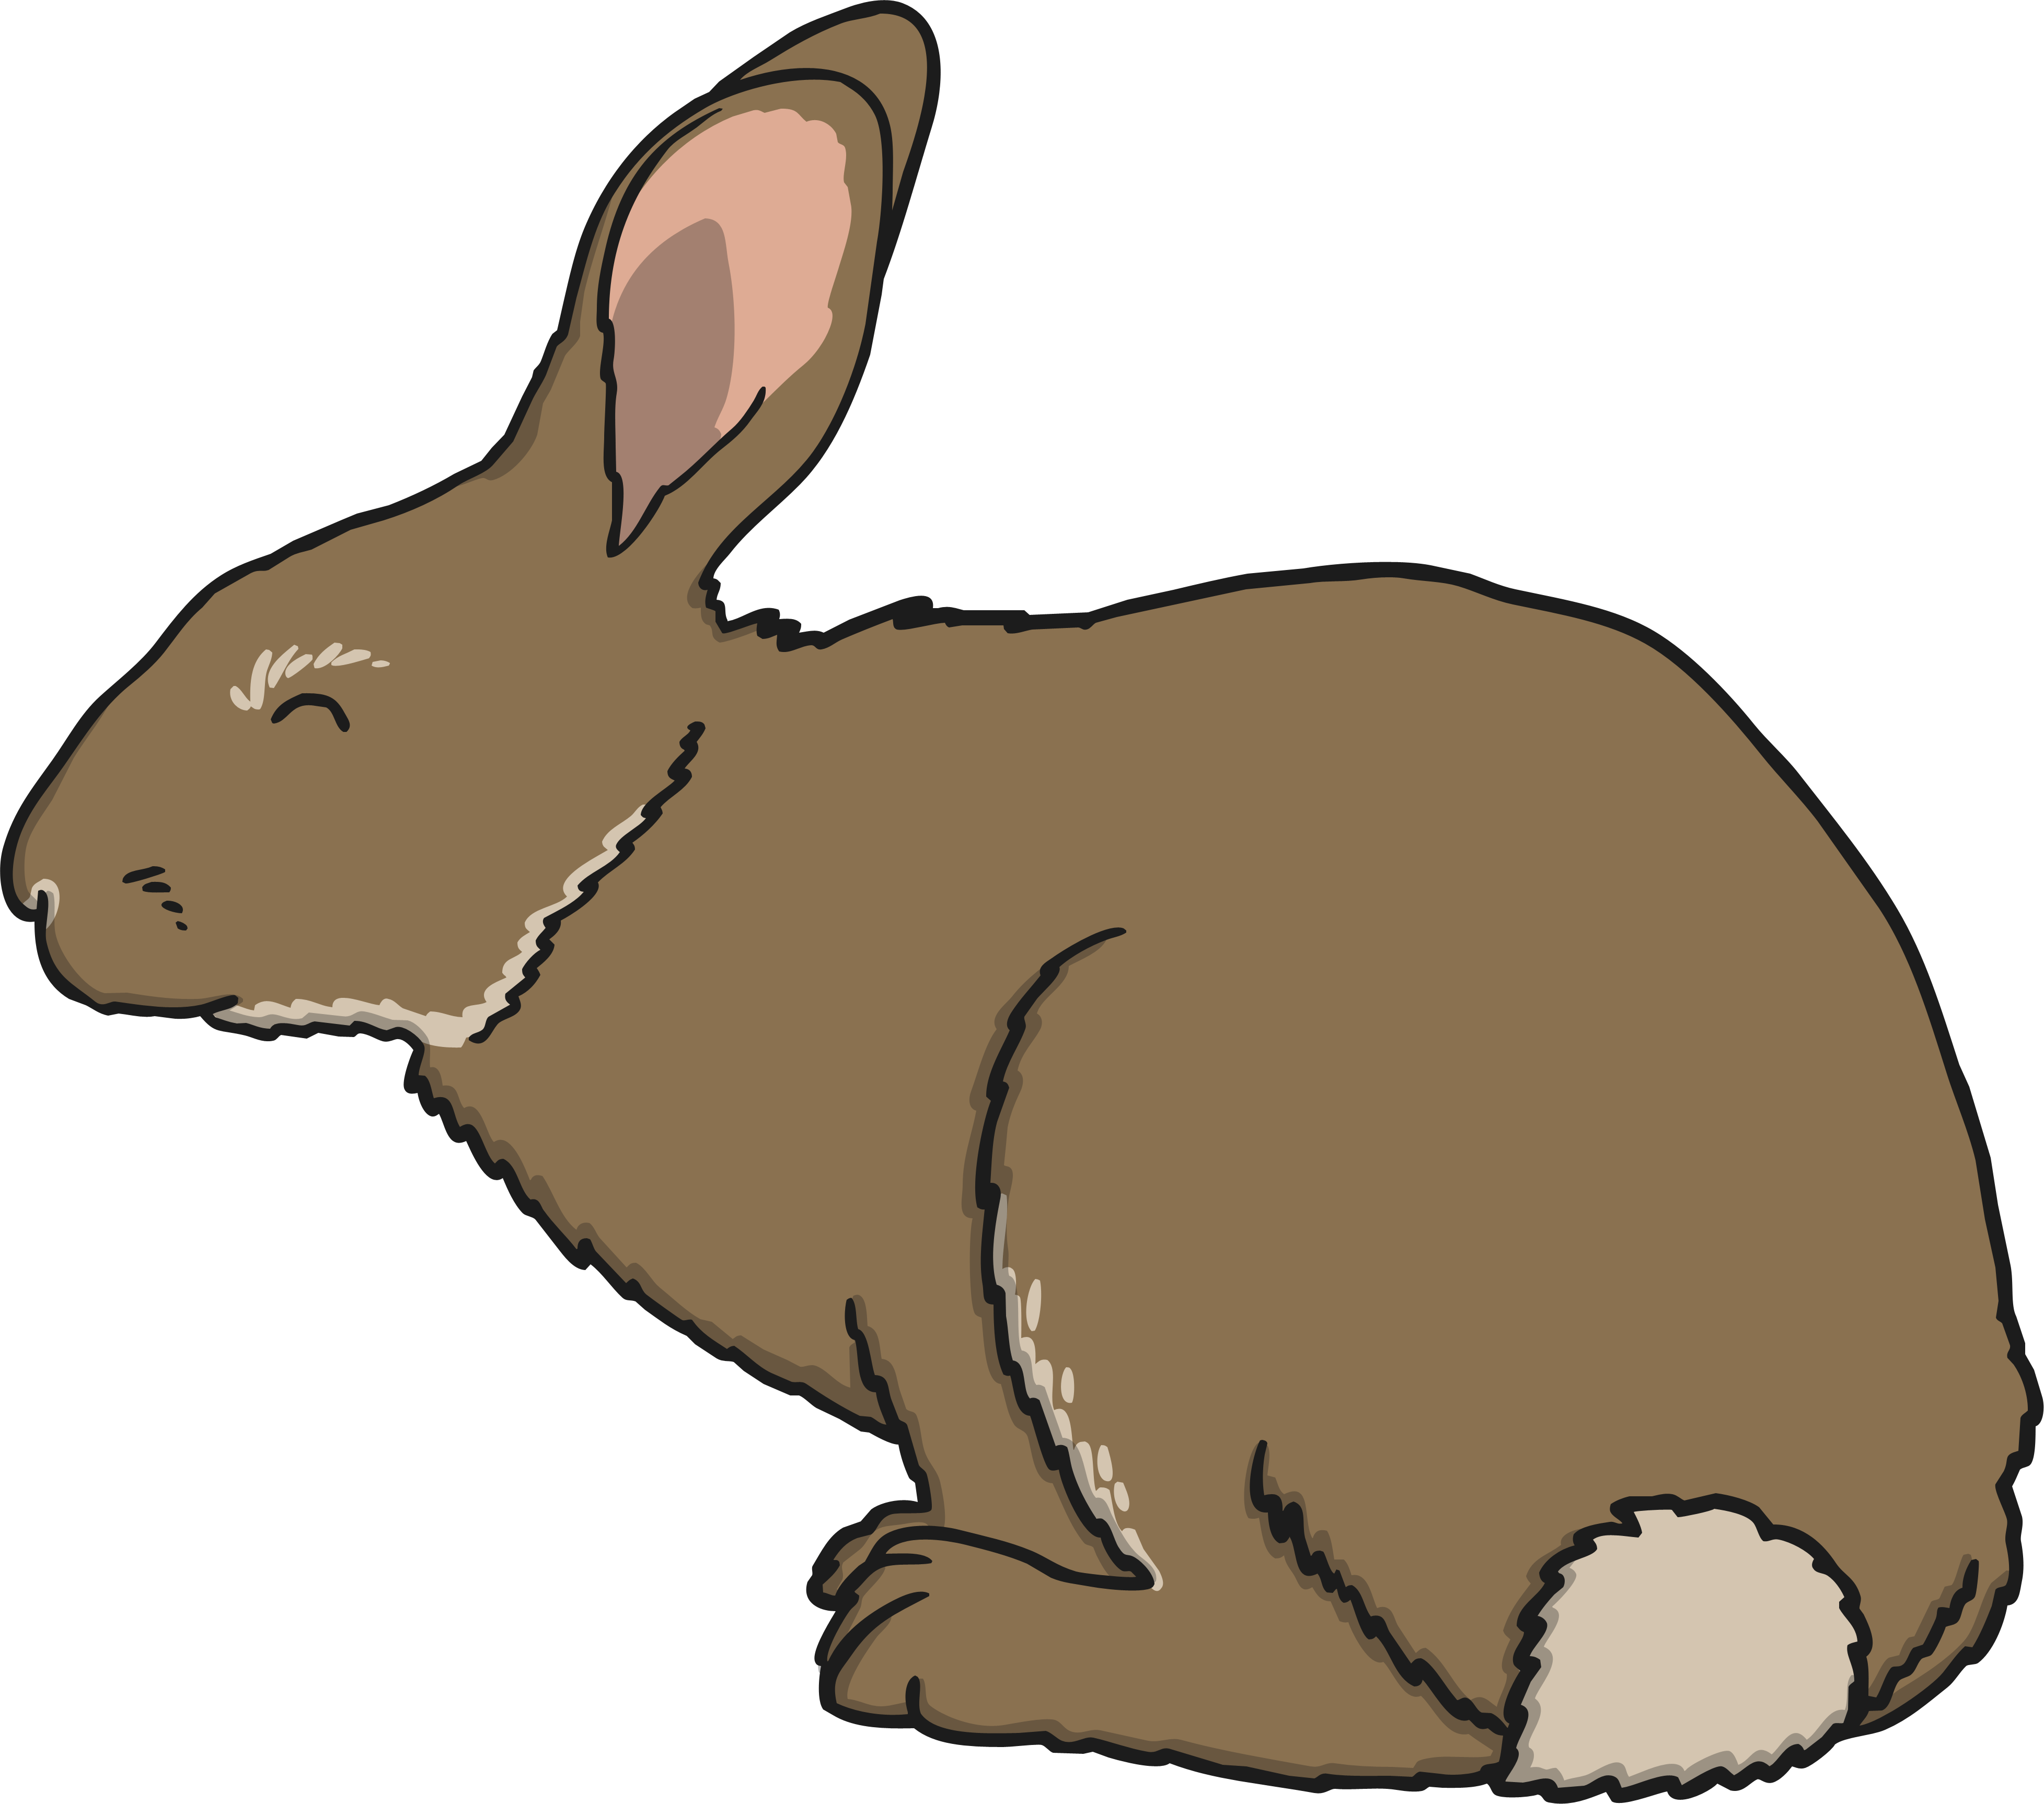

Life Processes
Nutrition
All living things need nutrition.
Animals may be carnivores, herbivores or omnivores.
Food is eaten to provide energy to live.
Green plants make their own food using sunlight.
Green plants make their own food using the energy from the sun.

Slide 13

Life Processes
All living organisms share these characteristics. This is how we know they are alive!
Living things have lots of other similarities, and many differences too. We can use these similarities and differences to sort the living things into groups.

Slide 14

Grouping Living Things
With a partner, think of a way we could sort these organisms into two groups.

Slide 15



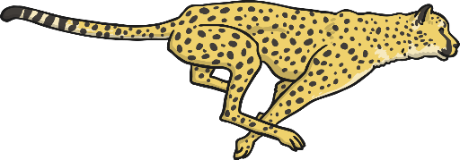
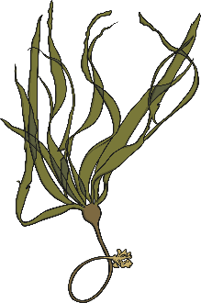



Grouping Living Things
Here the organisms have been sorted into two groups. We have used a diagram to represent these groups.
Can an organism be in both groups at the same time?
plants
animals

Slide 16
Grouping Living Things
Here, an organism cannot be both an animal and a plant, so it can not be in both groups at the same time.
plants
animals

Slide 17
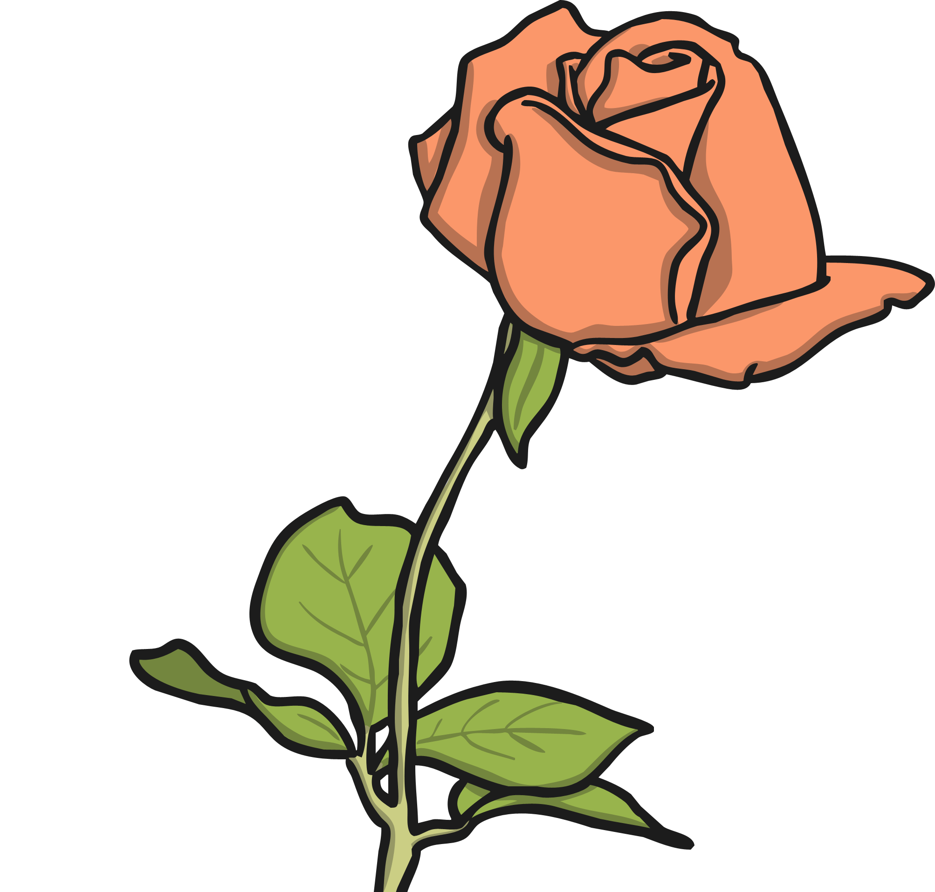
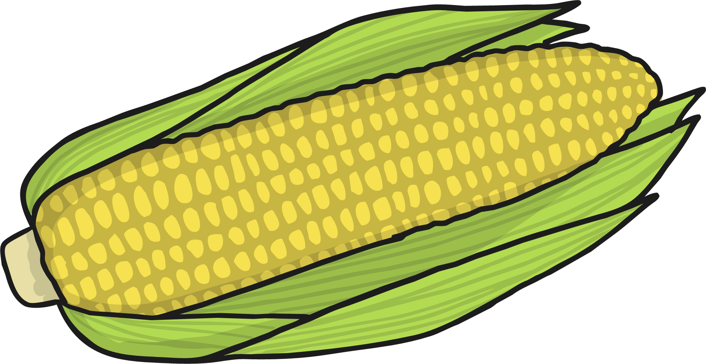

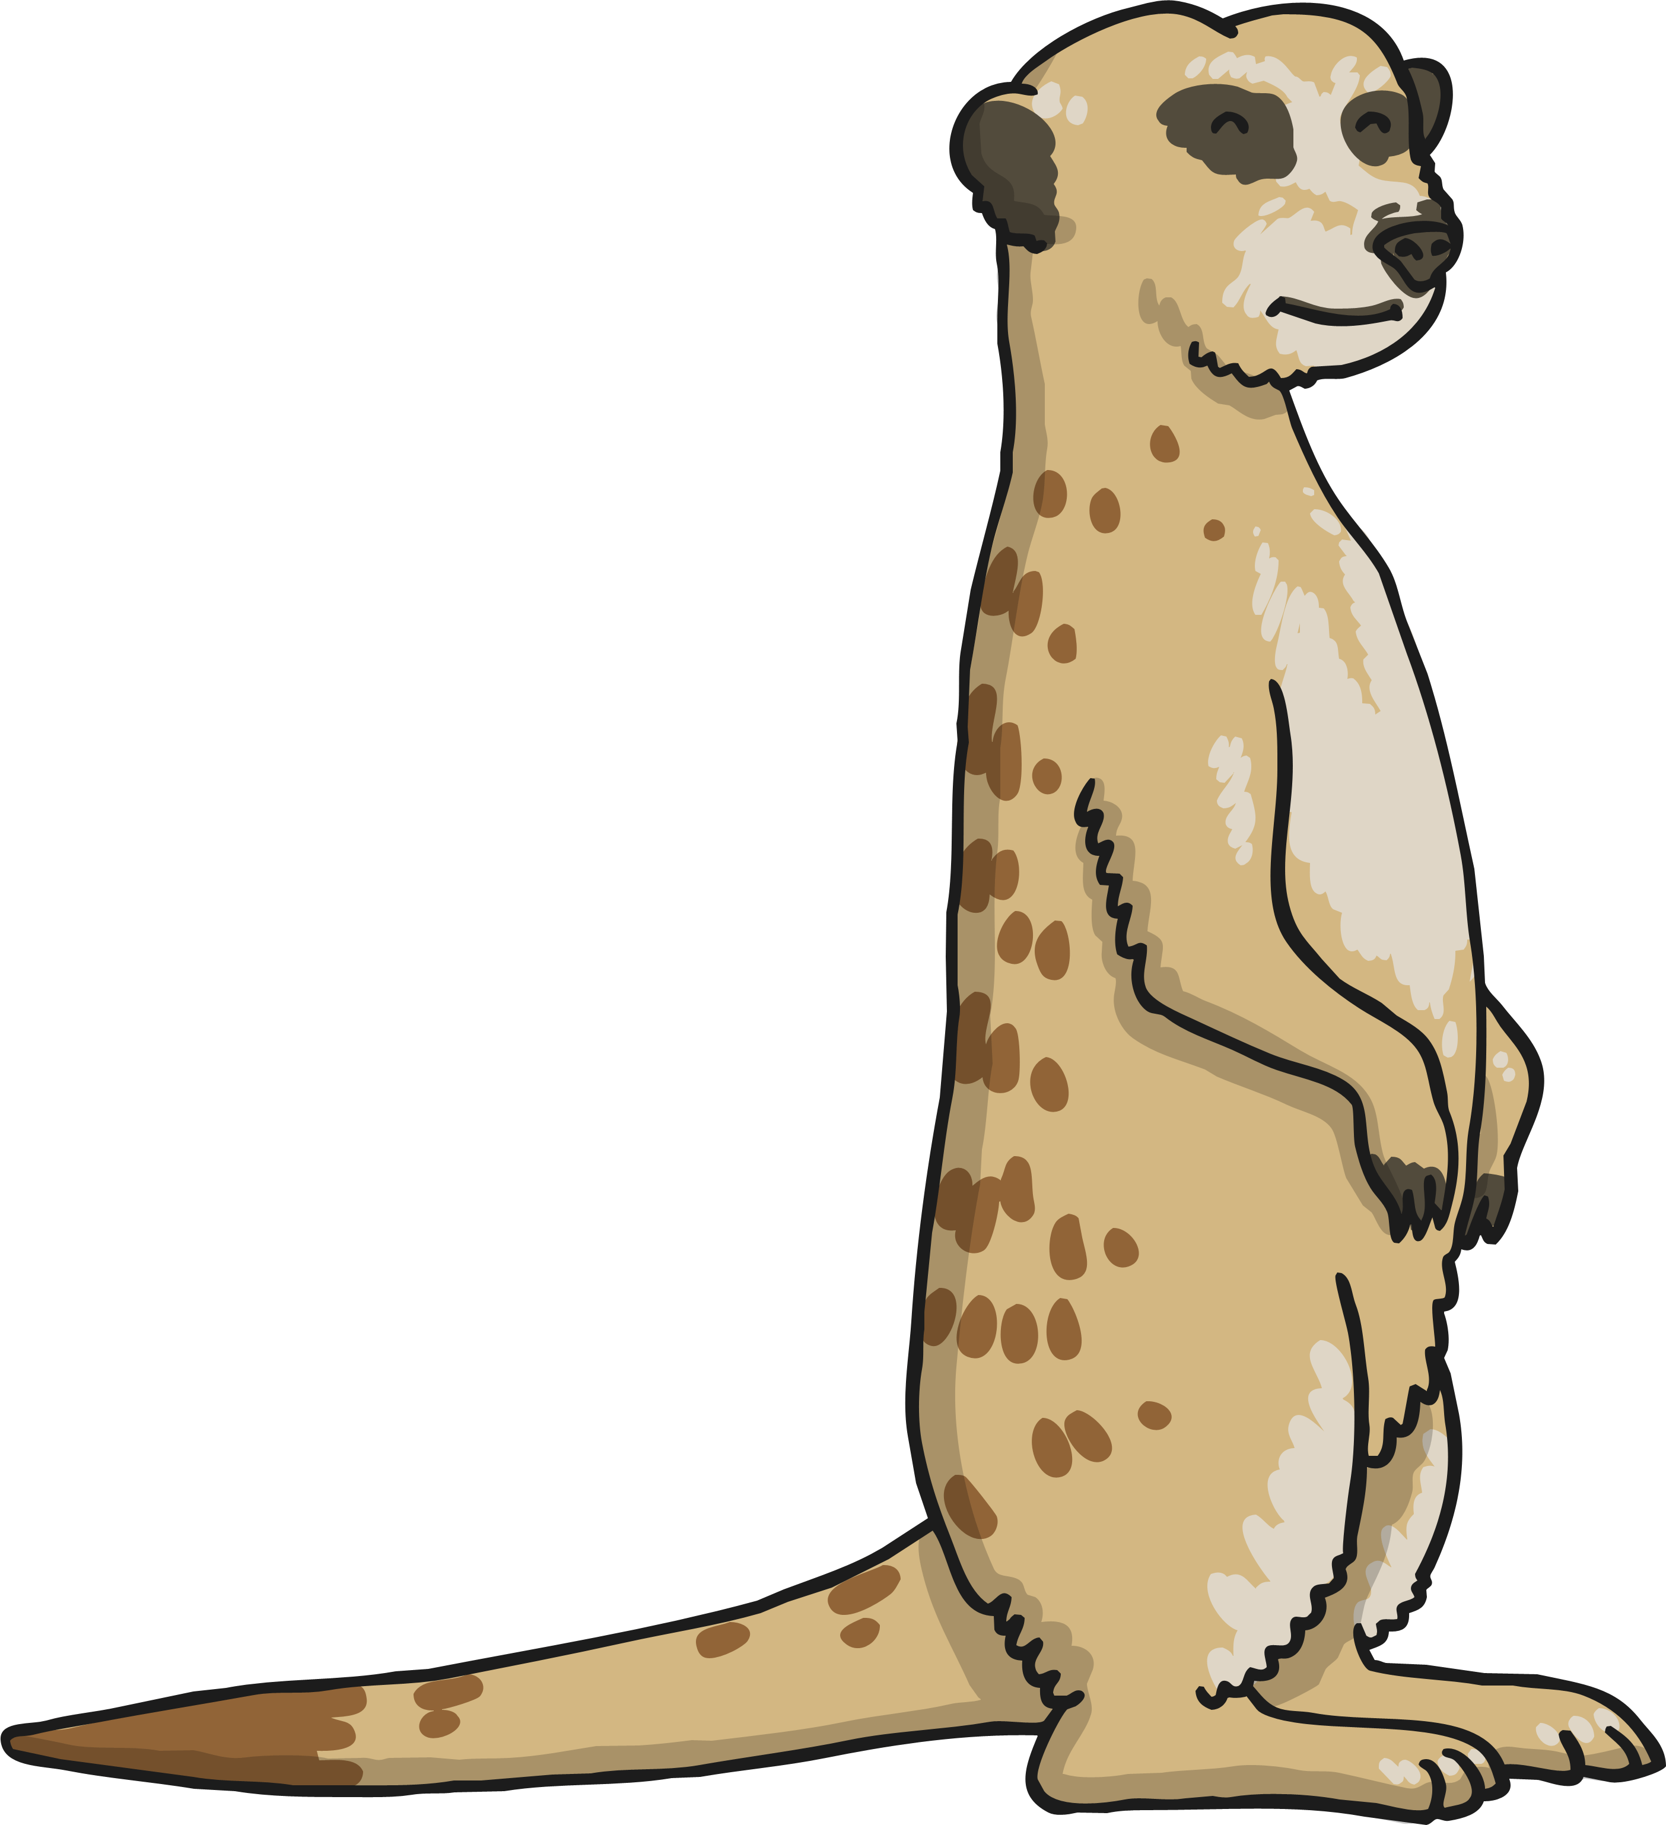
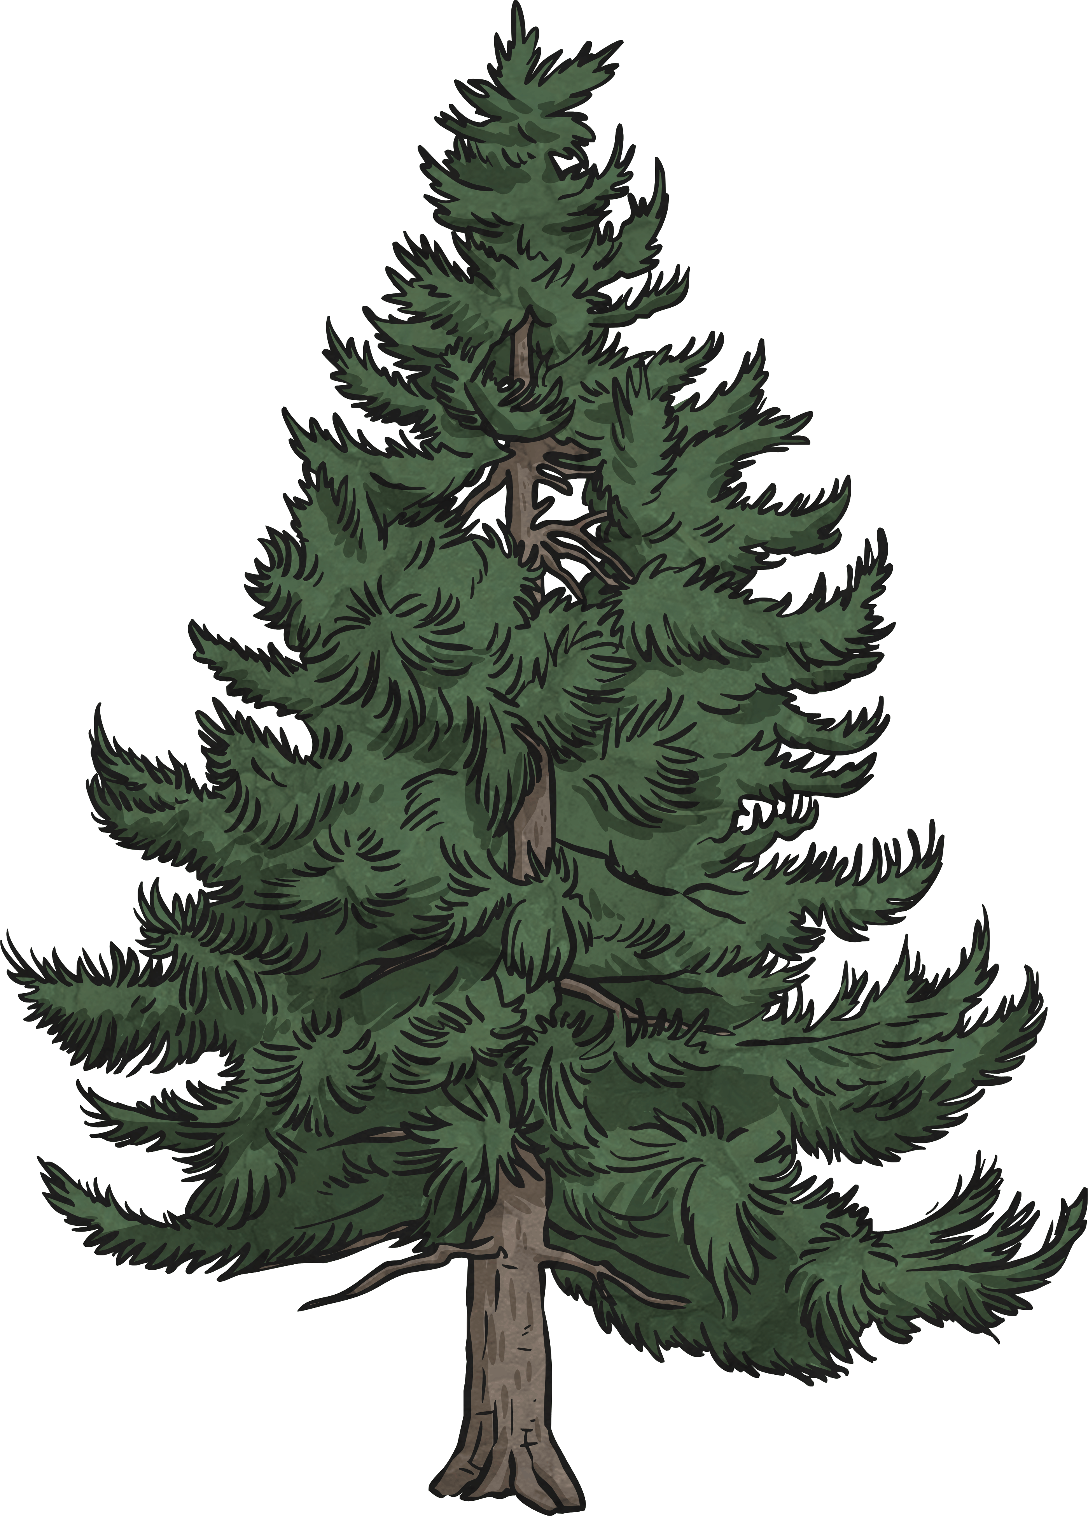

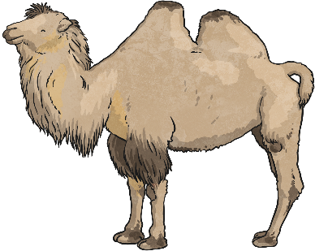
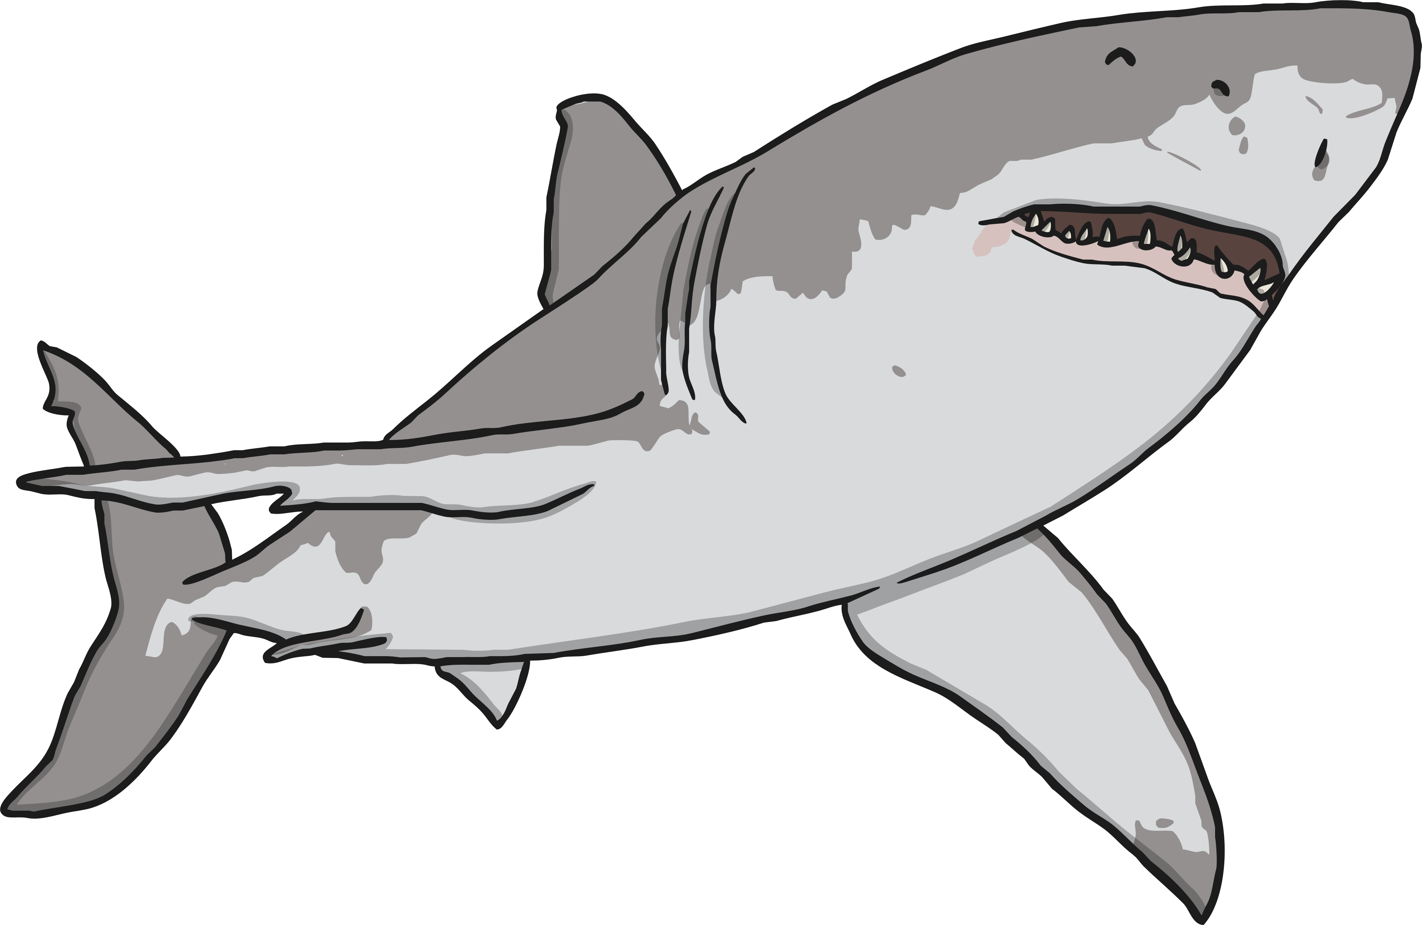
Grouping Living Things
This is called a Venn Diagram. Where does a cactus go in this diagram? How about a polar bear?
plants
lives in the desert
How is this diagram different to the previous diagram?

Slide 18
Grouping Living Things
This is a Carroll Diagram. Can you name an animal to go in each section of this diagram?
Lives in water
Lives on land
Has legs
Crab
Sea otter
Horse
Spider
Does not have legs
Whale
Fish
Snake
Worm
Could you put a plant in this diagram? What about a dandelion? Or seaweed?

Slide 19

Criteria
We have asked some questions to sort our living things into groups so far.
We sometimes call these criteria, which means a rule that we use to decide something.
Plant or animal.
Lives in the desert or does not live in the desert.
Has legs or does not have legs.
Lives on the land or lives in the water.
Today, you are going to be sorting animals.
With a partner, think of different groups that you could sort animals into.
Think of as many different groups as you can.

Slide 20
Criteria
What criteria did you think of?

Slide 21

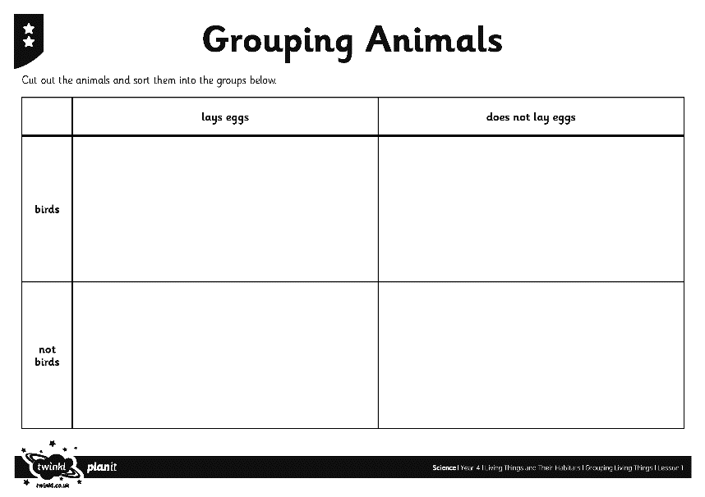
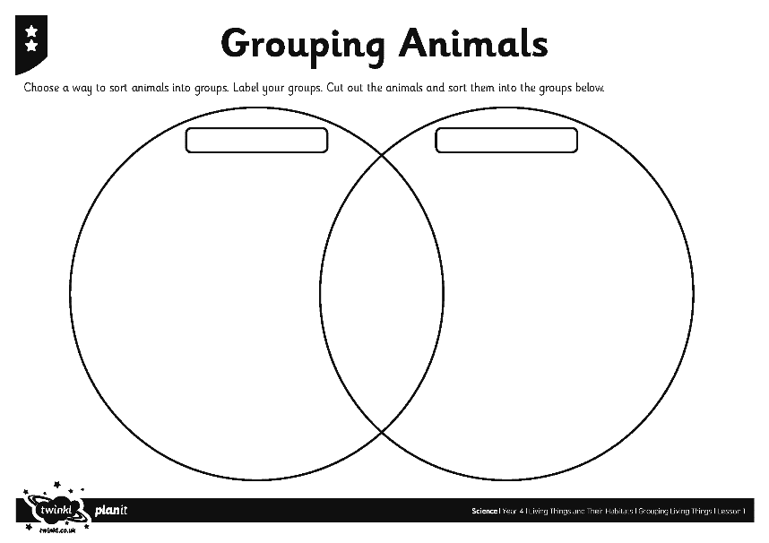
Grouping Animals
You are going to group animals in a variety of ways, using some criteria that have been chosen for you, and some that you choose yourself.

Slide 22
Sorting into Three Groups
Lays eggs
Venn diagrams can be used to sort lots of groups of animals.
Where would a turtle go on this diagram?
Where would a cat go?
snake
penguin
dragonfly
butterfly
duck
kangaroo
parrot
human
bat
Has two legs
Can fly

Slide 23
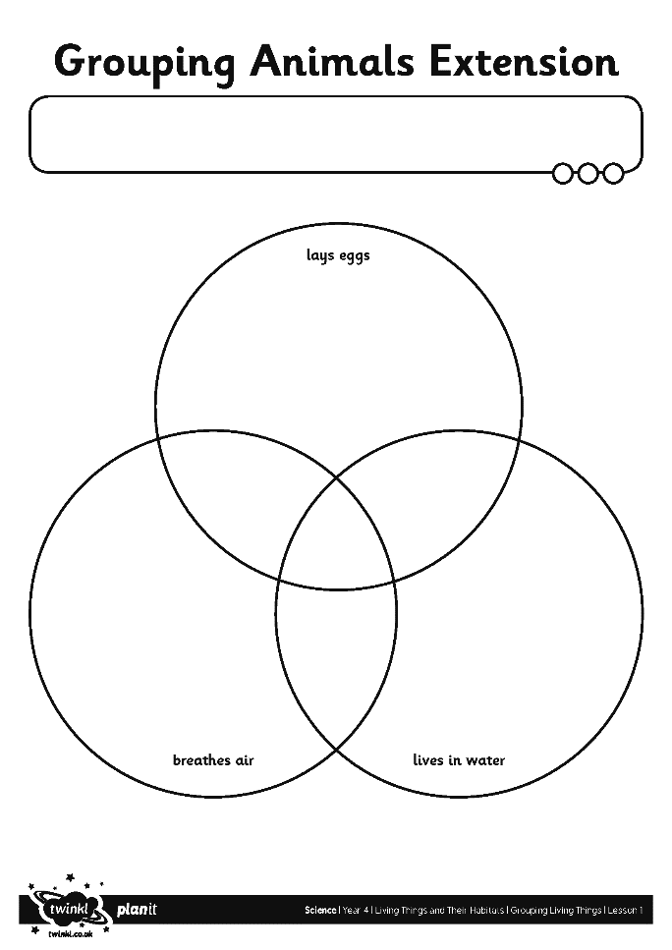
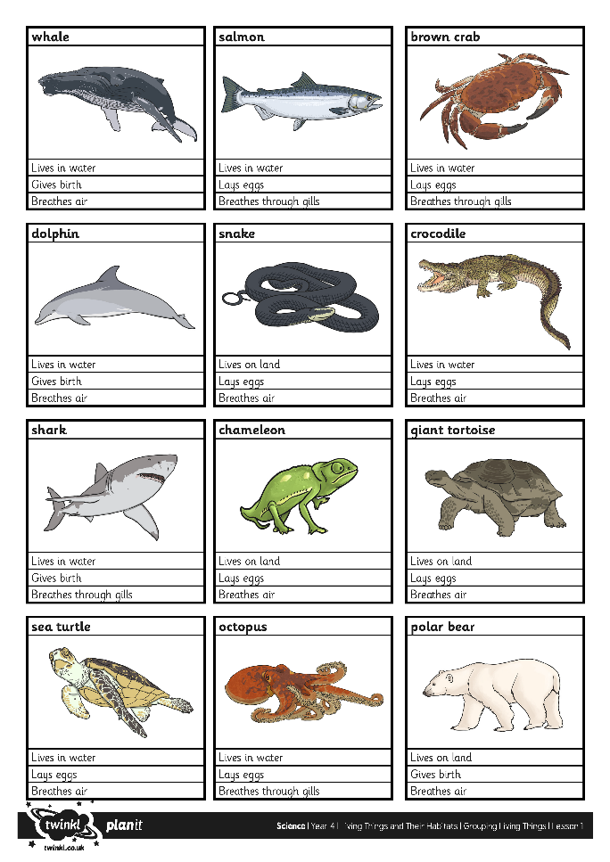
Sorting into Three Groups

