Slide 1


Year 5 – Summer Block 2 – Geometry
Thursday
Measuring with a Protractor 2
You’ll need a pencil, protractor and paper. Some different coloured pens or pencils crayons.
© Classroom Secrets Limited 2019

Slide 2
Introduction
Look at the word below, how many obtuse angles can you see? It might help it you mark them with an arc and use a different colour. Now swap colours and find all the acute angles. Go to the next slide to see how you did.
© Classroom Secrets Limited 2019

Slide 3
Introduction
How many acute angles can you see? 8
How many obtuse angles can you see? 3
© Classroom Secrets Limited 2019

Slide 4
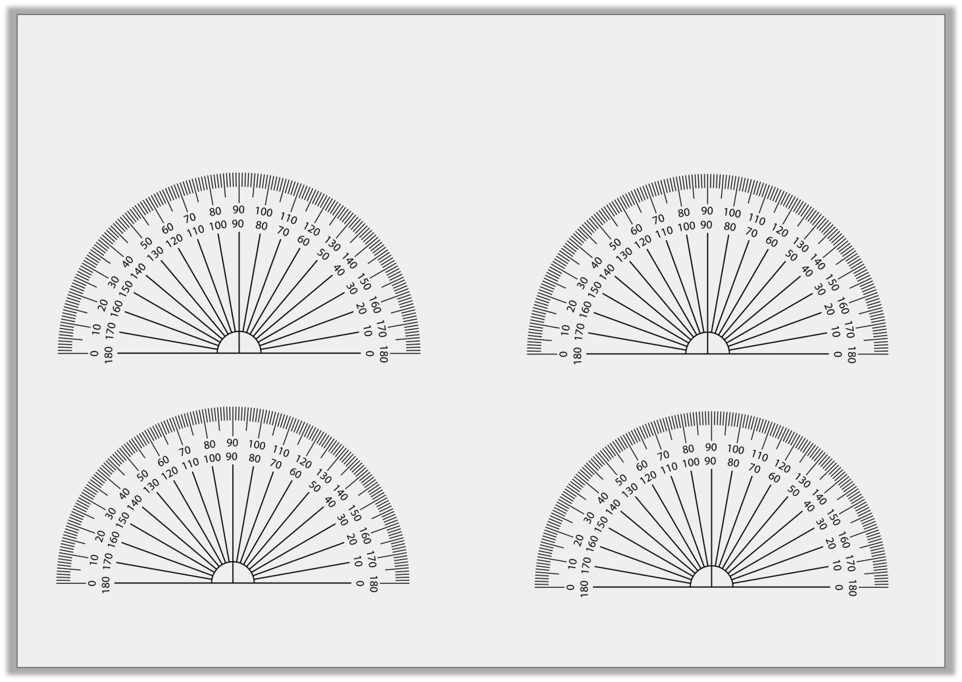
Varied Fluency 1
Tell someone what the definition of an obtuse angle is, then tick which angles below are obtuse. Can’t remember? Google it.
a
b
c
d
© Classroom Secrets Limited 2019

Slide 5
Varied Fluency 1
Which angles are obtuse?
a
b
c
d
© Classroom Secrets Limited 2019

Slide 6
Varied Fluency 2
Estimate these obtuse angles.
b.
a.
d.
c.
© Classroom Secrets Limited 2019

Slide 7
Varied Fluency 2
Estimate these obtuse angles.
Accept answers 5˚ either side of given answers.
b. 150˚
a. 100˚
d. 140˚
c. 130˚
© Classroom Secrets Limited 2019

Slide 8
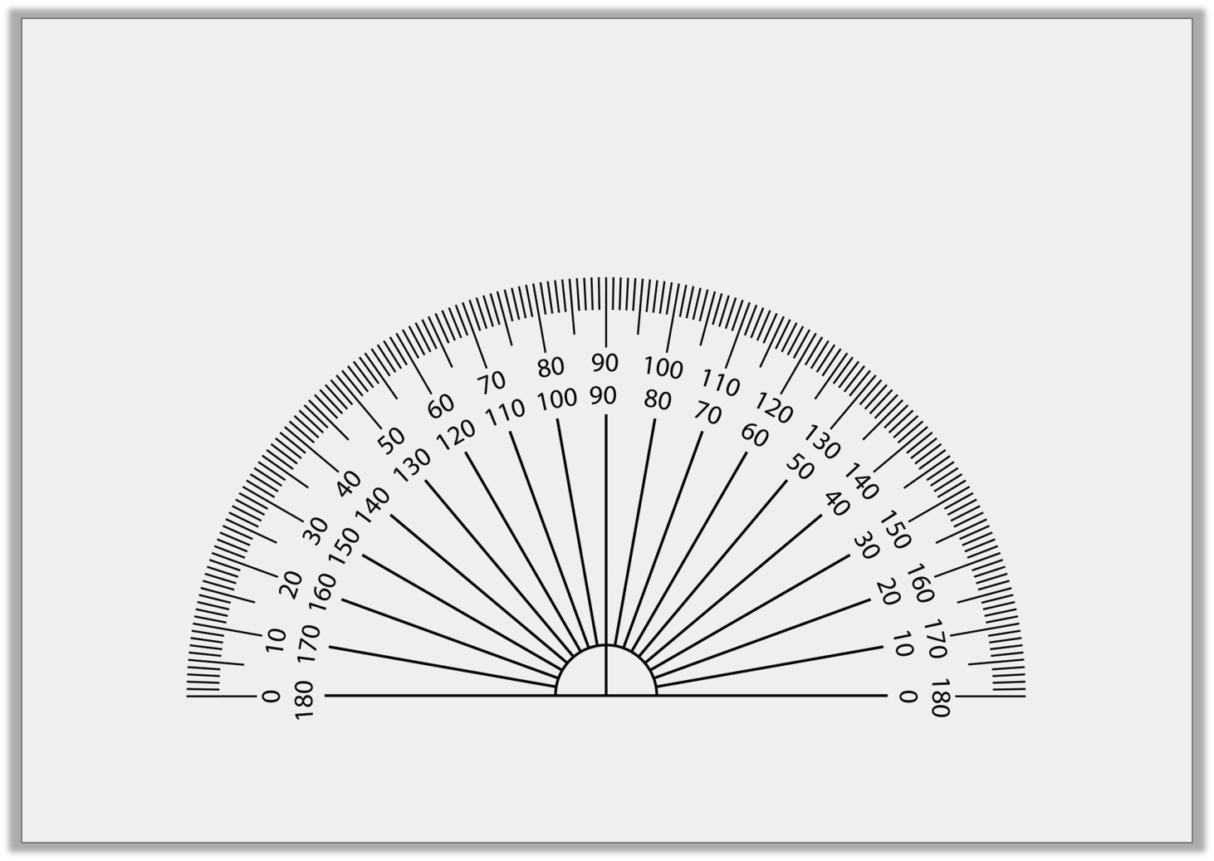
Varied Fluency 3
Draw an obtuse angle using the outer scale.
© Classroom Secrets Limited 2019

Slide 9
Varied Fluency 4
First measure each of these answers accurately, then order them smallest to largest.
a
c
b
e
d
f
© Classroom Secrets Limited 2019

Slide 10
Varied Fluency 4
Order these angles from smallest to largest.
b, d, c, a, f, e
a
c
b
e
d
f
© Classroom Secrets Limited 2019

Slide 11
Now find the document called Thursday-Varied Fluency.
First decide how confident you are feeling.
Super confident – you’ll need the sheet with GD written in the star.
OK – find sheet with E written in the star.
Not sure – complete the sheet with D on it, you could then move on to E if you have time.
Just complete one half of the sheet. Then mark.

Slide 12
Problem Solving 1
Choose two of the given angles to label the
obtuse angles.
95˚
120˚
170˚
© Classroom Secrets Limited 2019

Slide 13
Problem Solving 1
Choose two of the given angles to label the
obtuse angles.
120˚
95˚
95˚
120˚
170˚
© Classroom Secrets Limited 2019

Slide 14
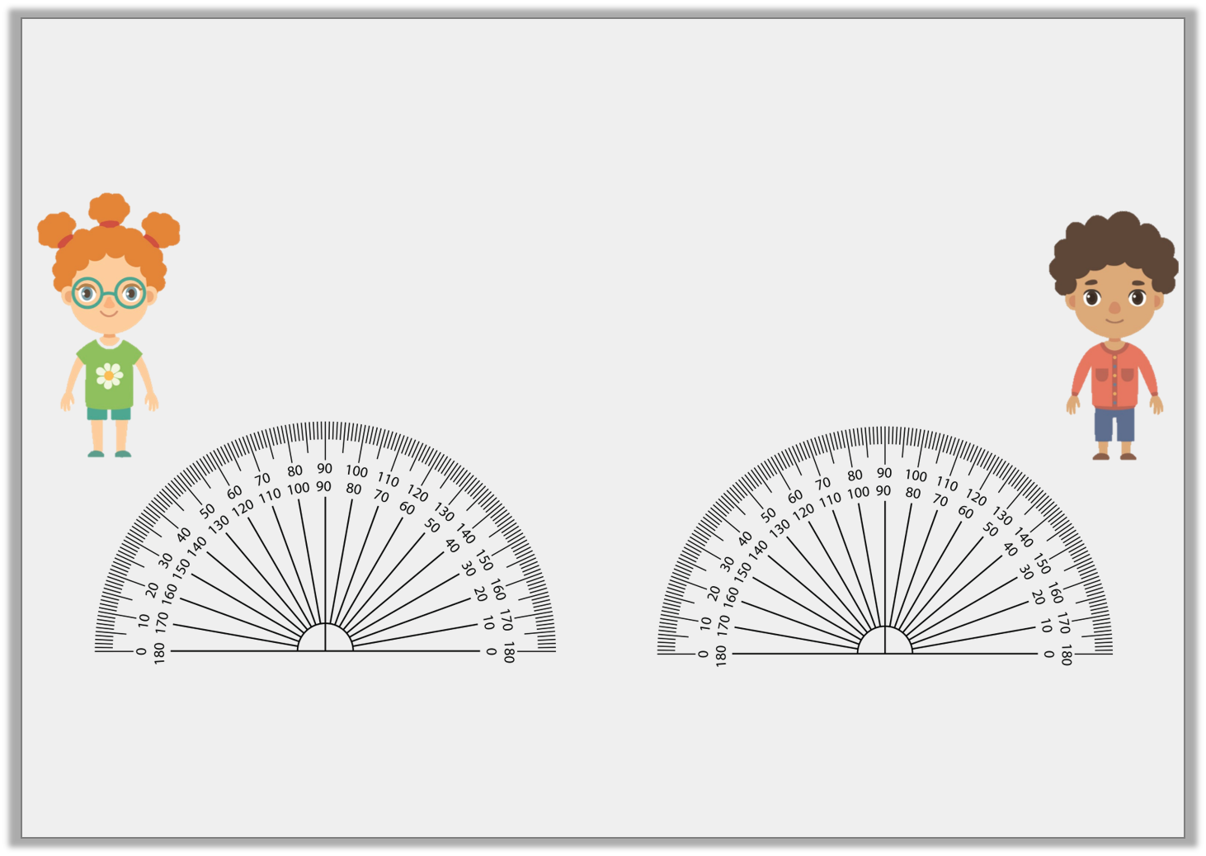
Reasoning 1
Who has measured correctly? Explain why.
The angle is 111˚
The angle is 115˚
Susie
Caleb
© Classroom Secrets Limited 2019

Slide 15
Reasoning 1
Who has measured correctly? Explain why.
Susie has measured correctly because…
The angle is 111˚
The angle is 115˚
Susie
Caleb
© Classroom Secrets Limited 2019

Slide 16
Reasoning 1
Who has measured correctly? Explain why.
Susie has measured correctly because the corner of the angle is in the centre of the protractor.
The angle is 111˚
The angle is 115˚
Susie
Caleb
© Classroom Secrets Limited 2019

Slide 17
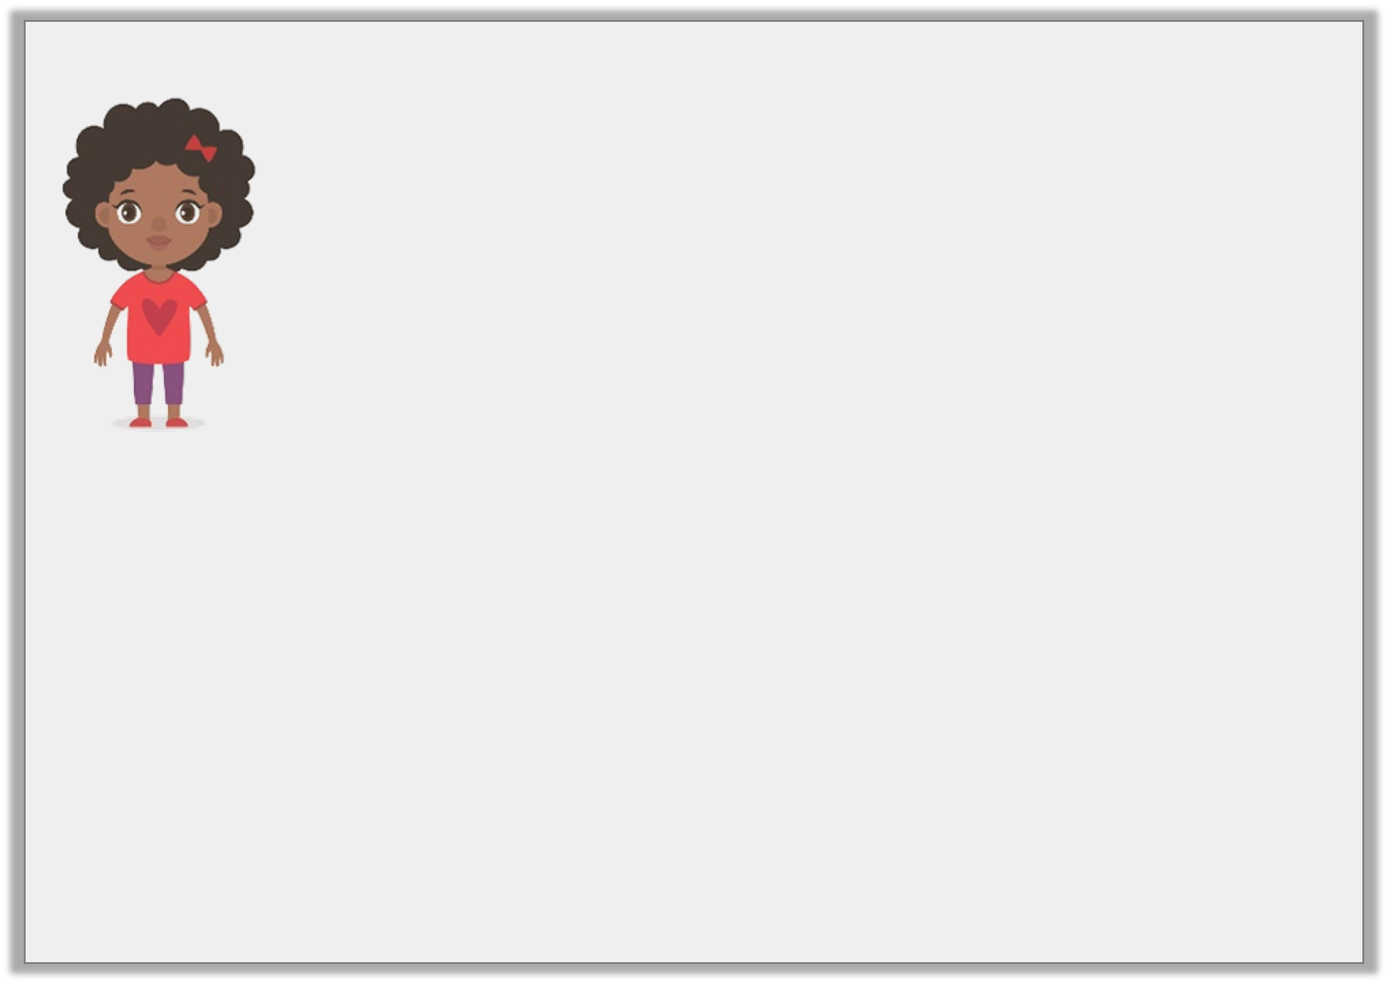
Reasoning 2
Is this a good estimation? Why?
I used my knowledge of right angles to estimate that this angle is 95˚
Rose
© Classroom Secrets Limited 2019

Slide 18
Reasoning 2
Is this a good estimation? Why?
Yes because 95˚ is close to…
I used my knowledge of right angles to estimate that this angle is 95˚
Rose
© Classroom Secrets Limited 2019

Slide 19
Reasoning 2
Is this a good estimation? Why?
Yes because 95˚ is close to 90˚, and this angle is just slightly bigger than a right angle.
I used my knowledge of right angles to estimate that this angle is 95˚
Rose
© Classroom Secrets Limited 2019

Slide 20
Now find the document called Thursday-Problem Solving.
First decide how confident you are feeling.
Super confident – you’ll need the sheet with GD written in the star.
OK – find sheet with E written in the star.
Not sure – complete the sheet with D on it, you could then move on to E if you have time.
Just complete one half of the sheet. Then mark.

