Slide 1

Year 5 – Summer Block 2 – Geometry
Wednesday
Measuring with a Protractor 1
You will need paper, a sharp pencil and a protractor.
~Keep referring to this steps to success.
Measuring an angle
Line the zero line of the protractor on the baseline.
Place the upside-down T on one end of the line.
Count FROM THE ZERO LINE to line creating the angle.
Read the scale, making sure you’ve followed the scale from zero.
Check the size of the angle – does it make sense?
© Classroom Secrets Limited 2019

Slide 2
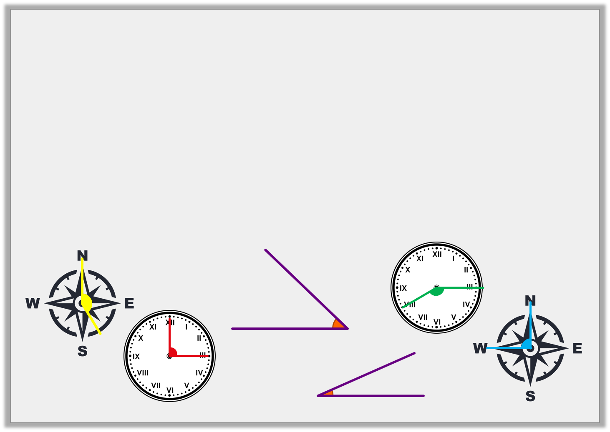
Introduction
Look at the images and the angles shown, either tell someone or if you’re working by yourself jot down where each image would go.
Right angles | Obtuse angles | Acute angles
Do you need to remind yourself what right angles, obtuse angles and acute angels are? If so have a look on the next few pages.
© Classroom Secrets Limited 2019

Slide 3
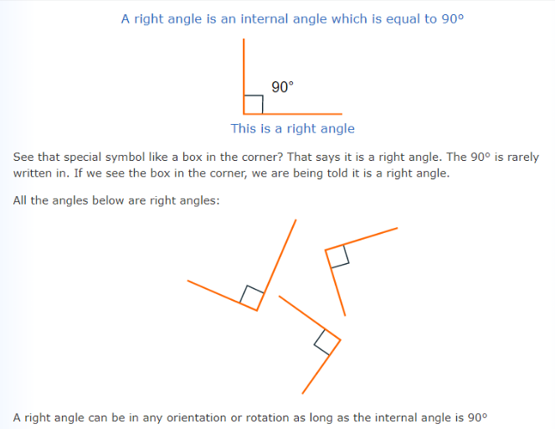

Slide 4
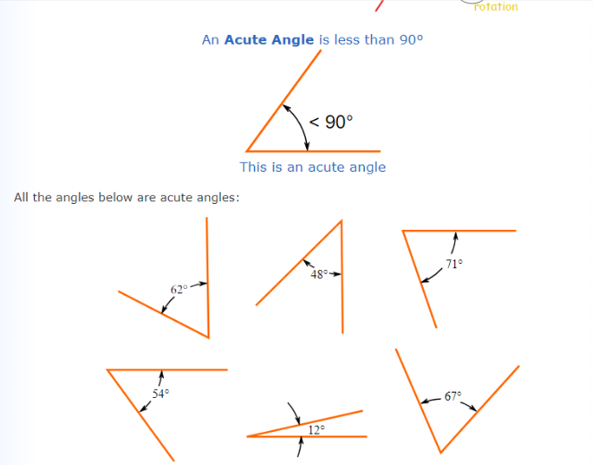

Slide 5
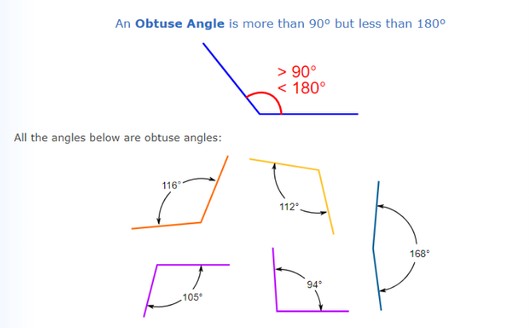

Slide 6

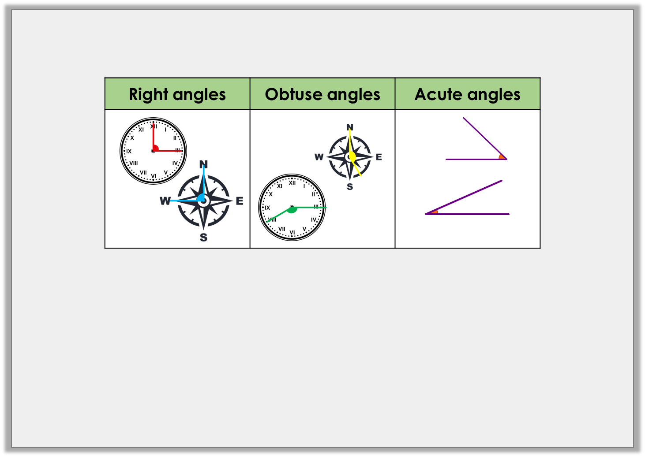
Introduction
Sort the angles.
© Classroom Secrets Limited 2019

Slide 7
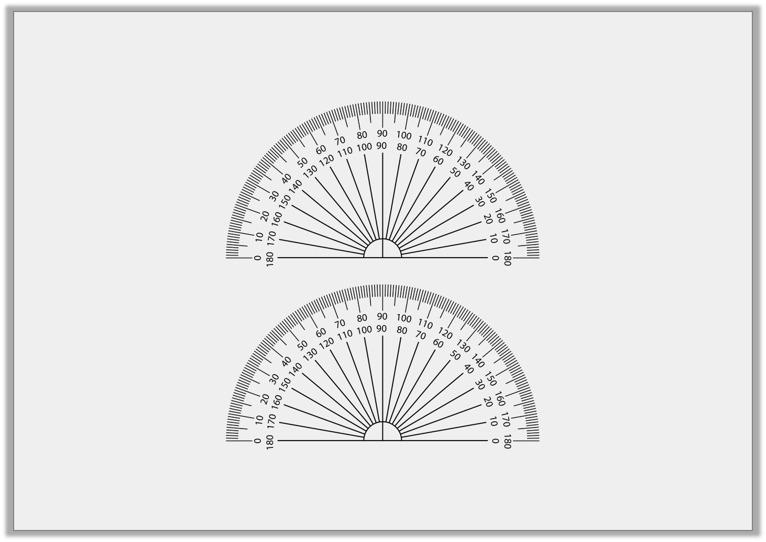
Varied Fluency 1
Circle the letter of the angle that is < 90°?
A.
B.
Give the measurement of each angle:
Remember
< means less than
>means more than
Don’t forget the little circle above the number, this means degrees.
A = |  |  | B =
© Classroom Secrets Limited 2019

Slide 8
Varied Fluency 1
Circle the letter of the angle that is < 90°?
A.
B.
Give the measurement of each angle:
A = | 95° |  | B = | 45°
© Classroom Secrets Limited 2019

Slide 9
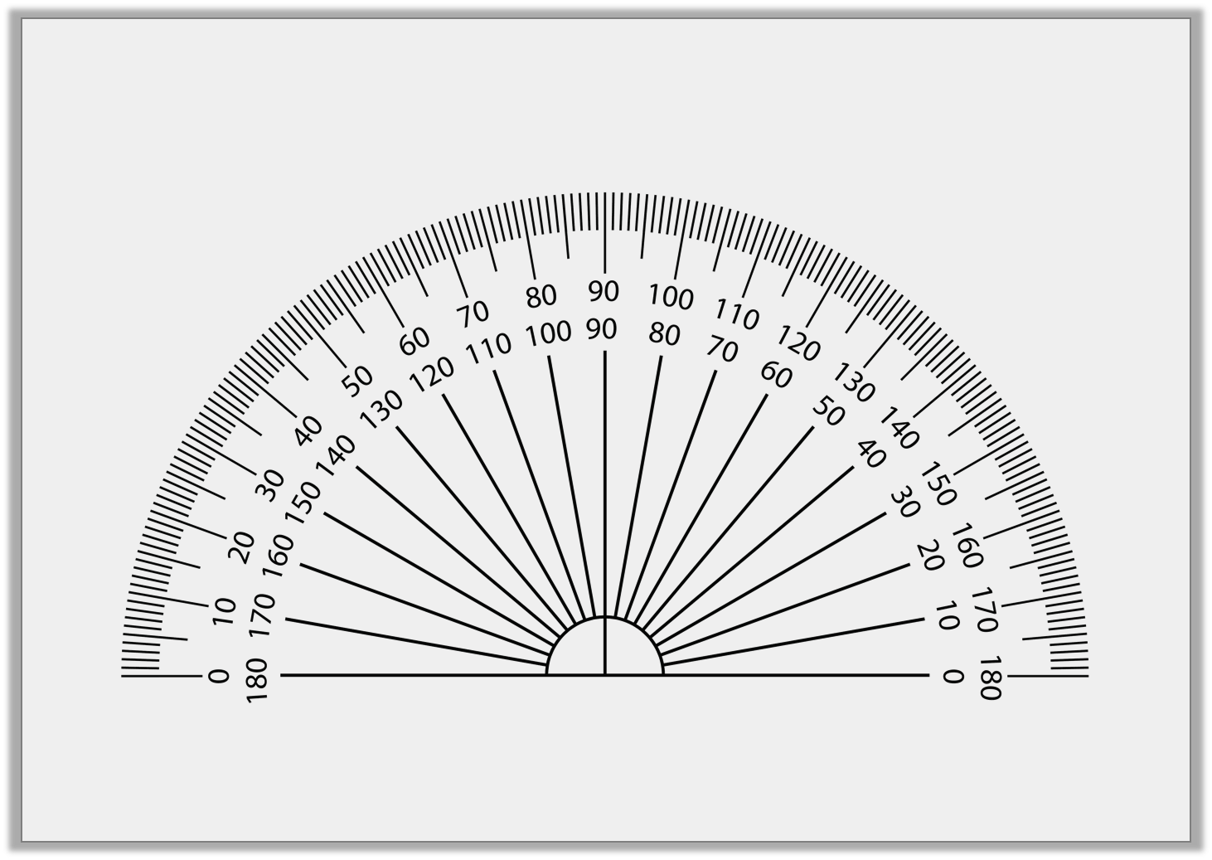
Varied Fluency 2
Can you find a protractor at home? Hopefully you’ll find one in a drawer somewhere. Find yourself a piece of paper and draw an angle which is <90° using the outer scale of your protractor.
© Classroom Secrets Limited 2019

Slide 10
Varied Fluency 3
Estimate the size of the acute angles:
Record your estimates in the table:
B.
A.
C.
 | Estimated | Measured
A.
B.
C.
© Classroom Secrets Limited 2019

Slide 11
Varied Fluency 3
Estimate the size of the acute angles:
Record your estimates in the table:
B.
35º-45º
A.
A.
55º-65º
C.
70º-80º
 | Estimated | Measured
A. | 55º-65º
B. | 35º-45º
C. | 70º-80º
© Classroom Secrets Limited 2019

Slide 12
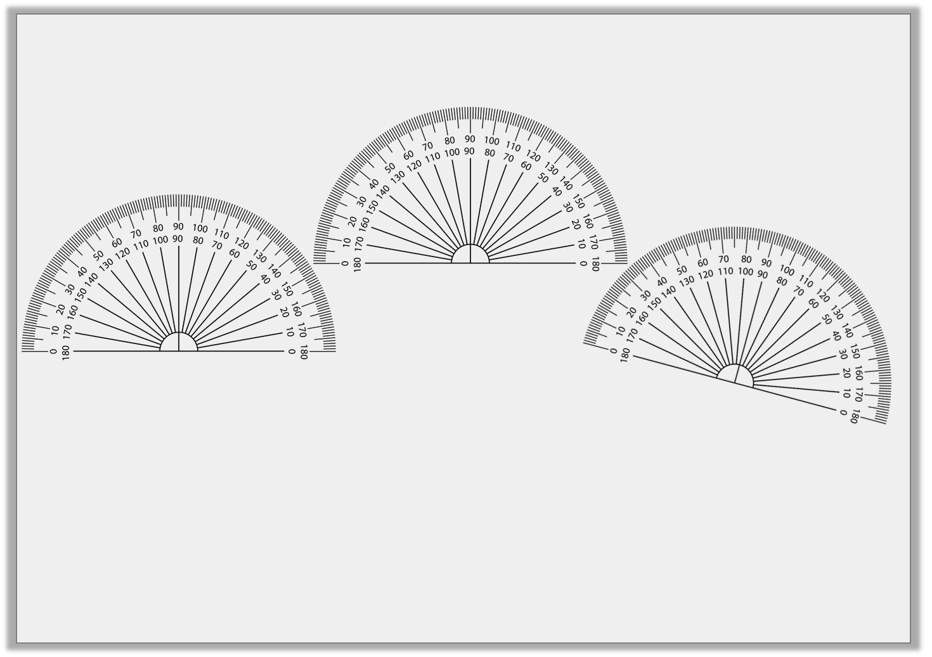
Varied Fluency 3
Now measure the size of the acute angles using a protractor:
Record your measurements in the table:
B.
B.
A.
C.
 | Estimated | Measured
A. | 55º-65º
B. | 35º-45º
C. | 70º-80º
© Classroom Secrets Limited 2019

Slide 13
Varied Fluency 3
Now measure the size of the acute angles using a protractor:
Record your measurements in the table:
B.
B.
A.
C.
 | Estimated | Measured
A. | 55º-65º | 60º
B. | 35º-45º | 40º
C. | 70º-80º | 75º
© Classroom Secrets Limited 2019

Slide 14
Varied Fluency 4
Order the angles from smallest to largest:
B.
C.
A.
D.
© Classroom Secrets Limited 2019

Slide 15
Varied Fluency 4
Order the angles from smallest to largest:
B.
C.
A.
D.
B |  | C |  | D |  | A
© Classroom Secrets Limited 2019

Slide 16
Now find the document called Wednesday-Varied Fluency.
First decide how confident you are feeling.
Super confident – the sheet with GD written in the star.
OK – the sheet with E written in the star.
Not sure – complete the sheet with D on it, you could then move on to E if you have time.
Just complete one half of the sheet. Then mark.

Slide 17
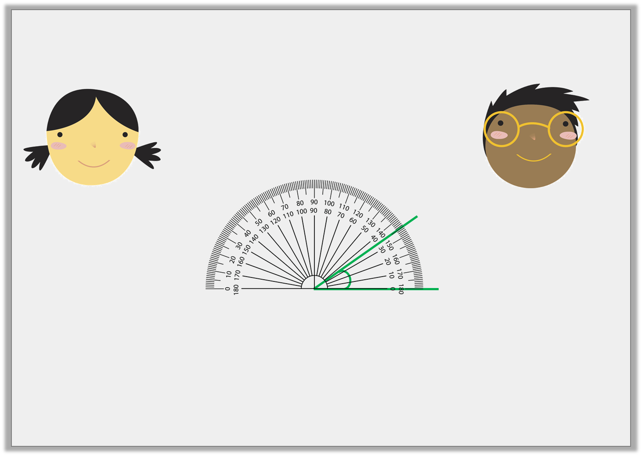
Reasoning 1
Who has measured the angle correctly?
Explain any errors.
Chloe is correct because she has read the …
The angle is 35º.
The angle is 145º.
Chloe
Tariq
© Classroom Secrets Limited 2019

Slide 18
Reasoning 1
Who has measured the angle correctly?
Explain any errors.
Chloe is correct because she has read the inner scale as the baseline is at 0 on the inner scale.
Tariq is incorrect because he has read the angle from 0 on the outside scale.
The angle is 35º.
The angle is 145º.
Chloe
Tariq
© Classroom Secrets Limited 2019

Slide 19
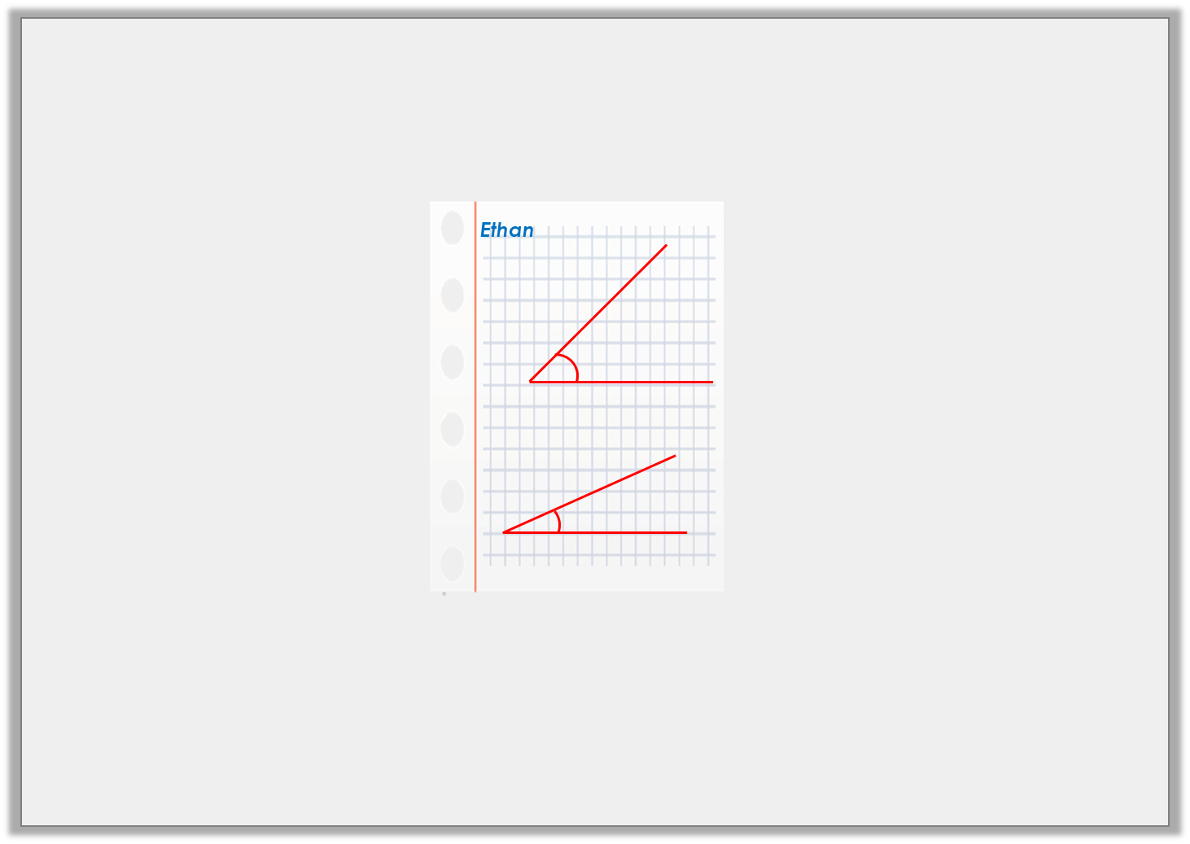
Problem Solving 1
The question said ‘Draw 2 angles which, when put together, will still be acute’. Has Ethan succeeded?
© Classroom Secrets Limited 2019

Slide 20
Problem Solving 1
The question said ‘Draw 2 angles which, when put together, will still be acute’. Has Ethan succeeded?
Yes, Ethan has succeeded because his angles measure 25º and 45º, which combine to make a total of 70º. This is still acute.
© Classroom Secrets Limited 2019

Slide 21
Problem Solving 2
How many acute angles can you see? Mark them with an arc.
Then measure to confirm the angles are <90º.
© Classroom Secrets Limited 2019

Slide 22
Problem Solving 2
How many acute angles can you see? Mark them with an arc.
Then measure to confirm the angles are <90º.
© Classroom Secrets Limited 2019

Slide 23
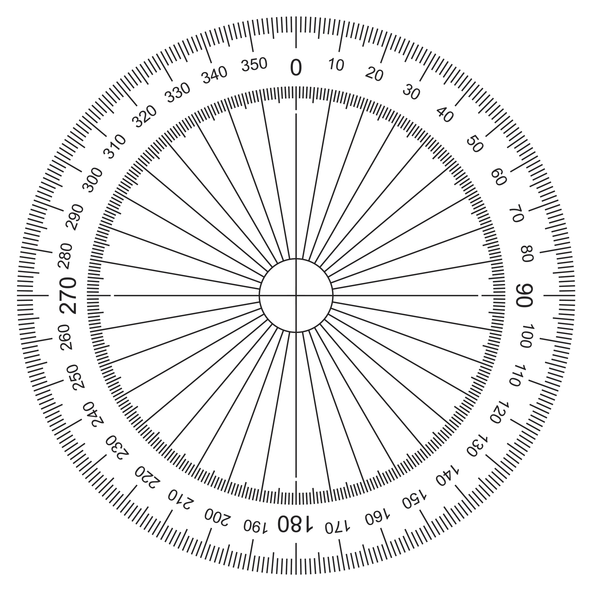
Problem Solving 2
How many acute angles can you see? Mark them with an arc.
Then measure to confirm the angles are <90º.
45º
45º
© Classroom Secrets Limited 2019

Slide 24
Now find the document called Wednesday-Problem Solving.
First decide how confident you are feeling.
Super confident – the sheet with GD written in the star.
OK – the sheet with E written in the star.
Not sure – complete the sheet with D on it, you could then move on to E if you have time.
Just complete one half of the sheet. Then mark.

