Slide 1
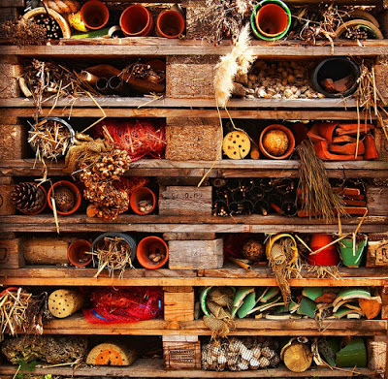
Bug Hotels

Slide 2
Why do bugs need hotels?
In natural habitats there are endless nooks and crannies where mini-beasts can shelter. Crevices in bark, holes in dead wood, piles of fallen leaves, gaps between rocks, hollow plant stems, spaces in dead logs – all these can provide a home for the small creatures that need somewhere to nest or to escape from predators or bad weather.

Slide 3
What makes a good bug hotel?
The best bug hotels have lots of small spaces in different shapes and sizes and made from different materials. Ideally some should be nice and dry inside, and others a bit dampish. Bug hotels are generally made from reclaimed materials, or natural objects, which reduces cost, helps them blend in with their surroundings and is probably more attractive to the mini-beast guests.

Slide 4
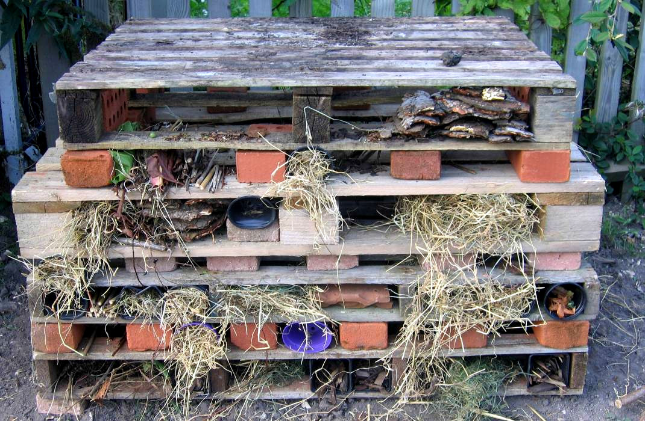
What do you like about this bug hotel?
What would you improve?

Slide 5
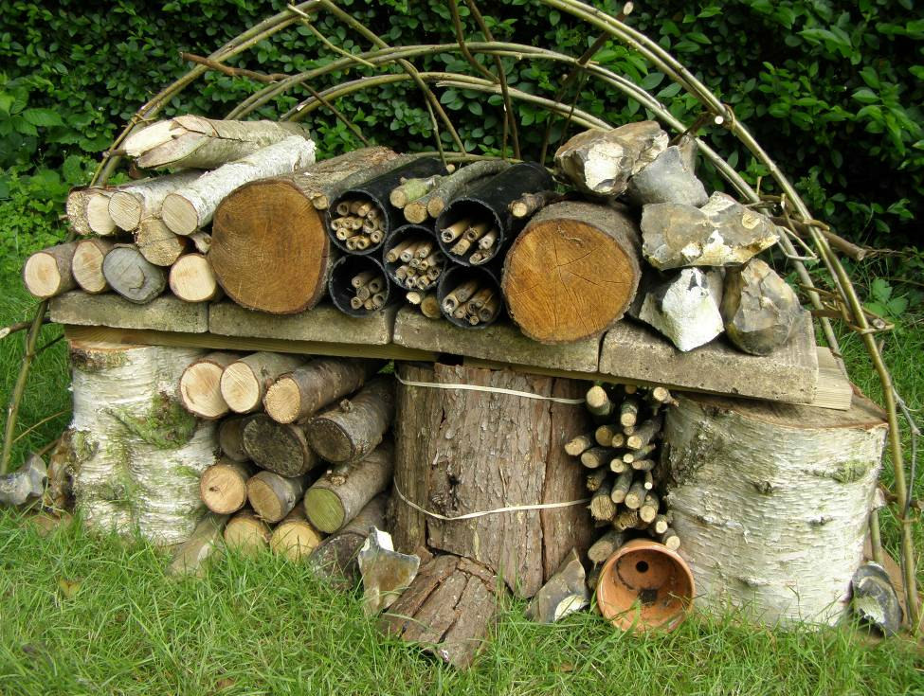
What do you like about this bug hotel?
What would you improve?

Slide 6
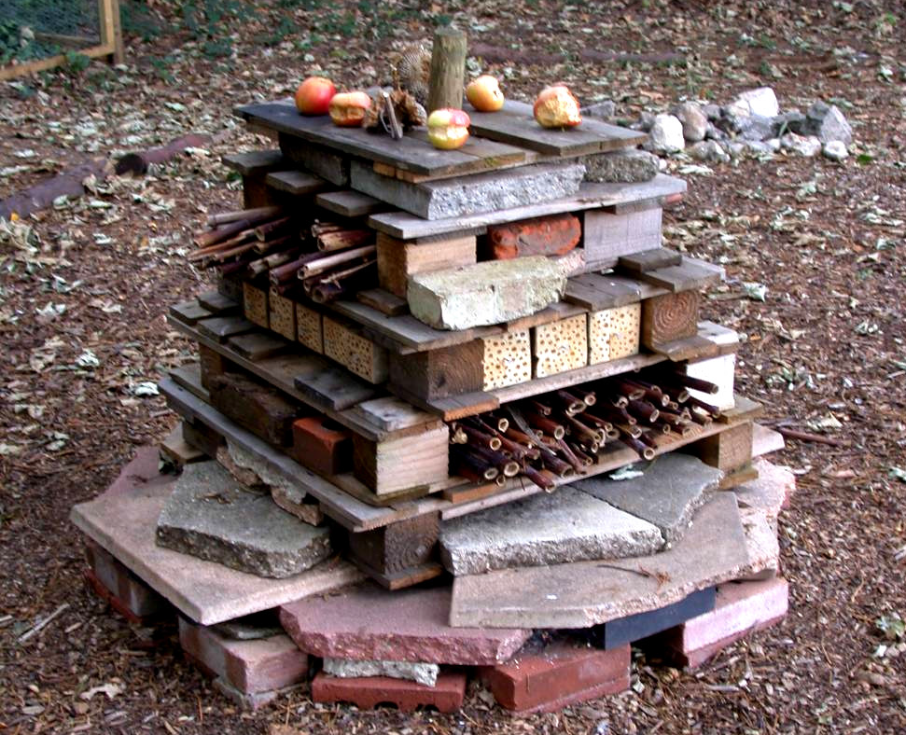
What do you like about this bug hotel?
What would you improve?

Slide 7
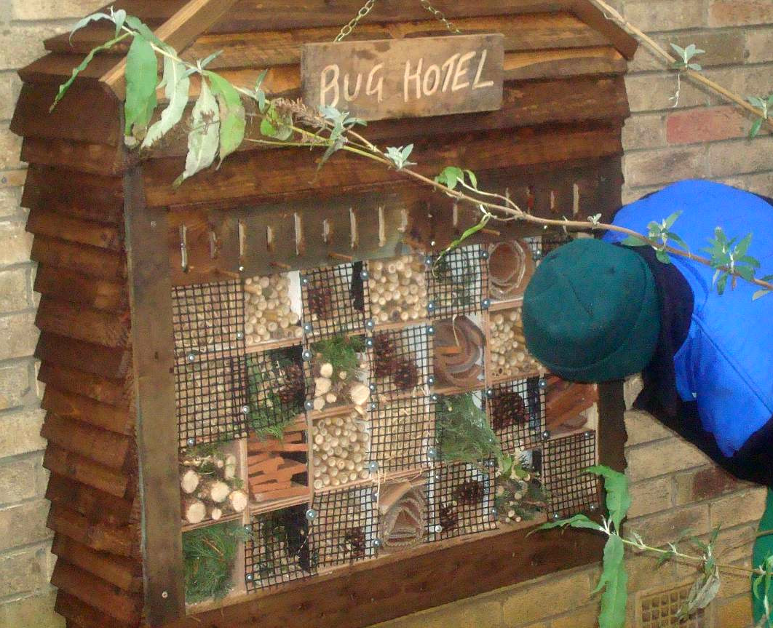
What do you like about this bug hotel?
What would you improve?

Slide 8
Glossary
habitats- the area where an animal normally lives
reclaimed-saved from being thrown away

Slide 9
Glossary
habitats- the area where an animal normally lives
reclaimed-saved from being thrown away

Slide 10
Glossary
habitats- the area where an animal normally lives
reclaimed-saved from being thrown away

