Slide 2
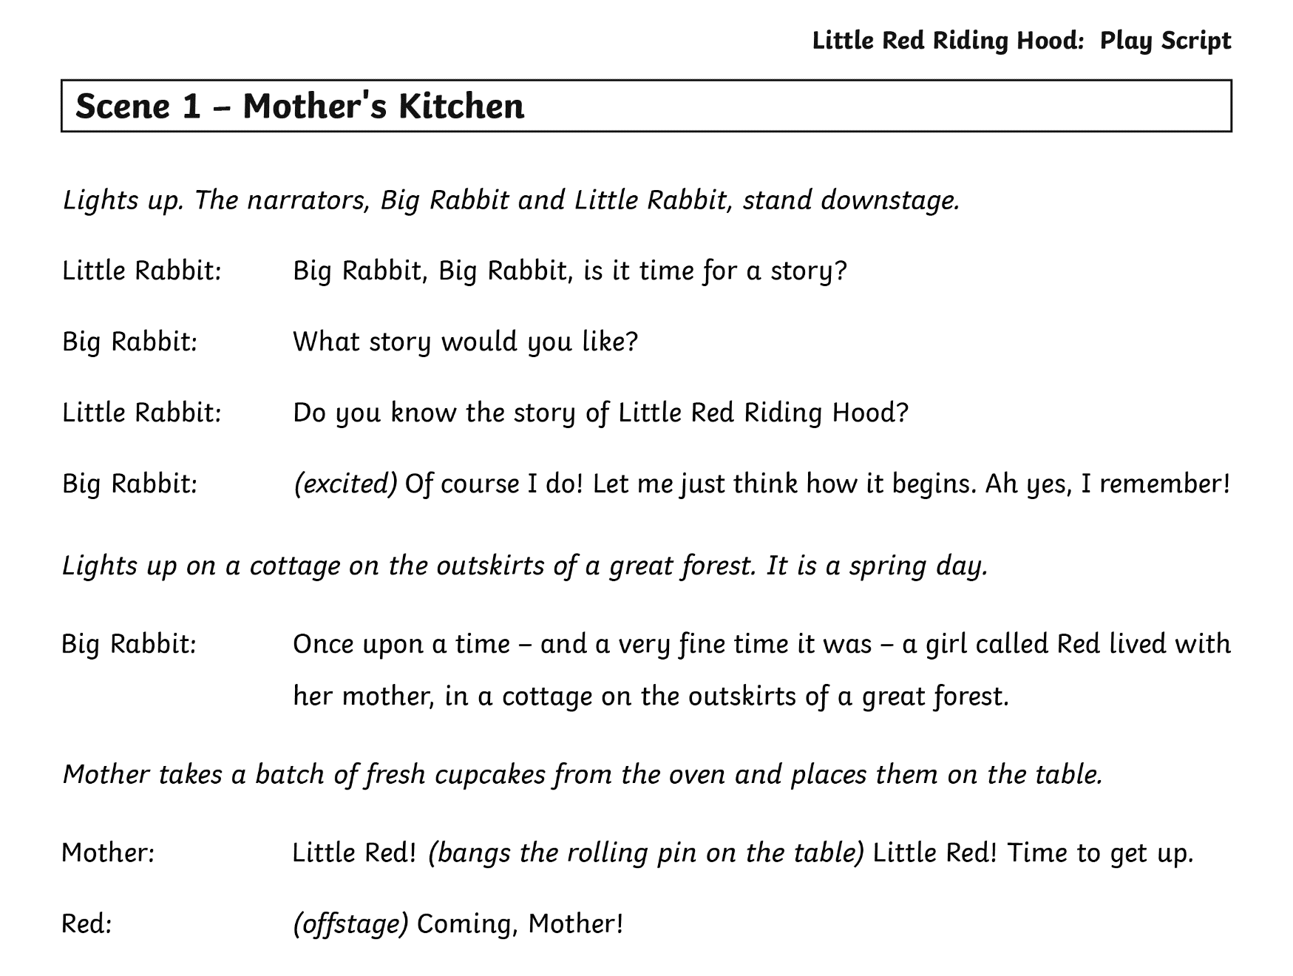
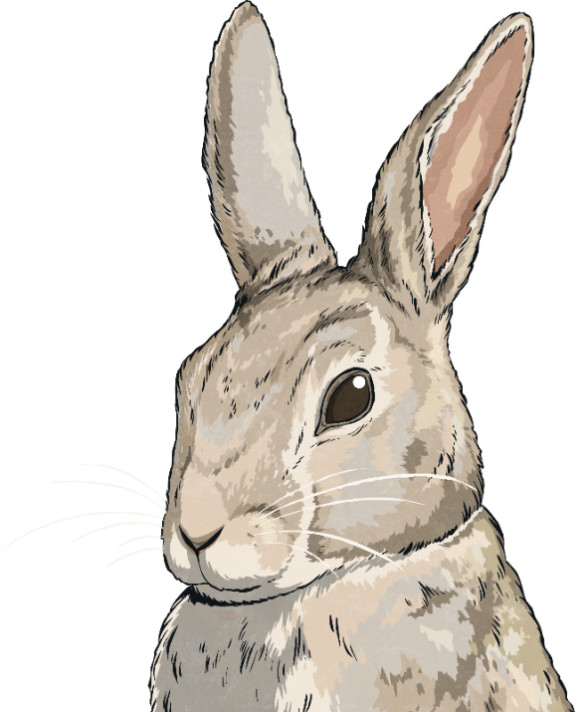
Writing a Play Script

Slide 3
Writing a Play Script
A play script is very similar to a story text (prose),
but it is set out differently to make it easier for
actors and directors to use.

Slide 4
Writing a Play Script
The script is organised into scenes, instead of chapters.
The scene ends whenever there is a jump in time, or when the scenery needs to be changed (a new setting).
The title of the scene often states where the action takes place.

Slide 5
Writing a Play Script
The script is made up of dialogue.
The speaker’s name is on the left, followed by a colon.
The character’s speech comes next. You might notice that there are no speech marks.

Slide 6
Writing a Play Script
      Some of the play script is written in italics.
      Who reads these parts?

Slide 7
Writing a Play Script
These are called stage directions. These parts are not read out loud; they are designed to tell the actors and stage crew what to do.
Big Rabbit should not read the word (excited). What should Big Rabbit do with his line? How would you read Big Rabbit’s line?

Slide 8
Writing a Play Script
Let’s look at how to go about writing a play script.

Slide 9


Writing a Play Script
“Now, you’re to take the cupcakes straight to Granny’s,” Mother said, piling them into a wicker basket. “No dilly-dallying, keep to the path, and never ever talk to strangers. Do you hear me?”
“Yes, Mother.” With a sigh, Red took the basket and hurried from the kitchen into the glorious spring sunshine.
Read this extract from the traditional tale, in which
Mother asks Red to go to Granny’s house. How could
this be changed to be a play script?

Slide 10
Writing a Play Script
“Now, you’re to take the cupcakes straight to Granny’s,” Mother said, piling them into a wicker basket. “No dilly-dallying, keep to the path, and never ever talk to strangers. Do you hear me?”
“Yes, Mother.” With a sigh, Red took the basket and hurried from the kitchen into the glorious spring sunshine.
Mother:
Now, you’re to take the cupcakes straight to Granny’s.
Who is the first speaker?
What does she say?
Add this next to Mother’s name and remove the speech
marks. You’ll also need to finish Mother’s sentence
with a full stop.

Slide 11
Writing a Play Script
(
)
“Now, you’re to take the cupcakes straight to Granny’s,” Mother said, piling them into a wicker basket. “No dilly-dallying, keep to the path, and never ever talk to strangers. Do you hear me?”
“Yes, Mother.” With a sigh, Red took the basket and hurried from the kitchen into the glorious spring sunshine.
piling cupcakes into wicker
basket
Mother:
Now, you’re to take the cupcakes straight to Granny’s.
Look at the rest of the sentence. Did Mother do anything
else that the actor needs to know about?
We can add a stage direction to tell the actors that
Mother should pile the cupcakes into the basket.
How do the actors know that they should not read
this bit out loud?

Slide 12
Writing a Play Script
(
)
“Now, you’re to take the cupcakes straight to Granny’s,” Mother said, piling them into a wicker basket. “No dilly-dallying, keep to the path, and never ever talk to strangers. Do you hear me?”
“Yes, Mother.” With a sigh, Red took the basket and hurried from the kitchen into the glorious spring sunshine.
piling cupcakes into wicker
basket
Mother:
Now, you’re to take the cupcakes straight to Granny’s.
No dilly-dallying, keep to the path, and never ever talk to strangers. Do you hear me?
Next, Mother continues to speak.
You don’t need to write her name again.
Add to her speech in normal font.

Slide 13
Writing a Play Script
“Now, you’re to take the cupcakes straight to Granny’s,” Mother said, piling them into a wicker basket. “No dilly-dallying, keep to the path, and never ever talk to strangers. Do you hear me?”
“Yes, Mother.” With a sigh, Red took the basket and hurried from the kitchen into the glorious spring sunshine.
Now, you’re to take the cupcakes straight to Granny’s.
Mother:
piling
cupcakes into wicker basket
(
)
No dilly-dallying, keep to the path, and never ever talk to strangers. Do you hear me?
Red:
Yes, Mother.
Who do you think speaks next?
Red is our next speaker.
Start a new line for the new speaker,
and write her name with a colon.
Write Red’s speech beside her name with no speech marks.

Slide 14
Writing a Play Script
“Now, you’re to take the cupcakes straight to Granny’s,” Mother said, piling them into a wicker basket. “No dilly-dallying, keep to the path, and never ever talk to strangers. Do you hear me?”
“Yes, Mother.” With a sigh, Red took the basket and hurried from the kitchen into the glorious spring sunshine.
Now, you’re to take the cupcakes straight to Granny’s.
Mother:
piling
cupcakes into wicker basket
(
)
No dilly-dallying, keep to the path, and never ever talk to strangers. Do you hear me?
Red:
(sighing)
Yes, Mother.
Yes, Mother.
Does the story tell us how Red said this line?
Red is sighing. Add this before she speaks, because the
actor needs to know this before they say the line.

Slide 15
Writing a Play Script
“Now, you’re to take the cupcakes straight to Granny’s,” Mother said, piling them into a wicker basket. “No dilly-dallying, keep to the path, and never ever talk to strangers. Do you hear me?”
“Yes, Mother.” With a sigh, Red took the basket and hurried from the kitchen into the glorious spring sunshine.
Now, you’re to take the cupcakes straight to Granny’s.
Mother:
piling
cupcakes into wicker basket
(
)
No dilly-dallying, keep to the path, and never ever talk to strangers. Do you hear me?
Red:
(sighing)
Yes, Mother.
Red takes the basket and hurries from the kitchen.
The story gives us more information about what Red does,
in a new sentence. We can add this as a stage direction
after Red has finished her line.
We don’t need all of the extra information. The actor
just needs to take the basket and hurry off the stage.
The audience will not see the ‘glorious spring sunshine’.

Slide 16
Writing a Play Script
“Now, you’re to take the cupcakes straight to Granny’s,” Mother said, piling them into a wicker basket. “No dilly-dallying, keep to the path, and never ever talk to strangers. Do you hear me?”
“Yes, Mother.” With a sigh, Red took the basket and hurried from the kitchen into the glorious spring sunshine.
Now, you’re to take the cupcakes straight to Granny’s.
Mother:
piling
cupcakes into wicker basket
(
)
No dilly-dallying, keep to the path, and never ever talk to strangers. Do you hear me?
Red:
(sighing)
Yes, Mother.
Red takes the basket and hurries from the kitchen.
Have you noticed that the stage directions
are written in the present tense?
This is because, for the actors, the story hasn’t
happened; it’s happening right now and will
happen again, every time they perform it!

Slide 17
Writing a Play Script
(
)
piling cupcakes into wicker
basket
Mother:
Now, you’re to take the cupcakes straight to Granny’s.
No dilly-dallying, keep to the path, and never ever talk to strangers. Do you hear me?
Red:
(sighing)
Yes, Mother.
Red takes the basket and hurries from the kitchen.
With a partner, read the script that we have
written so far. Make sure that you perform
the stage directions, but don’t read them!

Slide 18
Writing a Play Script
The wolf scurried up to the cottage door on tiptoes, so as not to alarm Granny.
Knock, knock, knock.
“Who is it?” quavered a frail voice
from inside.
“It’s me, Granny! It’s your granddaughter,” said Mr Wolf in a
high, squeaking voice.
“The door’s unlocked, dear,” Granny called out. The wolf lifted the latch.
Now, see if you can turn this story extract into a
play script. When you have finished, try performing
your script to see if it makes sense.

Slide 19
Writing a Play Script
The wolf scurried up to the cottage door on tiptoes, so as not to alarm Granny.
Knock, knock, knock.
“Who is it?” quavered Granny’s frail voice from inside.
“It’s me, Granny! It’s your granddaughter,” said Mr Wolf in a
high, squeaking voice.
“The door’s unlocked, dear,” Granny called out. The wolf lifted the latch.
The wolf scurries up to the cottage door on tiptoes and knocks three times.
(quavering) Who is it?
Granny:
Wolf:
(in a high, squeaky voice)
It’s me, Granny! It’s your granddaughter.
Granny:
The door’s unlocked, dear.
The wolf lifts the latch.
Here is the same extract as a play script.

Slide 20
Writing a Play Script
lights up
lights down
upstage
centre stage
stage left
stage right
downstage
offstage
narrator
audience
cast
props
Before you write a play script, you need to know some special words and phrases that are used to tell actors and stage crew what to do. Here are some important ones. Click on each button to find out what each one means.

Slide 21
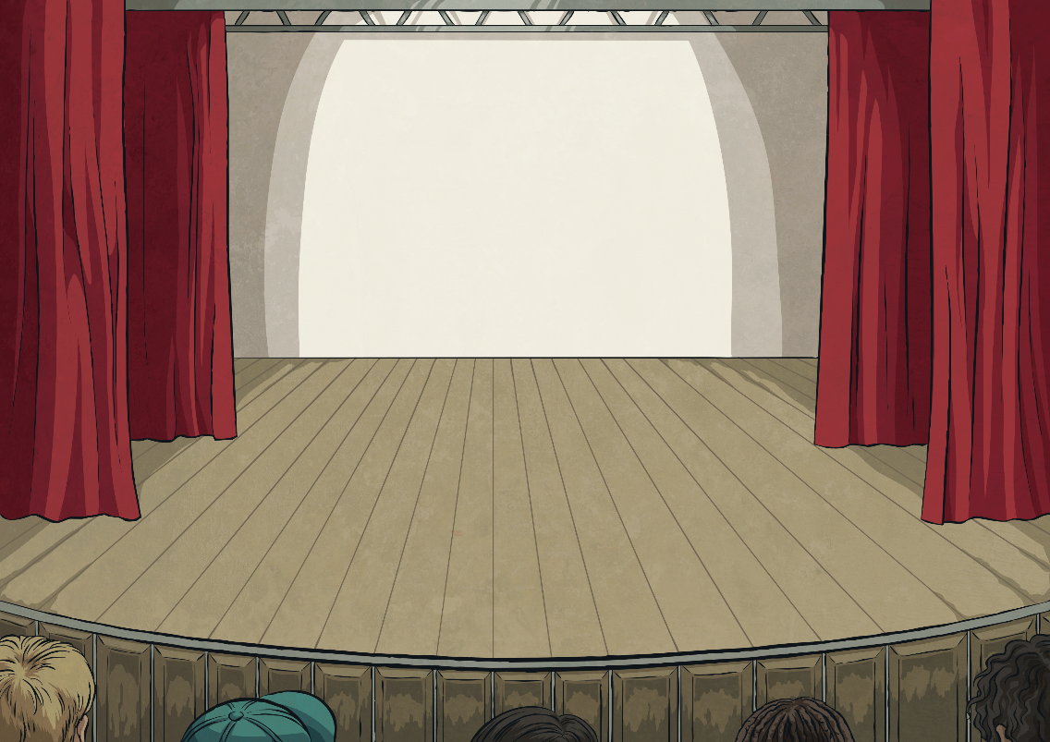

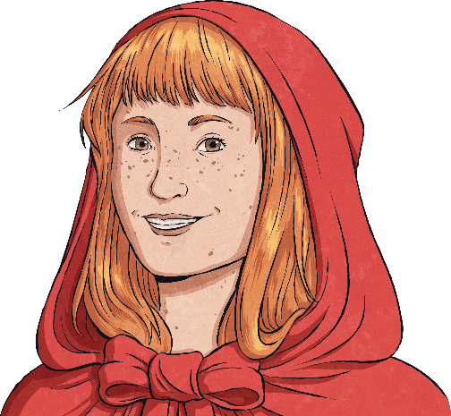
Writing a Play Script
back
lights up
‘Lights up’ means that the lights on the stage turn on, so that the audience can see the actors.

Slide 22
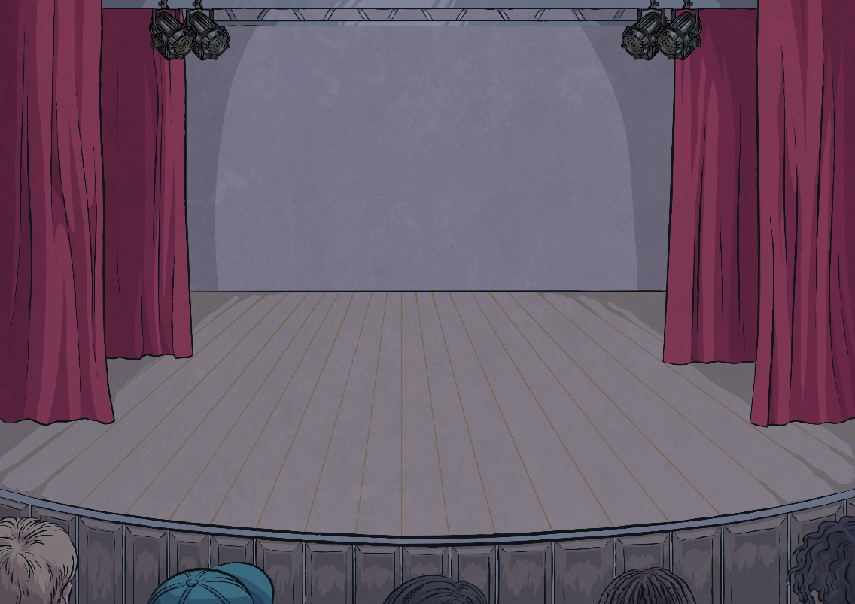
Writing a Play Script
back
lights down
‘Lights down’ means that the lights on the stage turn off, so that the audience can not see the stage. This is usually so that the scenery can be changed in between scenes.

Slide 23
Writing a Play Script
back
upstage
‘Upstage’ means the back of the stage, furthest away from the audience. It’s called ‘up’ because most stages are slightly higher at the back so that people can see the action.

Slide 24
Writing a Play Script
back
downstage
‘Downstage’ means the front of the stage, closest to the audience. It’s called ‘down’ because most stages are slightly higher at the back so that people can see the action.

Slide 25

Writing a Play Script
back
stage left
‘Stage left’ means the left-hand side of the stage, when you are an actor facing the audience. These directions are written from the actor’s point of view, because it is the actor who will be reading and following the instructions.

Slide 26
Writing a Play Script
back
stage right
‘Stage right’ means the right-hand side of the stage, when you are an actor facing the audience. These directions are written from the actor’s point of view, because it is the actor who will be reading and following the instructions.

Slide 27
Writing a Play Script
back
centre stage
‘Centre stage’ means that you are standing right in the middle of the stage.
This is usually because the most important action is going on here.

Slide 28
Writing a Play Script
back
offstage
‘Offstage’ means that an actor is not standing on the stage. Things can be shouted from offstage, or an actor can ‘walk offstage’, which means that they are exiting the scene.

Slide 29
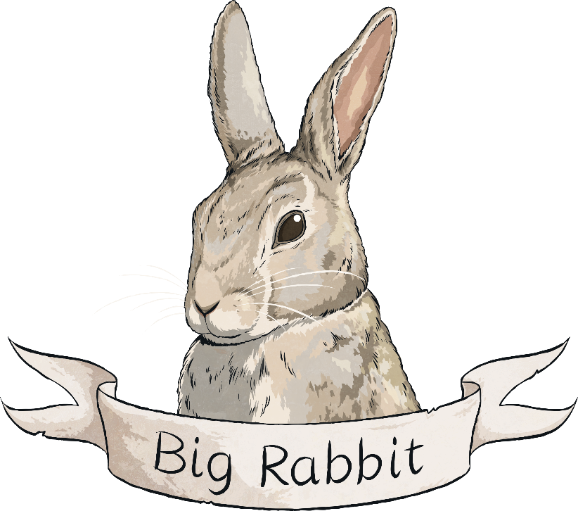
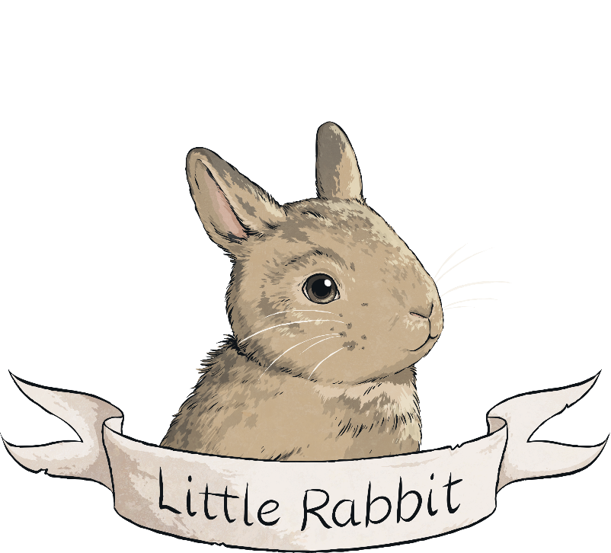
Writing a Play Script
back
narrator
A ‘narrator’ is an extra character who might not appear in a traditional story. In the original story of ‘Little Red Riding Hood’, there is no narrator but in our play, we used Big Rabbit and Little Rabbit as storytellers, to give the audience some extra information.

Slide 30
Writing a Play Script
back
audience
The ‘audience’ is the group of people watching the play.

Slide 31
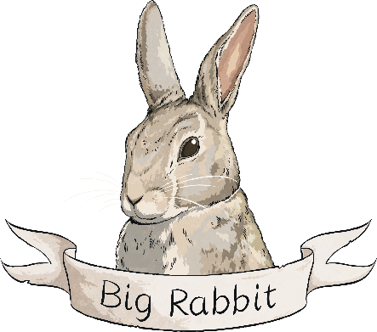

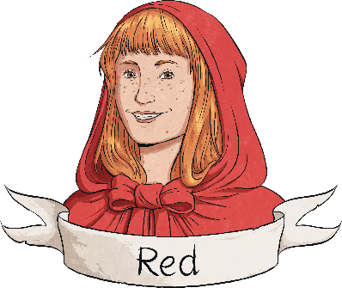
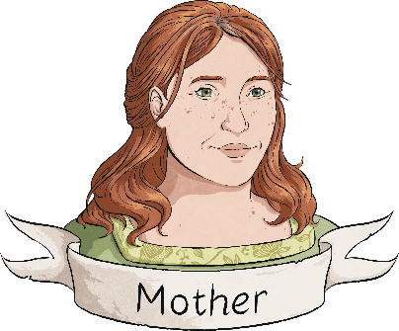
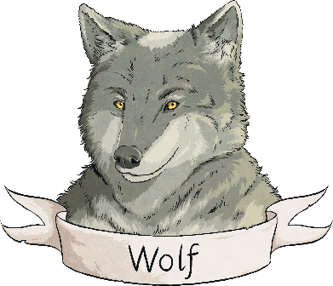
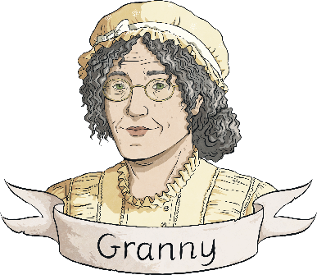
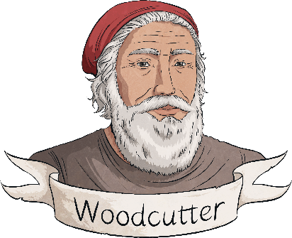
Writing a Play Script
back
cast
The ‘cast’ are the actors in the play. You might see a cast list when you go to see a play, which tells you who is playing each character.

Slide 32
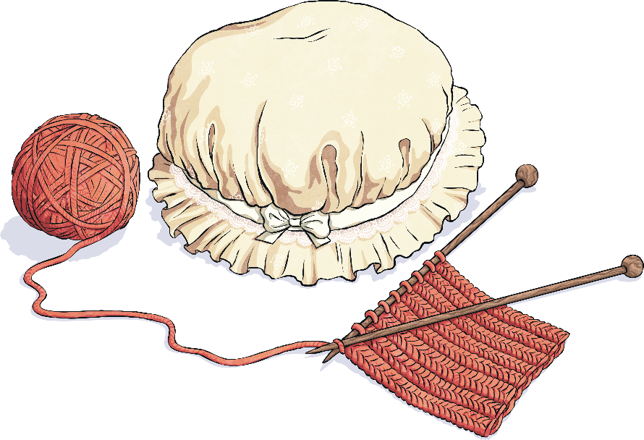
Writing a Play Script
back
props
‘Props’ is short for properties. These are objects that the actors will need on the stage
with them. For example, Granny might need to remember to bring her knitting needles
onto the stage!

Slide 33

Writing a Play Script
Includes a cast list
May include a narrator
Includes speakers’ names on the left
Includes dialogue with no speech marks
Is structured using numbered scenes
Includes stage directions, with brackets when added into dialogue
Includes short descriptions of each scene’s setting
Starts a new line for each speaker
Now, you’re ready to write your play script!
Be sure to include all of the things on this checklist.

