Slide 1
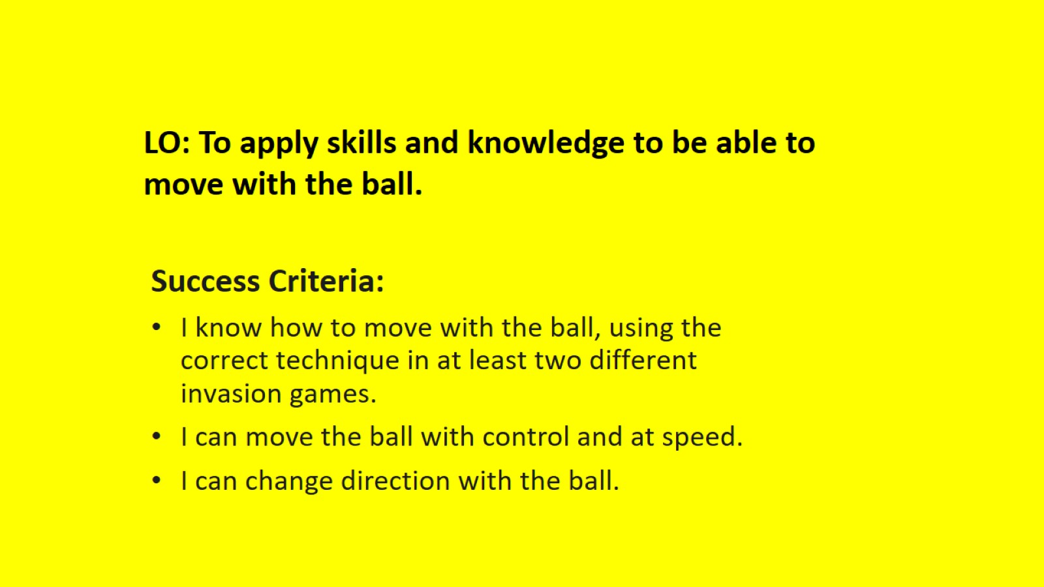

Slide 2
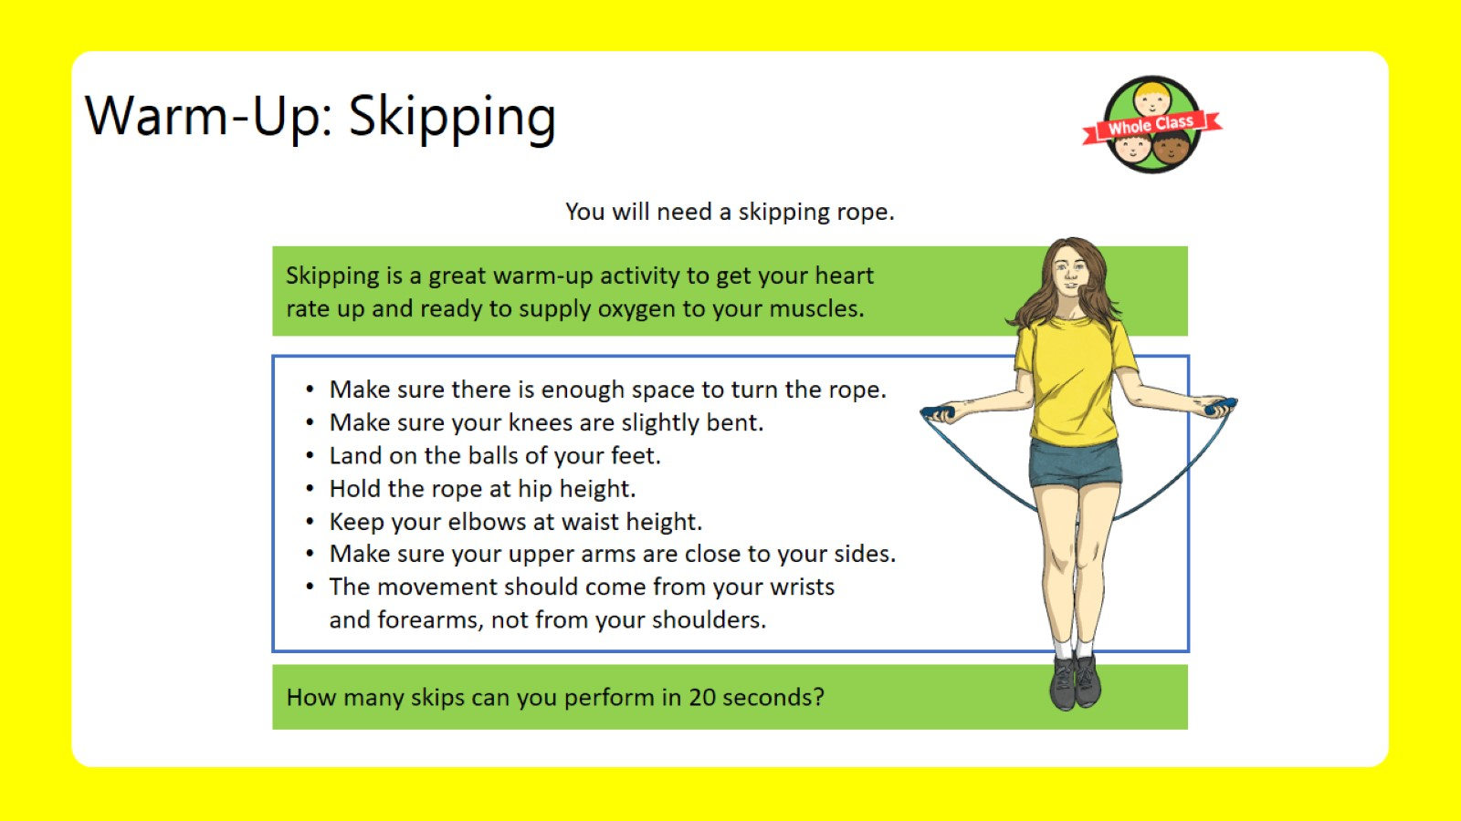
Warm-Up: Skipping

Slide 3
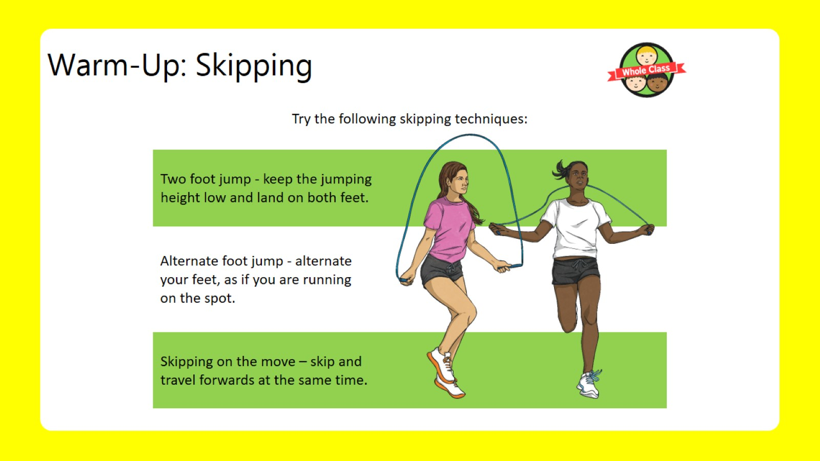
Warm-Up: Skipping

Slide 4
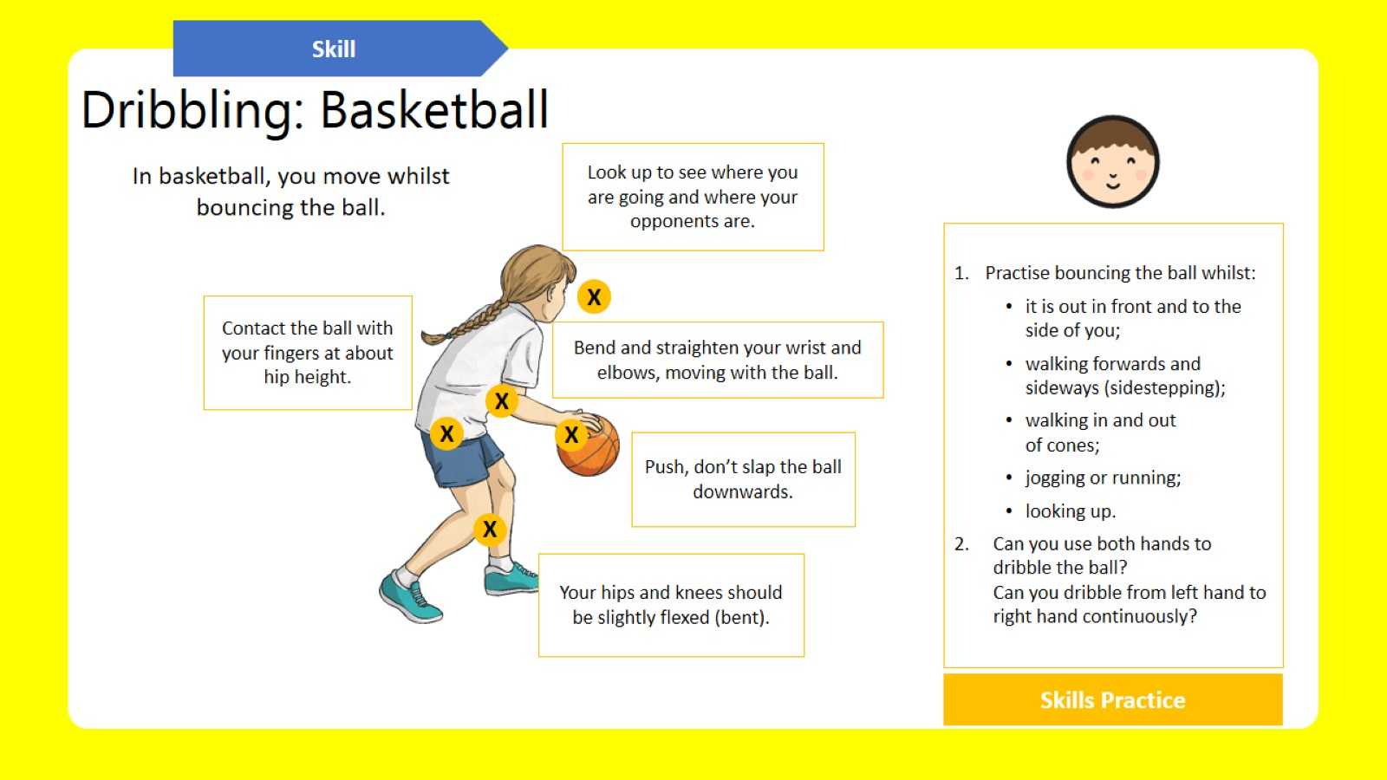
Dribbling: Basketball

Slide 5
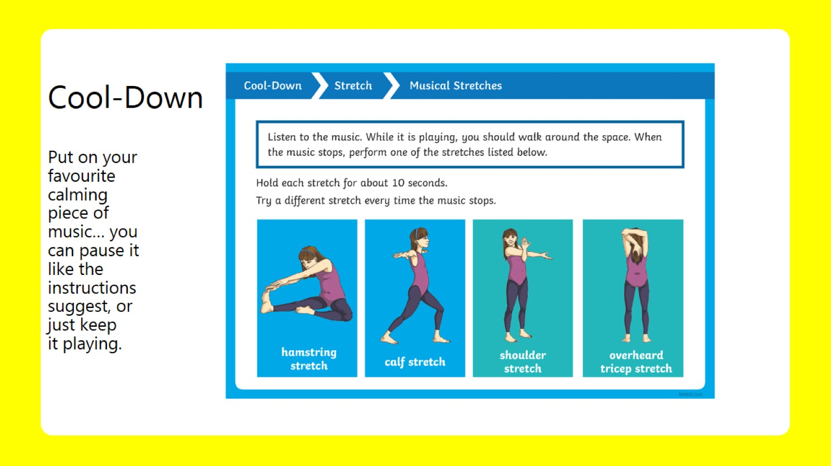
Cool-Down
Put on your favourite calming piece of music… you can pause it like the instructions suggest, or just keep it playing.

