Slide 1
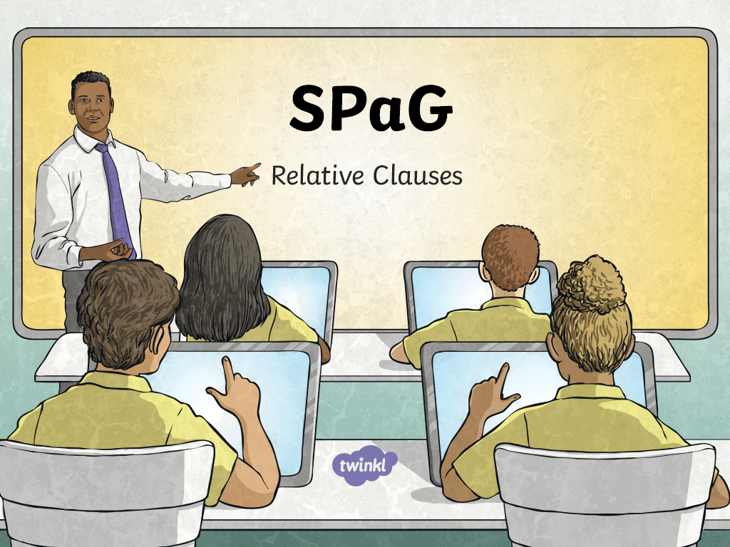

Slide 2
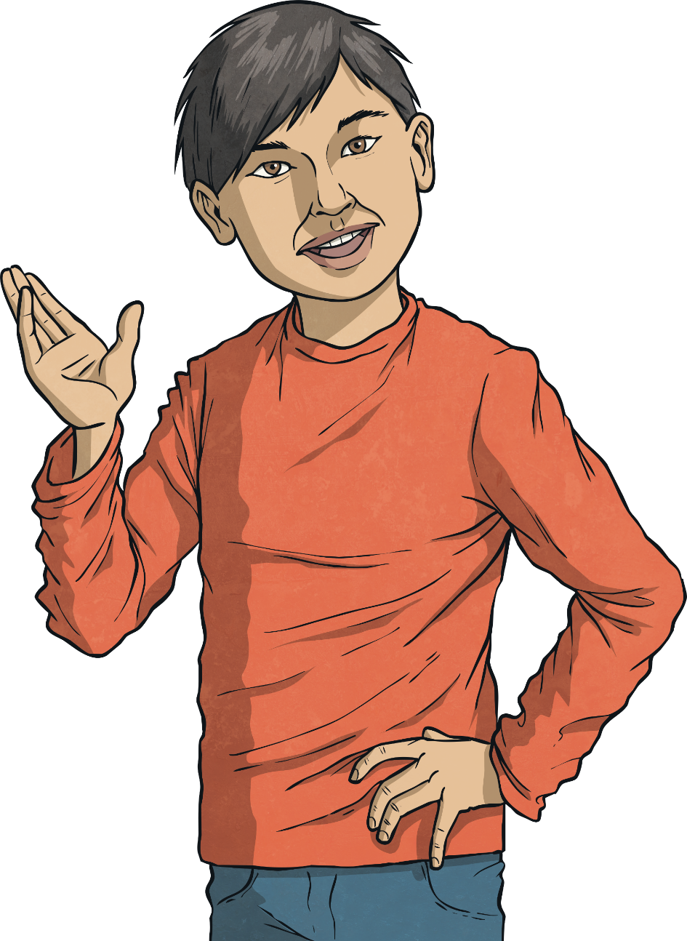
Relative Clauses
Introductory Activity
Independent Focused Activity
Review Activity
Consolidation Activity
Assessment

Slide 3
Aim
To use relative clauses.
Success Criteria
I can explain that a multi-clause (or ‘complex’) sentence has at least two clauses.
I can identify and use relative pronouns and relative clauses.
I can explain when commas are needed with relative clauses.
I can explain that an object relative pronoun can be left out of a clause.

Slide 4

Introductory Activity

Slide 5
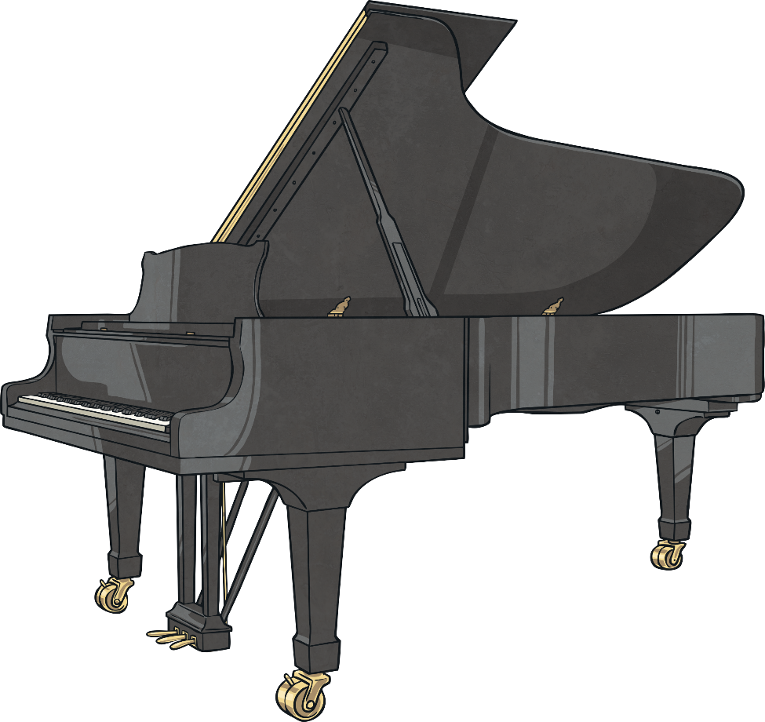
Relative Clauses
and Relative Pronouns
Let’s start with a simple sentence.
A simple sentence has one main clause = subject + verb.
A simple sentence must make sense on its own.
Example: John was playing the piano.
The simple sentence isn’t very interesting, is it? Why don’t we add some extra information?
John was playing the piano. He was in the hall.

Slide 6
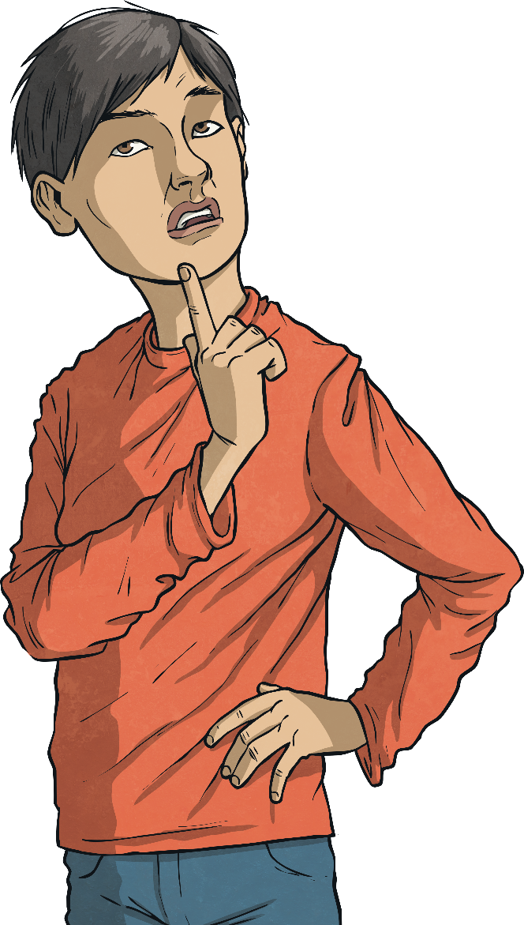
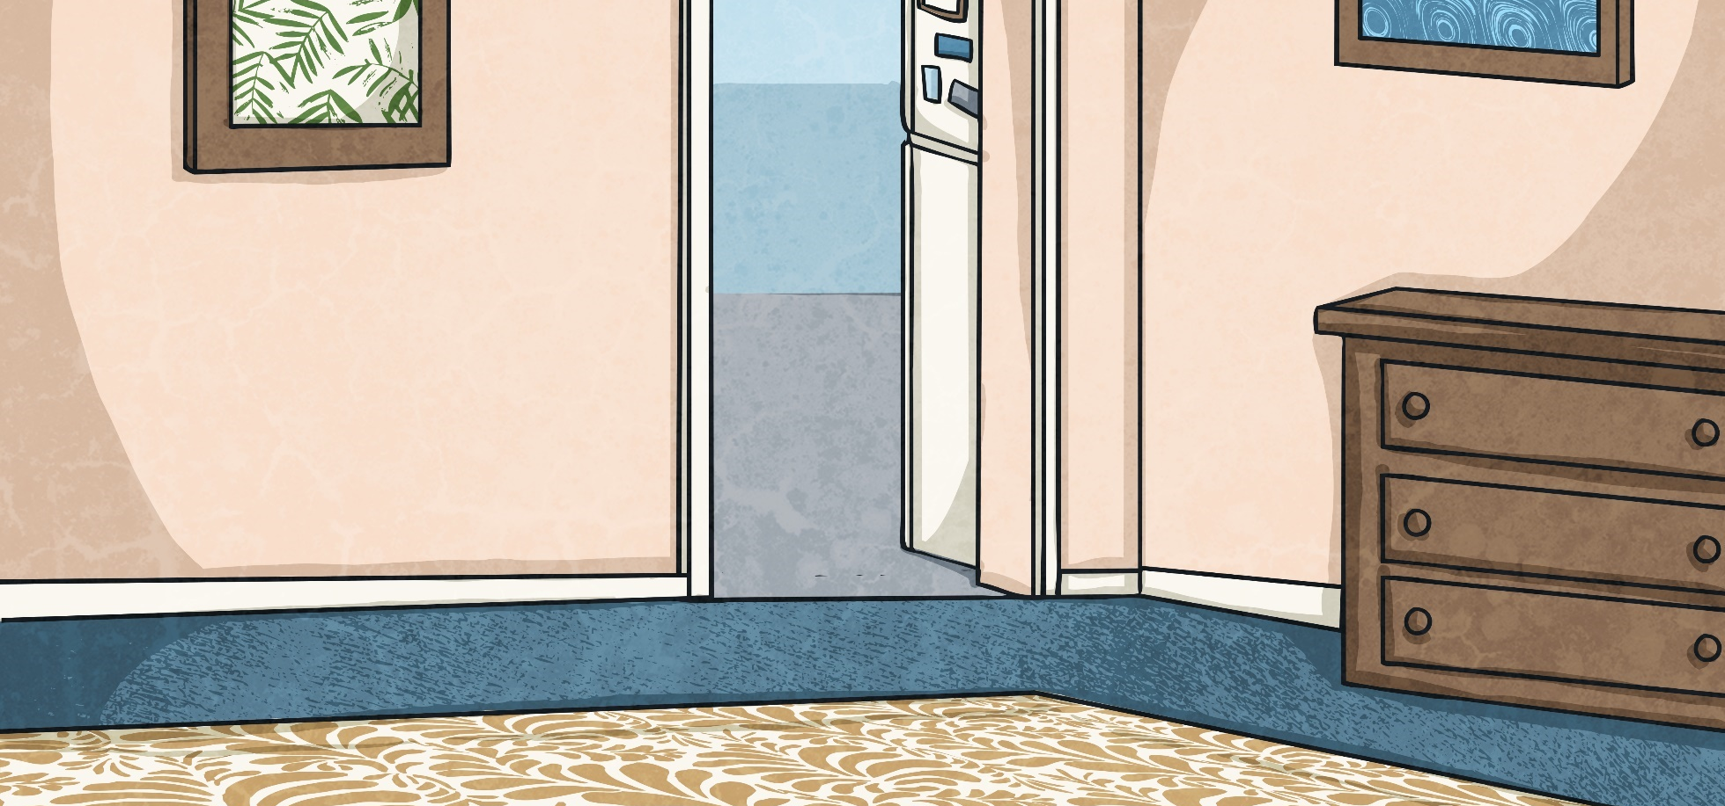
Relative Clauses
and Relative Pronouns
OK, still rather simple. How could we improve it?
John was playing the piano.
Let’s make it a multi-clause sentence.
The second sentence adds some extra information to the first one, so we can add it to the simple sentence to make a complex sentence, like this:
We can add a subordinate clause to the main clause. This is also known as a complex sentence.
John, who was in the hall, was playing the piano.
The subordinate clause must have its own subject and verb. The subordinate clause does not make sense on its own.
The subordinate clause does not make sense on its own.

Slide 7
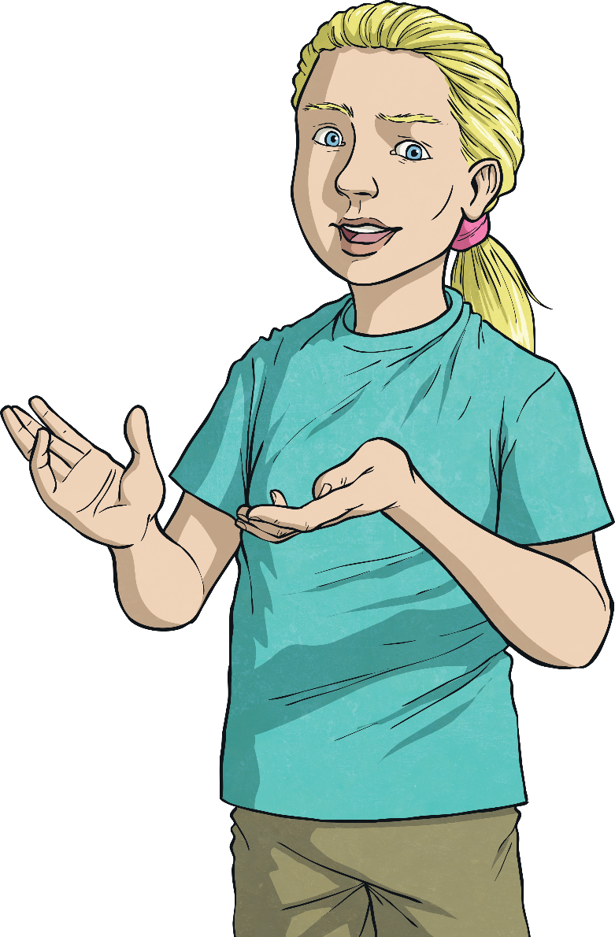
Relative Clauses
and Relative Pronouns
John was playing the piano. He was in the hall.
We’ve dropped in a relative clause!
relative pronoun
A relative clause gives us extra information about the noun in the main clause.
John, who was in the hall, was playing the piano.
Here are some other relative clauses you could add to this sentence:
It is connected to the main clause by a relative pronoun.
John, whose hair flopped as he moved his arms, was playing the piano.
relative clause
We’ve replaced the pronoun in the second sentence with the relative pronoun – who.
John, who had just eaten a light lunch, was playing the piano.
main clause

Slide 8
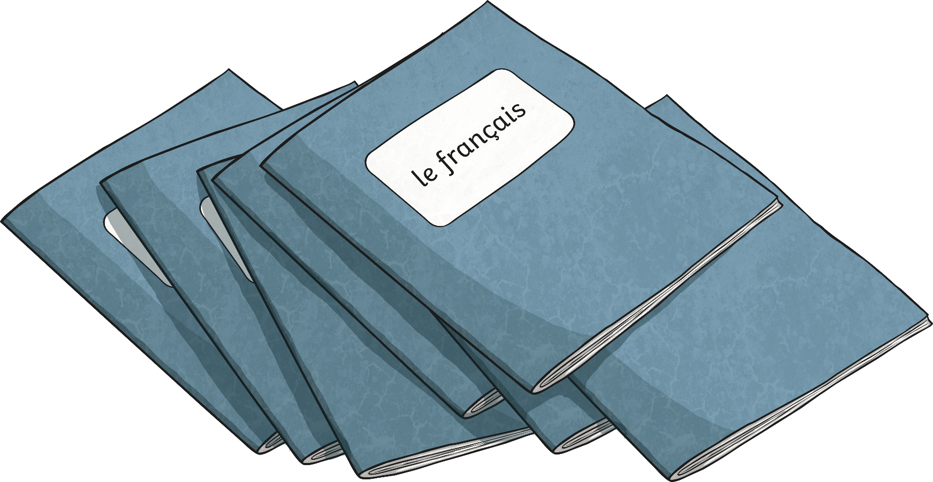
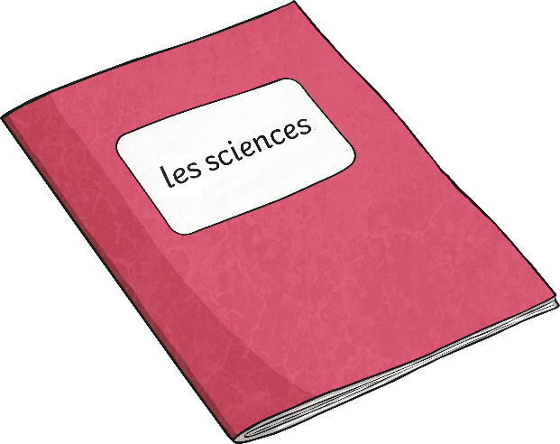
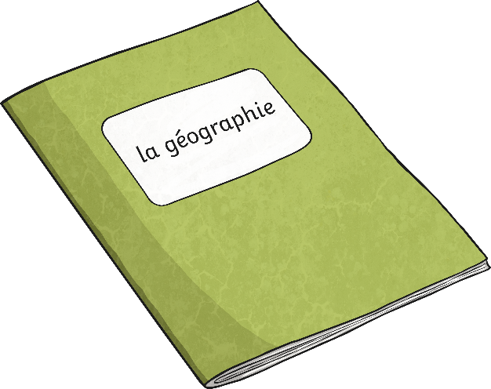


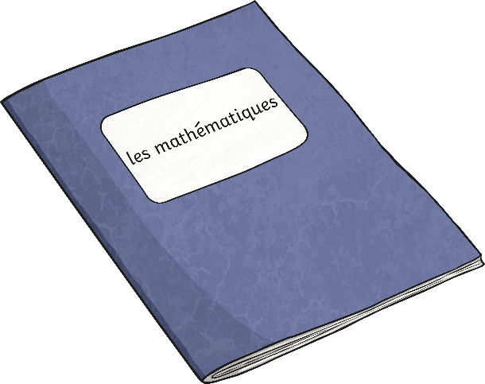
Relative Clauses
and Relative Pronouns
‘Where’ is a relative adverb, but it is used in exactly the same way as a relative pronoun.
Relative clauses often start with relative pronouns.
A relative clause (a clause which gives you extra information about a noun) might be at the end of a sentence or within the sentence.
These words are relative pronouns:
I ran quickly towards the oak tree, which had stood in that spot for hundreds of years.
where
which
whose
who
whom
My grandmother, whose shiny hair sparkled in the morning sunshine, stood looking over the bay.
that

Slide 9

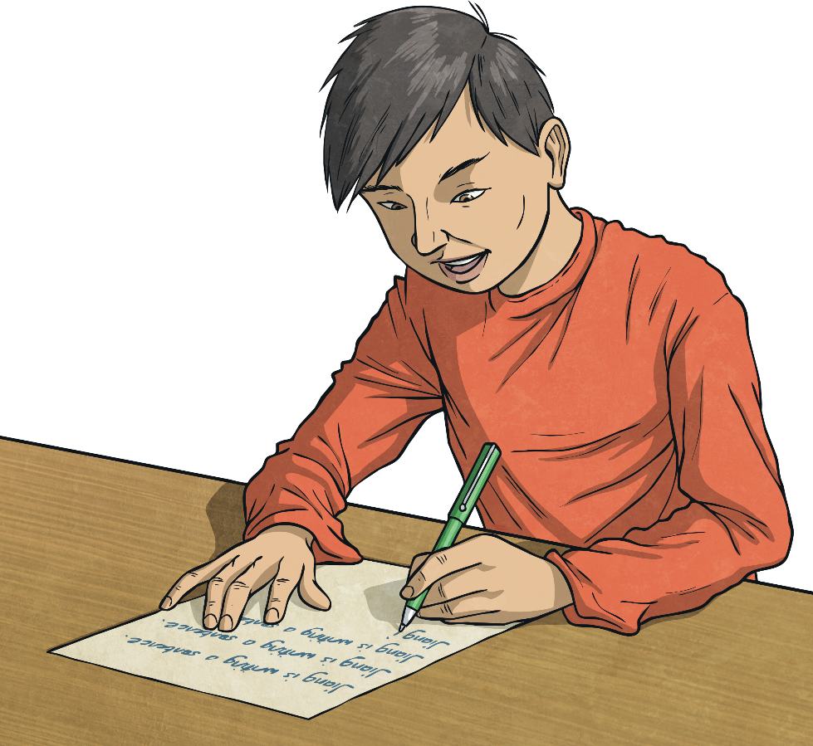
Relative Clauses
and Relative Pronouns
Relative clauses add information to a sentence, using relative pronouns.
Here are the main points about relative clauses and relative pronouns:
A relative pronoun is usually seen in a sentence at the beginning of a relative clause.
John was playing the piano. He was in the hall.
A relative clause functions as an adjective, modifying nouns and pronouns.
relative pronoun
John, who was in the hall, was playing the piano.
A relative clause starts with either a relative adverb (where) or a relative pronoun: that, who, whom, whose, which.
relative clause
main clause

Slide 10
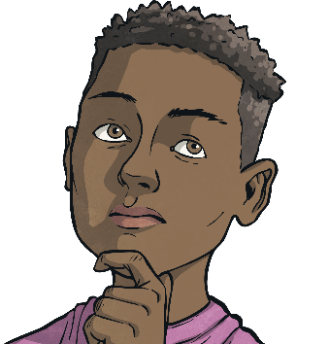
Relative Clauses
and Relative Pronouns
The following are examples of sentences that have relative clauses starting with relative pronouns.
Can you identify the relative pronouns?
Never go to a doctor whose office plants have died. - Erma Bombeck
I have a friend whose cat is annoying.
We didn’t bring the receipt, which was a big mistake.
The driver who went through the stop sign was careless.
People who are clever can always find a way.
Grandma remembers a time when radio shows were popular.
This is the book that everyone is talking about.
Spaghetti, which many of us enjoy, can be messy.
She wrote to the person whom she had met last month.

Slide 11
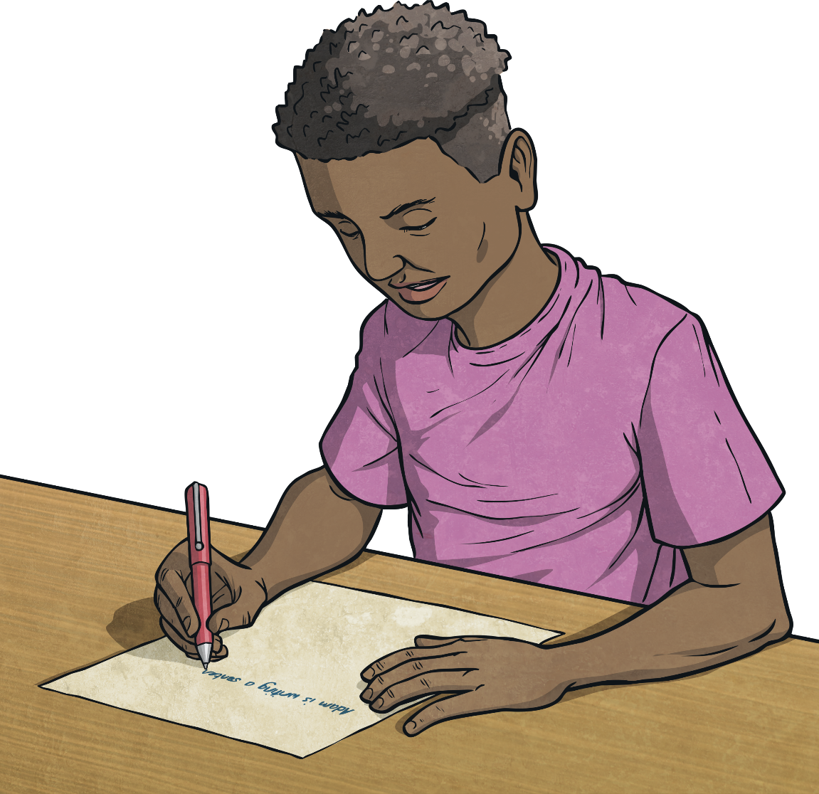
Independent Focused Activity

Slide 12
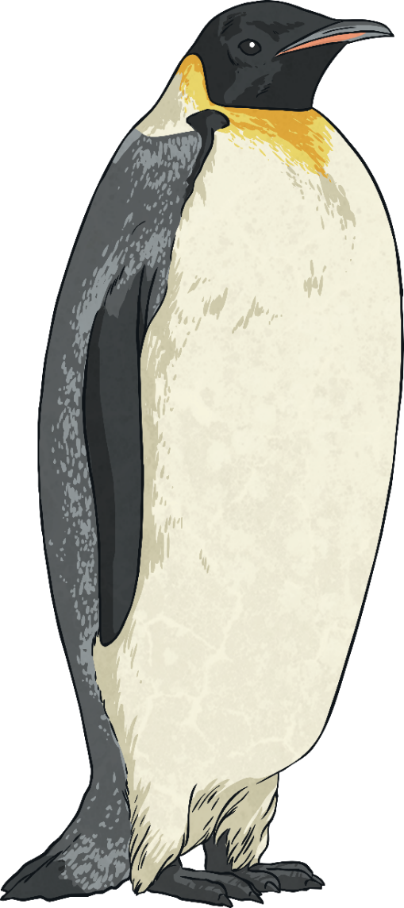
Commas and Relative Clauses
Commas are used when the relative clause contains additional, non-essential information.
You will have noticed that sometimes relative clauses have commas to separate them from the main clause and sometimes they do not.
The penguin, who was enjoying the morning sunshine, waddled towards the water.
Because the information is not essential to the meaning of the sentence, this is called a non-essential relative clause.
The penguin, who was enjoying the morning sunshine, waddled towards the water.
The relative clause gives the reader some extra information about the penguin. It is not essential to the meaning of the sentence.
The penguin who banged his head on the side of the rock needed to be rescued by a specialist team of vets.
He is waddling towards the water. The fact that he is enjoying the sunshine as well is not very relevant. If you got rid of what was inside the commas, the sentence would have the same meaning.

Slide 13
Commas and Relative Clauses
When the relative clause contains essential information, no commas are needed.
The penguin who banged his head on the side of the rock needed to be rescued by a specialist team of vets.
Because the information is essential to the sentence, this is called an essential relative clause.
This specifies a particular penguin. The fact that this penguin has a head injury is very relevant to the meaning of the sentence.
If you removed the relative clause from this sentence, the meaning of the sentence would change.

Slide 14
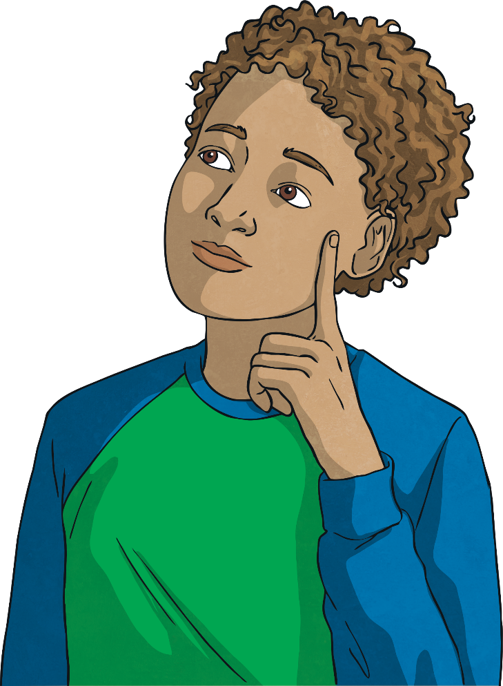
Commas and Relative Clauses
To recap:
There are two types of relative clauses: non-essential and essential.
The lamp post, where the girl was standing, was lit.
Non-essential relative clauses offer additional information about the noun.
This gives the reader the extra information about the lamp post.
They are separated from the rest of the sentences by commas because the information they provide can be left off without changing the meaning of the sentence.
The lamp post where the girl was standing was lit.
This specifies the particular lamp post – the one where the girl
was standing rather than the one by the bus stop, for example.

Slide 15
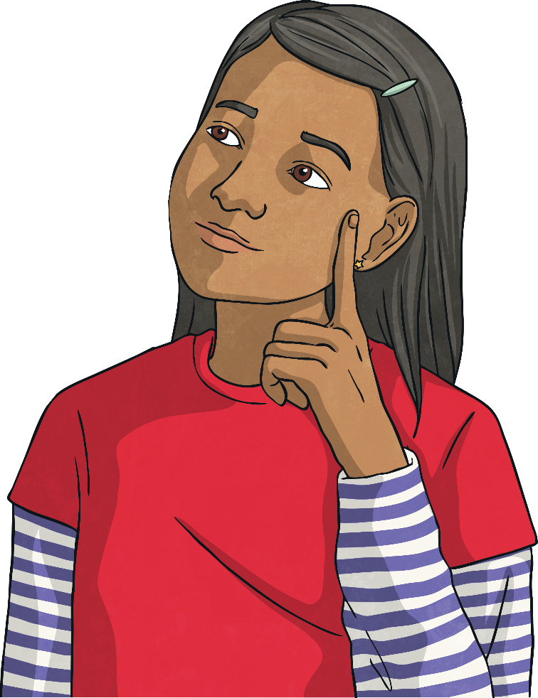
Commas and Relative Clauses
To recap:
The test which we did yesterday was really easy.
There are no commas in this sentence.
This is because the relative clause information
defines the subject of the main clause.
In this example, there might have been lots of tests,
but we are only interested in yesterday’s test.
This is an essential relative clause, so we don’t use commas.

Slide 16
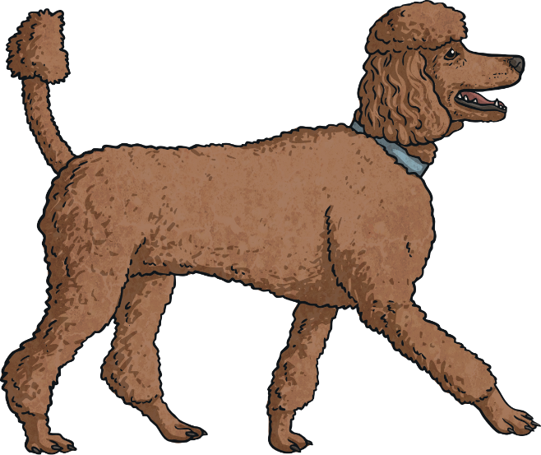
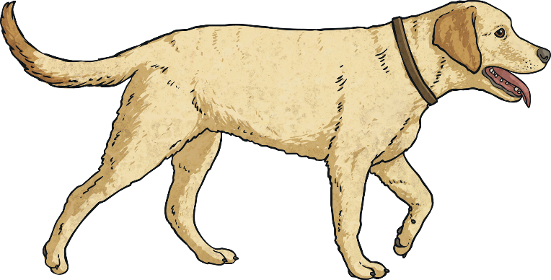
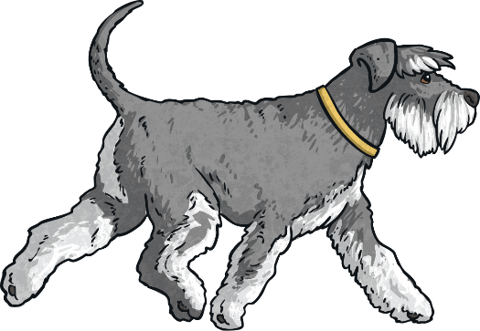
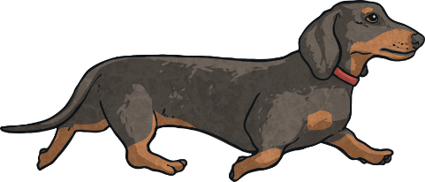
Commas and Relative Clauses
Another example:
Dogs that howl annoy me.
I can't get rid of the words ‘that howl’ because then I'd be saying all dogs annoy me, not just the ones that howl, which isn't true.
The relative clause in this example is essential.

Slide 17
Commas and Relative Clauses
Which of these sentences need commas adding in?
The meerkat who bit the zookeeper had to be calmed down.
The baby giraffe, who had a delicate soft nose, ambled towards her mother.
The hotel where my parents got married was on television last night.
My school, which recently won a sports award, was holding a Christmas fair.
The crown that was worn by a famous ancient king came to the town museum.
The crown, which had been recently cleaned, was placed on the head of the new king.
Remember – if you are adding in non-essential, additional information, add commas.

Slide 18

Review Activity

Slide 19
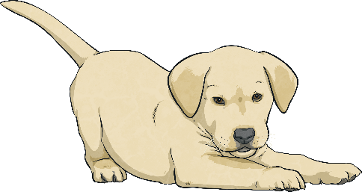

Identifying When
a Pronoun Can Be Omitted
Example
Sometimes a relative pronoun can be omitted from a relative clause without affecting the sense of a sentence. This only works if the pronoun is the object of the clause – the person or thing receiving the action.
Jack had to clean up the mess that the dog had made.
This is the object of the relative clause, so it can be omitted without changing the meaning of the sentence.
essential relative clause
Jack had to clean up the mess the dog had made.
The sentence makes sense without the relative pronoun and object that.

Slide 20
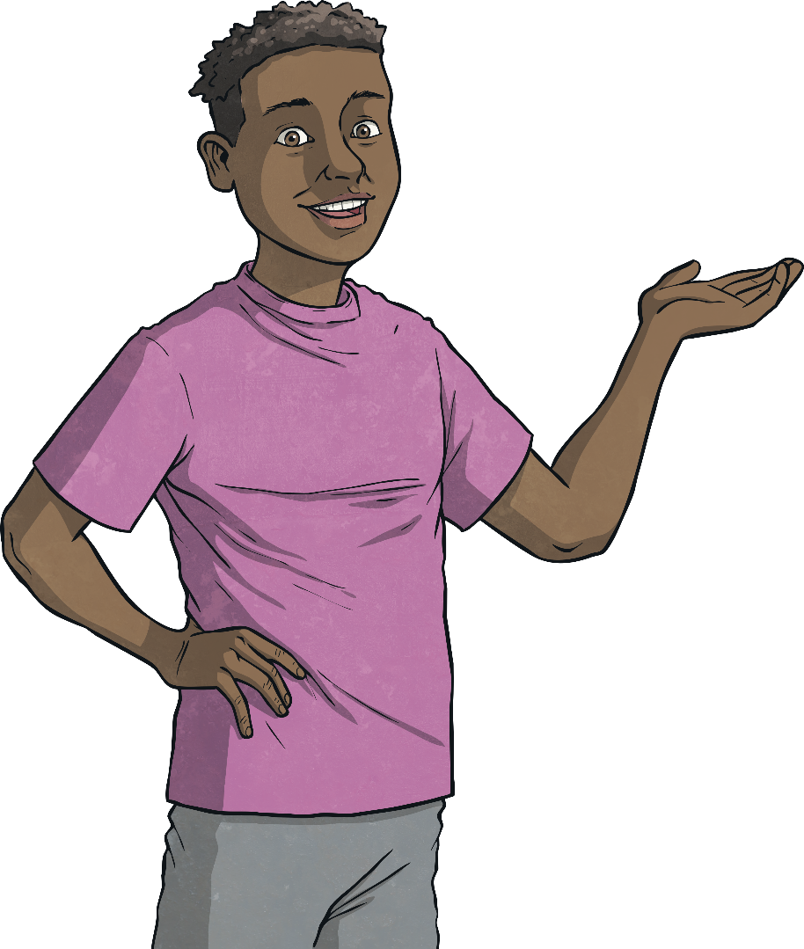
Identifying When
a Pronoun Can Be Omitted
In some relative clauses, the relative pronouns who, which or that can be omitted.
Another Example:
Is this the jacket you were looking for?
Is this the jacket (which/that) you were looking for?
The shoes I want cost £10.50.
The shoes (which/that) I want cost £10.50.
Your clever brain reads the missing words in for you to complete the sentence!
When we leave out the relative pronoun, the sentence still makes sense.

Slide 21
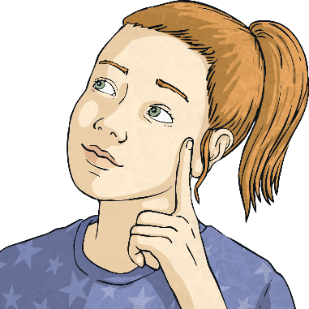
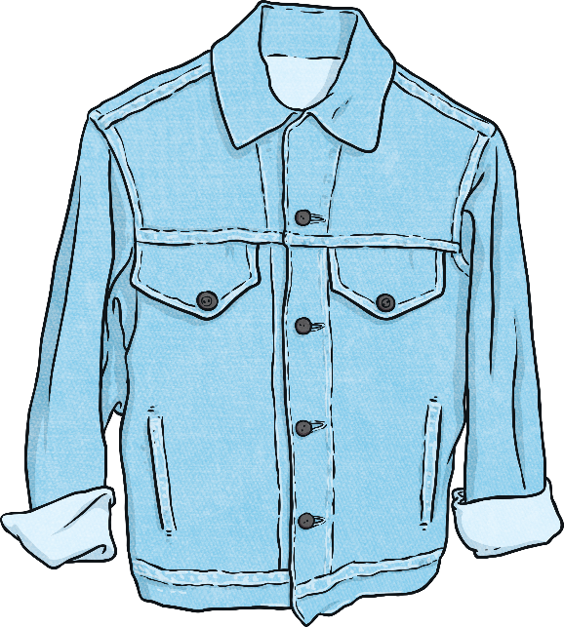
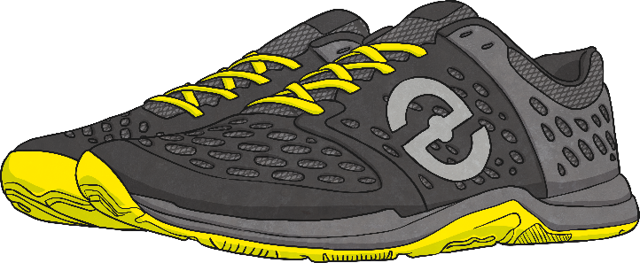
Identifying When
a Pronoun Can Be Omitted
How do you know a relative pronoun has to be omitted?
Remember! Relative pronouns can be omitted if they refer to the object of the verb.
Break up the multi-clause sentence into two simple sentences to find out.
The shoes (which/that) I want cost £10.50.
Is this the jacket (which/that) you were looking for?
The shoes cost £10.50. I want them.
Is this the jacket? You were looking for it.
subject
subject
verb
verb
object
object

Slide 22
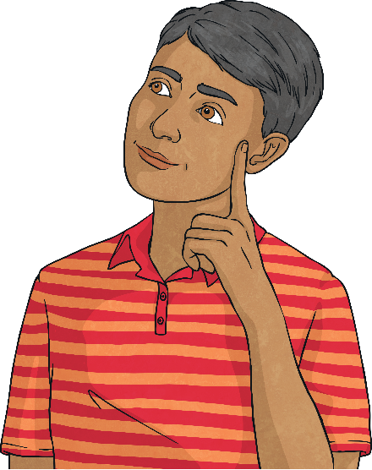
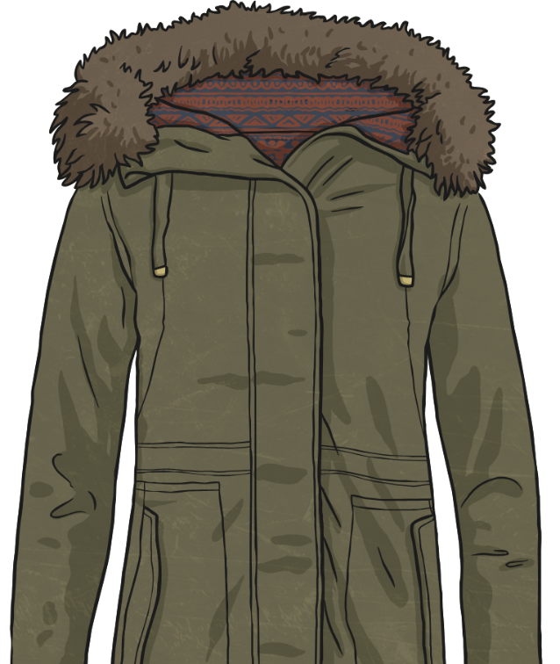
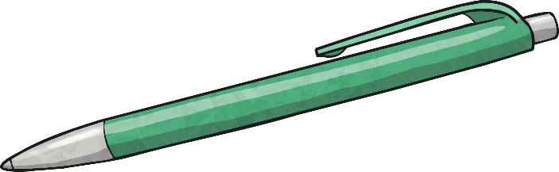
Identifying When
a Pronoun Can Be Omitted
How do you know a relative pronoun has to be kept?
Relative pronouns have to stay in the sentence if they refer to the subject of the verb.
I’m looking for my coat, which has a furry hood.
Where is the pen that was on my desk?
Where is the pen? It was on my desk.
I’m looking for my coat. It has a furry hood.
subject
verb
subject
verb

Slide 23
Identifying When
a Pronoun Can Be Omitted
For each of these multi-clause sentences, decide whether the relative pronoun can be left out of the subordinate clause or must stay in.
Jake, who is only ten, has been scouted for United.
The chocolate bar that we left on the table has melted!
Your bags, which have huge straps, are blocking the corridor.
Where is the homework which I asked for yesterday?

Slide 24
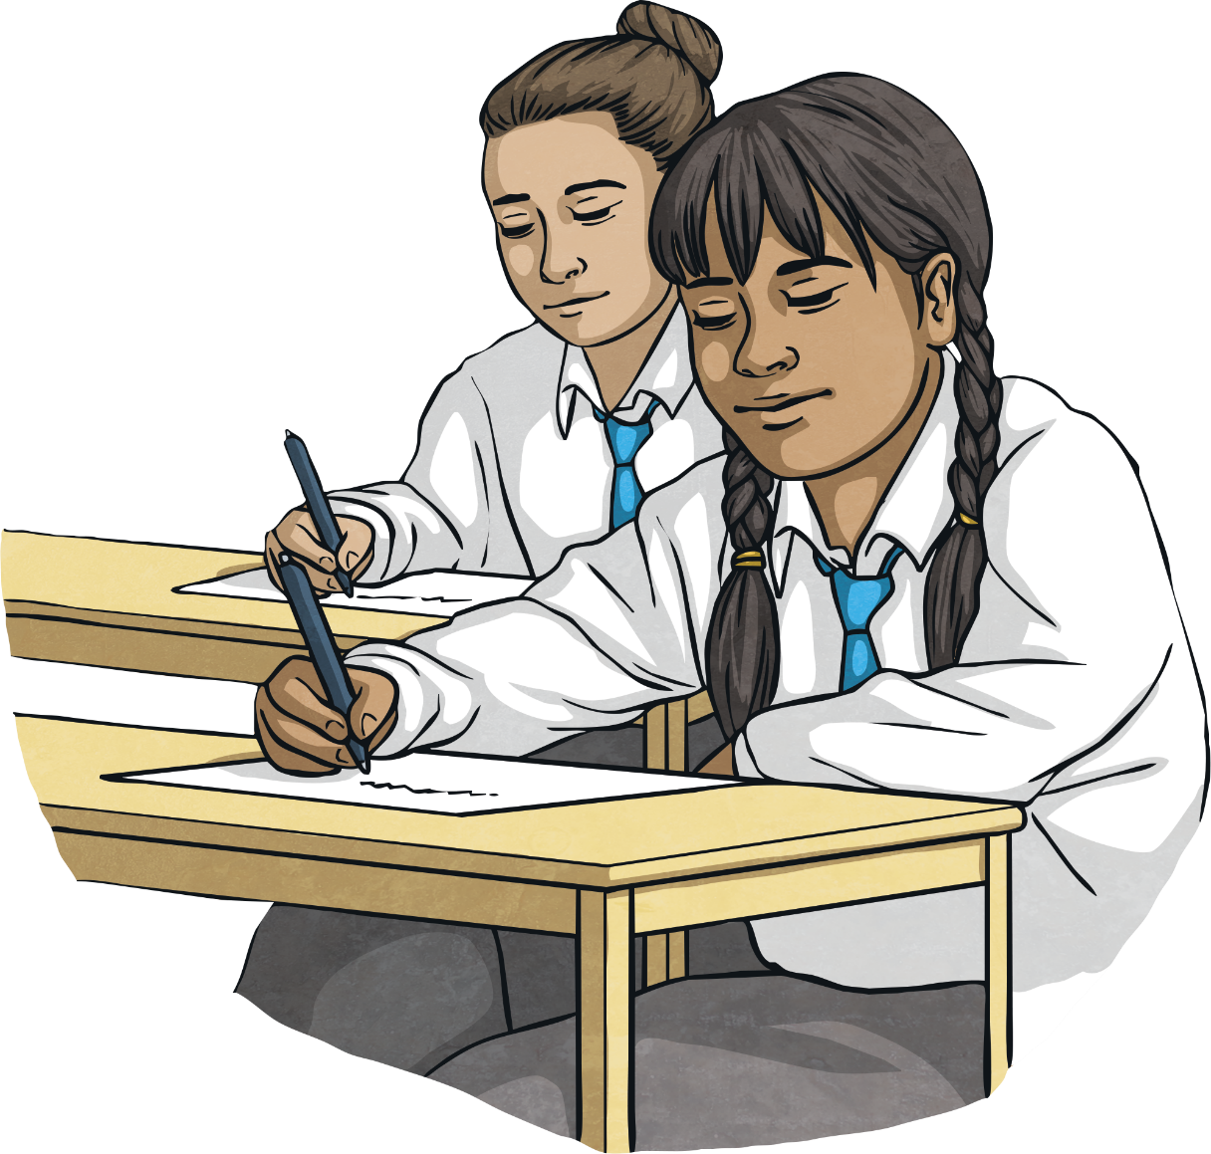
Consolidation Activity

Slide 25
Spot the Clauses
For each of the following sentences, can you identify the main clause, subordinate clause and relative pronoun?
We have a lot of cousins who live in other cities.
The rain that had been forecast poured heavily.
The machine which broke down has been mended.
Your PE bag should be on your peg, where you can also hang up your coat.

Slide 26
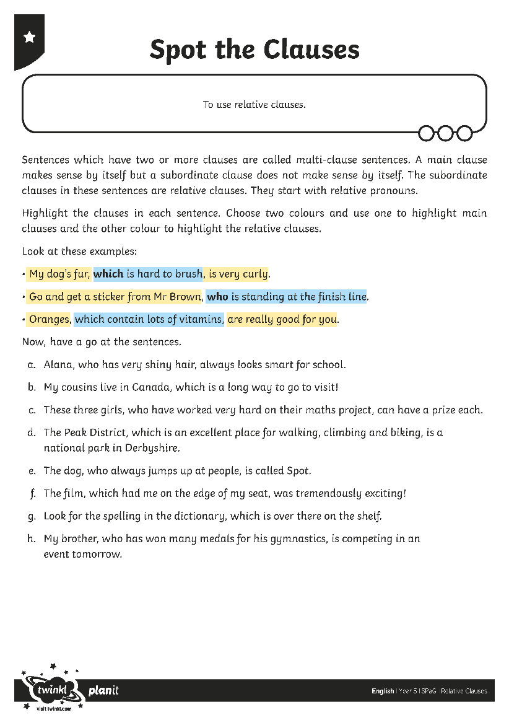
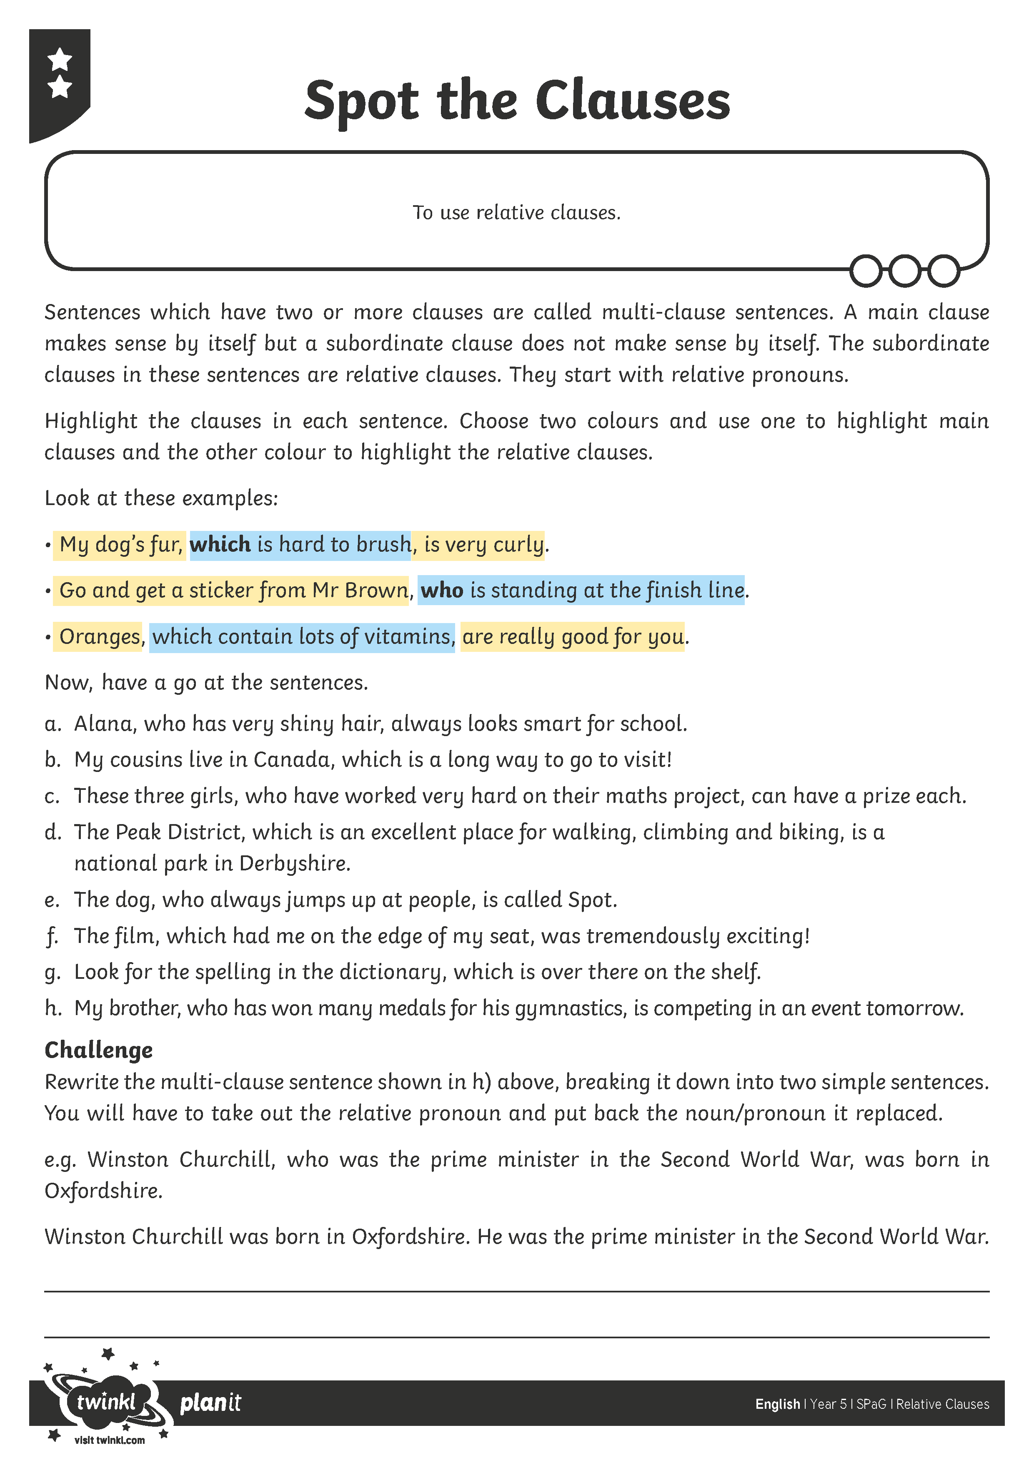
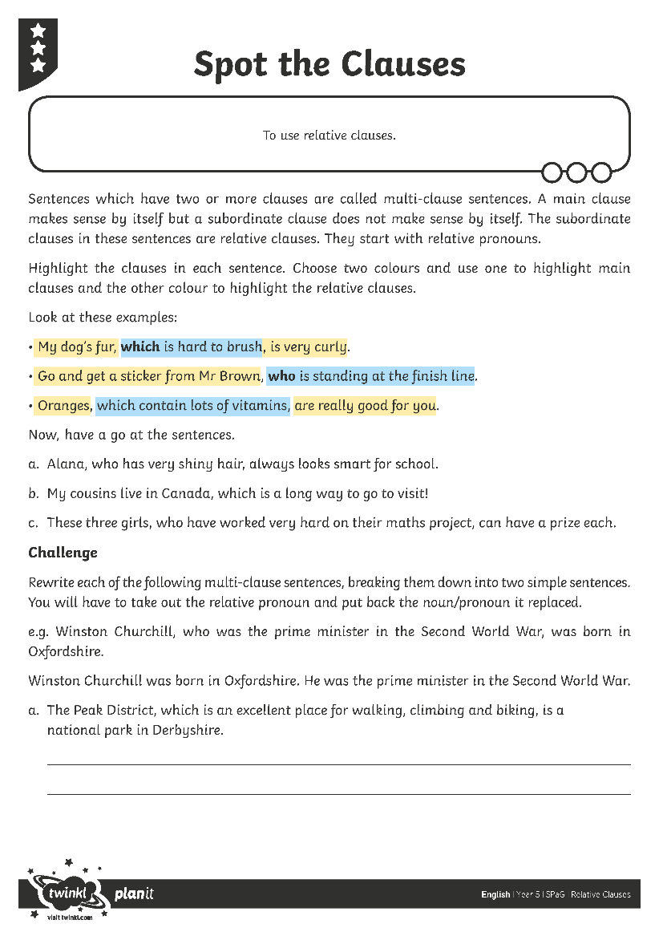

Spot the Clauses

Slide 27
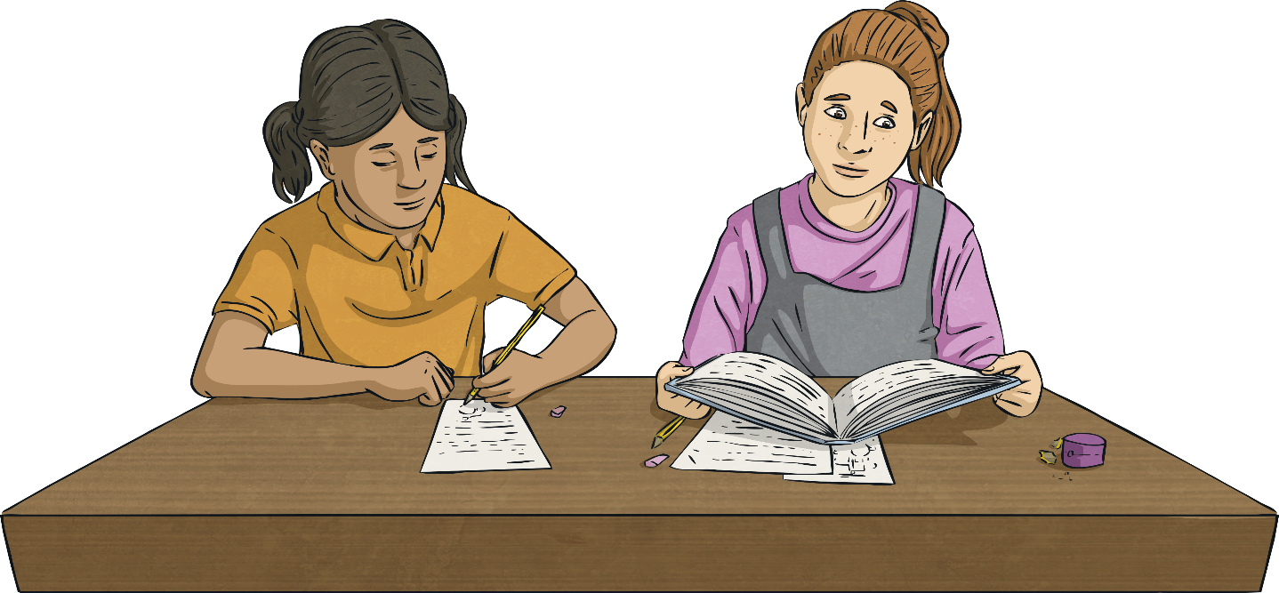
Assessment

Slide 28
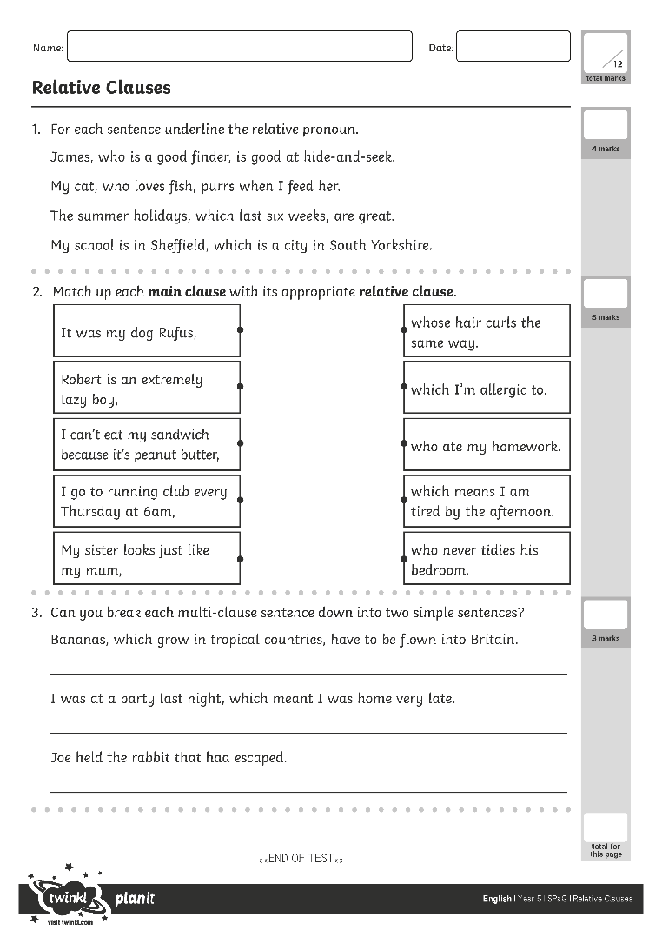
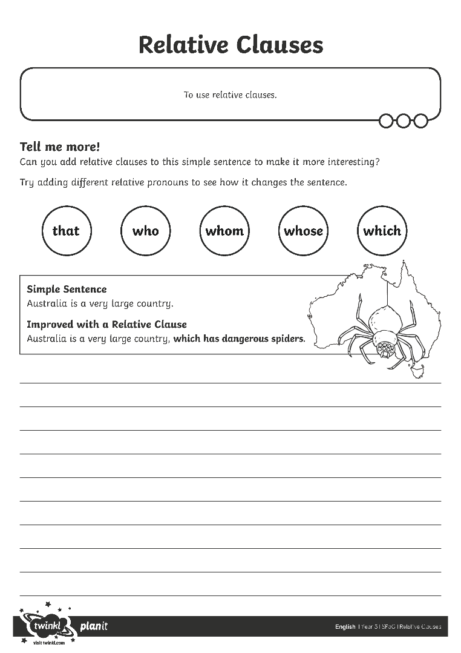
Relative Clauses
Use all you have learnt about relative clauses and the skills you have practised.
Use all you have learnt about relative clauses and the skills you have practiced.
Work on your own to complete the Assessment Activity Sheet.
Work on your own to complete the Application Activity Sheet.

Slide 29

Aim
To use relative clauses.
Success Criteria
I can explain that a multi-clause (or ‘complex’) sentence has at least two clauses.
I can identify and use relative pronouns and relative clauses.
I can explain when commas are needed with relative clauses.
I can explain that an object relative pronoun can be left out of a clause.

