Slide 1
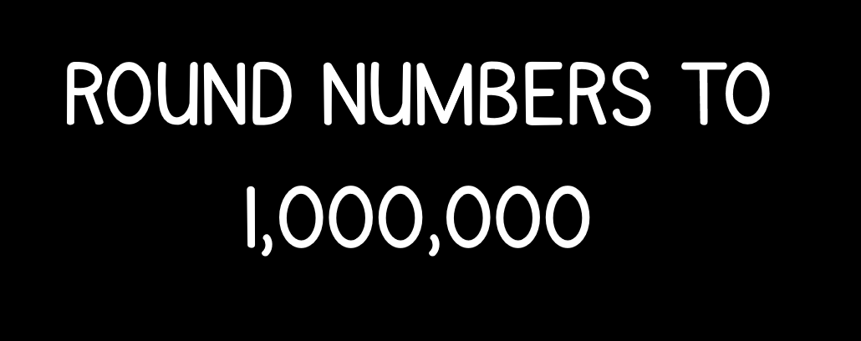

Slide 3
Round 268,002 to the nearest 100,000
2) 371,000 271,000 _____ _____
3) _____ 762,913 862,913 _____

Slide 4
Round 268,002 to the nearest 100,000
2) 371,000 271,000 _____ _____
3) _____ 762,913 862,913 _____
300,000
171,000
71,000
662,913
962,913

Slide 6
Place 268,000 on the number lines.
100,000
100,000 ÷ 10 =
10,000
208,000
308,000
268,000
200,000
200,000 ÷ 10 =
20,000
228,000
208,000
408,000
268,000

Slide 7

Round 419,722 to the nearest 100,000
Have a think
Round to nearest 10
Ones column
Round to nearest 100
Tens column
Round to nearest 1,000
Hundreds column
Round to nearest 10,000
Thousands column
Round to nearest 100,000
Ten thousands
_____________column

Slide 8
Round 419,722 to the nearest 1,000
420,000
Round to nearest 1,000
HTh | TTh | Th | H | T | O
4
1
9
7
2
2
Round 419,722 to the nearest 100,000
400,000
HTh | TTh | Th | H | T | O
4
1
9
7
2
2

Slide 9
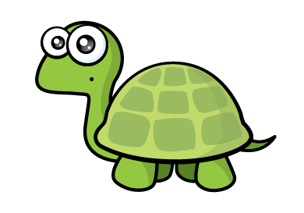
Round 705,872 to the nearest 100,000
700,000
We need to round down to 600,000
100,000
100,000 ÷ 2 =
50,000
705,872
700,000
750,000
800,000
700,000
800,000
705,872 is closer to _______ than ______
700,000
705,872 rounds to _______ to the nearest 100,000

Slide 10
Round 933,000 to the nearest 100,000
900,000
Round 19,456 to the nearest 100,000
0
Round 350,931 to the nearest 100,000
400,000

Slide 11
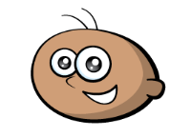
My number is 500,000 when I round it to the nearest 100,000
What is the smallest number Tommy could be thinking of?
450,000
Have a think
450,000
470,000
490,000
510,000
530,000
550,000
549,999
460,000
480,000
500,000
520,000
540,000
All the numbers on this number line round to 500,000 to the nearest 100,000

Slide 12


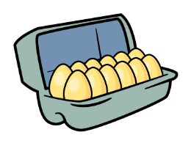
Annie and Teddy are baking some cupcakes.
They need 64 eggs.
Eggs are sold in boxes of 12
Have a think
64 rounded to the nearest 10 is 60, so they should buy 5 boxes of eggs.
5 boxes each with 12 eggs
5 × 12 = 60 eggs
Have a think
How many boxes should they buy?
6 × 12 = 72 eggs
6 boxes
They will have 8 eggs left over.

Slide 13
Have a go at the questions on the worksheet

