Slide 1
Y5 – Autumn – Block 1 – Step 9 – Compare and order numbers to one million Answers
Question | Answer
1 | Dani is wrong, because each of the three counters in B have a value of 10,000, whereas in A, there are only 2 counters with a value of 10,000 and the other counters all have lower values.
2 | 10,000 174,000 49,995 8,000 365,008
3 | 7,069 7,096 7,906 7,960 7,960 7,906 7,096 7,069 The list of greatest to smallest is the reverse order of smallest to greatest.
4 | 19,207 17,099 43,409 Start with the column with highest value. If they are the same look at the next column. For example, for a) all the numbers have 1 ten thousand, so the column that is important to decide the highest value is the thousands column.
5 | > > < >
6 | £201,770 < £309,075 < £310,675 < £312,075
7 | 455,705 < 557,450 < 575,540 < 755,540

Slide 2
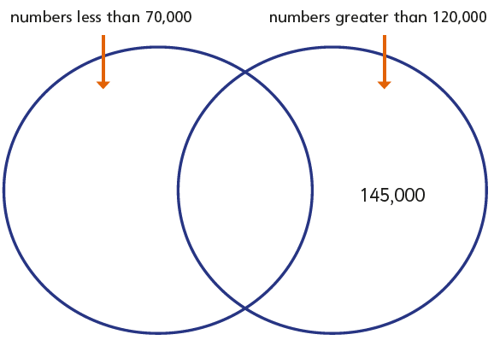
Y5 – Autumn – Block 1 – Step 9 – Compare and order numbers to one million Answers
Question | Answer
8 | There are no numbers in the overlapping section because if a number is smaller than 70,000, then it can’t be greater than 120,000 (and vice versa).
9 | 0, 1, 2, 3, 4, 5 6, 7, 8, 9
three hundred thousand
799
62,000
620,000
85,400

