Slide 1


Slide 3
1) Write 49,012 in words.
2) Draw counters to represent 31,043
3) What is the value of the digit 2 in 52,301?
TTh | Th | H | T | O

Slide 4
1) Write 49,012 in words.
Forty-nine thousand and twelve
2) Draw counters to represent 31,043
3) What is the value of the digit 2 in 52,301?
Two thousand / 2,000
TTh | Th | H | T | O

Slide 6
TTh | Th | H | T | O
HTh | TTh | Th | H | T | O

Slide 7
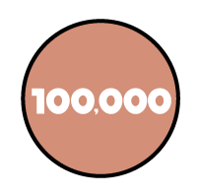




100,000
20,000
0
600
30
5
HTh | TTh | Th | H | T | O
1
2
0
6
3
5
One hundred and twenty thousand, six hundred and thirty-five
120,635

Slide 8

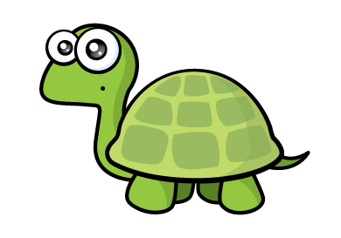
Have a think
Four hundred and three thousand, two hundred and ten
That’s 43,210 in numerals

Slide 9
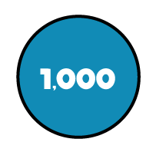
403,210
400,000
0
3,000
200
10
0
HTh | TTh | Th | H | T | O
Four hundred and three thousand, two hundred and ten

Slide 10
Find the number that has a 6 in the thousands column.
HTh | TTh | Th | H | T | O
6
864,592
5,607
326,704

Slide 11
Have a think
What is the value of the 7 in each number?
HTh | TTh | Th | H | T | O
70,000
4
7
47,964
2,
6
9
2
23,671
70
7,000

Slide 12
Have a go at questions 1 - 6 on the worksheet

Slide 13
1,000 less | Number | 1,000 more
 | 168,763
 | 469,706
167,763
169,763
468,706
4610,706
470,706

Slide 14
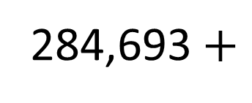
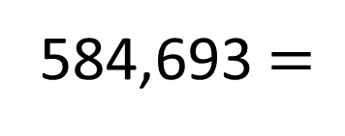
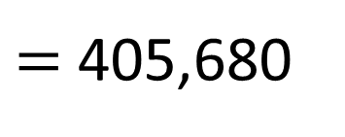
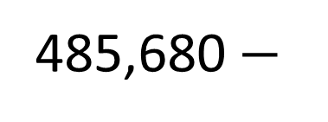
Have a think
300,000
584,693 $=$
284,693 $+$
?
485,680 $−$
80,000
?
$=$ 405,680
I need to use a written method to work out the missing number.

Slide 15

Rosie is thinking of a 6-digit number.
The first and last digits add up to 11
The greatest digit has the largest possible value.
The value of the digit in the thousands column is 3
The value of the digit in the hundreds column is double the ones.
There is the same digit in the 1s, 10s and 10,000s columns.
What is Rosie’s number?
Have a think
HTh | TTh | Th | H | T | O
9
8
2
3
923,422
2
3
4
2
2
3
9
8

Slide 16
Have a go at the rest of the worksheet

