Slide 1
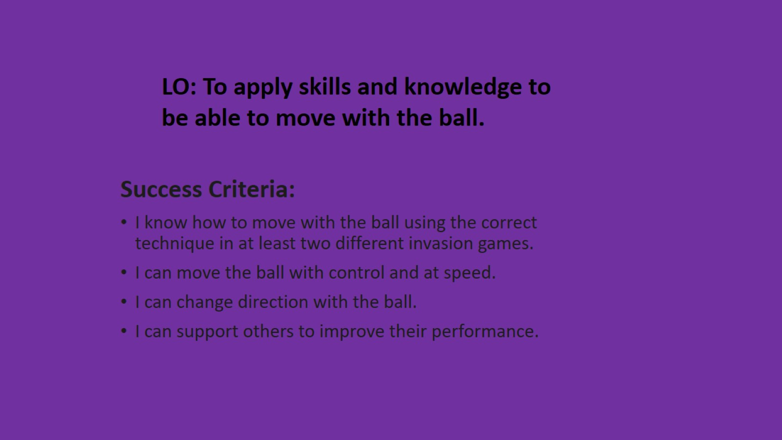

Slide 2
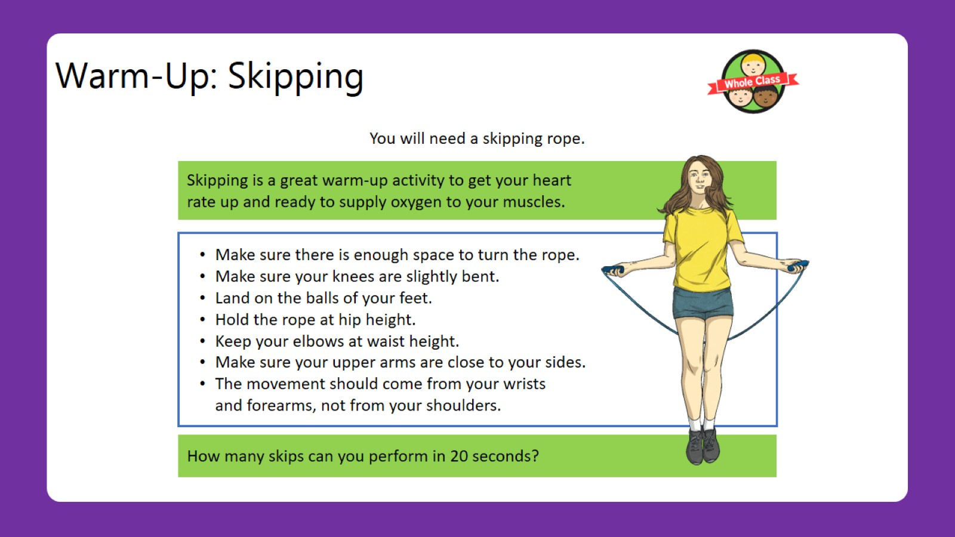
Warm-Up: Skipping

Slide 3
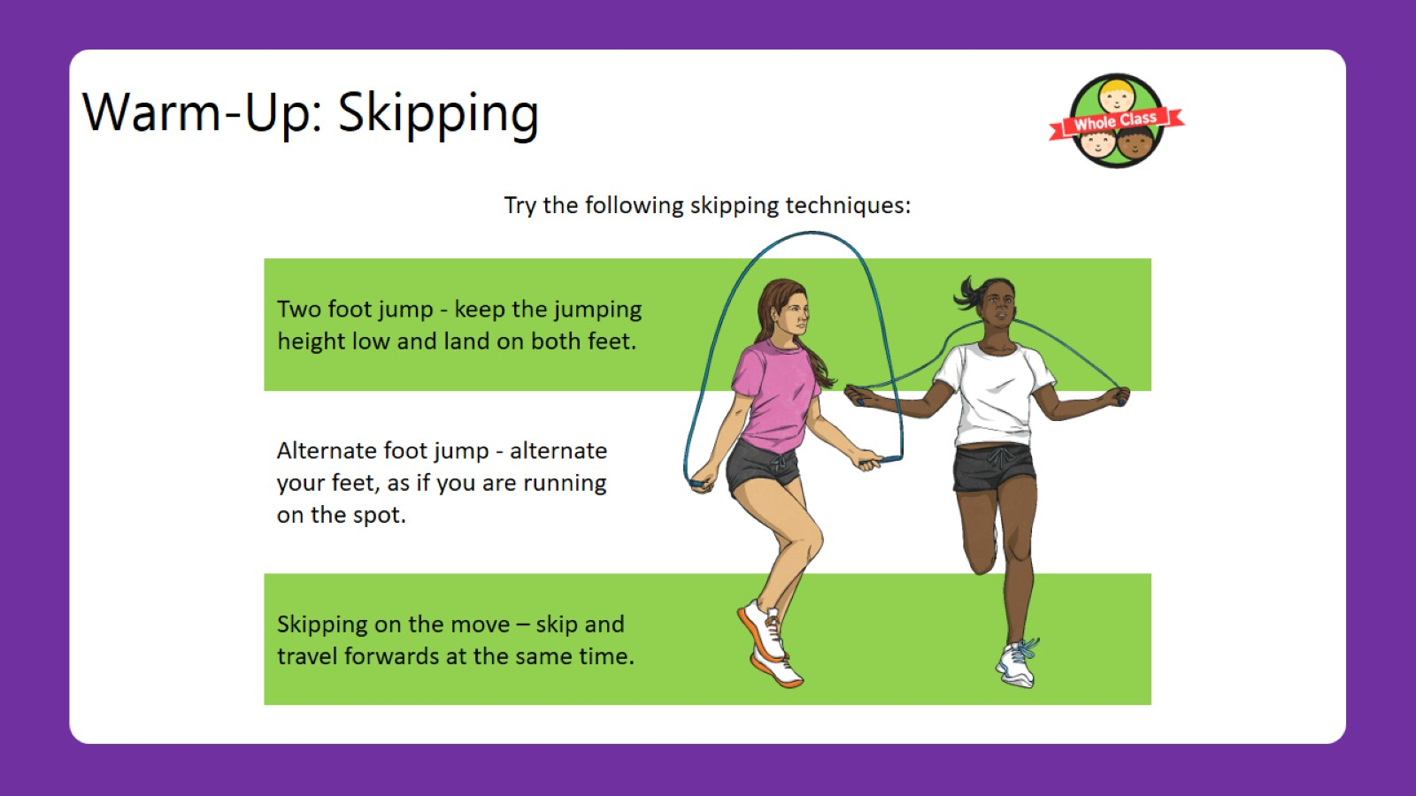
Warm-Up: Skipping

Slide 4
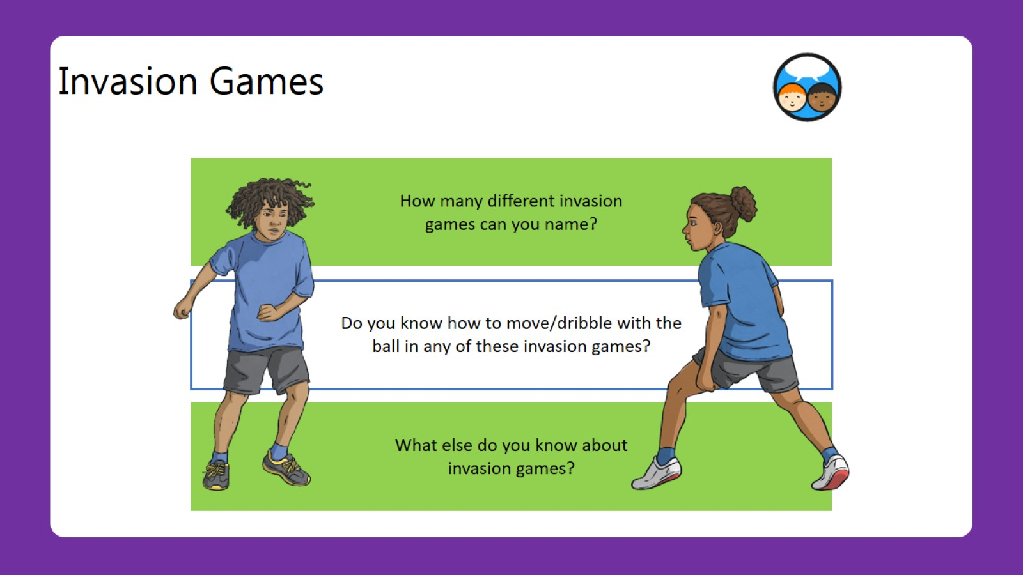
Invasion Games

Slide 5
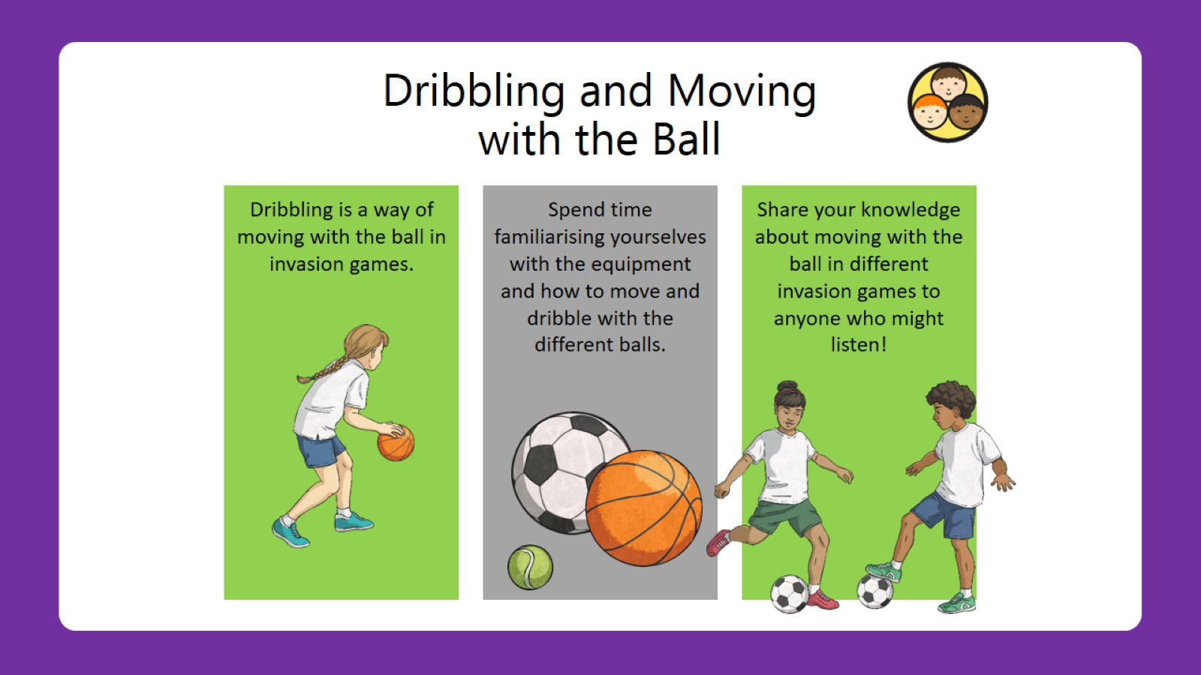
Dribbling and Moving with the Ball

Slide 6
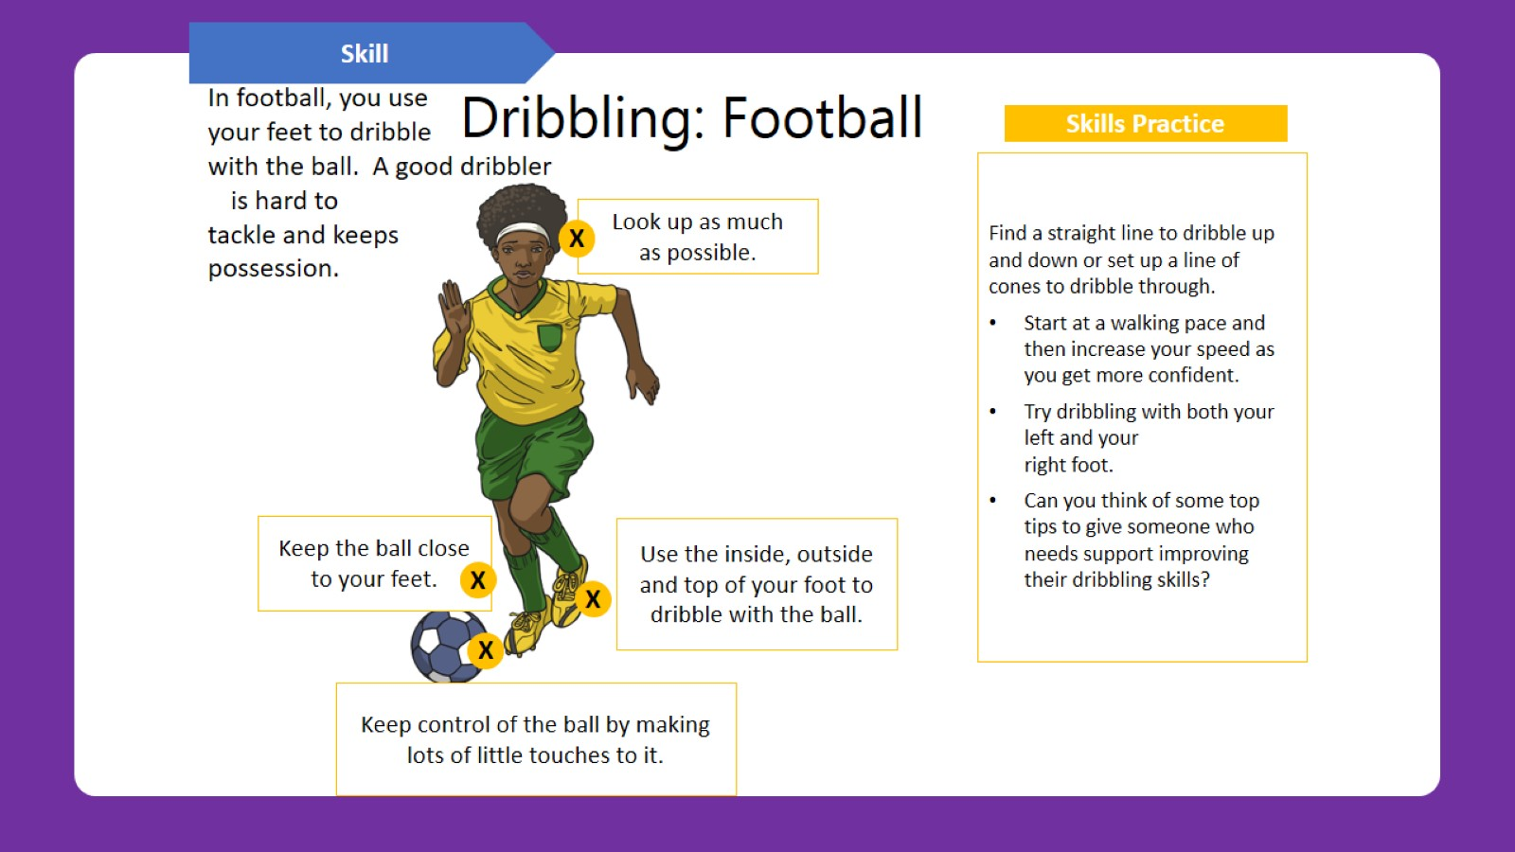
Dribbling: Football

Slide 7
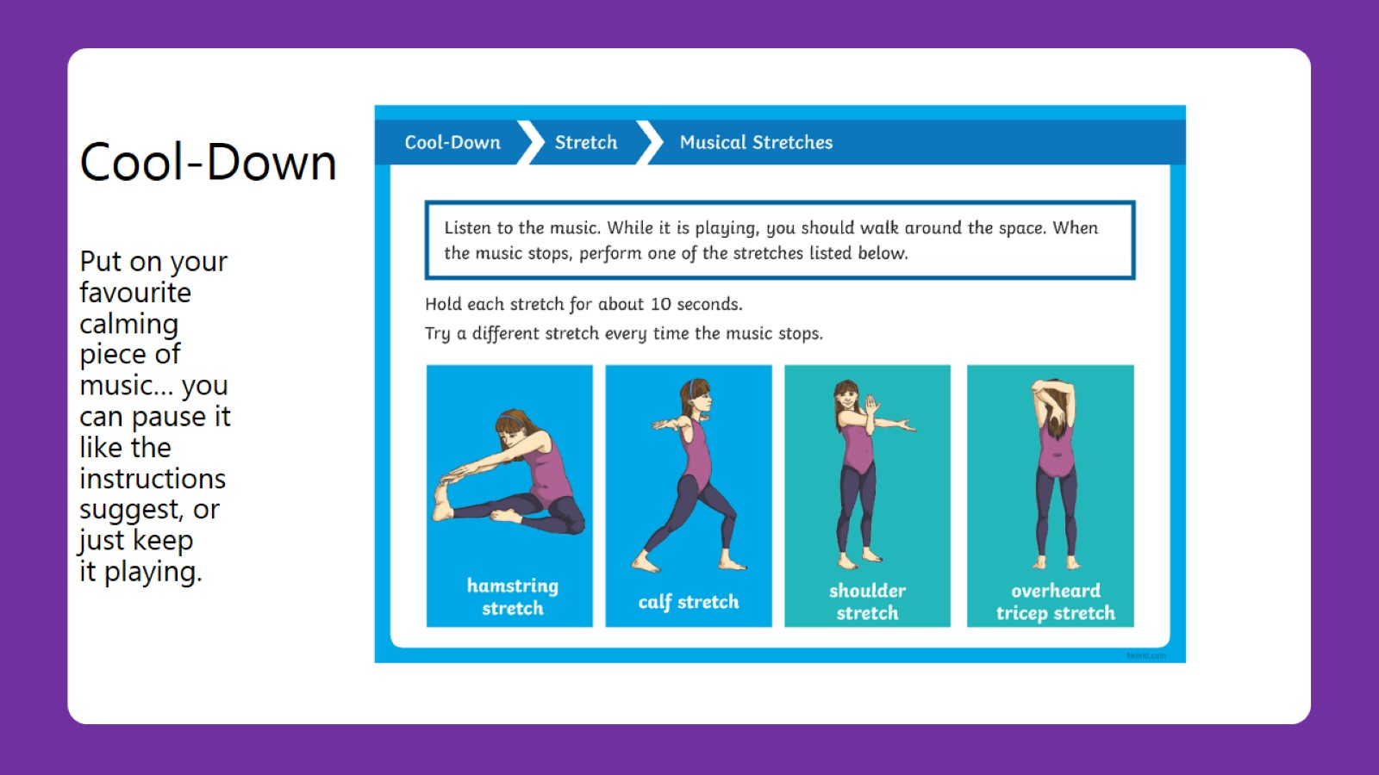
Cool-Down
Put on your favourite calming piece of music… you can pause it like the instructions suggest, or just keep it playing.

