Slide 1


Slide 3
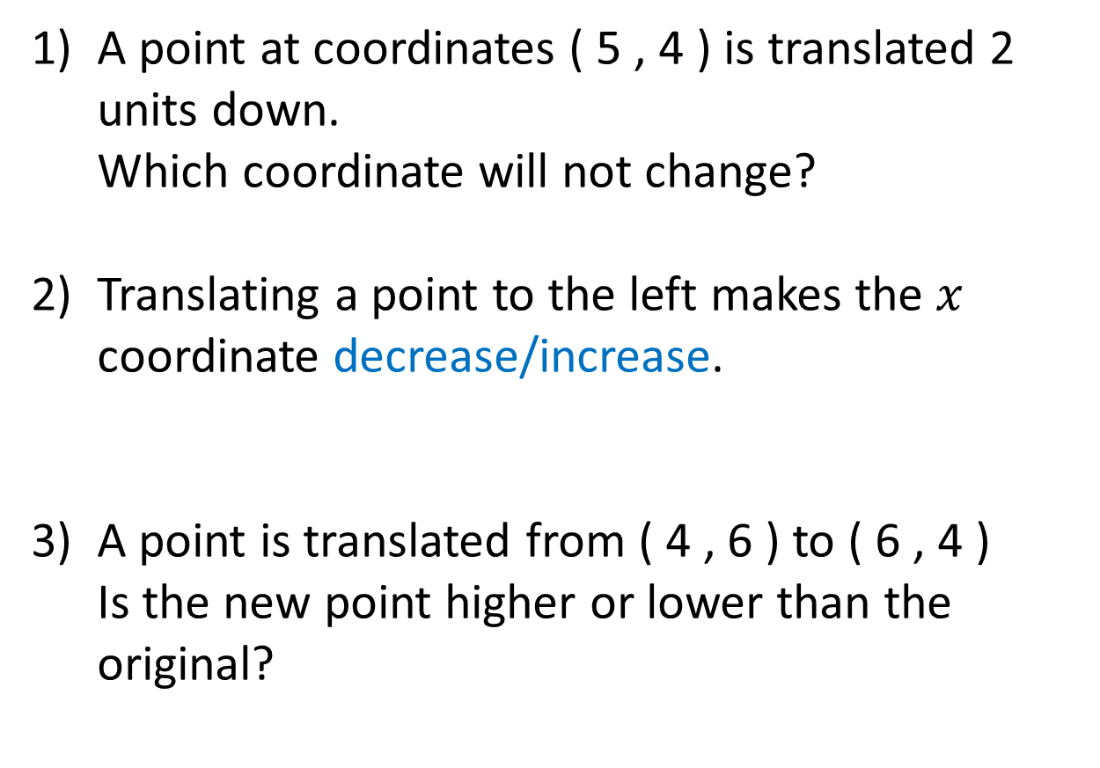
1) A point at coordinates ( 5 , 4 ) is translated 2 units down.
Which coordinate will not change?
2) Translating a point to the left makes the $x$ coordinate decrease/increase.
3) A point is translated from ( 4 , 6 ) to ( 6 , 4 )
Is the new point higher or lower than the original?

Slide 4

1) A point at coordinates ( 5 , 4 ) is translated 2 units down.
Which coordinate will not change?
2) Translating a point to the left makes the $x$ coordinate decrease/increase.
3) A point is translated from ( 4 , 6 ) to ( 6 , 4 )
Is the new point higher or lower than the original?
$x$ coordinate
5
Lower

Slide 6
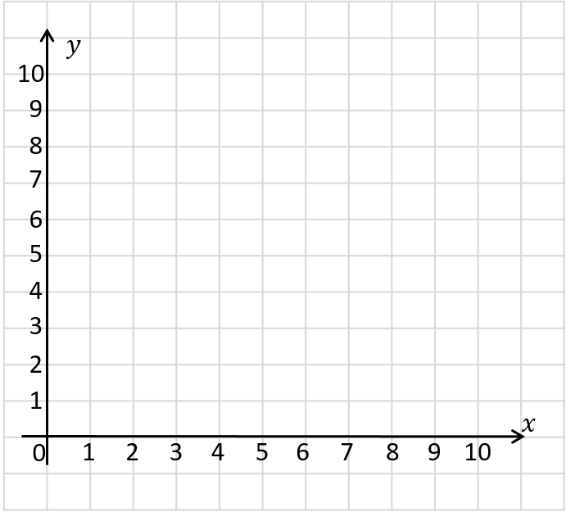
( 9 , 6 ) is translated 1 right and 2 up.
What are the new coordinates?
( 10 , 8 )

Slide 7

( 9 , 6 ) is translated 1 right and 2 up.
What are the new coordinates?
( 10 , 8 )
( 9 , 6 ) is translated 1 left and 2 down.
What are the new coordinates?
4
( 8 , )
Have a think

Slide 8
Have a go at questions
1 - 2 on the worksheet

Slide 9



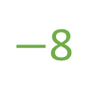
A point is translated 3 left and 8 down and after being translated is at ( 0 , 1 )
What were the original coordinates?
( 3 , 9 )
( , )
Have a think
Original
3
9
$+$3
$−$3
$−$8
$+$8
After
translation
( 0 , 1 )

Slide 10
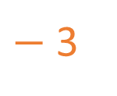
Points A, B and C are all translated in the same way.
Find the missing coordinates.
 | Before | After
A | ( 4 , 6 ) | ( __ , 8 )
B | ( 6 , 6 ) | ( 3 , __ )
C | ( __ , 9 ) | ( 2 , __ )
1
8
5
11
$−$ 3
+ 2
Have a think

Slide 11
Have a go at questions
3 - 7 on the worksheet

