Slide 1


Slide 3
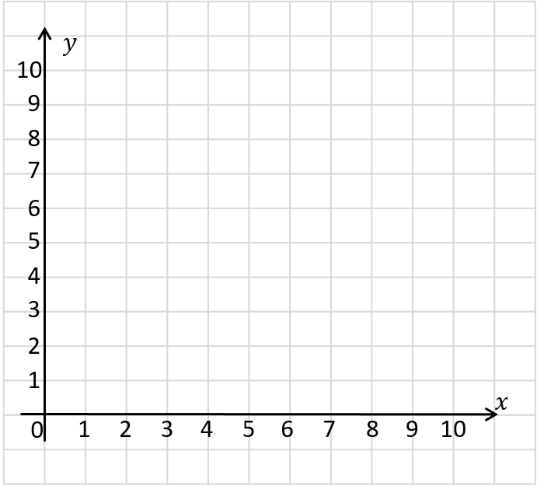
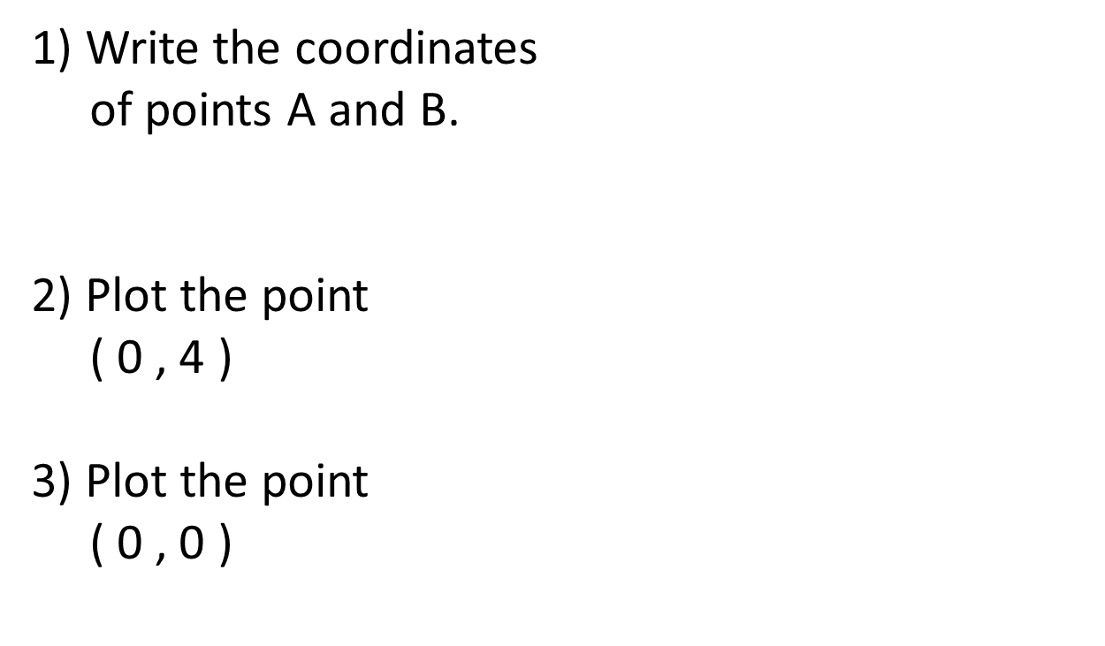
1) Write the coordinates
of points A and B.
2) Plot the point
( 0 , 4 )
3) Plot the point
( 0 , 0 )
A
B

Slide 4
1) Write the coordinates
of points A and B.
2) Plot the point
( 0 , 4 )
3) Plot the point
( 0 , 0 )
( 2 , 9 )
( 6 , 0 )
A
C
D
B

Slide 6
2 up
4 right
The point has been translated 4 right and 2 up.

Slide 7

Have a think
3 right
3 down
Can you describe the translation?
The point has been translated 3 right and 3 down.

Slide 8
Can you describe the translations?
Have a think
A
B
A
B
5 right
1 down
B
C
C
2 left
3 down
B
A
5 left
1 up

Slide 9
Translate the rectangle 1 left and 5 down.

Slide 10
5 right
What is the translation of triangle A to triangle B?
A
5 down
B
5 right and 5 down
Have a think

Slide 11

Translate shape A 3 left and 4 down
Have a think
A
B
I think I’ve got this one!

Slide 12
Translate shape A 3 left and 4 down
A
B

Slide 13
Have a go at questions
1 - 3 on the worksheet

Slide 14
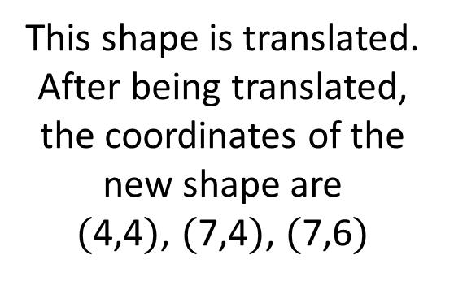
Have a think
This shape is translated.
After being translated, the coordinates of the new shape are
$($4,4$)$, $($7,4$)$, $($7,6$)$
What was the
translation?

Slide 15
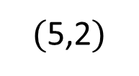
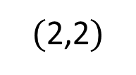

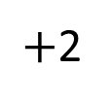
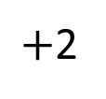
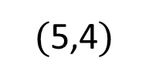
Original shape
$($2,2$)$
$($5,2$)$
$($5,4$)$
$+$2
$+$2
$($4,4$)$ $($7,4$)$ $($7,6$)$
New shape
2 right and 2 up
What’s stayed the same? What’s changed?

Slide 16
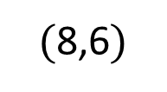
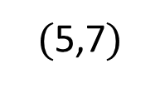
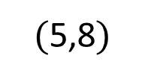
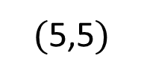
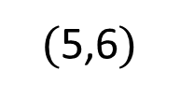
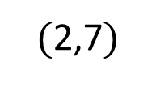
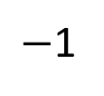
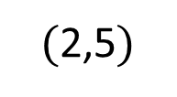
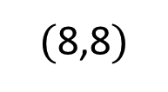
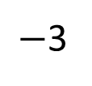
What was the translation?
Have a think
Original shape
$($5,6$)$
$($5,8$)$
$($8,6$)$
$($8,8$)$
$−$3
$−$1
$($2,5$)$
$($2,7$)$
$($5,5$)$
$($5,7$)$
New shape
3 left, 1 down

Slide 17
Have a go at questions
4 - 6 on the worksheet

