Slide 1


Slide 3

1) Find the origin on
the graph.
2) Label the $x$ and $y$
axes on the graph.
3) Which number represents the $y$coordinate in the coordinate pair ( 5 , 7 )?
10
9
8
7
6
5
4
3
2
1
0
1
2
3
4
5
6
7
8
9
10

Slide 4



1) Find the origin on
the graph.
2) Label the $x$ and $y$
axes on the graph.
3) Which number represents the $y$ coordinate in the coordinate pair ( 5 , 7 )?
$$y$$
10
9
8
7
6
5
4
3
2
1
$$x$$
0
1
2
3
4
5
6
7
8
9
10
7

Slide 6
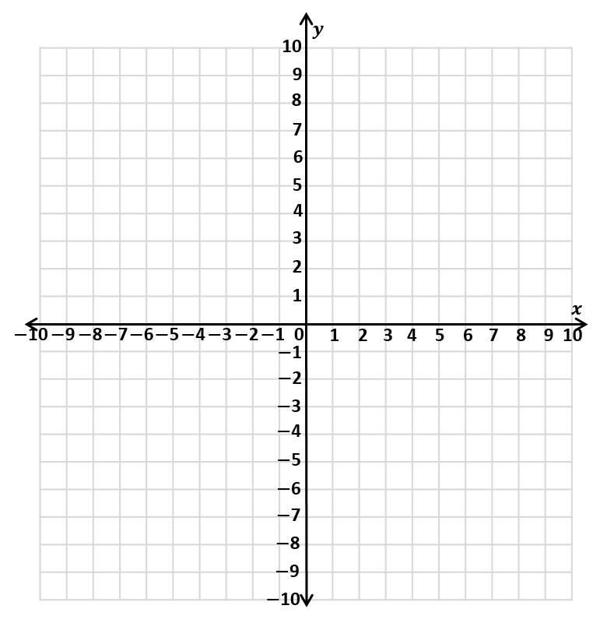
The first quadrant
2nd quadrant
1st quadrant
3rd quadrant
4th quadrant

Slide 7
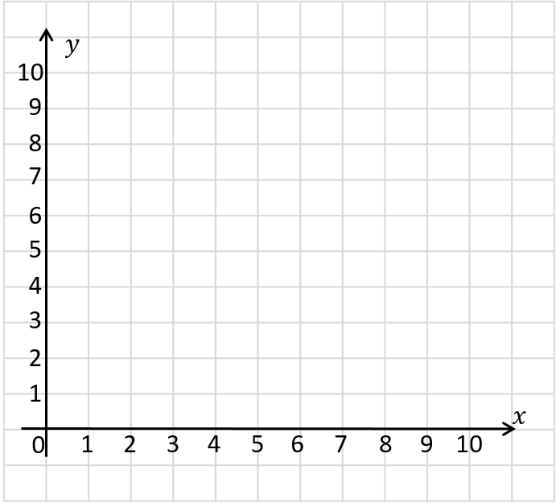
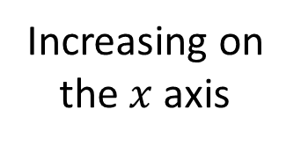
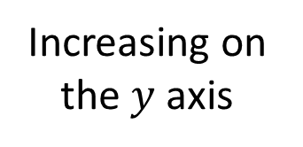
Increasing on the $y$axis
Increasing on the $x$axis

Slide 8
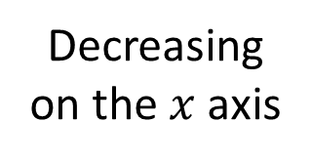
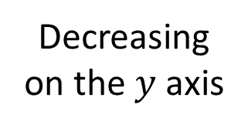
Decreasing on the $y$ axis
Decreasing on the $x$ axis

Slide 9
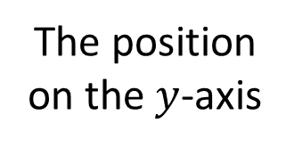
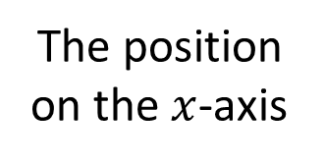
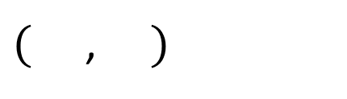
How can we describe the position of point ?
$($ , $)$
2
4
The position on the $x$-axis
The position on the $y$-axis

Slide 10

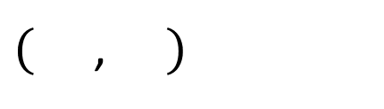
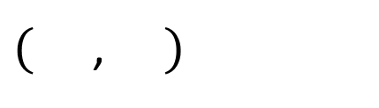

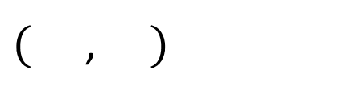

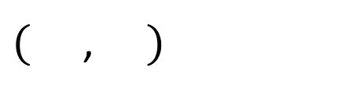
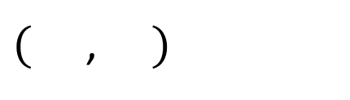
Have a think
$$x$$
$$y$$
$($ , $)$
2
4
$($ , $)$
4
2
$($ , $)$
5
7
$($ , $)$
0
6
$($ , $)$
9
0

Slide 11


Have a think
What’s the same?
What’s different?
$$a$$
$$b$$

Slide 12

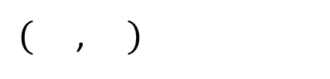
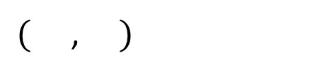


What other points could be on the line $y=$ 4?
$($ , $)$
2
4
$$a$$
$($ , $)$
5
4
$$b$$
$$a$$
$$b$$

Slide 13

Have a think
$$b$$
What’s the same?
What’s different?
$$a$$

Slide 14
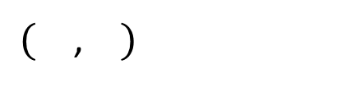
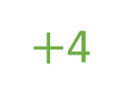

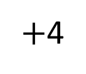

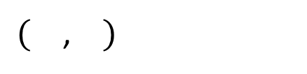


$($ , $)$
2
4
$$b$$
$$a$$
$+$4
$+$4
$($ , $)$
2
8
$$b$$
$$a$$

Slide 15
Have a go at questions
1 - 2 on the worksheet

Slide 16

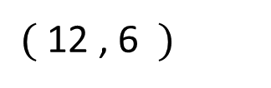
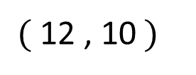

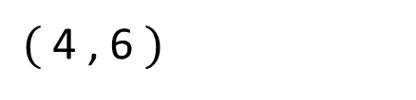

I think we can work out the coordinates of the red point…
$$y$$
Have a think
$($ 12 , 10$)$
$($ 4 , 6 $)$
$($12 , 6 $)$
$$x$$

Slide 17
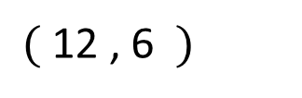
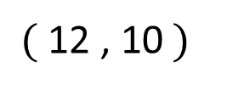
The 3 points form 3 vertices of a rectangle.
What are the coordinates of the missing vertex?
$$y$$
Have a think
$($ 12 , 10$)$
$($ 4 , 6 $)$
$($12 , 6 $)$
$$x$$

Slide 18
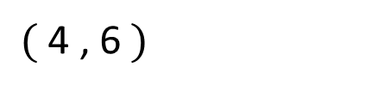
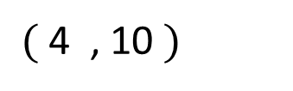
$$y$$
$($4 , 10 $)$
$($ 12 , 10$)$
$($ 4 , 6$)$
$($12 , 6 $)$
$$x$$

Slide 19
Have a go at questions
3 - 6 on the worksheet

