Slide 1


Slide 3
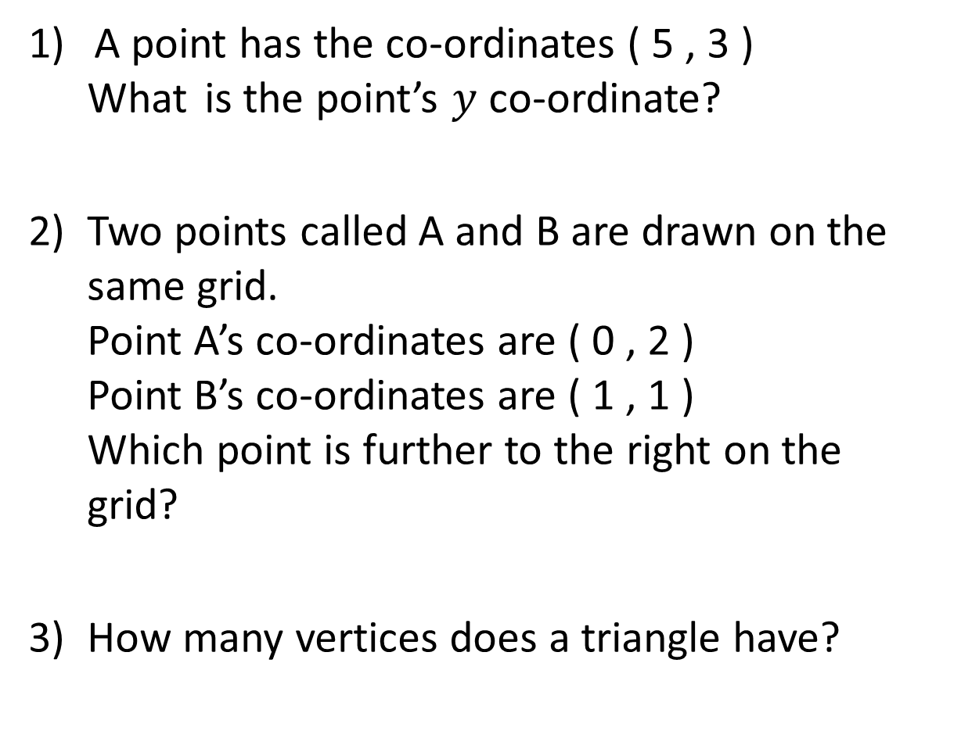
A point has the co-ordinates ( 5 , 3 )
What is the point’s $y$ co-ordinate?
2) Two points called A and B are drawn on the same grid.
Point A’s co-ordinates are ( 0 , 2 )
Point B’s co-ordinates are ( 1 , 1 )
Which point is further to the right on the grid?
3) How many vertices does a triangle have?

Slide 4
A point has the co-ordinates ( 5 , 3 )
What is the point’s $y$ co-ordinate?
2) Two points called A and B are drawn on the same grid.
Point A’s co-ordinates are ( 0 , 2 )
Point B’s co-ordinates are ( 1 , 1 )
Which point is further to the right on the grid?
3) How many vertices does a triangle have?
3
B
3

Slide 6

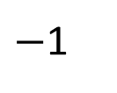
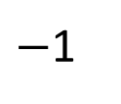


$$y$$
Plot ( 1, 8 ) on the grid.
8
D
$−$1
E
Label the point D.
7
$−$1
Plot ( 4, 7 ) on the grid.
Label the point E.
+3
F
6
+3
5
4
Can you continue the pattern?
3
2
What is the next co-ordinate in the pattern?
1
( 7, 6 )
0
1
2
3
4
5
6
7
8
$$x$$
Have a think

Slide 7
Have a go at questions
1 - 2 on the worksheet

Slide 8


$$y$$
8
The vertices of a shape are ( 4 , 5 ),
( 8 , 5 ) and ( 4 , 1 )
What is the shape?
7
6
5
4
Triangle
3
2
1
0
$$x$$
1
2
3
4
5
6
7
8

Slide 9


$$y$$
8
Have a think
7
Three vertices of a rectangle are
( 1 , 1 ), ( 1 , 7) and ( 3, 7 )
What are the co-ordinates of the fourth vertex?
( ___ , ___ )
6
5
4
3
2
1
0
$$x$$
1
2
3
4
5
6
7
8
3
1

Slide 10
Have a go at questions
3 - 4 on the worksheet

Slide 11


$$y$$
8
Have a think
7
1) Three vertices of a rectangle are
( 8 , 3 ), ( 8 , 1) and
( 0 , 1 )
What are the co-ordinates of the fourth vertex?
( ___ , ___ )
6
5
4
3
2
0
3
1
0
$$x$$
1
2
3
4
5
6
7
8
2) Two vertices of a square are ( 4 , 6 ), ( 6 , 6 )
What could the co-ordinates of the other vertices be?
(___,___) and (___,___) or (___,___) and (___,___)
4
4
6
4
4
8
6
8

Slide 12
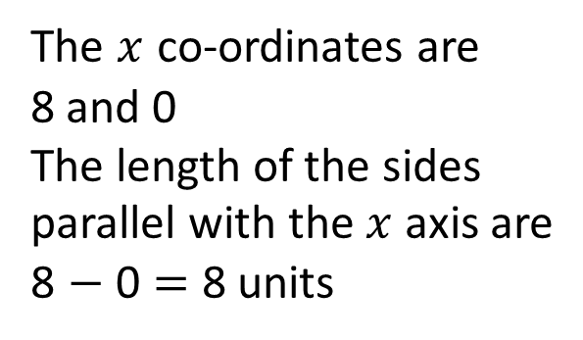


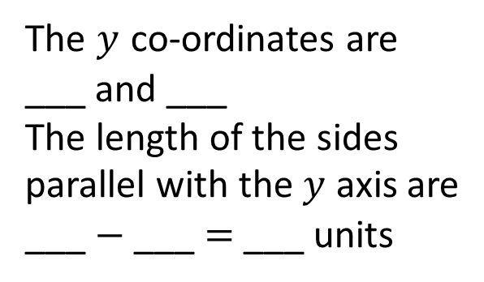
$$y$$
8
Four vertices of a rectangle are
( 8 , 3 ), ( 8 , 1 ),
( 0 , 1 ) and ( 0 , 3 )
How long are the sides of the rectangle?
_____ units and _____ units
7
The $x$ co-ordinates are
8 and 0
The length of the sides parallel with the $x$ axis are
8 $−$ 0 = 8 units
6
5
4
The $y$ co-ordinates are
___ and ___
The length of the sides parallel with the $y$ axis are
___ $−$ ___ = ___ units
3
1
3
8
2
2
1
3
1
2
0
$$x$$
1
2
3
4
5
6
7
8

Slide 13
Have a go at questions
5 - 6 on the worksheet

