Slide 1


Slide 3
1) Which letter is further to the right?
G P
2) Name these shapes.
3) What does vertical mean?
4) What does horizontal mean?

Slide 4
1) Which letter is further to the right?
G P
2) Name these shapes.
3) What does vertical mean?
4) What does horizontal mean?
hexagon
pentagon

Slide 6
8
The coordinates of the yellow cross are
( ___ , ___ )
7
6
2
6
5
4
3
The coordinates of the blue cross are
( ___ , ___ )
2
5
4
1
0
1
2
3
4
5
6
7
8

Slide 7

8
1) The coordinates of the arrow are
( ___ , ___ )
7
6
0
7
5
2) The coordinates of the triangle are
( ___ , ___ )
4
3
6
3
2
1
3) The coordinates of the _____ are ( 7 ,0 )
face
0
1
2
3
4
5
6
7
8
Have a think

Slide 8
Have a go at questions
1 - 2 on the worksheet

Slide 9
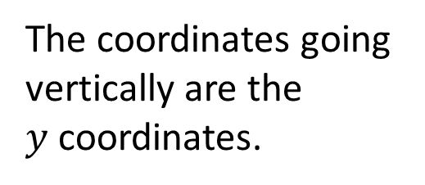
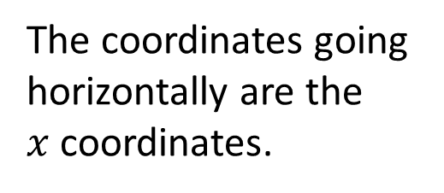


$$y$$
8
What do you notice about this grid?
7
6
Have a think
5
The coordinates going horizontally are the
$x$ coordinates.
4
3
The coordinates going vertically are the
$y$ coordinates.
2
1
( 4 , 1 )
0
$$x$$
1
2
3
4
5
6
7
8
4
1) What is the $x$ coordinate of the triangle? ___
1
2) What is the $y$ coordinate of the triangle? ___

Slide 10

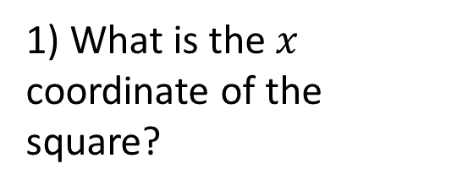
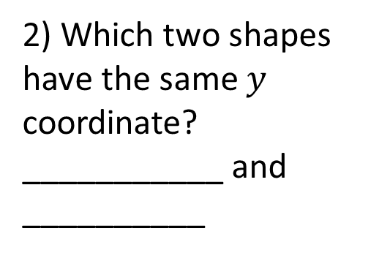

$$y$$
1) What is the $x$ coordinate of the square?
8
7
3
6
2) Which two shapes have the same $y$ coordinate? ___________ and __________
5
4
semi-circle
3
pentagon
2
3) What are the coordinates of the moon?( ___ , ___ )
1
6
8
0
$$x$$
1
2
3
4
5
6
7
8
Have a think

Slide 11
Have a go at questions
3 - 4 on the worksheet

