Slide 1


Slide 3

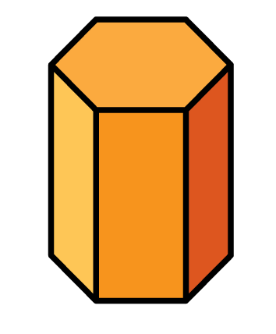
1) All the edges of this shape are of equal length. What is the shape called?
2) These two shapes are both examples of
________.
3) Explain why this shape is not a polygon.

Slide 4
1) All the edges of this shape are of equal length. What is the shape called?
2) These two shapes are both examples of
________.
3) Explain why this shape is not a polygon.
Cube
prisms
It does not have straight sides.

Slide 6
2 dimensions
3 dimensions
Is flat
Has width and length
Is not flat
Has width and length and height

Slide 7

This is a net of a cube.
A net is a
2-dimensional object.

Slide 8

Edge
2
1
3
5
6
4
Face
6 faces
Have a think
The faces of a cube are all _________.
squares

Slide 9
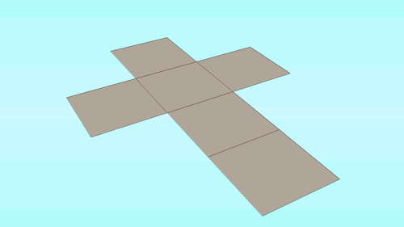

Slide 10
What will change?
What will stay the same?
Have a think

Slide 12
Have a go at questions
1 - 3 on the worksheet

Slide 13
Which nets will form a cuboid?
Have a think

Slide 14
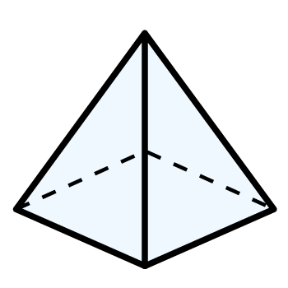
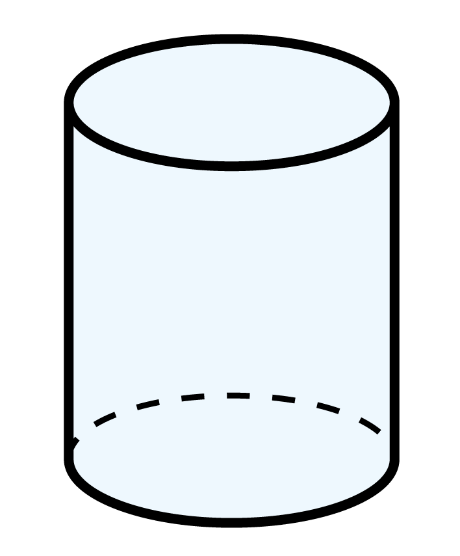
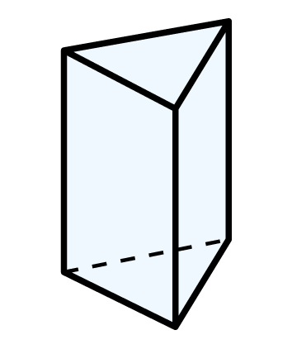
What 3-D shapes will these nets form?
Have a think
Squared-based pyramid
Cylinder
Triangular prism

Slide 15
Have a go at questions
4 - 7 on the worksheet

