Slide 1
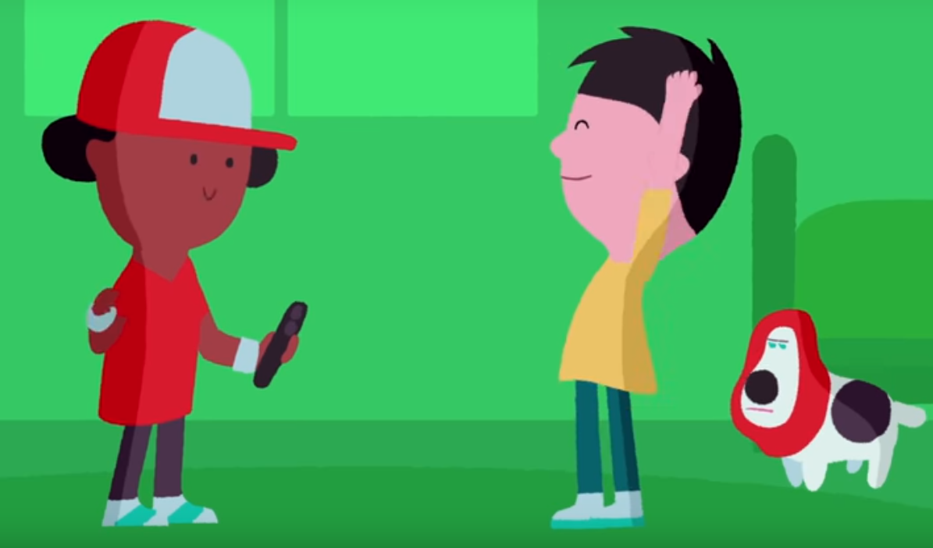
Watch NSPCC video
“Alex’s Willy”
about jokes and loss of control of images
https://www.youtube.com/watch?v=sch_WMjd6go

Slide 2
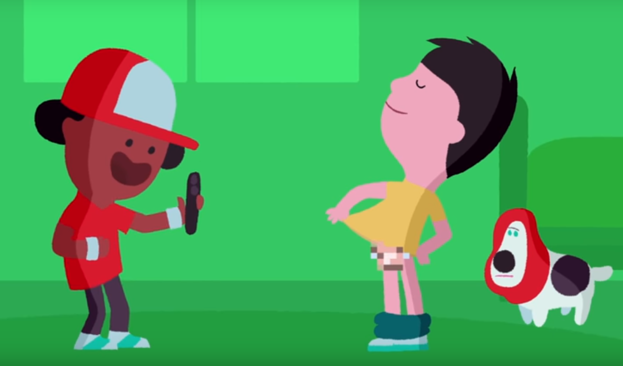
Was this a sensible thing to do?
Were the boys being mean?

Slide 3
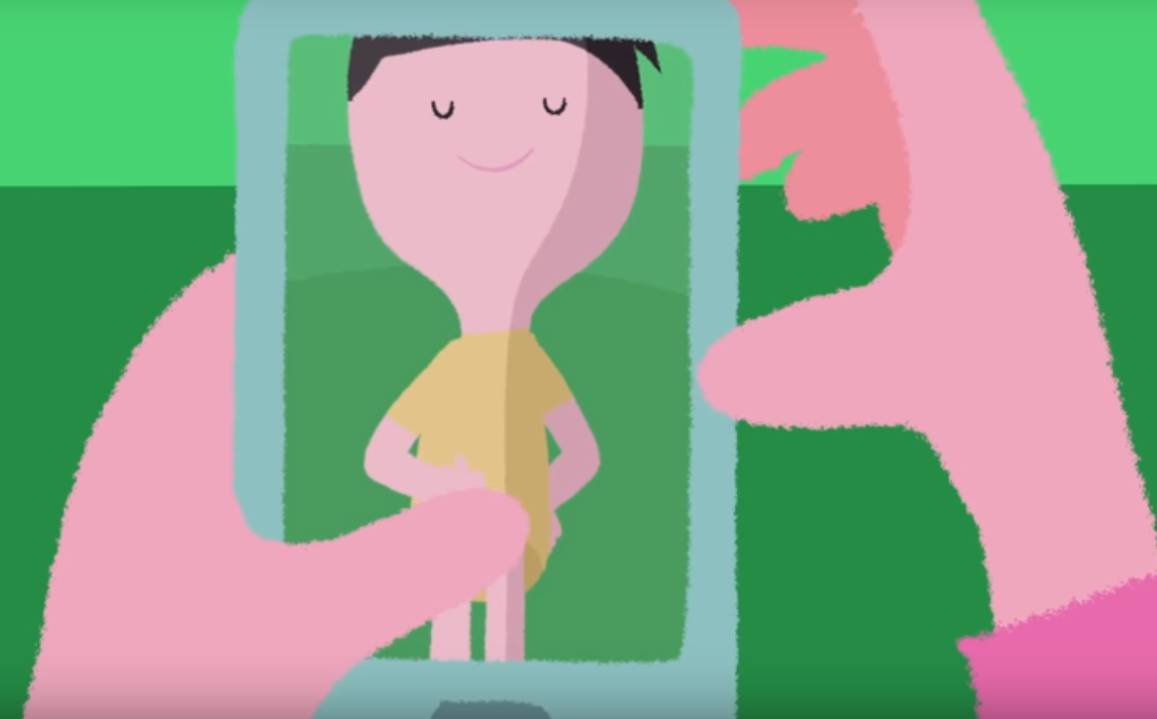
What did Katie do?
Why was this not a good idea?
How would you have felt if you received this picture?

Slide 4
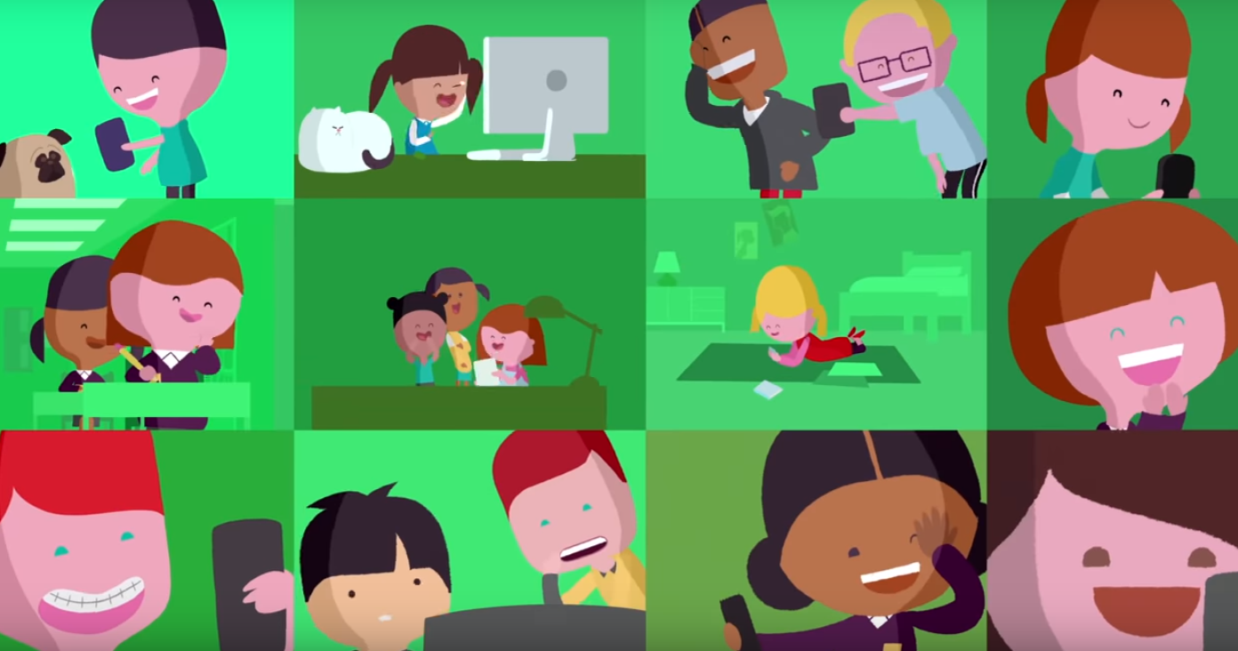
Why was it so quick and easy for everyone to see the picture?

Slide 5
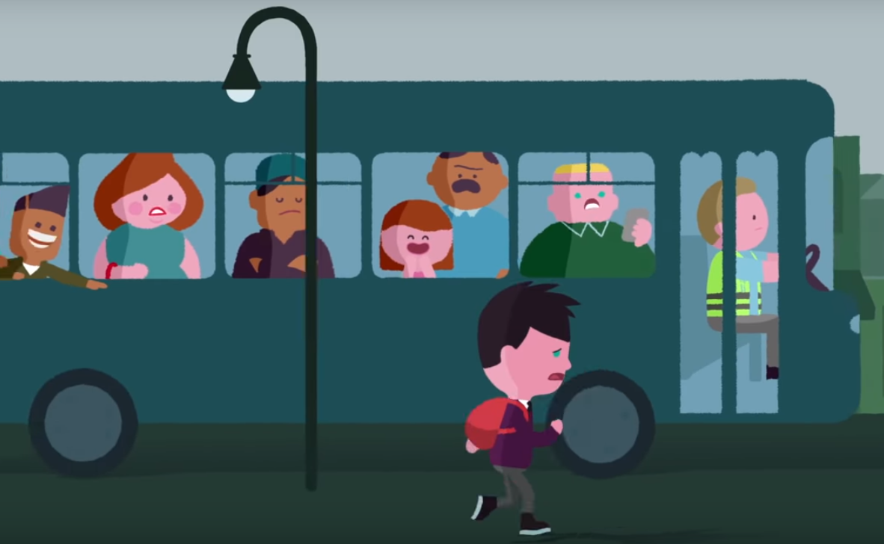
How did Alex feel now?

Slide 6
He probably felt like he was all alone, and that no-one could help him. But that is not true.

Slide 7
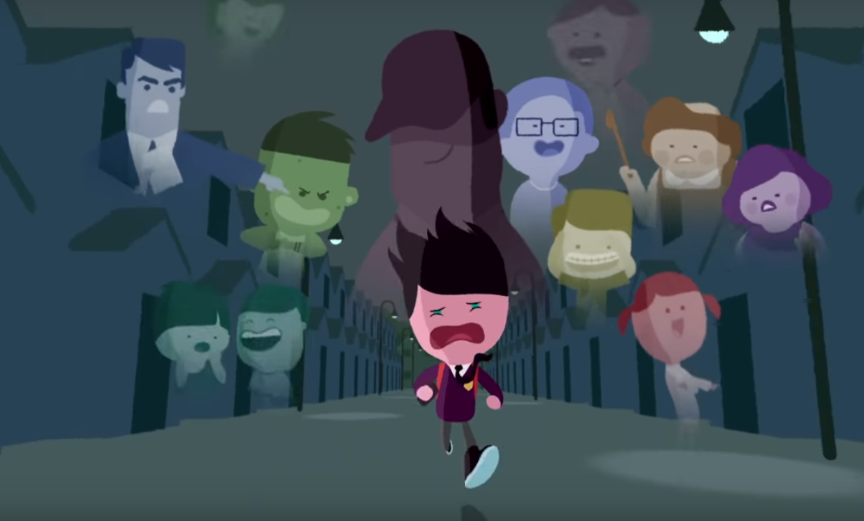
What made Alex decide that he had to get help?
Was this the right time to get advice?

Slide 8
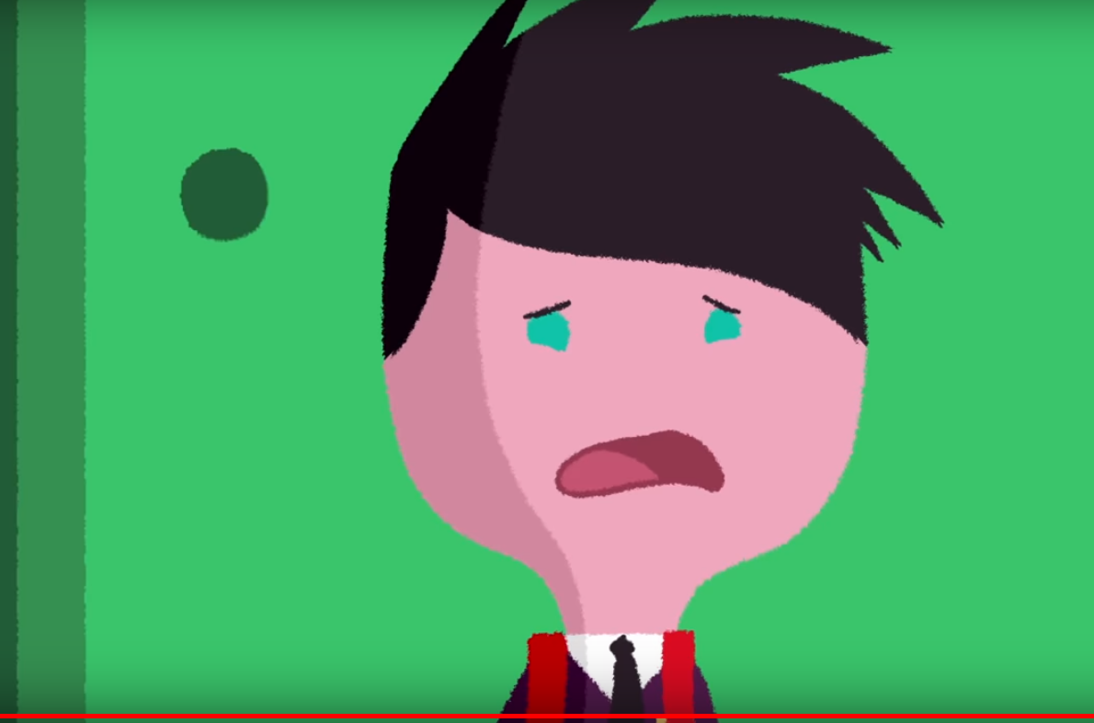
What should Alex do?

Slide 9
What should Alex do?
Tell an adult that he trusts
It is possible for the police to block images on the internet
They can give him advice
They can protect him from strangers, who might ask for more pictures
The police take this sort of thing really seriously, and will always be on your side.

Slide 10
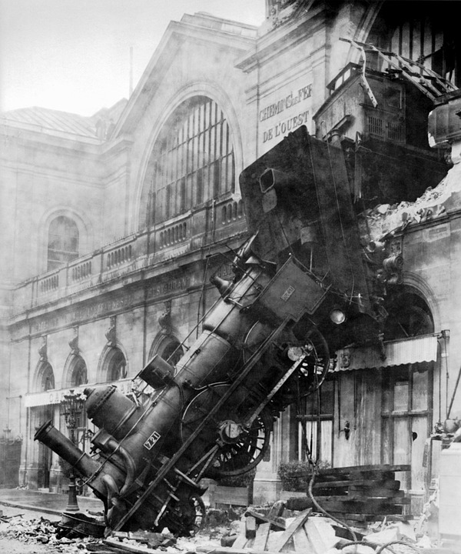
Sometimes we do silly things
Sometimes we make mistakes
This is ok!
You just have to learn what to do when things go wrong....
What can be done?
Who should I tell?
Is it my fault?
https://pixabay.com/en/train-wreck-steam-locomotive-67775/

Slide 11
Who should I tell?
An adult that you trust
Parent/carer
Older sister/brother
Auntie/uncle
School adult

Slide 12
What can be done?
The police can block images
It’s illegal to send these pictures, so they can stop people from doing that
Adults can protect you from strangers
The sooner you ask for help, the better

Slide 13
Is it my fault?
Never
We all do silly things sometimes
People will forgive you for making a mistake

Slide 14
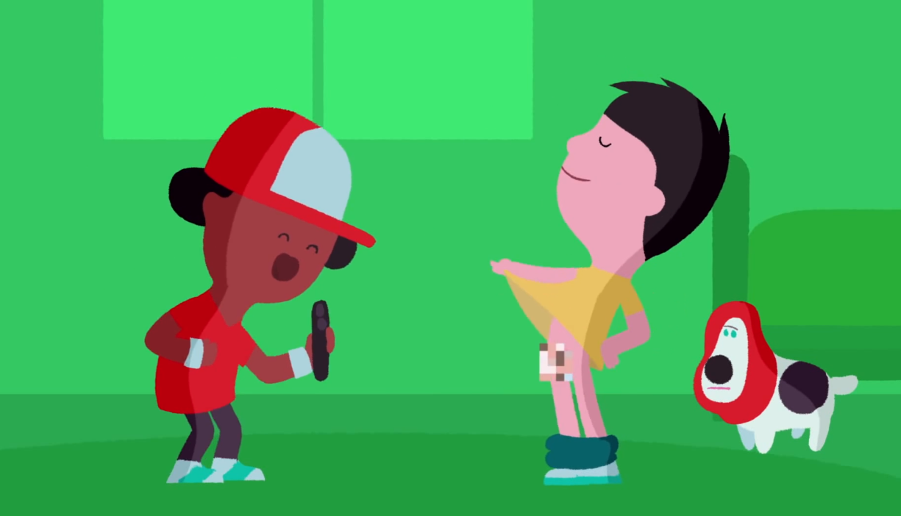
Task - Create a poster with advice and reassurance for Alex, using guidance from Help sheet and the pictures.
What should Alex have done?
Alex should have said “no” and shouldn’t have let his friend take the photo.
What mistake is being made?
Alex is posing for the photo.

