Slide 1
Learning Objectives
To practise our descriptive writing skills to create effective settings
Key words:
Metaphor
Simile
Personification
Synonym

Slide 2
Starter (5 minutes)
Below are some very boring and nondescript words. How many synonyms can you think of for each?
Synonym - A synonym is a word or phrase that means exactly or nearly the same as another word or phrase in the same language
HOT COLD GOOD BAD

Slide 3
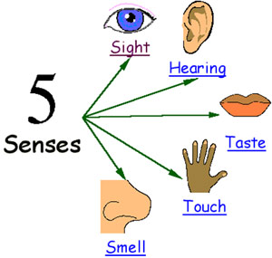
Setting
When you write about a setting, you need to make sure you use lots of description so a reader can picture themselves there.
Effective descriptions appeal to the senses.

Slide 4

One morning there was a different smell in the air, and the ship was moving oddly, with a brisker rocking from side to side instead of the plunging and soaring. Lyra was on deck a minute after she woke up, gazing greedily at the land: such a strange sight, after all that water, for though they had only been at sea a few days, Lyra felt as if they’d been on the ocean for months. Directly ahead of the ship a mountain rose, green-flanked and snow capped, and a little town and harbour lay below it: wooden houses with steep roofs, an oratory spire, cranes in the harbour, and clouds of gulls wheeling and crying. The smell was of fish, but mixed with it came land smells too: pine-resin and earth and something animal and musky, and something else that was cold and blank and wild: it might have been snow. It was the smell of the North.
SIGHT
HEARING
Seals frisked around the ship, showing their clown-faces above the water before sinking back without a splash. The wind that lifted spray off the white-capped waves was monstrously cold, and searched out every gap in Lyra’s wolfskin.
TOUCH
TASTE
SMELL

Slide 5
TASK: You are going to be shown a selection of different settings. Choose an image and write a description of the setting, including a specific language device.

Slide 6
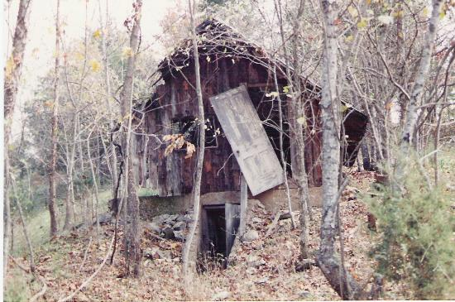

Vocabulary ideas: dilapidated, overgrown, wilderness, lonely, broken.
Describe this setting. You must include a simile (comparing two things using like or as e.g. The house shrivels and rots like a piece of discarded fruit).

Slide 7
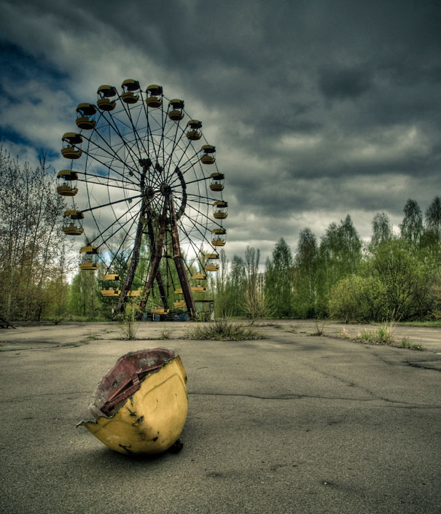

Vocabulary ideas: Menacing, abandoned, hostile, tragic, rotten
Describe this setting. You must include an example of personification (e.g. the clouds scowled)

Slide 8
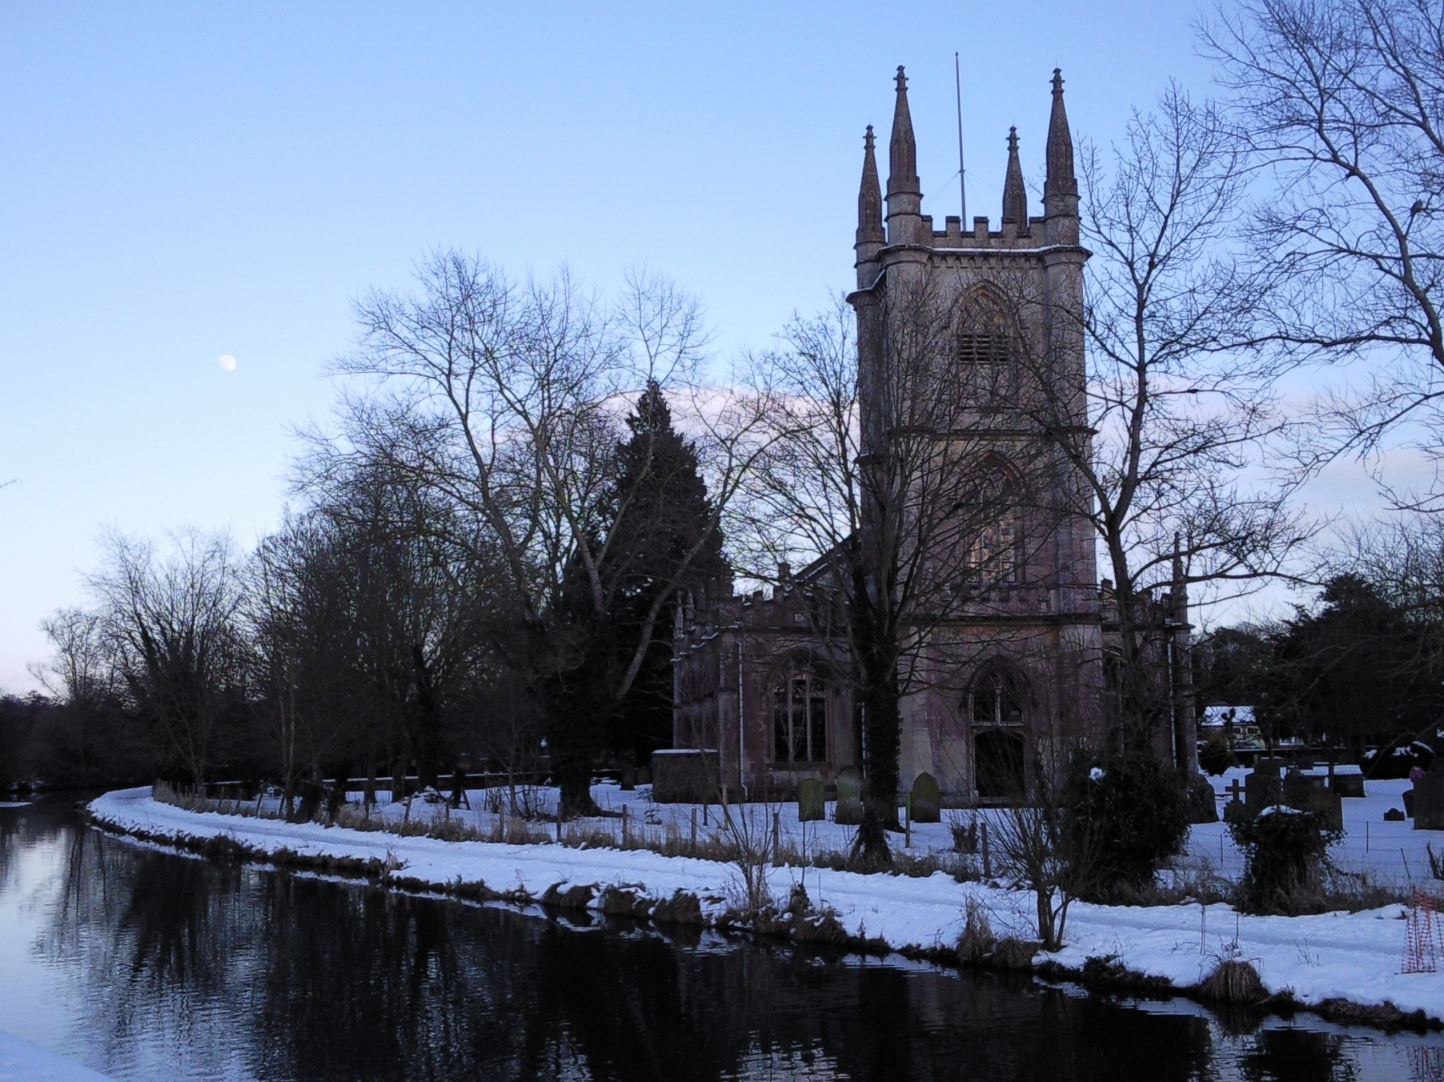

Vocabulary ideas: majestic, crisp, peaceful
Describe this setting. You must include a metaphor (saying something is something else e.g. the snow is soft velvet)

Slide 9
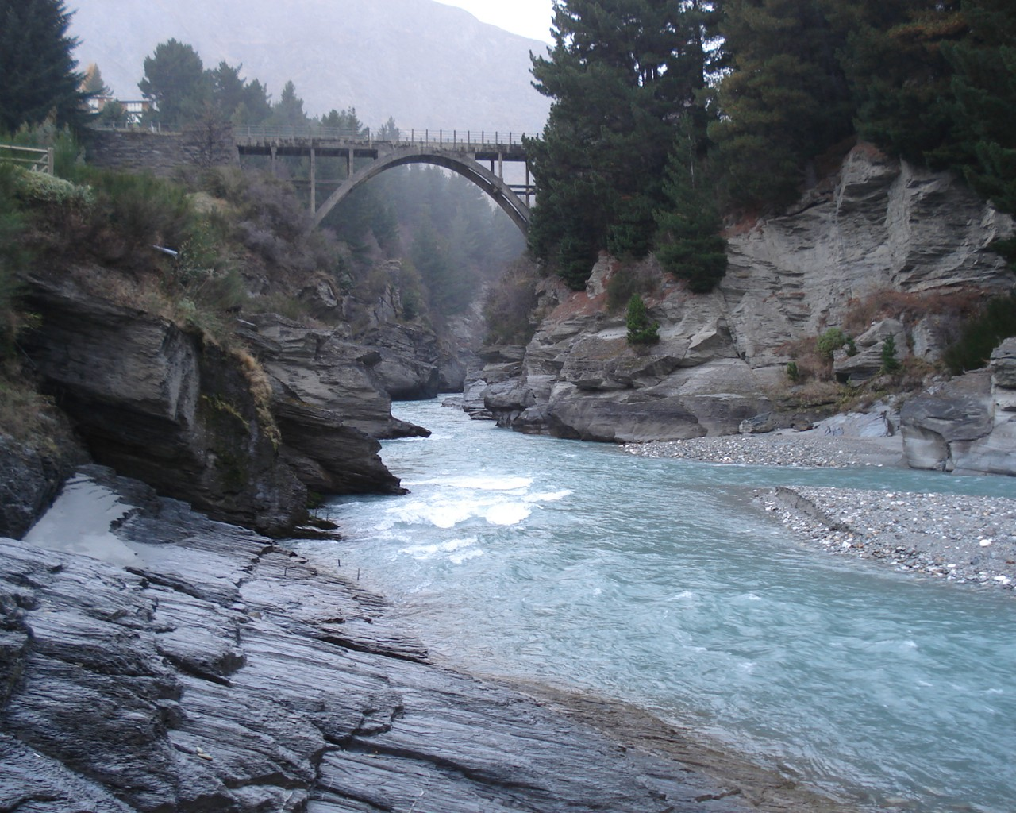

Vocabulary ideas: powerful, relentless, meanders , unforgiving
Describe this setting. You must include a simile (comparing two things using like or as e.g. The rocks jut out like...).

Slide 10
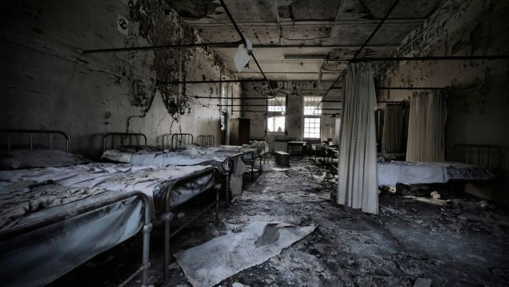
Vocabulary ideas: Sinister, Menacing, Evil, Intimidating
Describe this setting. You must include a simile (comparing two things using like or as e.g. The walls crumbled like hot ash.

Slide 11
Self assessment
Read through your paragraph. Have you included:
Interesting verbs
Interesting adverbs
A simile
A metaphor
Which senses have you appealed to?

