Slide 1
PSHE and Citizenship
Health and Wellbeing | Looking After Your Wellbeing
PSHE and Citizenship | Age 9-11 | Home Learning | Health and Wellbeing | Looking After Your Wellbeing

Slide 3


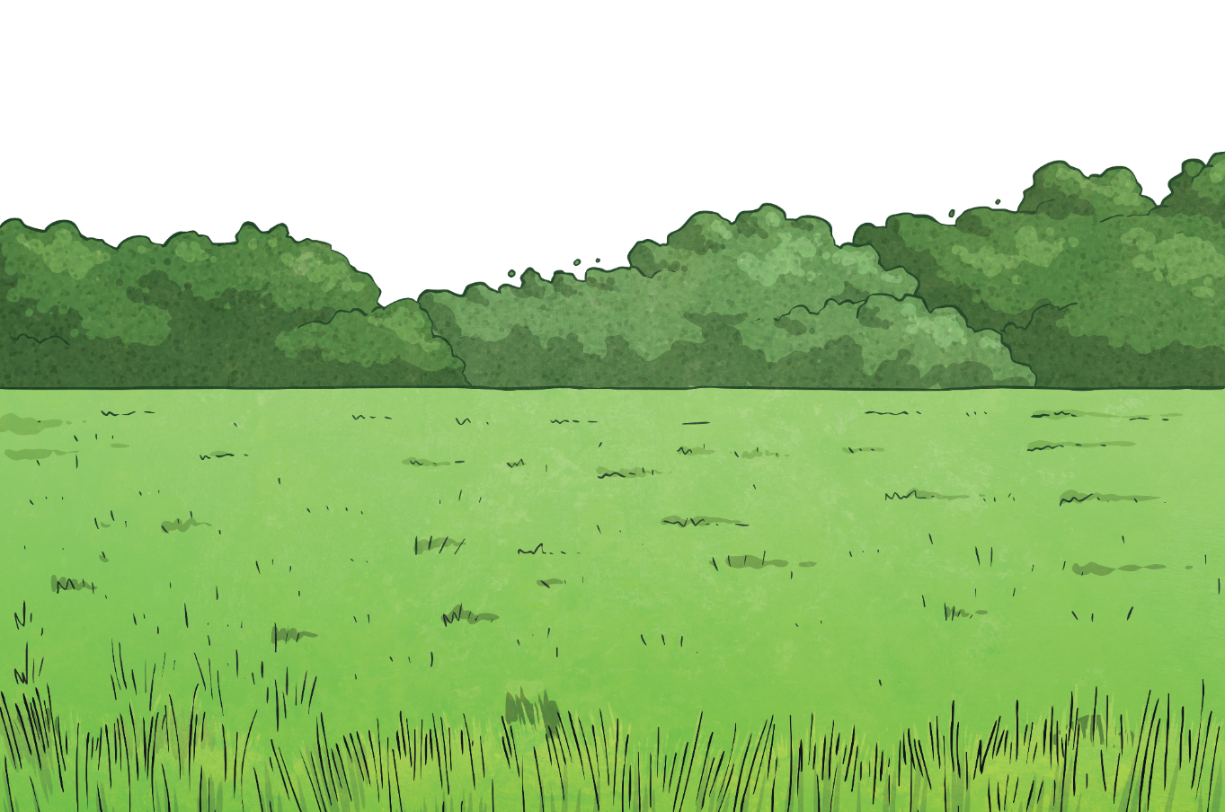
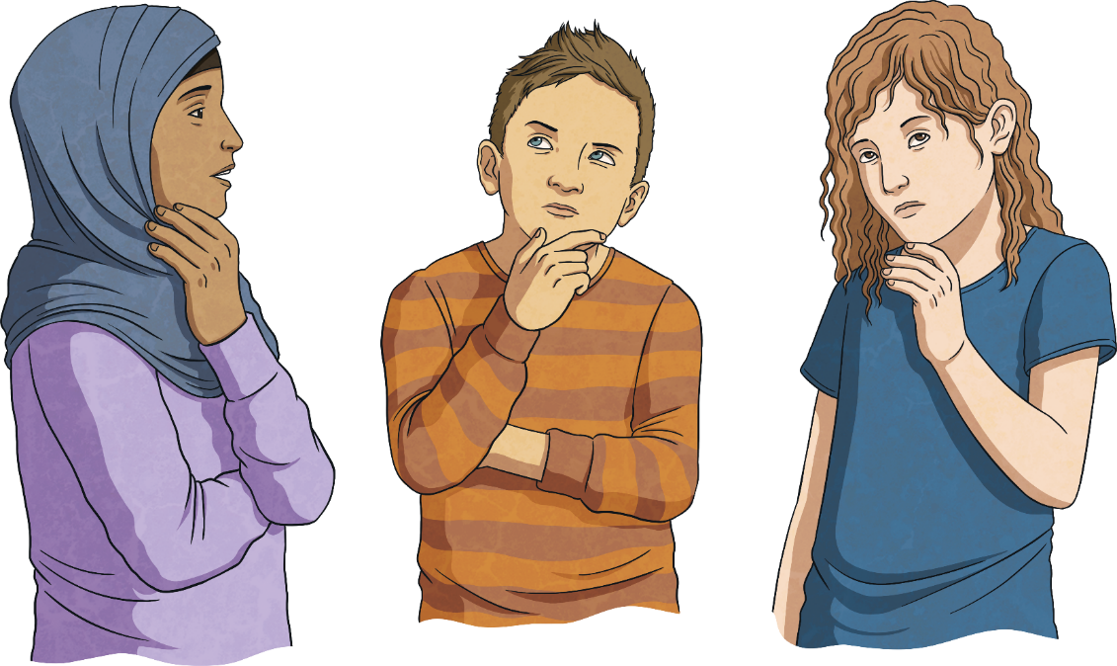
What is wellbeing?
How can I look after my own wellbeing?

Slide 4



What Is Wellbeing?
When you try to look after your own wellbeing, you think about:
how comfortable you are (both physically and mentally);
how healthy you are (both physically and mentally); and
how happy you are.
Wellbeing is explained as feeling…
comfortable,
healthy,
or happy.
If life changes, you may feel a lack of control, which can then make you feel unsettled. This can affect your wellbeing and how you feel. Changes can take you out of your comfort zone and make you see life a bit differently; all of which can be unsettling.

Slide 5
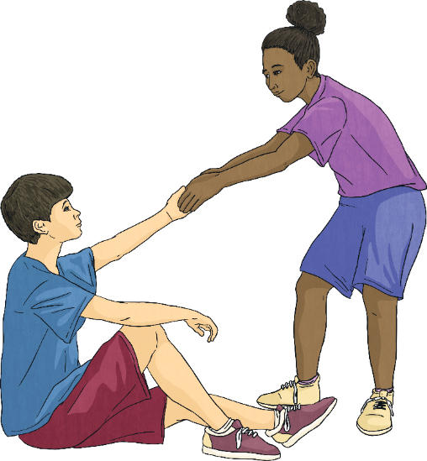
Support Networks
When you are looking after your own wellbeing, it is important to realise how much other people can help and support you.
As well as this, you can be there to support and help others. Often, focusing on other people can benefit your own wellbeing, as it helps you to feel good and positive.
Helping other people can make you feel needed and your support for them creates a support network for you when, or if, you need it.
It is important to reach out to others and say when you need help and support.
Remember, other people will feel good from helping you.

Slide 6
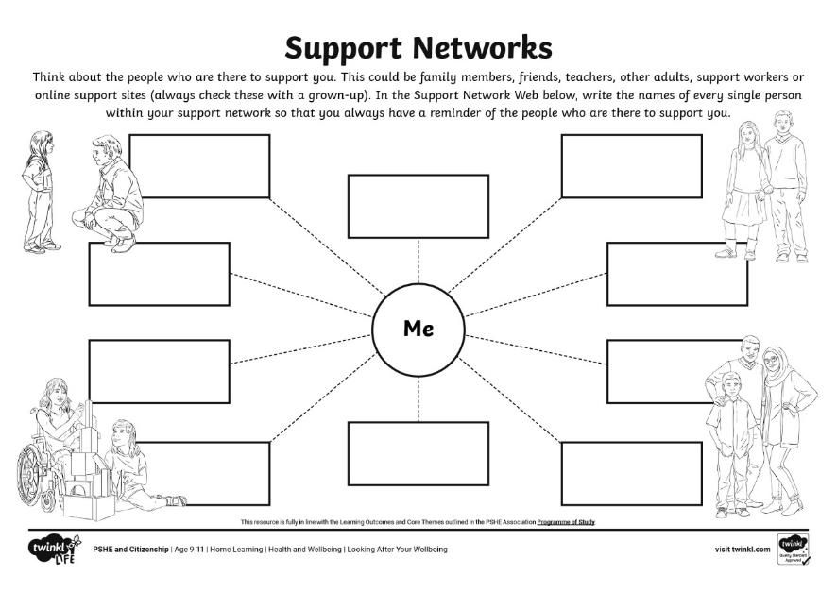
Support Networks
Use this Support Networks Activity Sheet to realise who is within your network of support.
Remember, you can go to anyone you feel comfortable talking to within your support network.

Slide 7

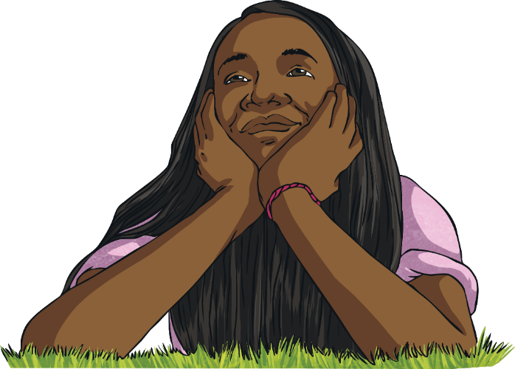

The Future
Think about:
How will life be different?
What will you do more of?
What will you do less of?
What will you worry about less?
How will you spend your time?
Whenever you are going through changes or a difficult situation, it can feel hard to see beyond the day or the situation you are living in.
While it can be sensible to think of life in this way, it can also be helpful to think about the future in a positive way as well.
Your future is ready and waiting for you!
These thoughts can help you to see the positive that can come from even the most difficult situations.

Slide 8
The Big Questions

Slide 9
What is wellbeing?
How can I look after my own wellbeing?

