Slide 1
Keeping control:
Protecting Ourselves Online
Losing control of images, identifying flattery and managing our self-esteem and confidence

Slide 2
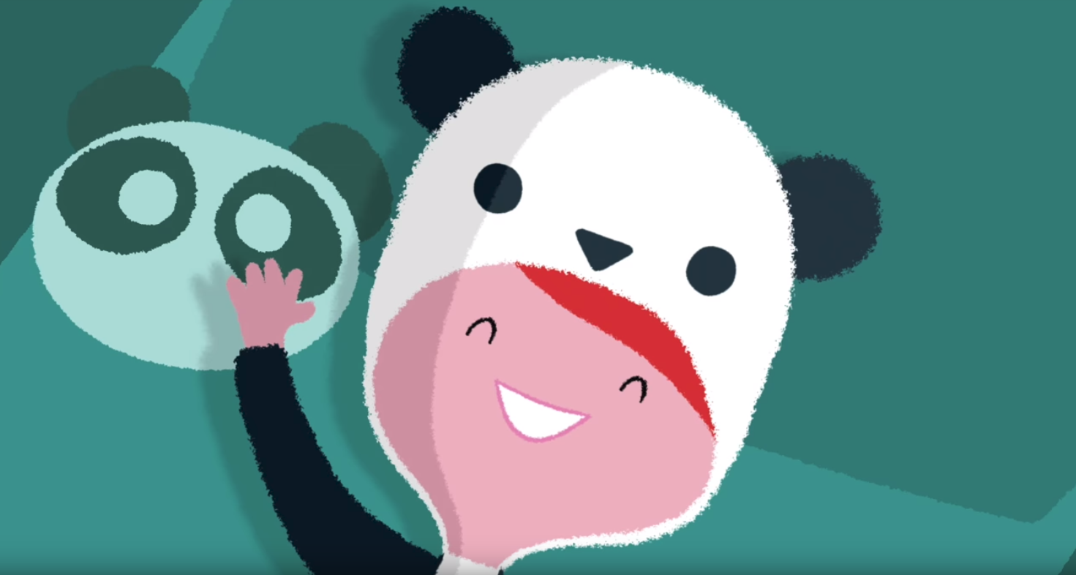
Watch NSPCC Video
“Lucy and the Boy”
https://www.youtube.com/watch?v=kwcL-VP3FYc

Slide 3
Lucy and the Boy
Q.
Why was Lucy enjoying chatting to this stranger (‘Superb0y’) online?
A.
She likes to share things
It was exciting
He flattered her
He made her feel special

Slide 4
Lucy and the Boy
Q.
How could Lucy tell that Superb0y was her age?
A.
He wasn’t!
She couldn’t tell, because he lied on his profile and probably had a fake picture
You can say anything on the internet

Slide 5
Lucy and the Boy
Q.
What were the warning signs, which Lucy should have spotted?
A.
He asked about her pants
He was giving inappropriate compliments
He was flattering her
He was a stranger, but he wanted to meet up in real life

Slide 6
Lucy and the Boy
Q.
What advice would you give to Lucy?
A.
Tell her parents/carers
Don’t give away personal information
Look out for warning signs
(flattery, inappropriate questions)

Slide 7
Types of flattery/manipulation...
Some types of flattery are based on your appearance, whilst some is based on your personality, the things that you say and the things that you do…
Which do you think is more important?

Slide 8

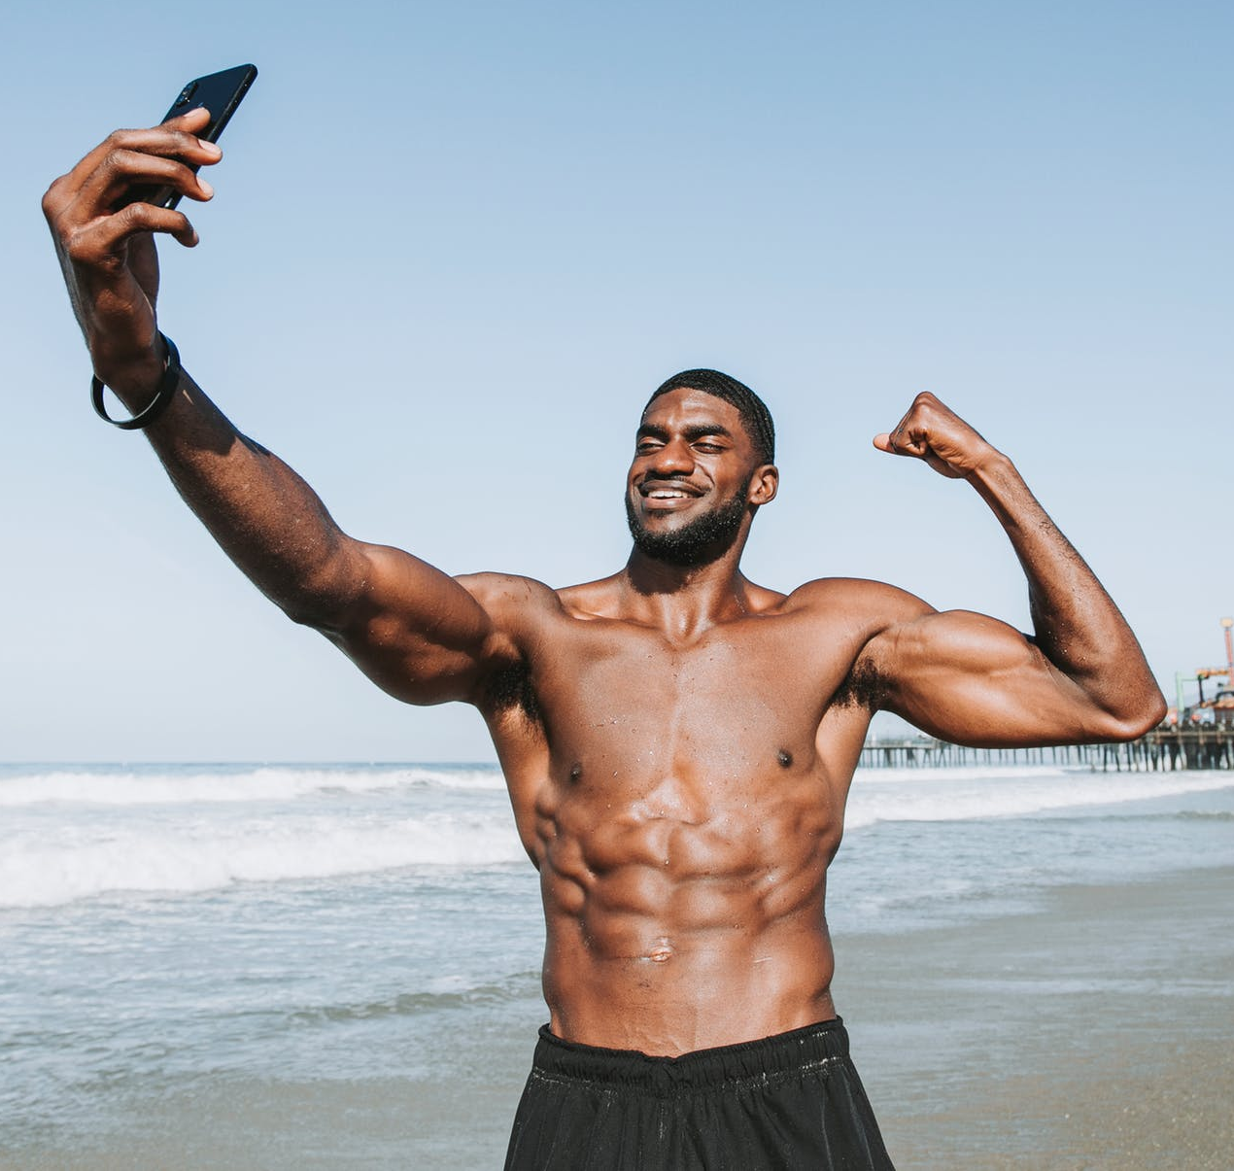
Is being flattered a good thing, or bad?
We all like to hear nice things about ourselves
But what if someone is only complimenting the way we look?
What might be the problem here?
https://www.pexels.com/photo/standing-man-on-seashore-taking-selfie-1437864
https://www.pexels.com/photo/girl-lying-on-yellow-flower-field-during-daytime-160699/

Slide 9
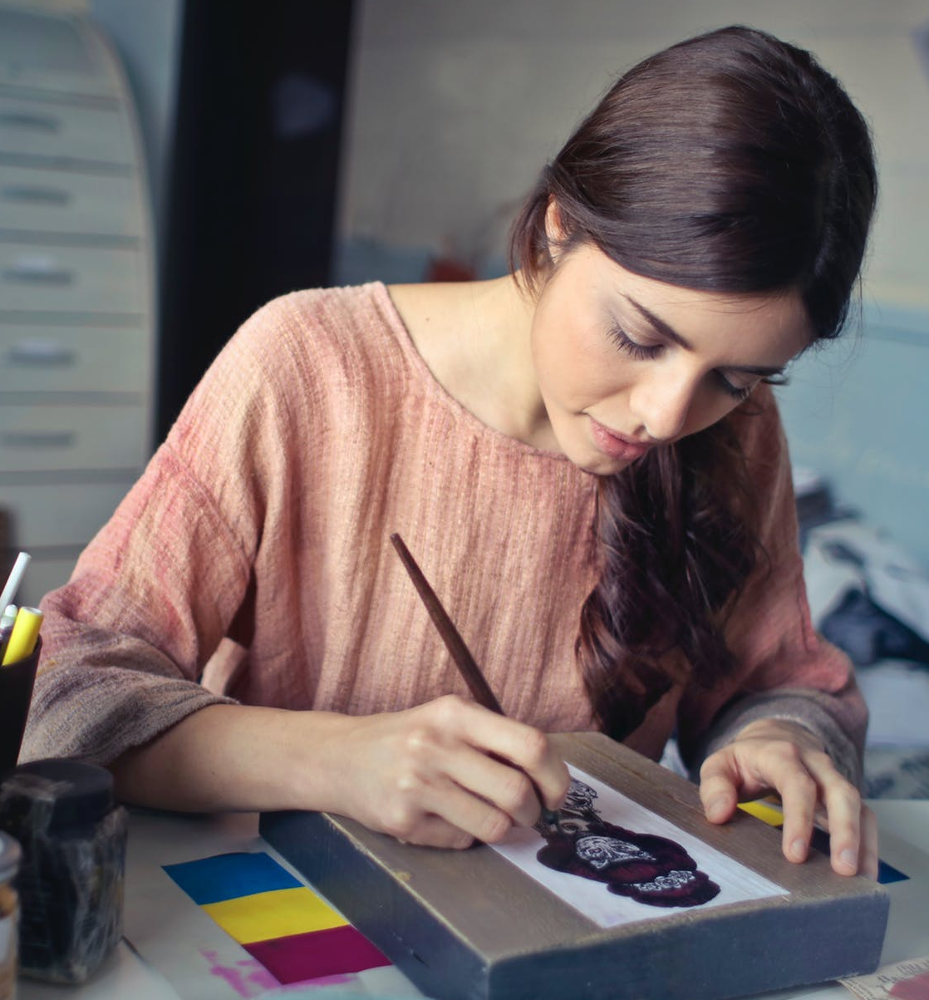
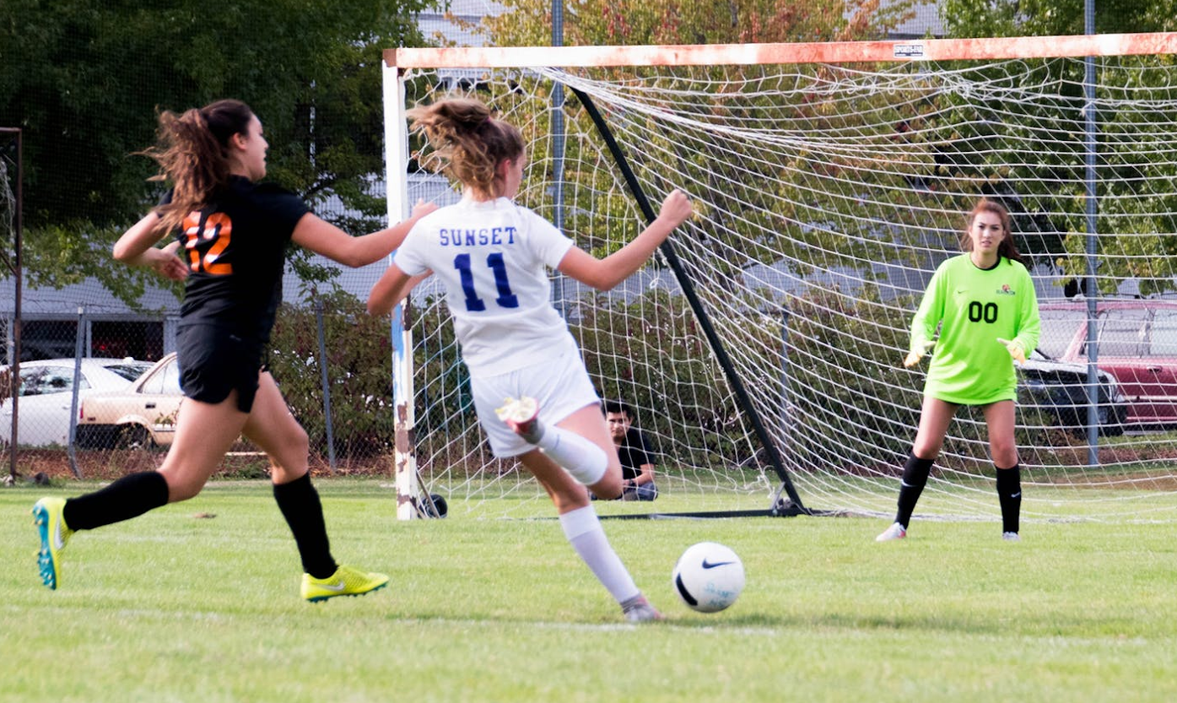
More than looks...
It’s ok to look good, so long as it isn’t the only thing that you care about…
There are many parts of your personality, and you have many skills. These are important too.
https://www.pexels.com/photo/woman-in-brown-scoop-neck-long-sleeved-blouse-painting-933255/
https://www.pexels.com/photo/three-women-playing-soccer-game-685382/

Slide 10


You are an amazing person
Personality
Freepik by Flaticon
Notes:
Click to reveal answer
10

Slide 11

Wow you are beautiful
Looks/appearance
Freepik by Flaticon
Notes:
Click to reveal answer
11

Slide 12

Your body looks good
Looks/appearance
Freepik by Flaticon
Freepik by Flaticon
Notes:
Click to reveal answer
12

Slide 13
You are really kind
Personality
Freepik by Flaticon
Notes:
Click to reveal answer
13

Slide 14

Your hair is really cool
Looks/appearance
Freepik by Flaticon
Notes:
Click to reveal answer
14

Slide 15

You have really good ideas
Personality
Freepik by Flaticon
Notes:
Click to reveal answer
15

Slide 16

You look so strong
Looks/personality
Freepik by Flaticon
Notes:
Click to reveal answer
16

Slide 17

You look like a model
Looks/appearance
Freepik by Flaticon
Notes:
Click to reveal answer
17

Slide 18

You make me really happy
Personality
Freepik by Flaticon
Notes:
Click to reveal answer
18

Slide 19

You are very thoughtful
Personality
Freepik by Flaticon
Notes:
Click to reveal answer
19

Slide 20

More than looks...
If someone focusses on your looks alone, this is a danger sign.
They might be trying to manipulate you!
https://www.pexels.com/photo/brown-wooden-mouse-trap-with-cheese-bait-on-top-633881/

Slide 21
Manipulation tactics
How was Lucy being Manipulated?
https://www.youtube.com/watch?v=kwcL-VP3FYc
https://www.pexels.com/photo/brown-wooden-mouse-trap-with-cheese-bait-on-top-633881/

Slide 22
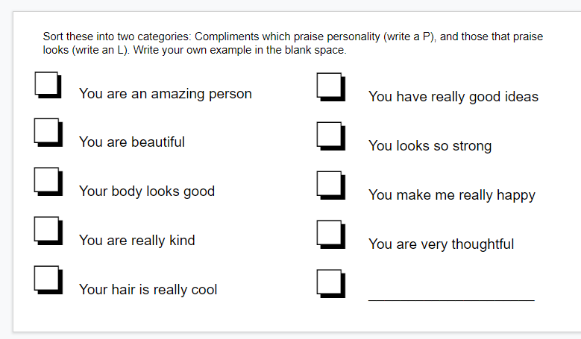

Slide 23
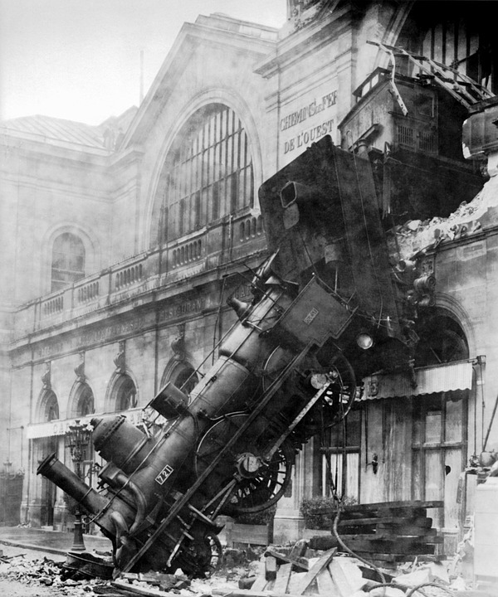
Sometimes we do silly things
Sometimes we make mistakes
This is ok!
You just have to learn what to do when things go wrong....
What can be done?
Who should I tell?
Is it my fault?
https://pixabay.com/en/train-wreck-steam-locomotive-67775/

