Slide 1


Slide 3
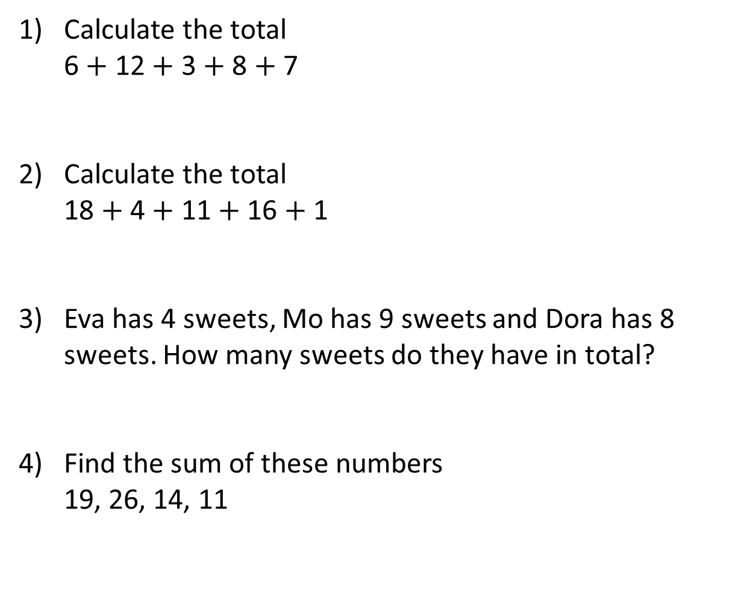
Calculate the total
6 $+$ 12 $+$ 3 $+$ 8 $+$ 7
2) Calculate the total
18 $+$ 4 $+$ 11 $+$ 16 $+$ 1
3) Eva has 4 sweets, Mo has 9 sweets and Dora has 8 sweets. How many sweets do they have in total?
4) Find the sum of these numbers
19, 26, 14, 11

Slide 4
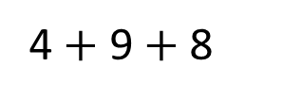
Calculate the total
6 $+$ 12 $+$ 3 $+$ 8 $+$ 7
2) Calculate the total
18 $+$ 4 $+$ 11 $+$ 16 $+$ 1
3) Eva has 4 sweets, Mo has 9 sweets and Dora has 8 sweets. How many sweets do they have in total?
4) Find the sum of these numbers
19, 26, 14, 11
36
20
10
50
30
20
4 $+$ 9 $+$ 8
21 sweets
70

Slide 6
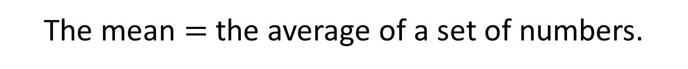
The mean $=$ the average of a set of numbers.
Allows us to calculate a ‘central’ value for a set of numbers that can allow comparisons.
The mean of these numbers is 5
5
7 3 5

Slide 7
The mean of this set of numbers is 4
4
2 6 1 3 6 6

Slide 8

Activity 1
Have a think
Use counters or blocks to find the mean of this set of numbers.
7 3 8

Slide 9
Use counters or blocks to find the mean of this set of numbers.
The mean of this set of numbers is 6
6
7 3 8

Slide 10
Activity 2
Have a think
Use counters or blocks to find the mean of each sets of numbers.
7 3 8 3 4
14 9 6 3
4 6 7 8 5 6

Slide 11
The mean of this set of numbers is 5
5
7 3 8 3 4

Slide 12
14 9 6 3
The mean of this set of numbers is 8
4 6 7 8 5 6
The mean of this set of numbers is 6

Slide 13
The mean of three numbers is 3
What could the numbers be?
3

Slide 14
The mean of three numbers is 3
What could the numbers be?
3
1 3 5
1 4 4

Slide 15
The mean of three numbers is 3
What could the numbers be?
3
2 2 5
2 3 4

Slide 16
Activity 3
Have a think
The mean of four numbers is 2
What could the numbers be?
2
1 3 2 2
1 4 1 2

