Slide 1
PSHE and Citizenship
Health and Wellbeing | Looking After Your Wellbeing
PSHE and Citizenship | Age 9-11 | Home Learning | Health and Wellbeing | Looking After Your Wellbeing

Slide 3
Aim
I understand that there are strategies and behaviours that support my mental health and wellbeing.
Success Criteria
I can think of ways I can show self-kindness.
I can list the areas I can control and the areas I can’t control.
I can think of ways to connect with other people for support.
This resource is fully in line with the Learning Outcomes and Core Themes outlined in the PSHE Association’s Programme of Study.

Slide 4
The Big Questions

Slide 5


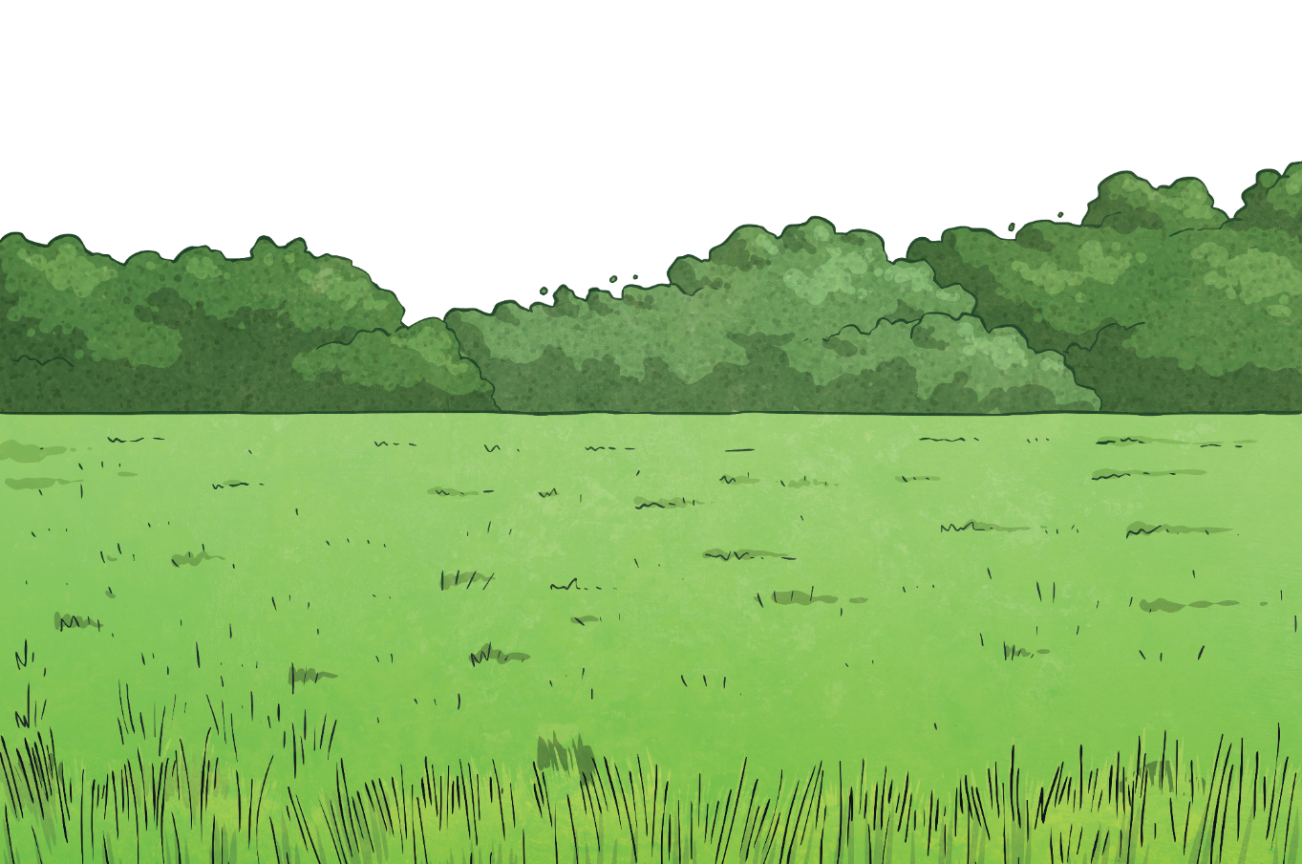
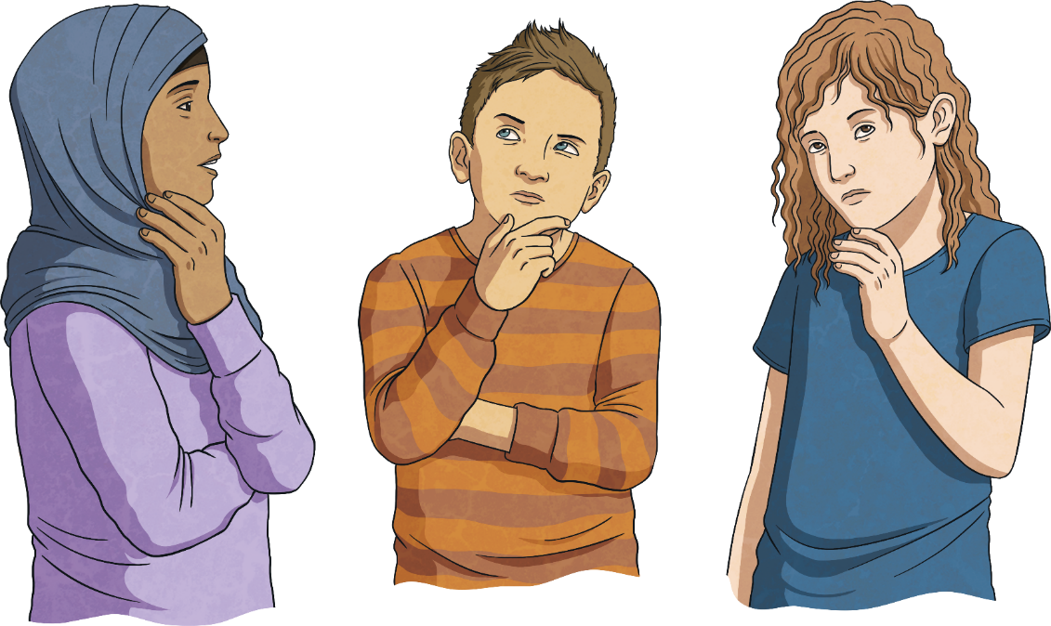
What is wellbeing?
How can I look after my own wellbeing?

Slide 6



What Is Wellbeing?
When you try to look after your own wellbeing, you think about:
how comfortable you are (both physically and mentally);
how healthy you are (both physically and mentally); and
how happy you are.
Wellbeing is explained as feeling…
comfortable,
healthy,
or happy.
If life changes, you may feel a lack of control, which can then make you feel unsettled. This can affect your wellbeing and how you feel. Changes can take you out of your comfort zone and make you see life a bit differently; all of which can be unsettling.

Slide 7
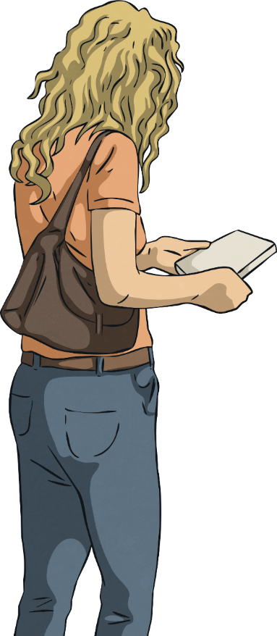
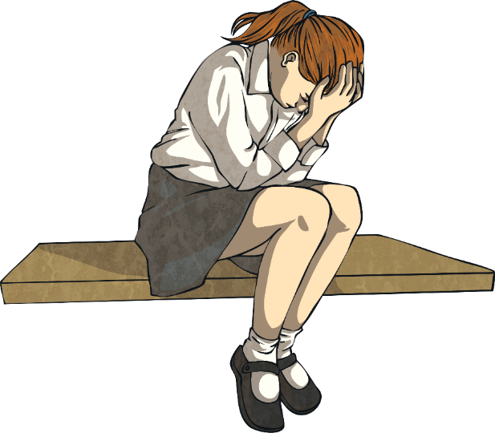
What Is Wellbeing?
When people feel anxious or worried about changes, they will try and control any areas of their life that they can.
This might not be the ‘right’ thing to do but it is often done by people trying to look after their wellbeing in the only way they know how.
When people are dealing with change, they often try and control the only things they can.
This might be what they buy from the shop or what their home looks like.
Today you will learn some other ways to look after your wellbeing, especially in a time of change.

Slide 8
Reconnecting

Slide 9
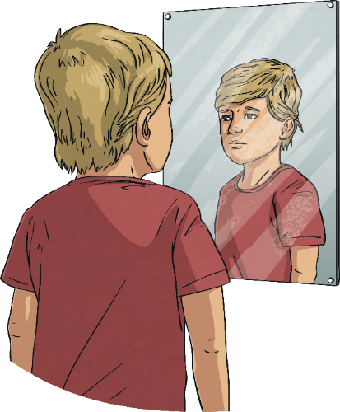
Be Kind
When change is happening in the world around you, or when things feel a bit more difficult, it is important to remember to be kind in your thoughts, words and actions.
This includes being kind to others but also being kind to yourself.

Slide 10
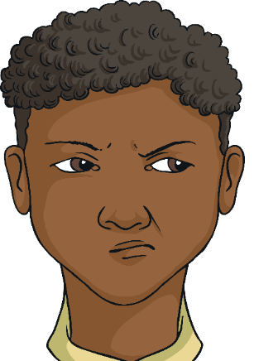
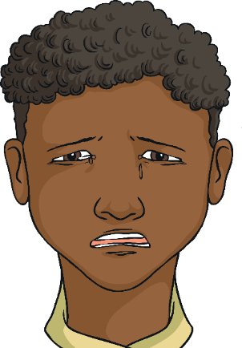

Be Kind
When deciding how to react and respond to other people, it is important to understand why they are behaving in a certain way, as well as their emotions or situation. This understanding can help you decide how to interpret their behaviour and words but also how to forgive and be kind, if necessary.
How could you show yourself some kindness?
It is also important to have the same patience and understanding
with yourself.

Slide 11
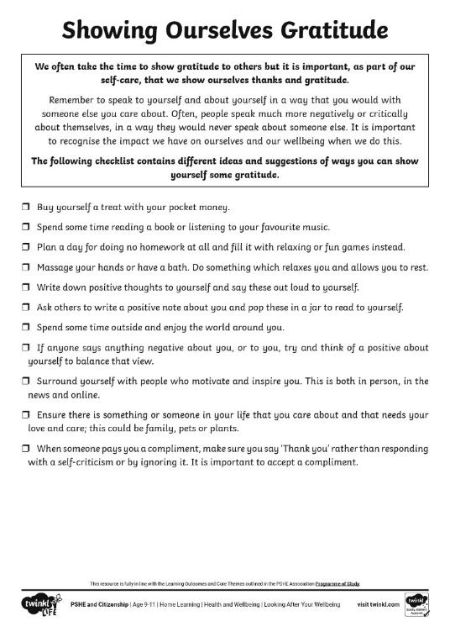
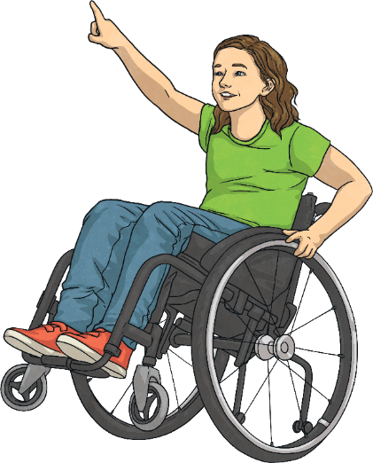
Self-Kindness
This Showing Ourselves Gratitude Activity Sheet can be used to help you think about ways you can be kind to yourself and show yourself some self-care.

Slide 12
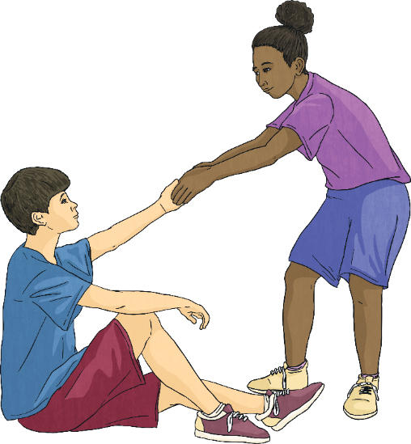
Support Networks
When you are looking after your own wellbeing, it is important to realise how much other people can help and support you.
As well as this, you can be there to support and help others. Often, focusing on other people can benefit your own wellbeing, as it helps you to feel good and positive.
Helping other people can make you feel needed and your support for them creates a support network for you when, or if, you need it.
It is important to reach out to others and say when you need help and support.
Remember, other people will feel good from helping you.

Slide 13
The Big Questions

Slide 14
What is wellbeing?
How can I look after my own wellbeing?

Slide 15
Aim
I can reflect on my learning.
Success Criteria
I can describe something I have learnt, and something I have learnt how to do.
I can explain how I can apply my learning.
I can set a goal for the future.

