Slide 1
Personification Poetry
Air raid / Blitz Poetry

Slide 2
What is personification?
It just means to give objects human qualities
It helps us to write amazing images and powerful poetry

Slide 3
Poetry
Making pictures with words is all that we are trying to do
IT DOES NOT NEED TO rrrrrrrrrr something?
Rhyme !!!

Slide 4
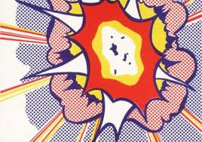
The best pictures have bright colours

Slide 5
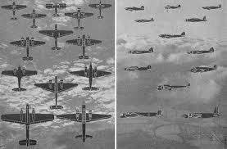
So the best poetry has the best images
War planes fly over head
Aiming to drop bombs
To kill all those below

Slide 6
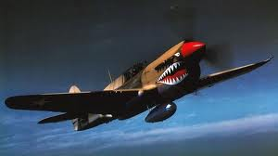
Make them seem human…!
Evil, chuckling planes fly overhead
Searching like look-outs
To drop their deadly load
Like a dart player
Accurately finishing the game
So the bombs finish us.

Slide 7
Think about bombs.. How can we make them seem human?
Black bombs falling
Down from the sky

Slide 8
Use adjectives to describe them in human terms
Boisterous noisy bombs
Whistling like teenagers
Screeching like a witch
As they fall randomly
Hitting out like a bully

Slide 9
Try it with sirens
Sirens

Slide 10
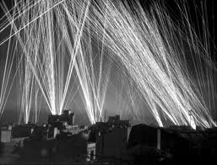
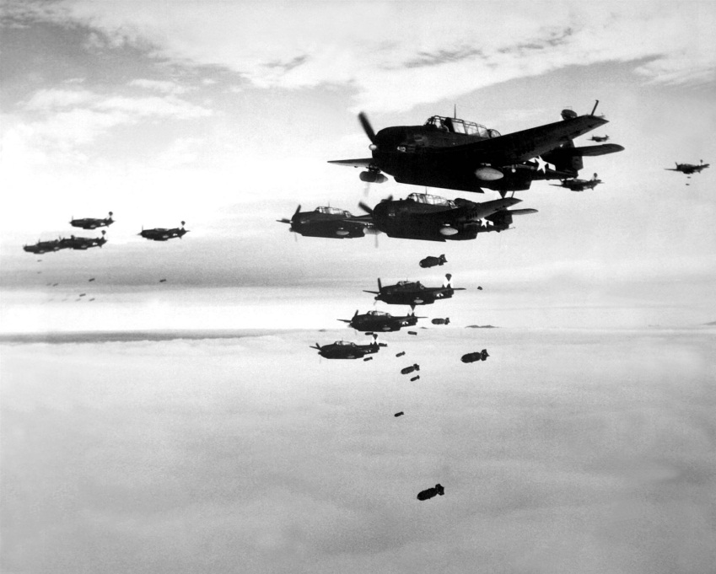
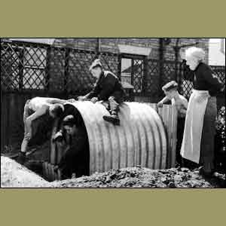
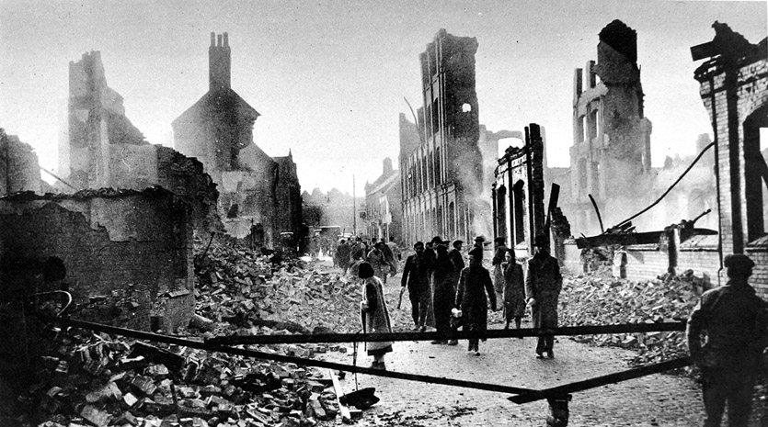
Think of what you would like in your poem….

Slide 11
.. Then think of ways to give the objects human qualities
Licking flames
Bullying bombs
Evil cackling planes
Discuss with partner and then write them in rough and we’ll put them onto dark paper with bright pens
I’ll help if needed
ENJOY THE PROCESS….

