Slide 1


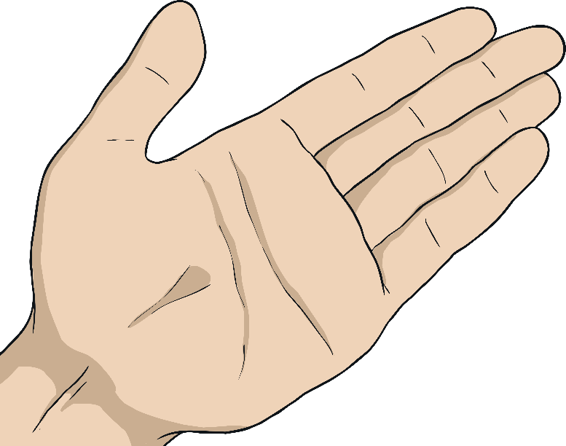
What Would You Do?
Look at the examples of some online conversations.
Use the highlighter pens to indicate where you find examples of somebody revealing something they shouldn’t online. Make notes at the side to explain why you think they shouldn’t give that information away.

Slide 2
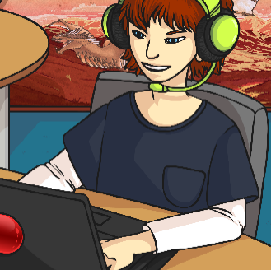




What Would You Do?
Scott2009:
It’s my birthday next week!
NoST57:
Yeah? When?
Scott2009:
On the 13th.
Scott2009 has
given away:
His real name in
his username
His birthday
Where he’ll be on Saturday morning
NoST57:
What you getting?
Scott2009:
Asking for new football boots. I play on a Saturday near Warburton.

Slide 3


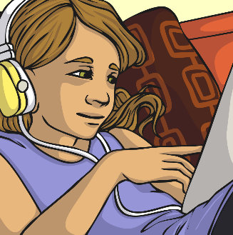




What Would You Do?
Leedsgirl41:
Been on a school trip today.
DrGamerKy:
Where to?
Leedsgirl41:
Just to Carlton Hall. It’s a place down the road from my school
DrGamerKy:
What school you go to?
Leedsgirl41 has
given away:
Her city
Where her school is
A teacher’s name…
Leedsgirl41:
Hmm… don’t think I should say online.
DrGamerKy:
Fair enough. Any favourite teachers?
What could DrGamerKy work out from this?
Leedsgirl41:
Miss Riley is pretty fun.

Slide 4


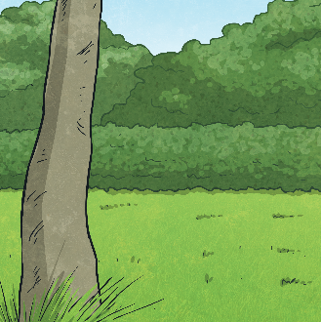
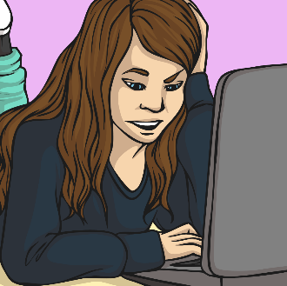



What Would You Do?
Jonesy1010:
Hi!
cAr12Ta:
Hi, who are you?
Jonesy1010:
I’m Lauren.
cAr12Ta:
Hi Lauren, do you live anywhere near Manchester?
Leedsgirl41 has
given away:
Her city
Where her school is
A teacher’s name…
Jonesy1010:
Not too far, I sometimes go into Manchester shopping
cAr12Ta:
Me too, my school is St Peters in Manchester so I get the bus in on Friday after school sometimes.
What could DrGamerKy work out from this?

