Slide 1
PSHE and Citizenship
Health and Wellbeing | Looking After Your Wellbeing
PSHE and Citizenship | Age 9-11 | Home Learning | Health and Wellbeing | Looking After Your Wellbeing

Slide 3
Aim
I understand that there are strategies and behaviours that support my mental health and wellbeing.
Success Criteria
I can think of ways I can show self-kindness.
I can list the areas I can control and the areas I can’t control.
I can think of ways to connect with other people for support.
This resource is fully in line with the Learning Outcomes and Core Themes outlined in the PSHE Association’s Programme of Study.

Slide 4
The Big Questions

Slide 5


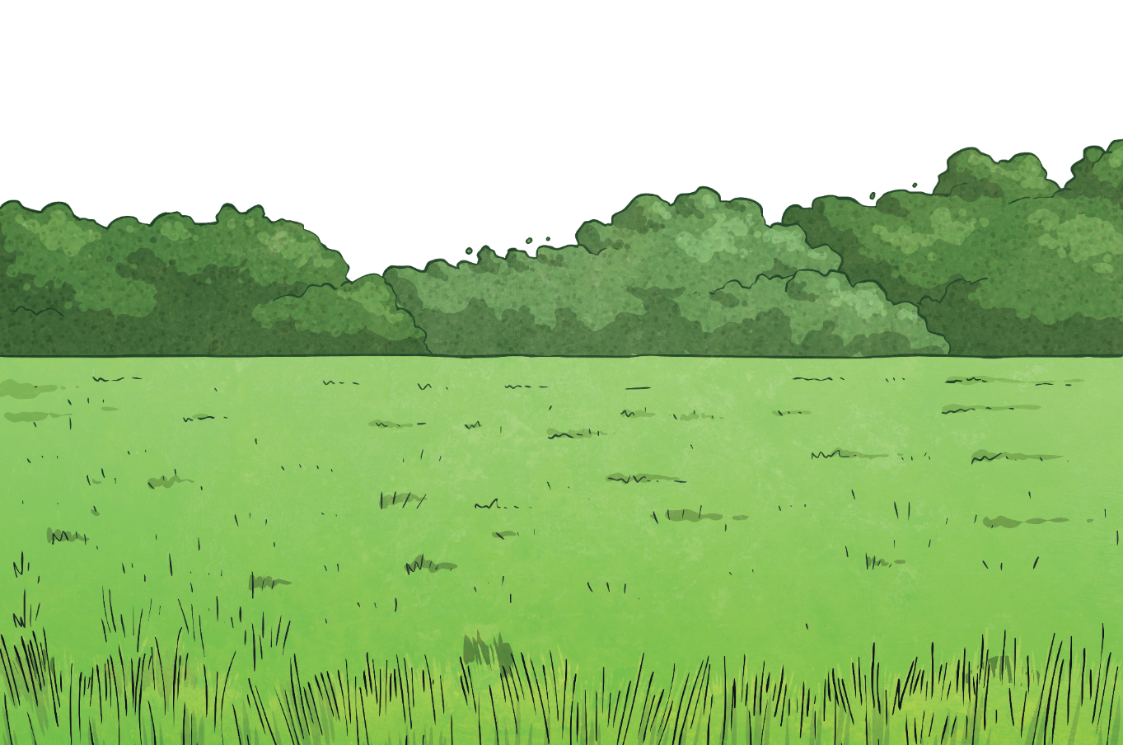
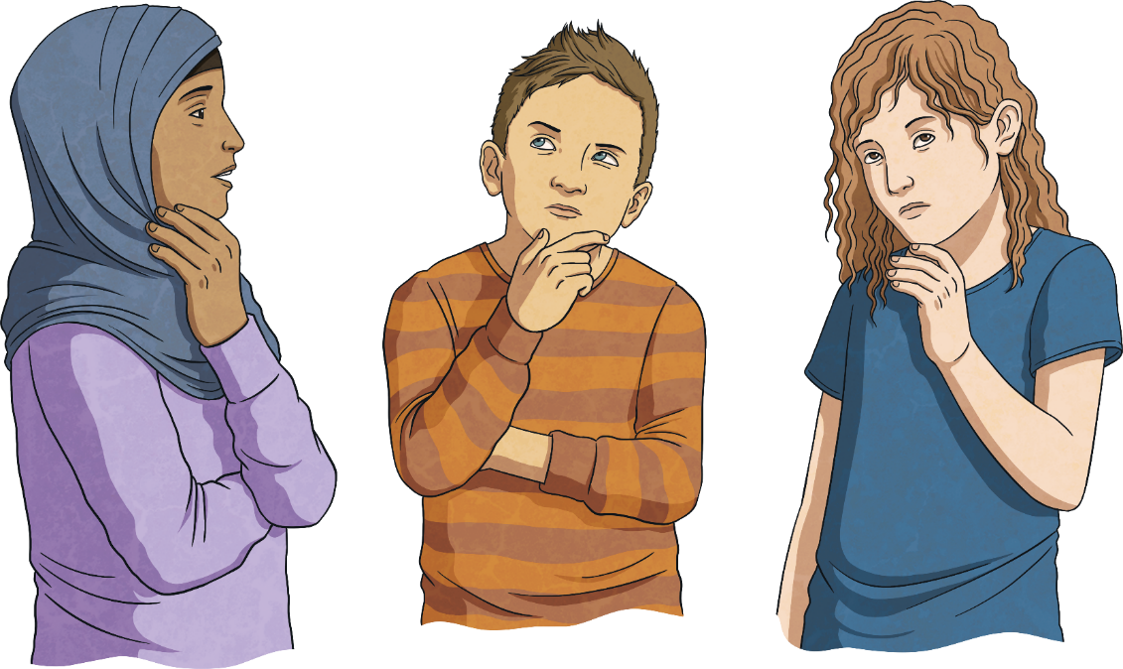
What is wellbeing?
How can I look after my own wellbeing?

Slide 6



What Is Wellbeing?
When you try to look after your own wellbeing, you think about:
how comfortable you are (both physically and mentally);
how healthy you are (both physically and mentally); and
how happy you are.
Wellbeing is explained as feeling…
comfortable,
healthy,
or happy.
If life changes, you may feel a lack of control, which can then make you feel unsettled. This can affect your wellbeing and how you feel. Changes can take you out of your comfort zone and make you see life a bit differently; all of which can be unsettling.

Slide 7
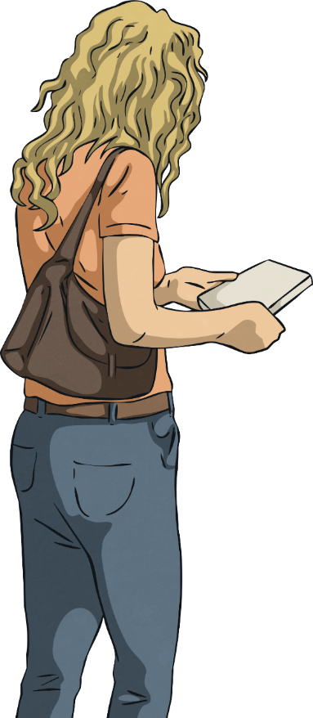
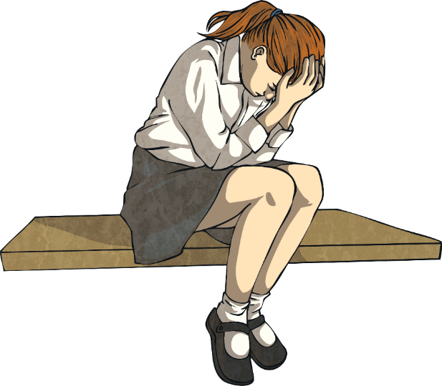
What Is Wellbeing?
When people feel anxious or worried about changes, they will try and control any areas of their life that they can.
This might not be the ‘right’ thing to do but it is often done by people trying to look after their wellbeing in the only way they know how.
When people are dealing with change, they often try and control the only things they can.
This might be what they buy from the shop or what their home looks like.
Today you will learn some other ways to look after your wellbeing, especially in a time of change.

Slide 8
Reconnecting

Slide 9
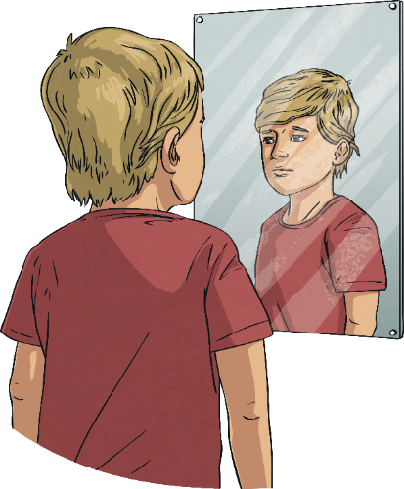
Be Kind
When change is happening in the world around you, or when things feel a bit more difficult, it is important to remember to be kind in your thoughts, words and actions.
This includes being kind to others but also being kind to yourself.

Slide 10
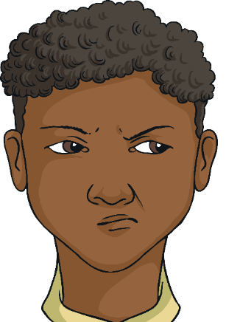
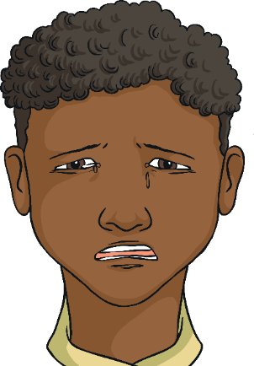

Be Kind
When deciding how to react and respond to other people, it is important to understand why they are behaving in a certain way, as well as their emotions or situation. This understanding can help you decide how to interpret their behaviour and words but also how to forgive and be kind, if necessary.
How could you show yourself some kindness?
It is also important to have the same patience and understanding
with yourself.

Slide 11
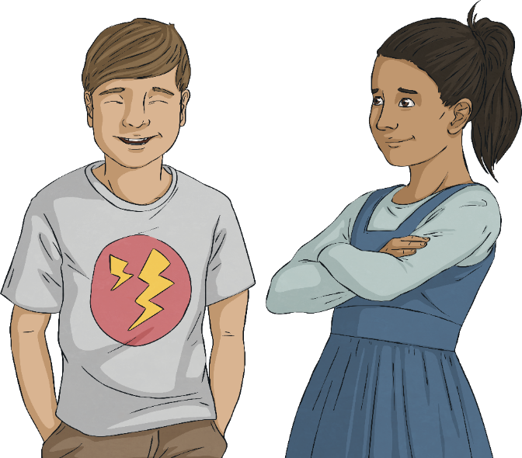
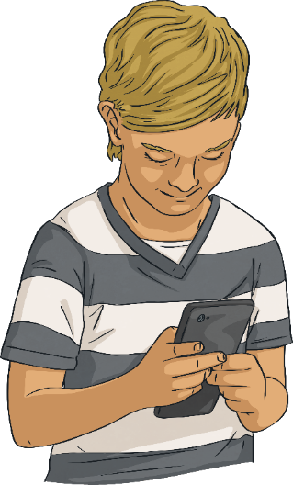
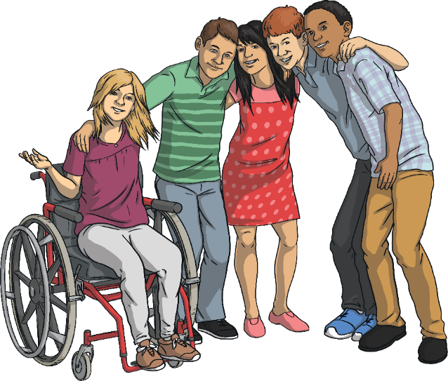
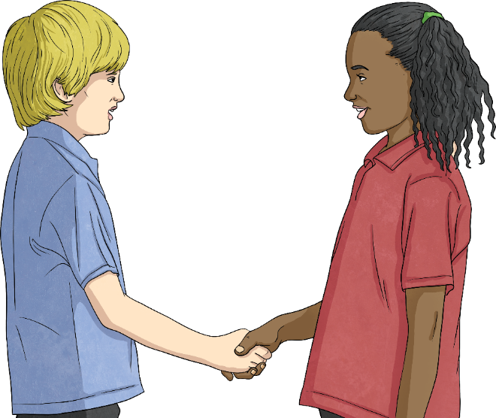
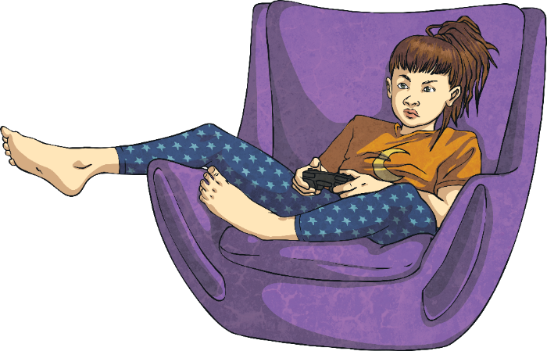
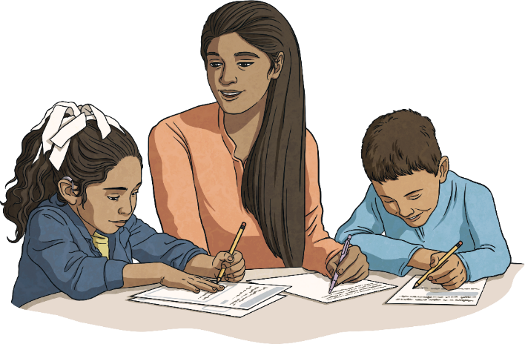
Connect with Others
Connections are a really important part of your wellbeing and for these to be strong, you need to put time and energy into creating and keeping these. It isn’t always easy but it is important for you to have others that look out for your wellbeing and support it.
An important part of wellbeing is being connected with other people. This is called a support network. You will be part of other people’s support networks, where you will support their wellbeing, and other people will be in your support network. This might include family, friends, teachers at school and members of the community.
If you are having difficulties with your wellbeing, it is really important to reach out and connect with someone in your support network.
This might be through face-to-face interactions or, if this is not possible or you’d prefer it a different way, it could be through letters, messaging, telephone calls, video calls or playing games together on the Internet (always check with your parents or carers first if you want to go online).
Who is in your support network?

Slide 12
Exploring

Slide 13
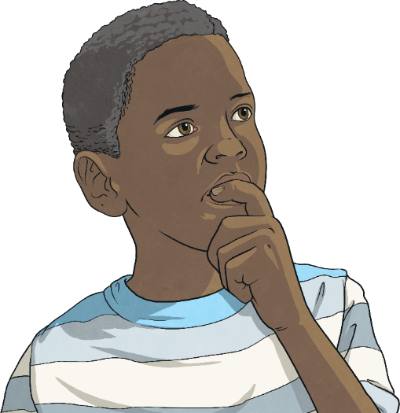
Positive Mindset
Part of coping with times of change or stress is ensuring that the way you see the situation is through a positive mindset.
This means looking for opportunities in every situation, no matter how challenging or difficult they are.
This approach can help you to:
see life in a different way;
organise or think about the priorities in your life;
value people over ‘things’;
remember what is important within your life;
recognise the value of your health and wellbeing; and
recognise the value of loving others and being loved.

Slide 14
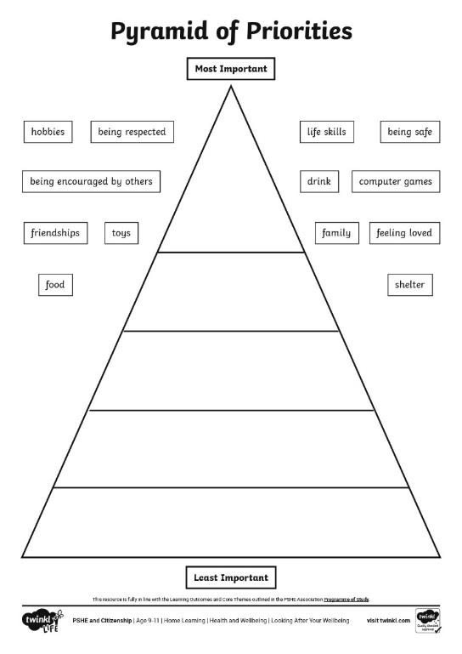
Positive Mindset
Look at the pyramid. Think about where you would put each of the different things in your own pyramid.
Discuss this with someone else in
your house and see if there are areas where you feel the same and areas where you differ.
Remember, all of the things within your triangle are important. This is about thinking which are more important to you than others. There is no ‘right’ or ‘wrong’ answers.

Slide 15
Aim
I can reflect on my learning.
Success Criteria
I can describe something I have learnt, and something I have learnt how to do.
I can explain how I can apply my learning.
I can set a goal for the future.

