Slide 1
Expectation vs. reality
Is there such thing as the perfect life?

Slide 2
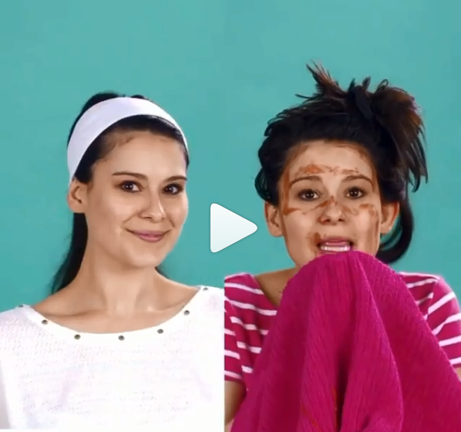


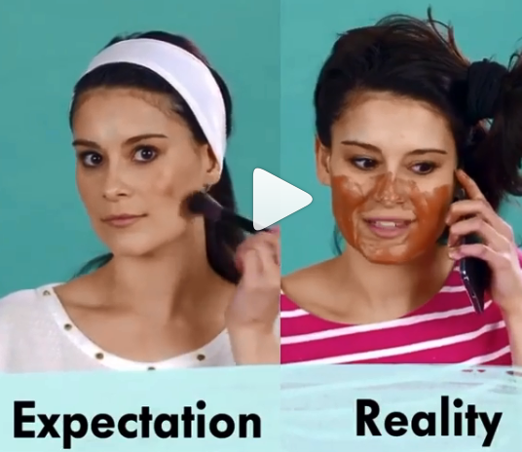
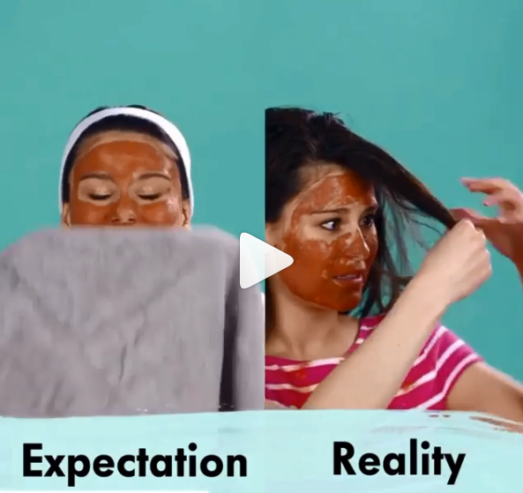
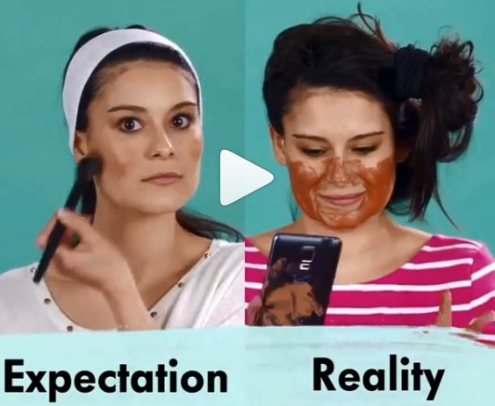
Taken from instagram account “theprettyvideo”
https://www.instagram.com/p/BWqshUFA5pH/?taken-by=womenirl

Slide 3

Expectation:
https://www.publicdomainpictures.net/en/view-image.php?image=226586&picture=shelti-dog-sitting-pretty
Photo by Karen Arnold and taken from ‘publicdomainpictures.net’

Slide 4

Reality:
https://commons.wikimedia.org/wiki/File:Pride_(9103931453)_(cropped).jpg
Photograph by Don McCullough
https://www.flickr.com/people/69214385@N04

Slide 5
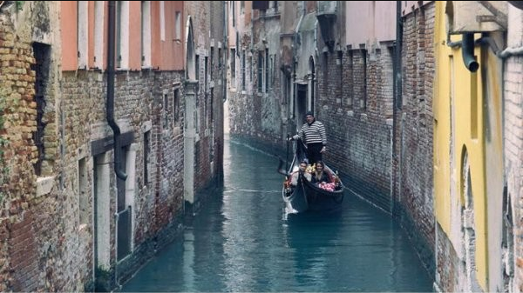
Expectations
Photo taken from ‘Pleated-Jeans.com’
https://pleated-jeans.com/wp-content/uploads/2017/11/afj-17.jpg

Slide 6
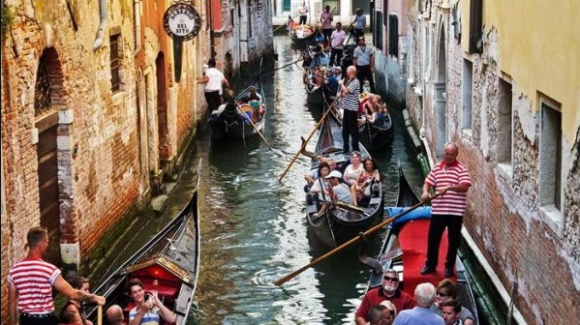
Reality
Photo taken from ‘Pleated-Jeans.com’

Slide 7
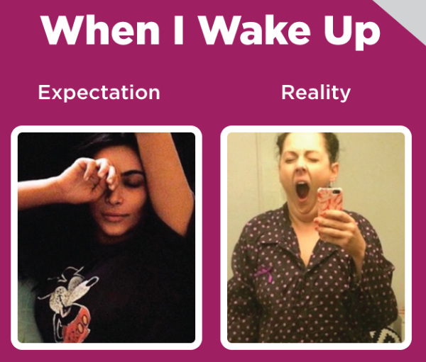
https://www.quoteistan.com/2016/11/expectation-vs-reality-when-i-wake-up.html
Photo taken from ‘quoteistan.com’

Slide 8
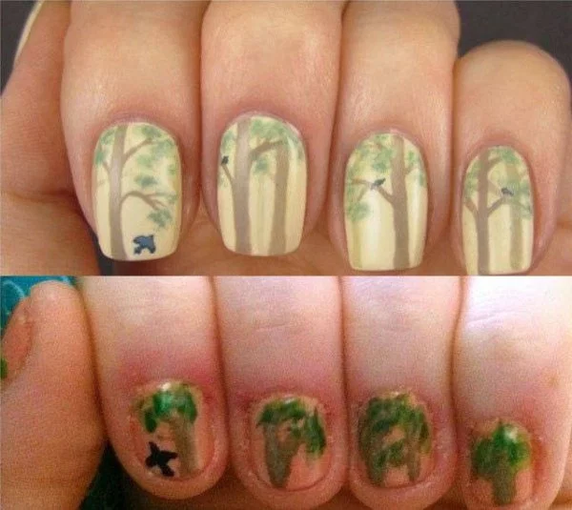
Expectations vs. Reality
https://thechive.files.wordpress.com/2017/10/expectations-versus-reality-disappointing-results-34.jpg?quality=85&strip=info&w=600
Photo taken from ‘thechive.files.wordpress.com’

Slide 9

https://www.quoteistan.com/2016/09/expectation-vs-reality-presents.html
Photo taken from ‘quoteistan.com’

Slide 10
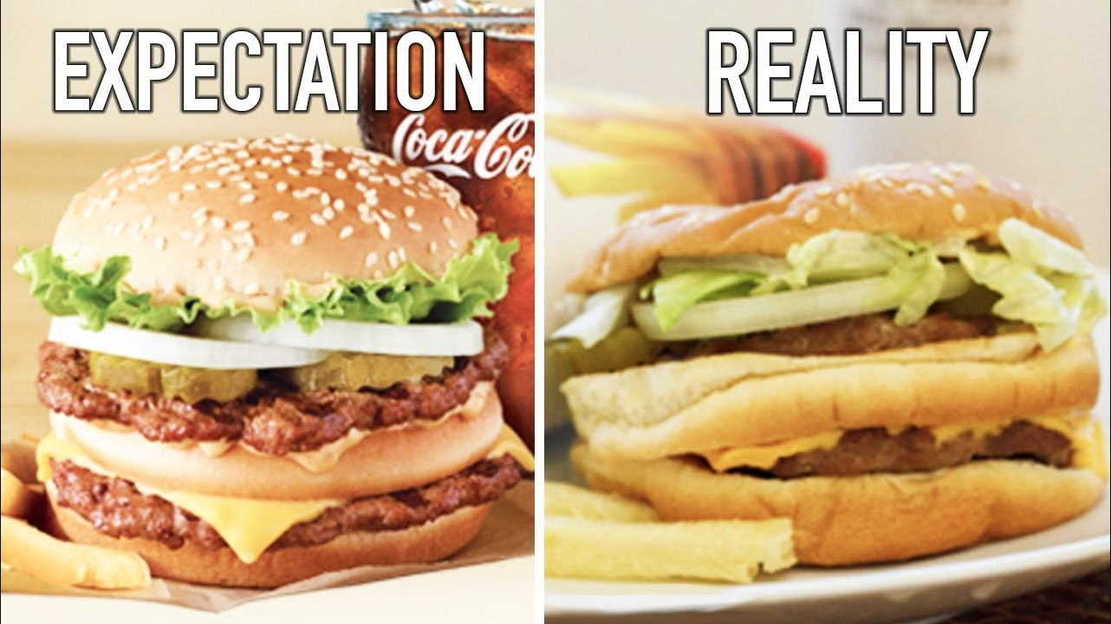
Expectations vs. Reality
https://i.ytimg.com/vi/pBHjCpUlJmo/maxresdefault.jpg
Photo taken from ‘thebalancingact.live’

Slide 11
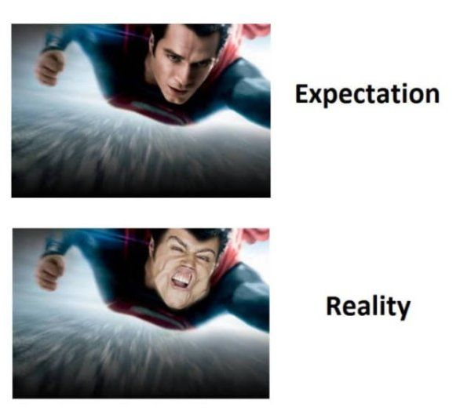
http://thetango.net/2017/11/09/expectations-vs-reality-november-9-2017-2/thetango-expectationsvsreality-1108201700/
Photo taken from ‘thetango.net’

Slide 12
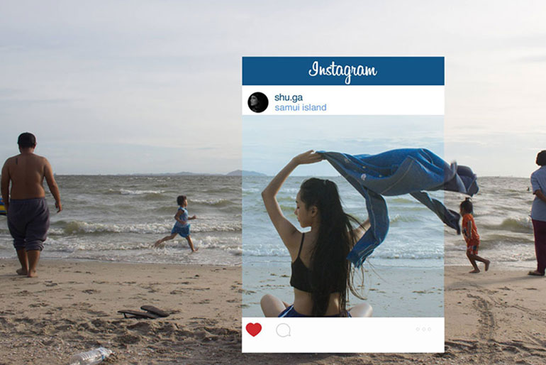
The perfect day at the beach?

Slide 13

Which photo would you put on social media?
Why do we sometimes feel the need to filter out the bad parts of reality on social media?
Saved from ‘knowyourmeme.com’
http://i0.kym-cdn.com/photos/images/newsfeed/000/498/650/595.jpg

Slide 14

Which photo would you put on social media?
Why did he take this picture (on the right) and put it on social media? What point do you think he was trying to make?
Saved from ‘knowyourmeme.com’
http://i0.kym-cdn.com/photos/images/original/000/498/628/861.jpg

Slide 15
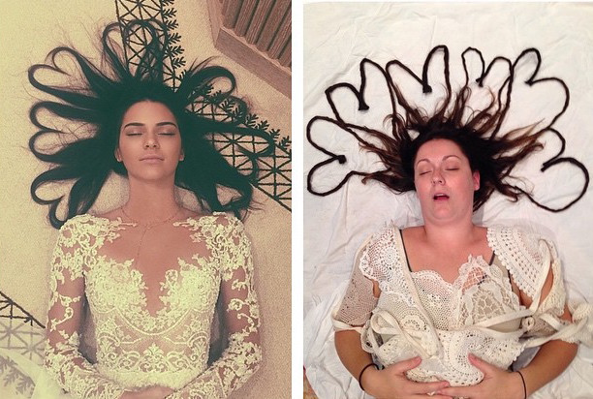
This woman made fun of the ‘perfect’ instagram post...
Saved from ‘mymodernmet.com’
https://mymodernmet.com/wp/wp-content/uploads/archive/wIVBmtX315V8tCE2M28o_BarberRecreation2.jpeg

Slide 16
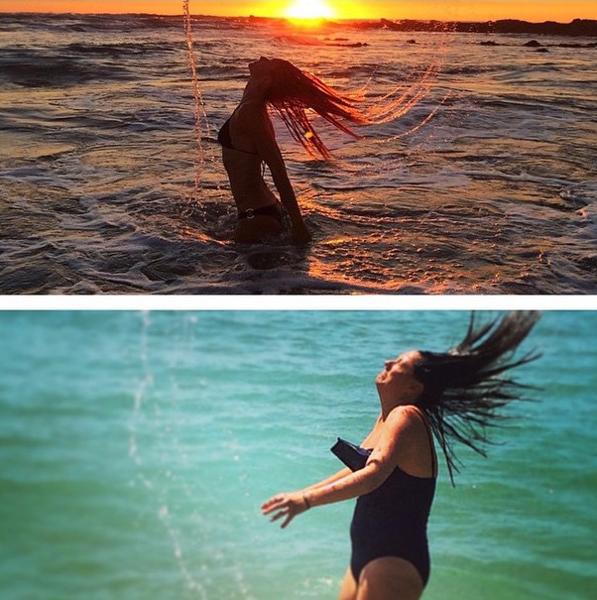
This woman made fun of the ‘perfect’ instagram post...
Saved from ‘mymodernmet.com’
https://mymodernmet.com/wp/wp-content/uploads/archive/9fcTFnJfDI2XHookGSuX_BarberRecreation3.jpeg

Slide 17
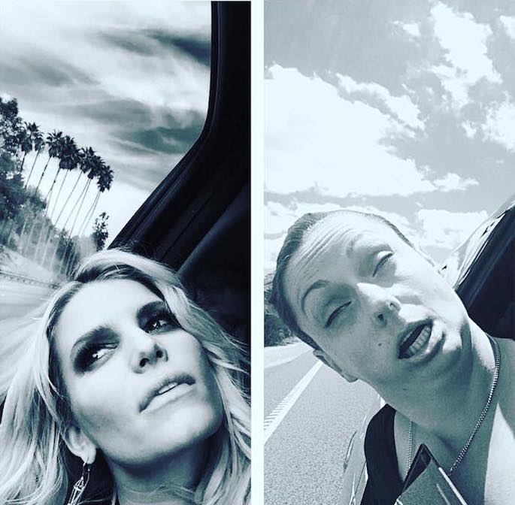
This woman made fun of the ‘perfect’ instagram post...
Saved from ‘mymodernmet.com’
https://mymodernmet.com/wp/wp-content/uploads/archive/zJYoEZufkAWr2lzVLPP8_BarberRecreation6.jpeg

Slide 18
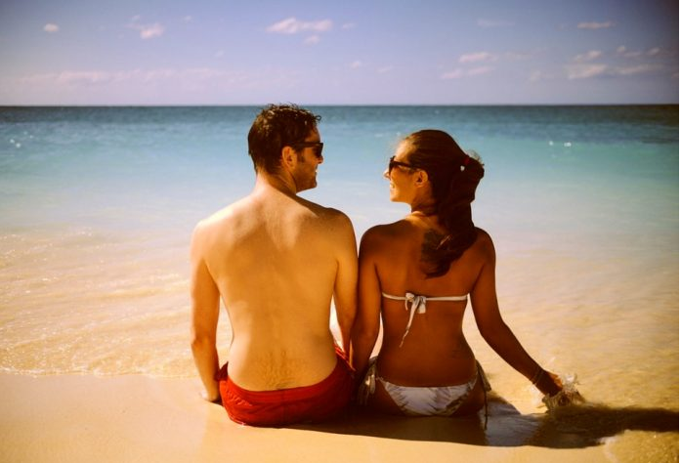
Are they having a good holiday?
Photo taken from ‘flashnews.bg’
http://flashnews.bg/kak-pocherneem-zdravoslovno-domashno-slantsezashtitno-maslo/

Slide 19
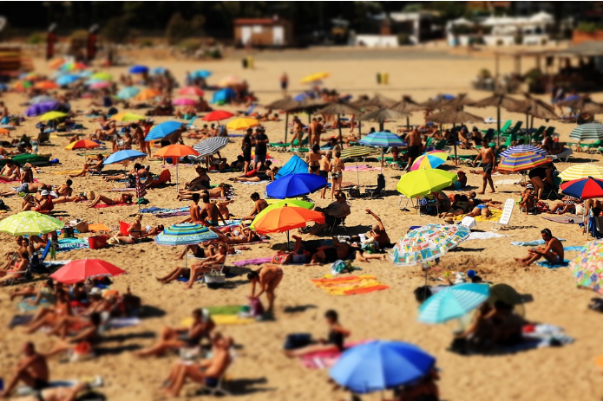
Are they having a good holiday?
Photo taken from ‘flashnews.bg’
http://flashnews.bg/kak-pocherneem-zdravoslovno-domashno-slantsezashtitno-maslo/

Slide 20
Could these have been taken on the same beach?
Which would you put on social media?
Which would you use to advertise a holiday destination?
Which photo is the more honest of the two?
http://flashnews.bg/kak-pocherneem-zdravoslovno-domashno-slantsezashtitno-maslo/
Photo taken from ‘flashnews.bg’

Slide 21
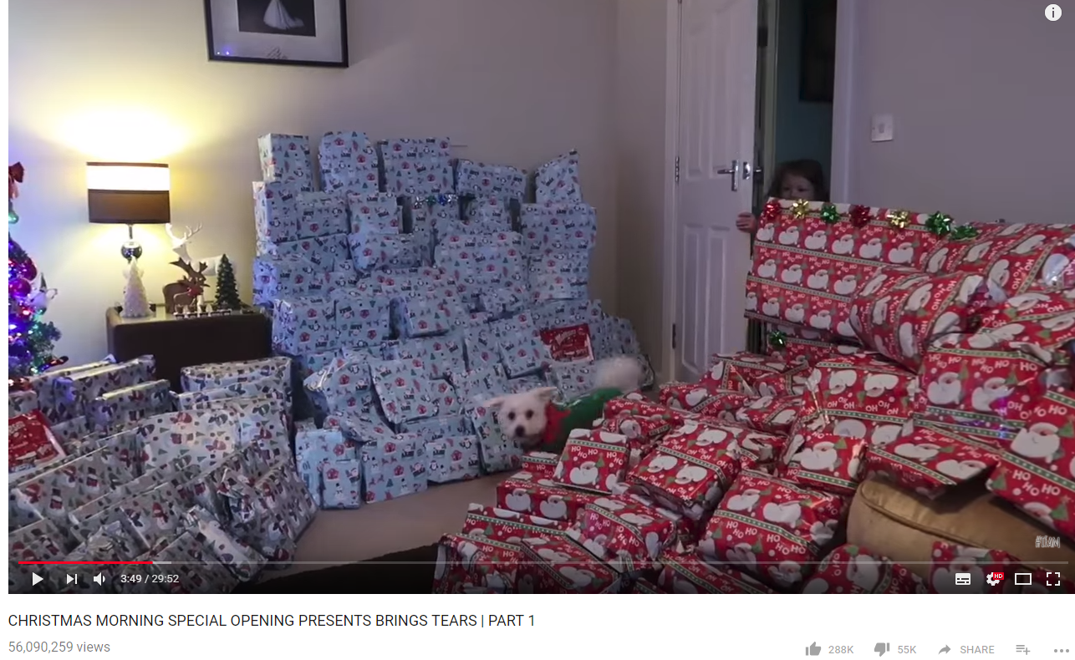
The Perfect Christmas?
Watch: https://www.youtube.com/watch?v=RFmPiEXzhvM

Slide 22
Why is this video popular?
Why might some children find it upsetting to watch this video?
Do you think it is encouraging a healthy lifestyle?
What is the downside to opening this many presents for the parents/children?

Slide 23



Screenshots taken from:
https://www.youtube.com/channel/UCPu78bdv1WY6b9Kk7xixhQw
What are the Ingham Family’s motivations?
Why have they put these videos on YouTube?

Slide 24


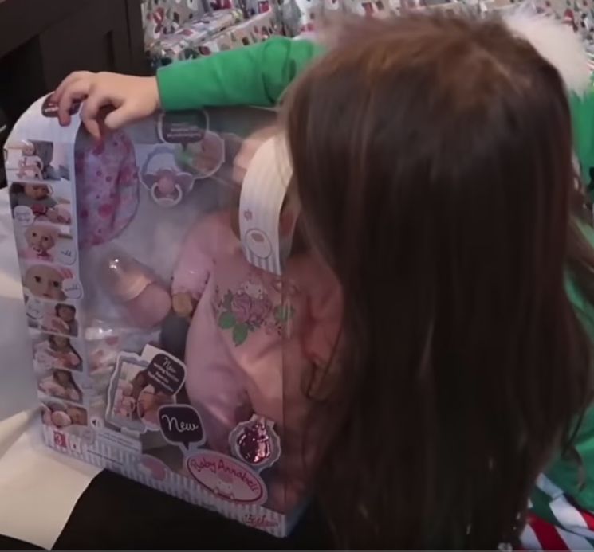
Why post?
Do they get any money for it?
If so, where does that money come from?
Screen shots from: https://www.youtube.com/watch?v=RFmPiEXzhvM

Slide 25
Big Question:
Does social media make you more or less happy?
What are the benefits?
What are the issues?
How could you improve the way you use and think about social media?

Slide 26
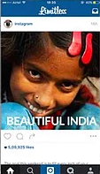
Does she look happy?
http://pictures.bokeh.hk/image/upload/w_1920,c_fill,q_40/v1443089189/dcouwvxnee8sbakmymx3.jpg
Photo taken from ‘digitalrev.com.com’

Slide 27

What might be hard about her life in reality?
http://culturainquieta.com/es/inspiring/item/9372-broken-india-la-triste-realidad-que-hay-detras-de-las-fotos-que-vemos-en-instagram.html
Photo taken from ‘culturainquieta.com’

Slide 28
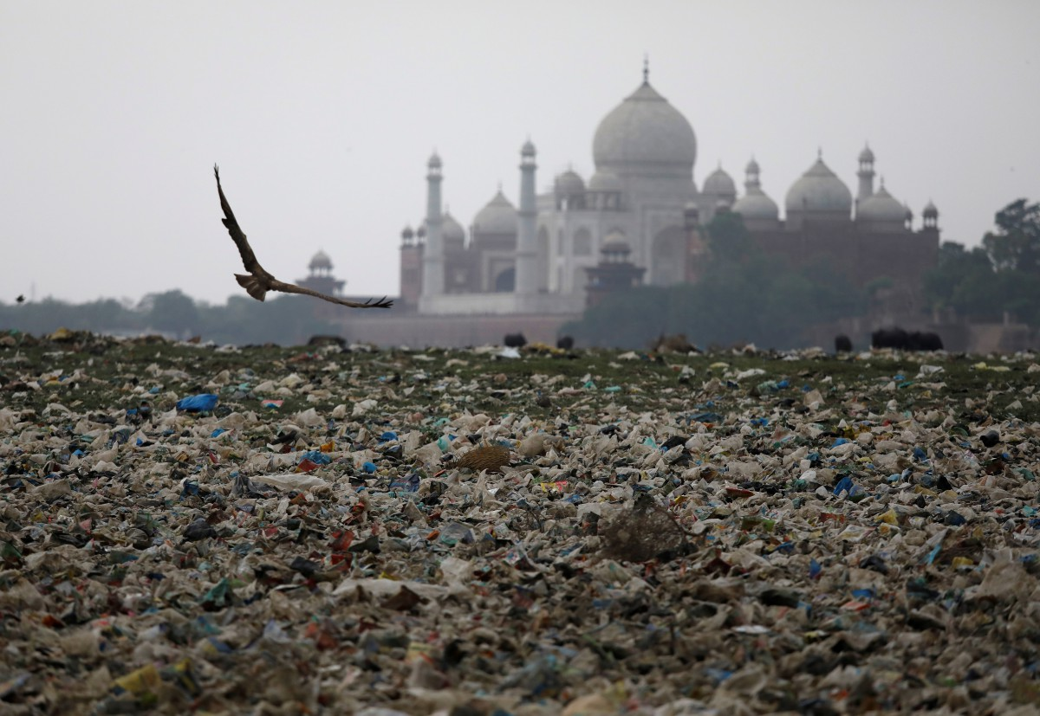
Beautiful Indian Attraction - Taj Mahal
https://cdn.asiancorrespondent.com/wp-content/uploads/2018/05/2018-05-22T003148Z_785797242_RC1E1FCB53D0_RTRMADP_3_HEALTH-POLLUTION-INDIA-TAJMAHAL.jpg
Photo taken from ‘asiancorrespondent.com’

Slide 29
The whole photograph...
https://cdn.asiancorrespondent.com/wp-content/uploads/2018/05/2018-05-22T003148Z_785797242_RC1E1FCB53D0_RTRMADP_3_HEALTH-POLLUTION-INDIA-TAJMAHAL.jpg
Photo taken from ‘asiancorrespondent.com’

Slide 30

Was it really raining?
Screenshot captured from: https://www.youtube.com/watch?v=6WQMAcaKn8E
Taken from channel: ‘Reaction Time’

Slide 31
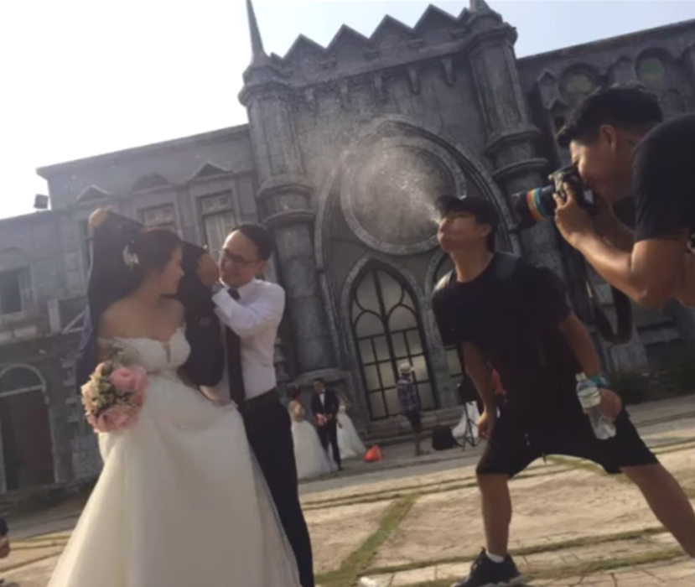
The man was spitting!
Screenshot captured from: https://www.youtube.com/watch?v=6WQMAcaKn8E
Taken from channel: ‘Reaction Time’

Slide 32

Is she really in a forest?
Screenshot captured from: https://www.youtube.com/watch?v=6WQMAcaKn8E
Taken from channel: ‘Reaction Time’

Slide 33
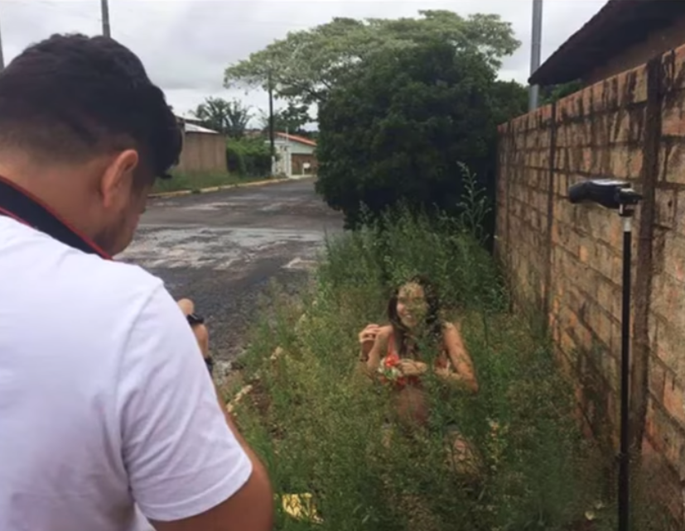
She’s crouching in some weeds!
Screenshot captured from: https://www.youtube.com/watch?v=6WQMAcaKn8E
Taken from channel: ‘Reaction Time’

Slide 34
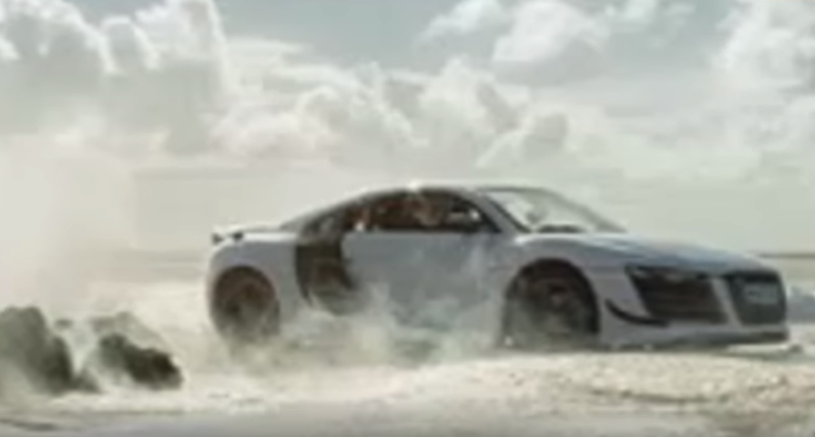
Is this car driving in the sea?
Screenshot captured from: https://www.youtube.com/watch?v=6WQMAcaKn8E
Taken from channel: ‘Reaction Time’

Slide 35
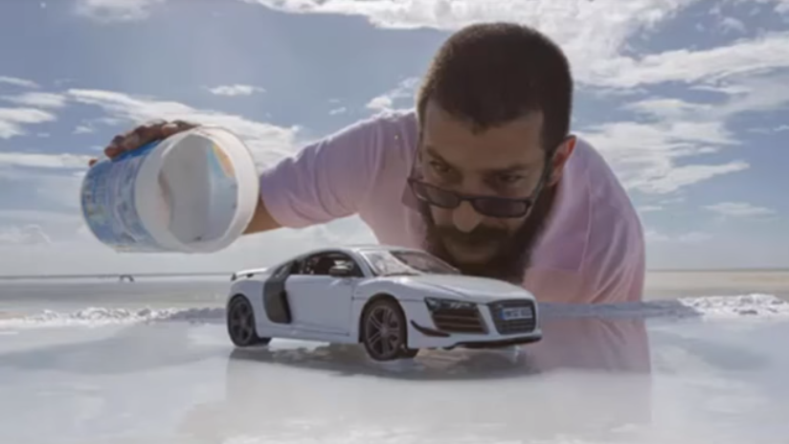
It’s a model!
Screenshot captured from: https://www.youtube.com/watch?v=6WQMAcaKn8E
Taken from channel: ‘Reaction Time’

Slide 36
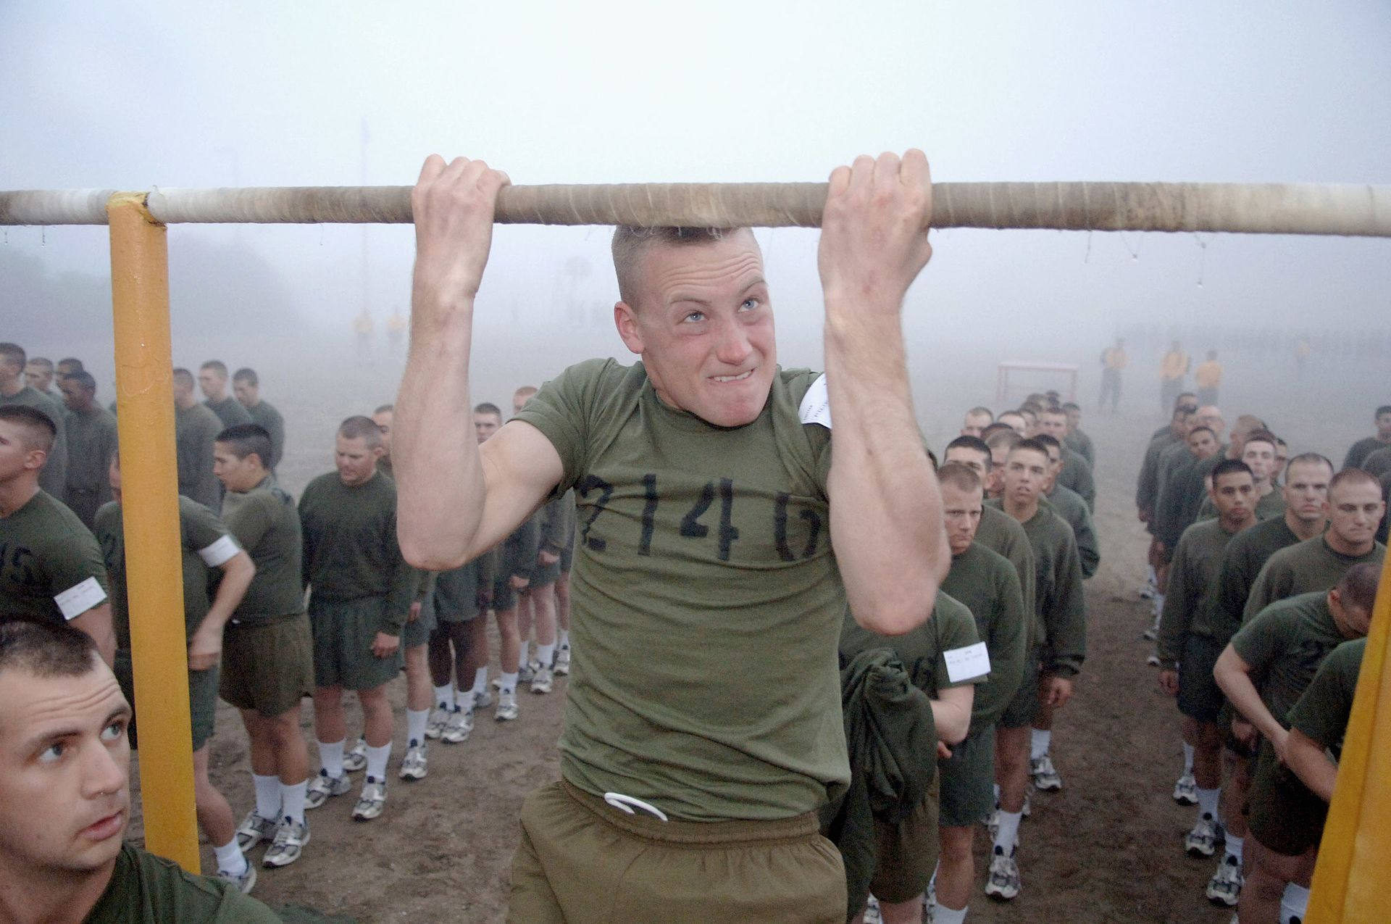
Can this man really do chin ups?
https://en.wikipedia.org/wiki/United_States_Marine_Corps_Physical_Fitness_Test#/media/File:USMC-04356.jpg

Slide 37
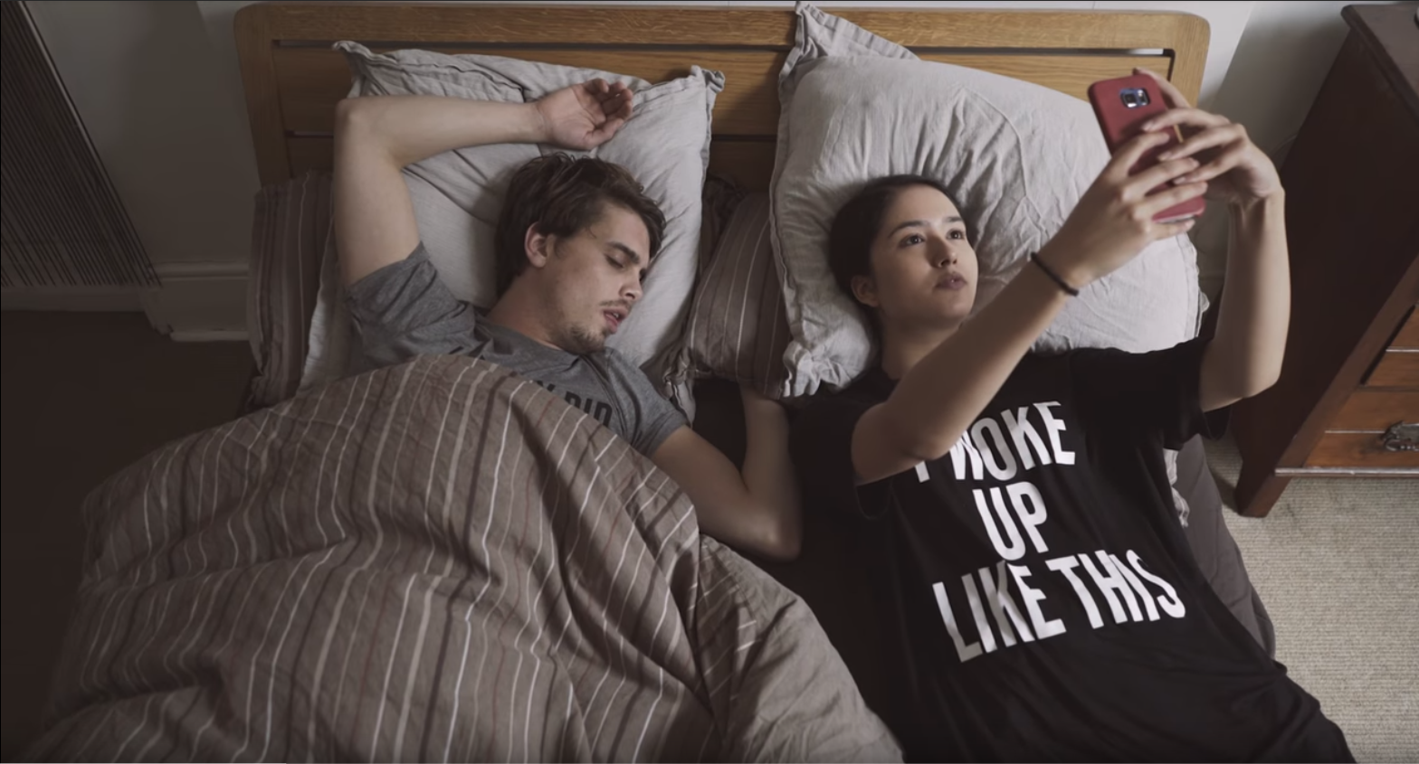
Watch: https://www.youtube.com/watch?time_continue=151&v=0EFHbruKEmw

Slide 38
Independent Activity:
Create a ‘realistic’ instagram feed:
Bad hair day
Fake exercises
Unflattering faces/poses
Having a miserable time
Messy/dirty
Ignoring your friends to look at a screen
Use any of the ideas that you’ve seen so far and also use your imagination!
You can create photos, or draw cartoons, depending on your skill set.

Slide 39
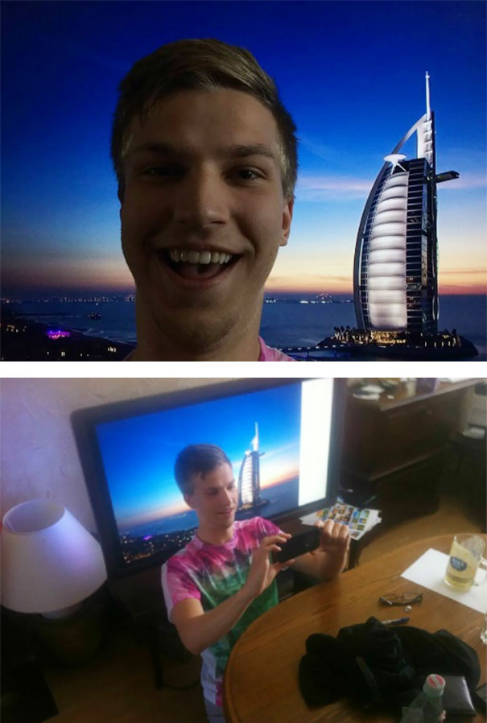
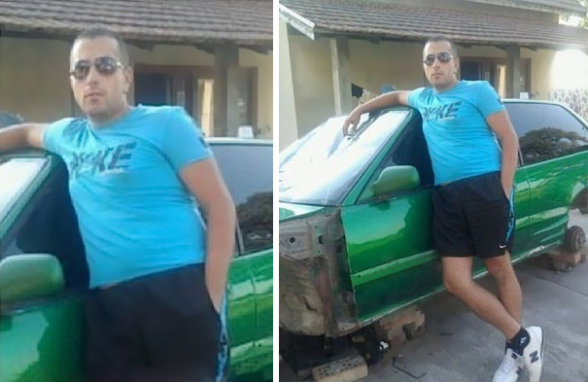
Extension task…
Crop a photo to make your life look better than it is!
http://doublemesh.com/wp-content/uploads/2016/11/20-funny-cropped-images-17.jpg
http://doublemesh.com/wp-content/uploads/2016/11/20-funny-cropped-images-15.jpg
Photos taken from ‘doublemesh.com’

Slide 40
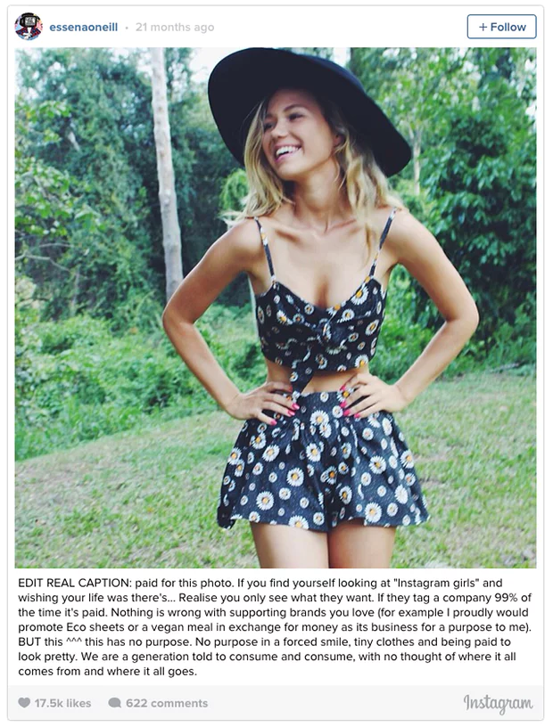
This woman deliberately quit social media because it was making her miserable:
She described how her smiles were faked, she was only happy if she looked ‘just right’, in terms of facial expression, clothing and body shape.
She was paid large amounts of money by clothing companies to wear their clothes and pretend that they belonged to her.
Most of the shots that look like everyday life are actually highly staged, with photographers, lighting specialists, as well as make-up and fashion experts.
She realised that she wasn’t helping people, but instead was setting unreasonably high expectations for her followers, and making them jealous of her (outwardly) glamorous lifestyle.
https://www.theguardian.com/media/2015/nov/03/instagram-star-essena-oneill-quits-2d-life-to-reveal-true-story-behind-images

Slide 41
Busy being happy?
Some people post less on social media than others
On average, do you think posting less is a good or a bad sign?

Slide 42

Extension P4C question: Can you take too many selfies?
Photo taken from ‘knowyourmeme.com’
http://knowyourmeme.com/photos/797595-auschwitz-selfie

