Slide 2

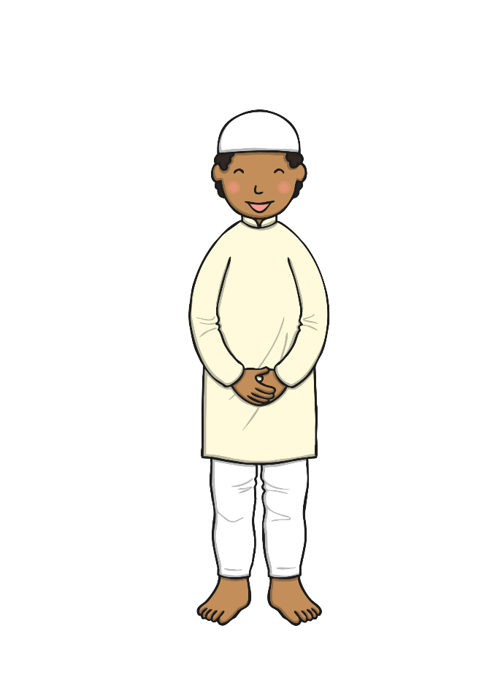
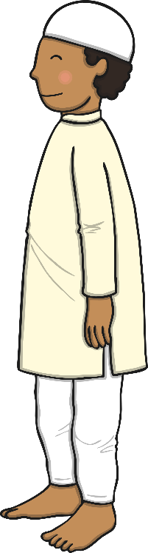
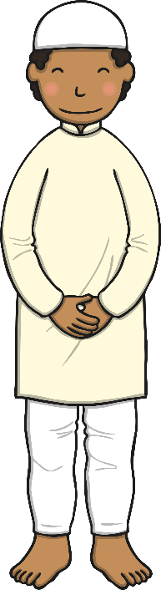
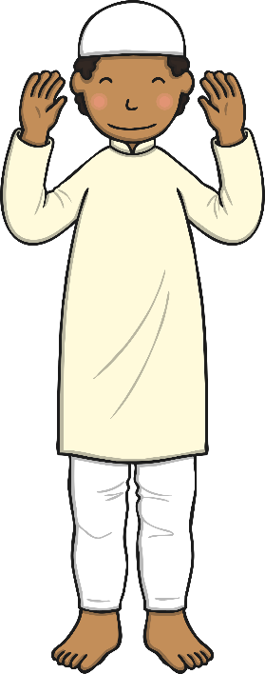
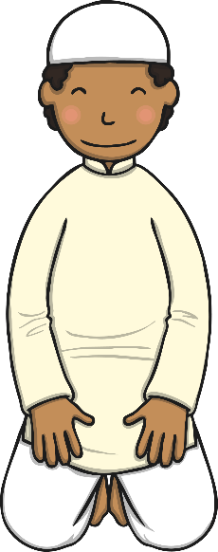
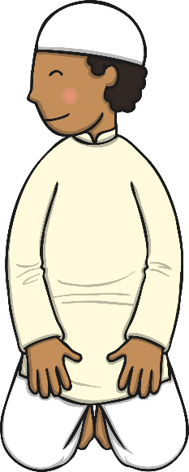
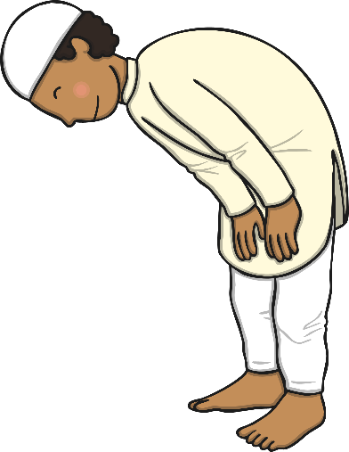
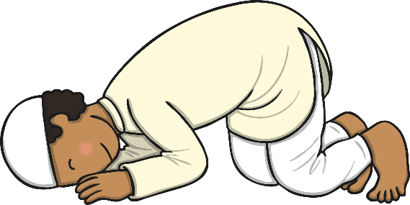
Ritual Prayer
When Muslims pray, they perform sets of movements and
gestures. Click on each number to find out more.
Muslims kneel up again and look down at their lap. They say the prayer words.
Muslims then look over their left shoulder to the angel to record their bad deeds. They then say their personal prayers.
Muslims then say surah Al-Fatiha and one short surah from the Qur’an.
Muslims then place their right hand over their left, on their chest or navel. They say the opening supplication.
To start the prayer, Muslims stand and say, “Allahu Akbar”, which means “God is great”. They raise they hands to their ears as they say this.
Muslims then drop into a prayer position with their hands on their knees, looking at their feet. They say the prayer words.
Muslims then go back to an upright position with their arms by their sides. They say the prayer words.
Muslims then kneel with their hands and feet to the ground. They say the prayer words.
Muslims then kneel up and look down at their lap. They say the
prayer words.
Muslims kneel again with their hands and face to the ground. They say the prayer words.
Muslims say the salawat. They look over their right shoulder to the angel to record their good deeds.
1
Niyyat
Sudjood
6
2
Qiyaam
Qu’ud
7
3
Fatiha
Sudjood
8
4
Ruku
Qu’ud
9
5
Qauma
Tasleem
10

