Slide 1


History
Ancient Egypt
Year One
History | UKS2 | Ancient Egypt | Who Were the Ancient Egyptians? | Lesson 1

Slide 2
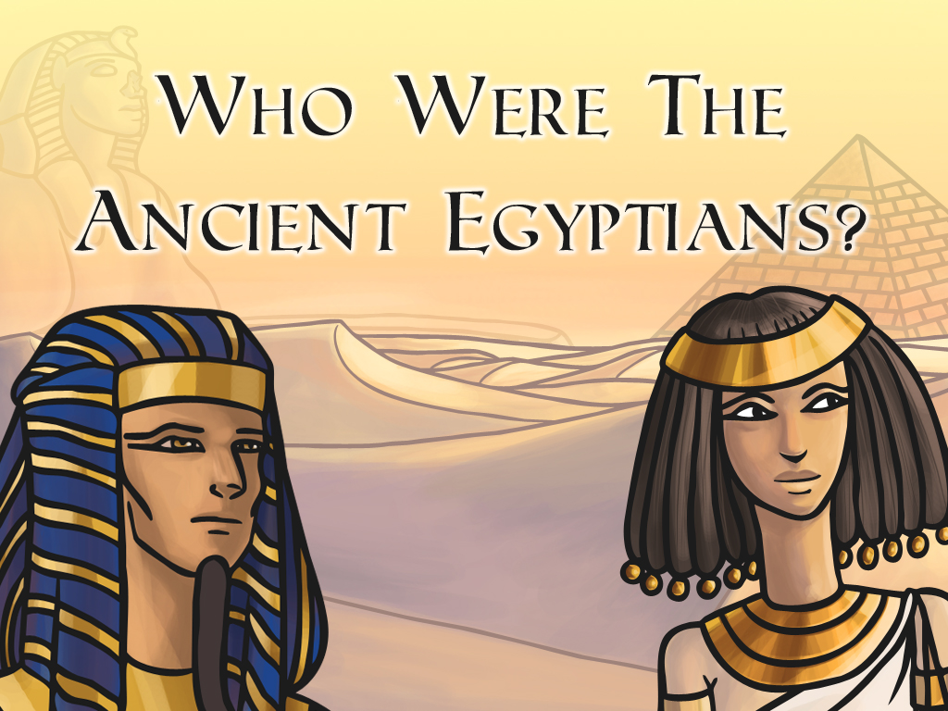


Slide 3
Aim
I can find out about the different ways in which ancient Egyptians lived and worked.
Success Criteria
I can point out where Egypt is on a map.
I can describe when the ancient Egyptians lived.
I can describe and name different roles in ancient Egyptian society and what those people did.

Slide 4
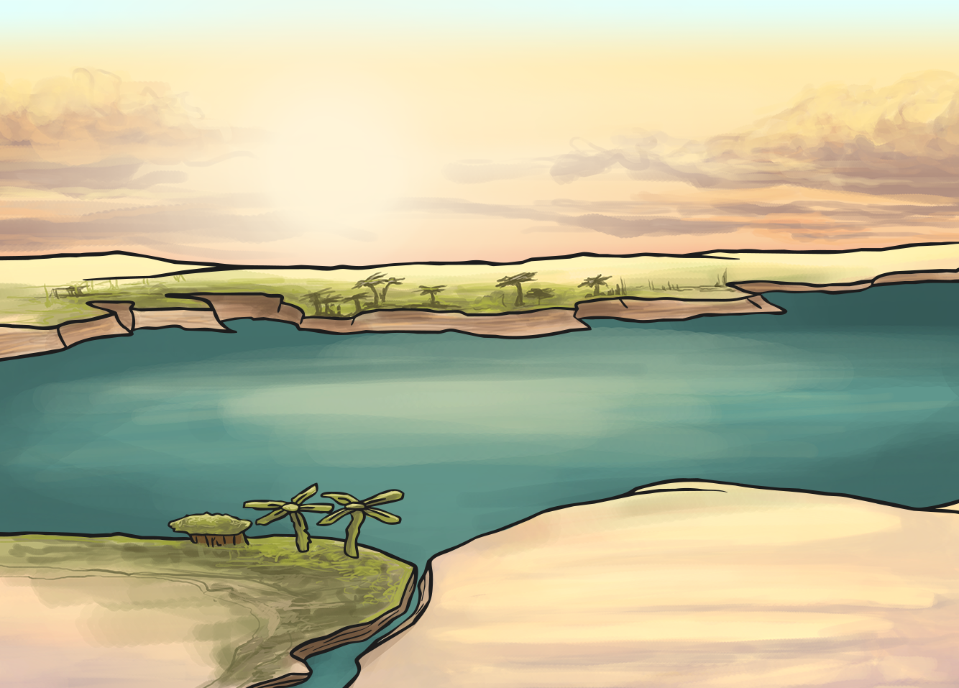
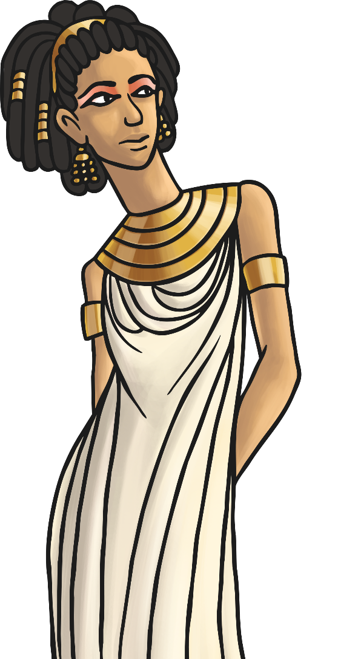
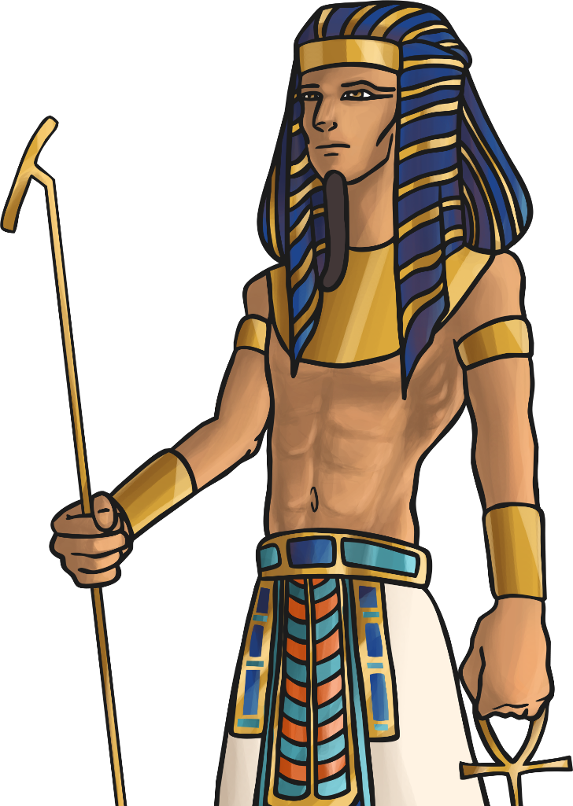
What do you think when someone says ‘ancient Egypt’?

Slide 5

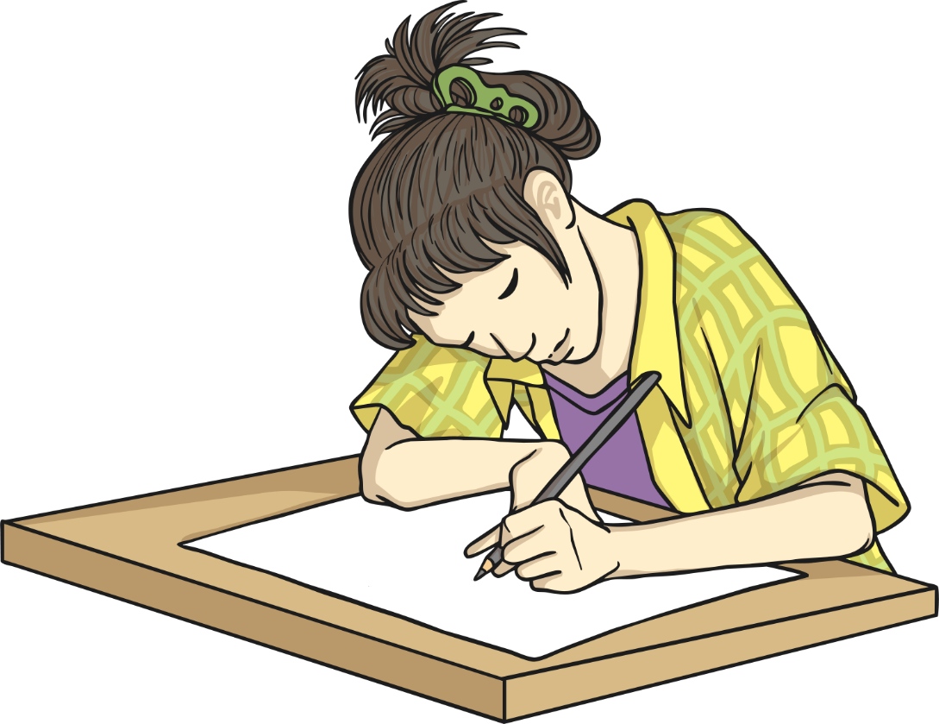
Ancient Egypt
Task A
Using either sketches or words, record what comes to mind.

Slide 6

Ancient Egypt
Task B
Can you come up with headings to group your knowledge underneath? E.g. religion, daily life, buildings, death etc.
Add any details you know underneath these headings.

Slide 7
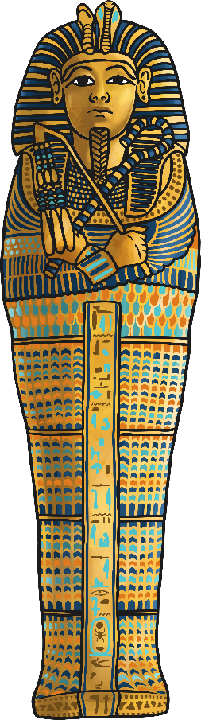

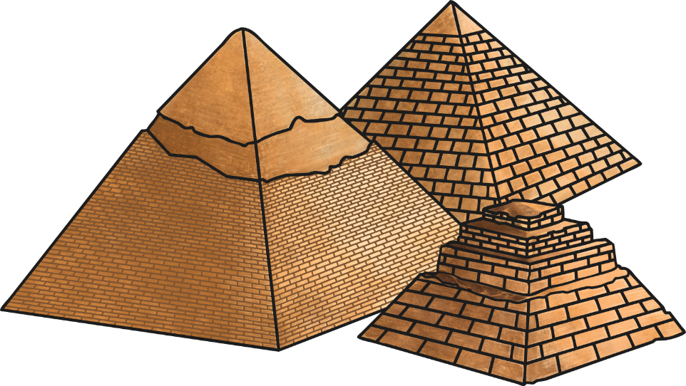
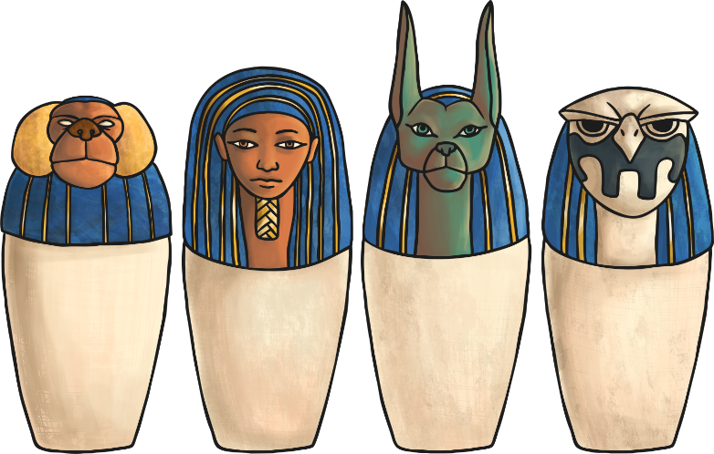
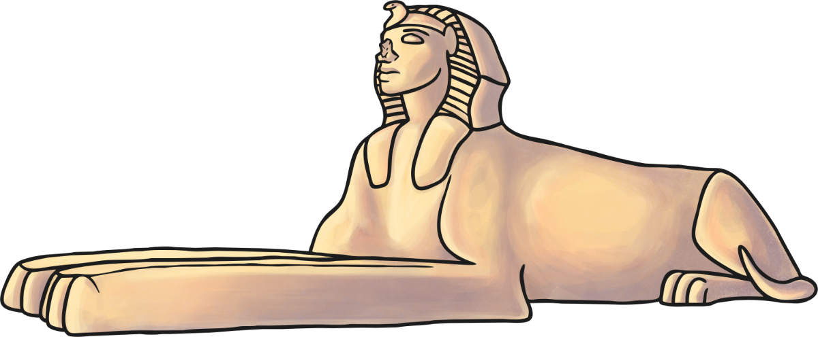
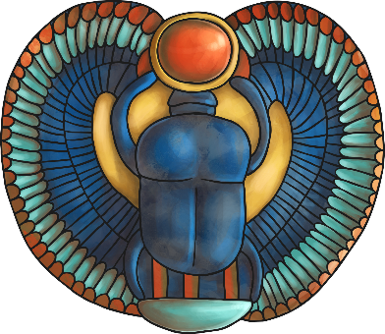
Ancient Egypt
Task C
What would you like to find out more about?
Add questions underneath your headings.

Slide 8

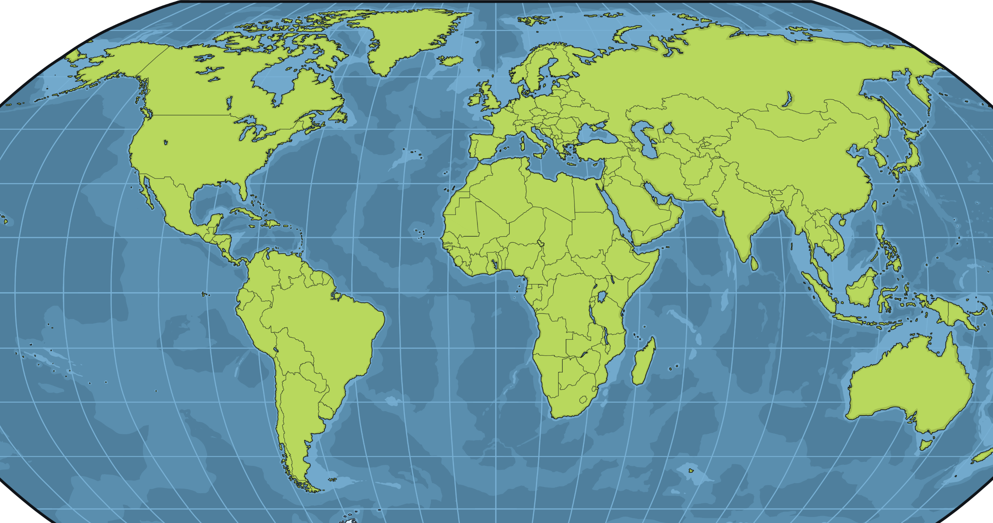
Ancient Egypt:
Where and When?
Can you find Egypt on the map?
Egypt

Slide 9
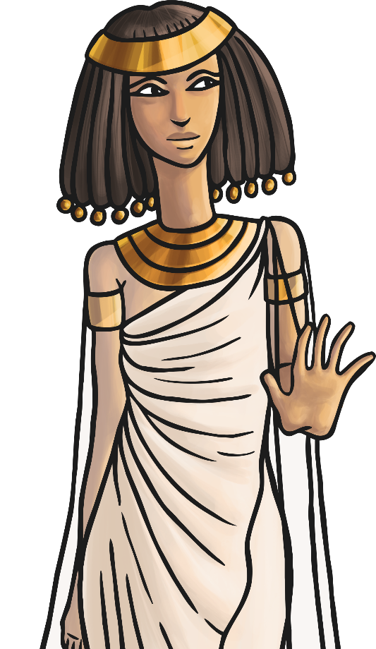
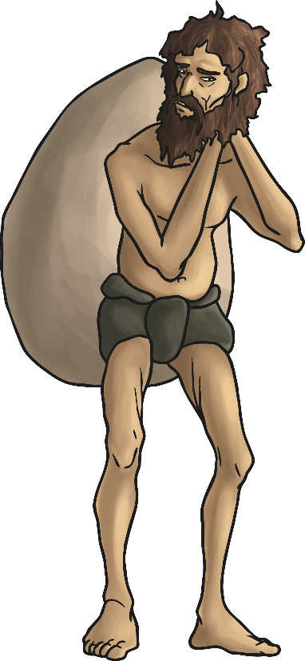
Ancient Egypt:
Where and When?
Ancient Egypt refers to the ancient civilisation in Egypt.
What does ‘ancient’ mean?
What does ‘civilisation’ mean?

Slide 10
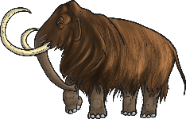
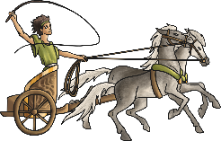

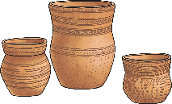
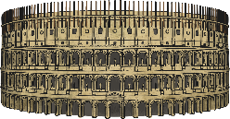
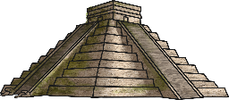
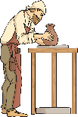
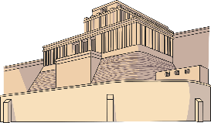
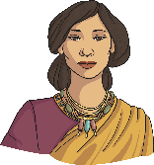



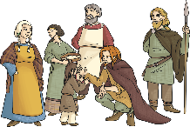

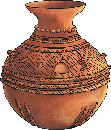
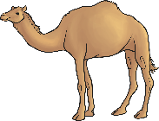

Ancient Egypt:
Where and When?
In 3100 BC, King Menes united two Egyptian kingdoms and built an empire that lasted until 30 BC, when the Romans took over by force.
What other periods of history do you know of that were before, during or after this time?
Stone Age
Bronze Age
(2800 BC)
Ancient Greece
(800 BC)
Roman Empire
(58 BC)
Maya
(250 AD)
Anglo-Saxons
(AD 410)
Ancient Egypt
3100 BC
30 BC
Ancient Sumer
(3100 BC)
Indus Valley
(2500 BC)
Shang Dynasty
(1650 BC)
Iron Age
(700 BC)
Benin
(AD 110)
Islamic Empire
(AD 610)

Slide 11
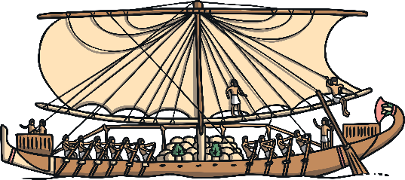
Who Were the
Ancient Egyptians?
Life in ancient Egypt focused around the river Nile.
The river Nile provided the ancient Egyptian people with water and also food. This is because when the river flooded, it left behind a special type of mud, called silt, which made the land fertile for farming.
Farming was a tough job to do in ancient Egypt, working under the very hot sun all day.
The river Nile was also important for travel and transportation. Merchants traded and transported goods between the major cities located along the river and further afield.

Slide 12

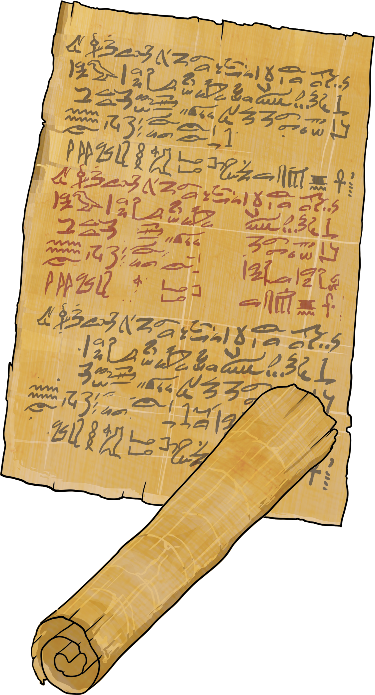
Who Were the
Ancient Egyptians?
One thing the ancient Egyptians are famous for is making a special type of paper called papyrus. They made this from the papyrus plant (a type of reed), which grows in the marshy land near the river Nile.
Scribes in ancient Egypt were trained to read and write. They wrote in special symbols called hieroglyphs.

Slide 13
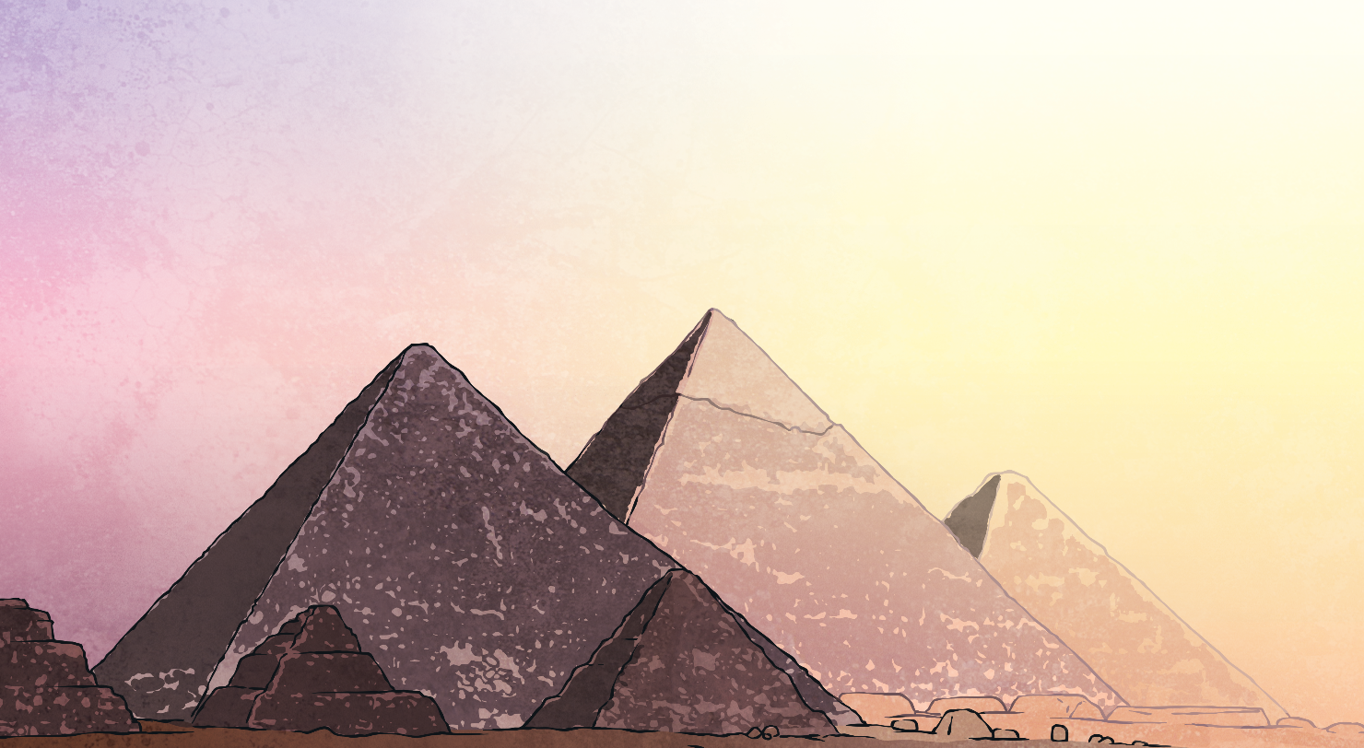
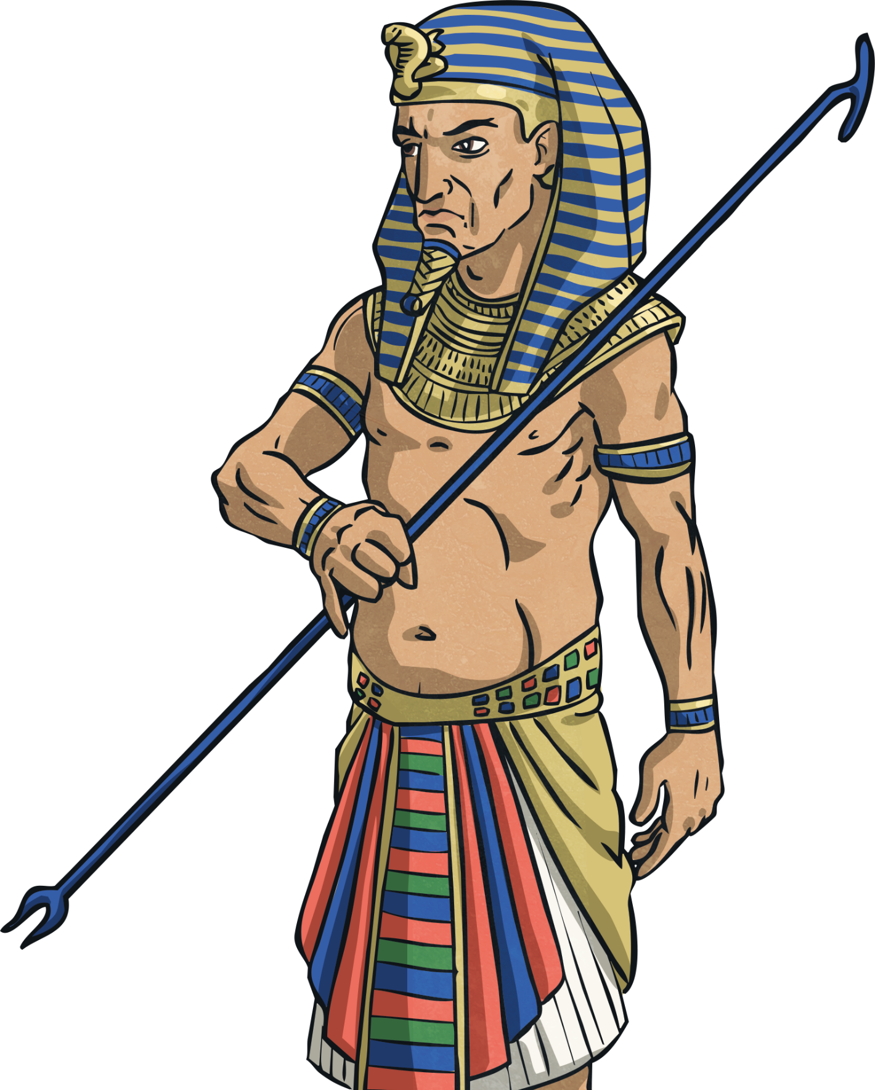
Who Were the
Ancient Egyptians?
The ancient Egyptians are also known for the buildings they built from stone, most famously the pyramids.
Architects and engineers were part of the huge teams involved in designing and planning these giant structures built to bury their pharaohs and other powerful people.
‘Pharaoh’ was the name given to the king or queen of Egypt.
Pharaohs were very important and would have lots of different people working for them, including a special adviser called a vizier.

Slide 14
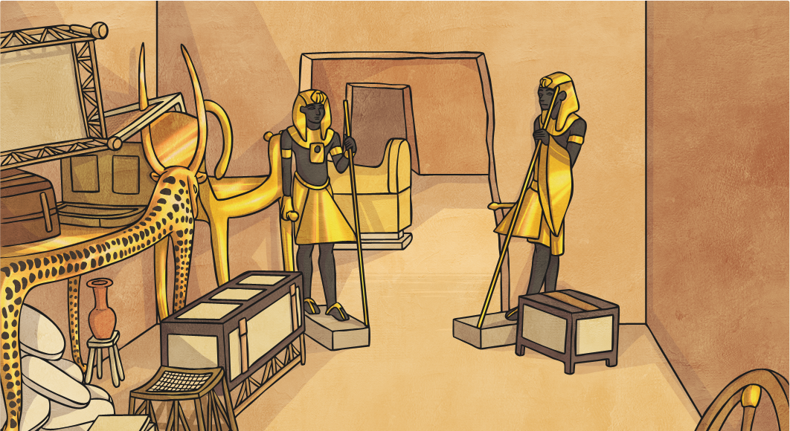
Who Were the
Ancient Egyptians?
The ancient Egyptians are also known for the buildings they built from stone, most famously the pyramids.
Architects and engineers were part of the huge teams involved in designing and planning these giant structures built to bury their pharaohs and other powerful people.
The ancient Egyptians believed that people needed to be buried with objects from their life on Earth as they would need them in the afterlife. Bodies of dead ancient Egyptians were embalmed (specially treated to preserve them) and then wrapped in bandages to make their bodies into mummies.

Slide 15
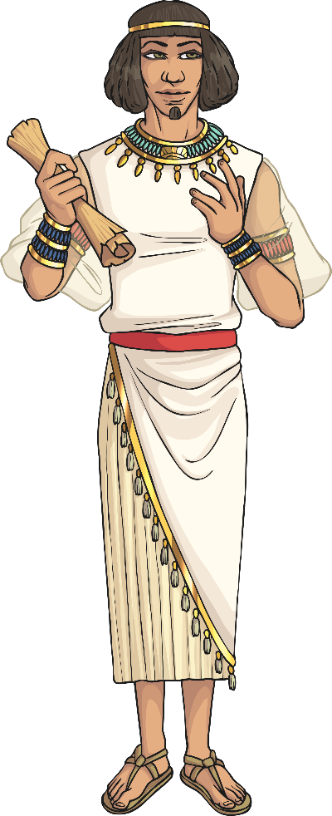
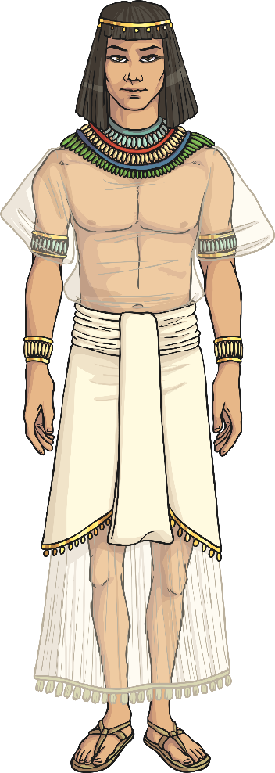
Ancient Egyptian Roles
Life in ancient Egypt was very varied, depending on a person’s wealth (money) and education.
On your sheet is a list of ancient jobs and their descriptions.
The roles and descriptions are muddled up.
Activity
You need to match the correct role to the description. Remember to read the information carefully.
You might have an ‘extra challenge’ to complete.

