Slide 1

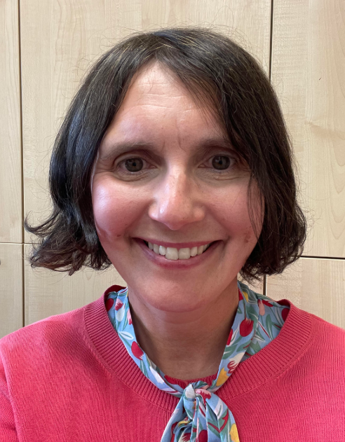

Welcome to Dobcroft Junior School
Nicola Sexton
Head Teacher
headteacher@dobcroft-jun.sheffield.sch.uk
Notes:
Hello, a really warm welcome to Dobcroft Junior School
I’m Nicola Sexton the head teacher
The Purpose of this evening is to introduce you to some of the key staff, familiarise yourself with the environment and to get to grip with some of the practicals
I will give a short presentation and then we will split off into 3 groups for a tour of the school
There will be opportunity to ask questions as you walk around the school with your child’s teacher

Slide 2
Our Governors chair@dobcroft-jun.sheffield.sch.uk
Katherine L Oglesby - Chair of governors
- Vice chair of governors
Andrew Davies- Safeguarding governor
Sadia Azam
Zaineb Nadeem
Jenny Judge
Jade Rose
Ian Wassell – Staff governor
– Staff governor
Matthew Hawker
Jade Potter
Notes:
We have a supportive governing body
Ian Besford is Chair and has 2 children in our school
Helena Jones is vice chair and has 2 children who have been in our school and one joining us in September
In September we have2 vacancies if you are interested

Slide 3
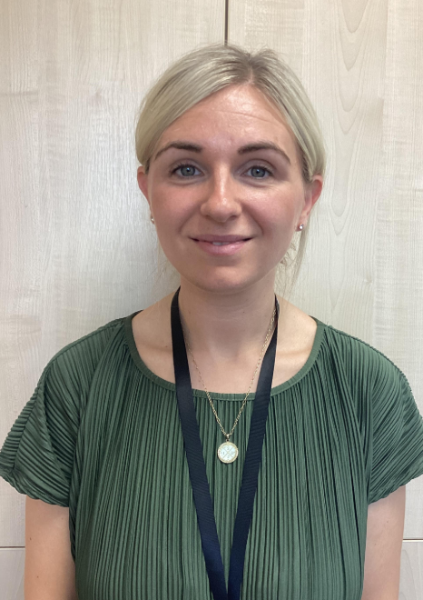
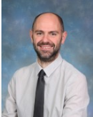
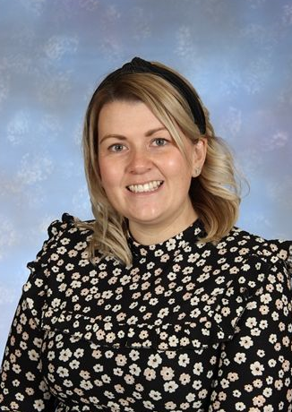
Who is Who?
Senior Leadership team
Mrs Doyle
Deputy Head
Head Teacher (Friday)
Mr Harrison
Assistant Head Teacher
enquiries@dobcroft-jun.Sheffield.sch.uk
Mrs Kirk
Assistant Head Teacher
Notes:
Our senior leadership team is made up of HT, DHT,- I am on playground every morning, Mrs Doyle in on playground every afternoon
Mr Harrison (Y5/6 phase leader)
and Mrs Kirk who is new to our school and will be teaching in year 3 and will be Y3 4 phase leader

Slide 4
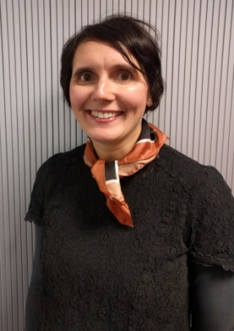
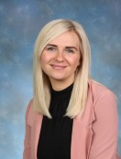
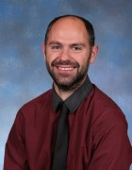
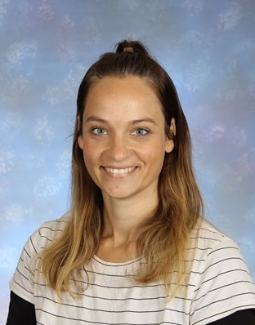
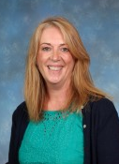
Who is Who?
Our Inclusion and safeguarding Team
Mrs Sexton- Designated safeguarding leader
Mrs Doyle- Designated safeguarding leader and Senior Mental Health Lead
Mr Harrison- Online safeguarding leader
Ms Little
Special Educational Needs Co-ordinator / SENDCo
Pastoral & Family liaison Lead
Deputy designated safeguarding leader
Notes:
Our senior leadership team is made up of HT, DHT,- I am on playground every morning, Mrs Doyle in on playground every afternoon
Mr Harrison (Y5/6 phase leader)
and Mrs Kirk who is new to our school and will be teaching in year 3 and will be Y3 4 phase leader

Slide 5
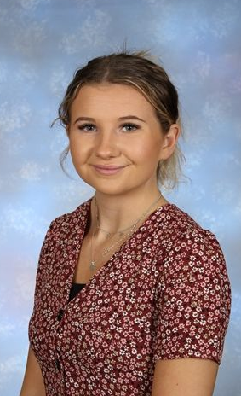
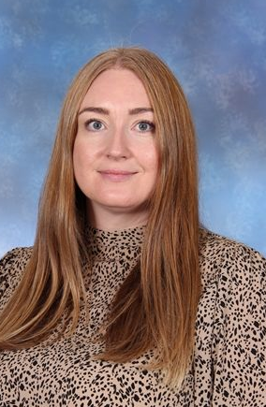
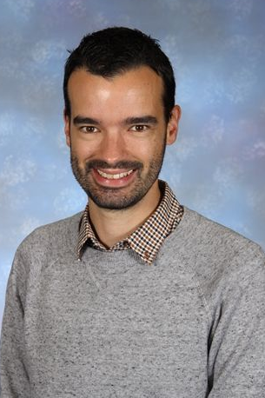
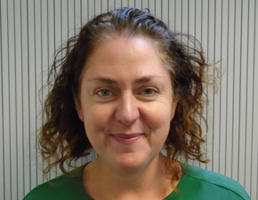
Office Staff
Miss Higgins
enquiries@dobcroft-jun.sheffield.sch.uk
Mrs Holden
Mr Wright
Mrs Murray
Notes:
We also have some other really important staff who are not hear this evening, but you and your children will get to know throughout the whole of their KS2 journey
KD & AH
JG- SENCo
KR- butterfly house offers pastoral support beyond the classroom
JM and KC- 1st aid

Slide 6
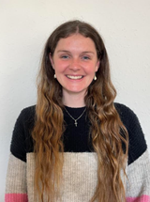
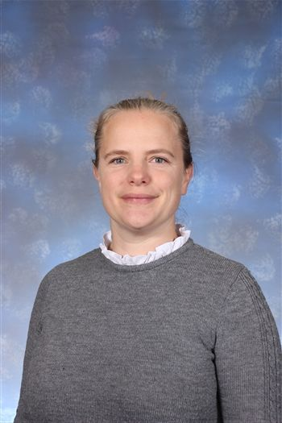

Year 3 Team
Miss Jackson
Miss Taylor
Mr Frampton
teachers@dobcroft-jun.sheffield.sch.uk
Notes:
Probably most important to you and your children at the moment is the year 3 team
We have a fabulous, energetic and enthusiastic team of teacher sin year 3 and they are
Mrs Collis & Mrs Scammell who job-share
Mr White
And Mrs Kirk (who has already given you a wave!)

Slide 7
Personal Development
RE
Online safety
Relationship and sex education
Personal, social and health education Assemblies
Our values (linked to British values)
Residential visits (Y4 & 6)
Outdoor education days (Y3 & 5)
Lunchtime provision & clubs
Educational visits
The core subjects
English
Maths
Reading
Science
The foundation subjects
Art & design
D&T
Computing
Geography
PE
Music
French
History
Our Curriculum
Notes:
As a maintained primary school we teach to the national curriculum
We cover the typical subjects and organise our curriculum delivery in this way
E&M generally 1 hour of each per day in the morning
Reading- generally after lunch, small groups, whole class or 1-1
French, music PE taught during PPA afternoon, (2 of them per week) PE is also taught by the class teacher for at least one other session
RE & PSHE tend to be taught separately as subjects by the class teacher- some year groups have a whole RE day
Topic- other subjects, around a common theme eg earth & space, the Romans

Slide 8

A Typical Week at DJS

Slide 9
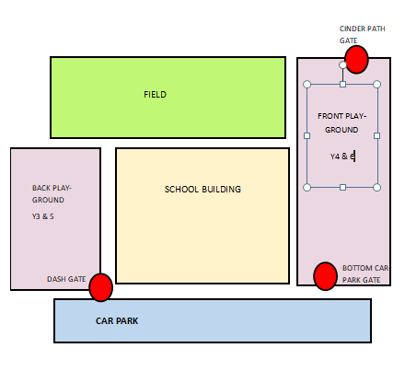
Our Building and Y3 classrooms
Y3 classrooms

Slide 10
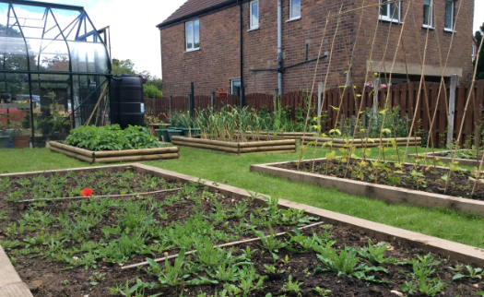
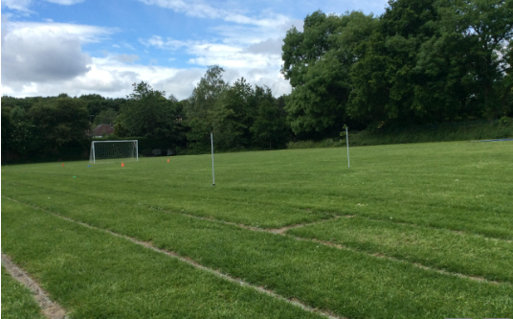
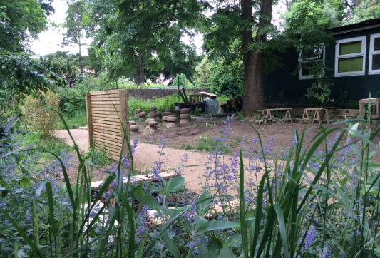
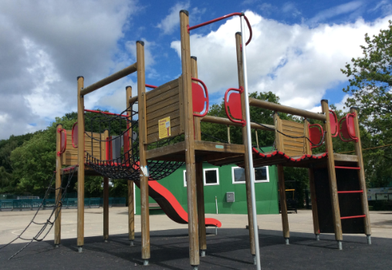

Slide 11
Our School Values
Together we are safe
Together we are kind
Together we embrace difference
Together we are problem solvers
Together we do our best
Our Motto: Together we make a difference
Notes:
School uniform
Logo leisure wear if you need a form I have some spare
This includes black or dark coloured shoes/trainers

Slide 12
Behaviour Policy
Available on our website and updated annually by governors
As well as rewards, we have consequences
‘Reminders’ and strategies
Reflection time and restorative practice
Serious incidents communicate with parents

Slide 13
Our School Values & Awards
DoJos
Head Teacher Awards
Warrilow Trophy
Maths Champion
Reading Champion
STEAM champion
Notes:
School uniform
Logo leisure wear if you need a form I have some spare
This includes black or dark coloured shoes/trainers

Slide 14
Anti-Bullying Policy
Available on our website and updated annually by governors
Clear process that we follow
If a parent raises a bullying concern then we ask that parents complete the form with their child wherever possible and then we thoroughly investigate

Slide 15

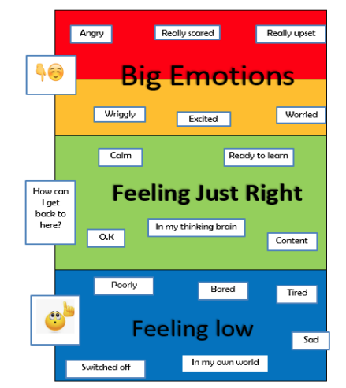
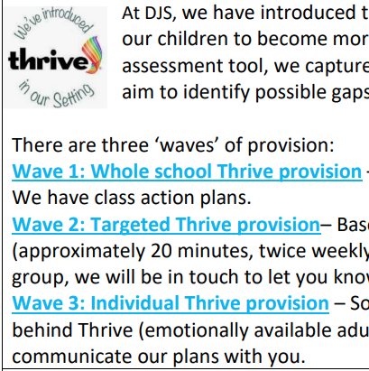
Wellbeing & Thrive

Slide 16

Things You will Need!
Stationery- (pencil, ruler, coloured pencil crayon, eraser, scissors, glue stick, whiteboard pen (no need for a handwriting pen)-
Please don’t worry if you can’t supply all of these ☺
Water bottle labelled
Book bag or back pack
PE kit

Slide 17
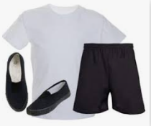
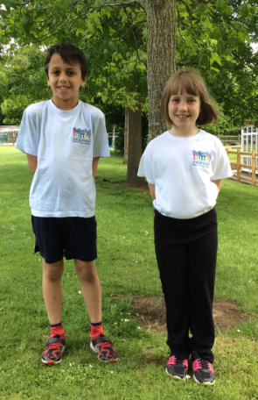
PE kit – ALL LABELLED!
black shorts, joggers or leggings
white T-shirt
pumps or trainers
children are asked to remove any jewellery, watches etc
children are asked to tie their hair back (bobbles)
optional Dobcroft hoodie
optional Dobcroft bobble hot
Notes:
We take changing for PE very seriously and all children are expected to have a full kit
Normally children leave them on their peg and half termly bring it home for washing
It is a good idea to have a separate kit that stays on their peg

Slide 18
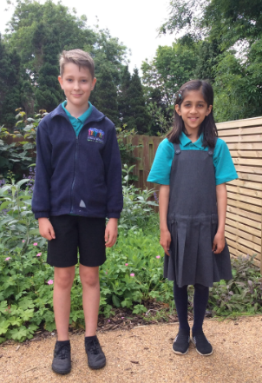
School Uniform
Navy / jade sweatshirt, cardigan or fleece (preferably with school logo)
Navy / jade / white t-shirt or polo shirt (with or without school logo)
Navy / grey / black smart trousers, smart shorts, pinafore or smart skirt (plain and not denim)
Blue or green checked school dresses may be worn in warmer months (no logo is required)
Plain dark and sensible shoes, boots or trainers
Dark or white sandals for summer wear
Notes:
We ask children to provide their own basic stationery- I know Mrs Collis has included this in the booklet
We find children take a lot more pride and care in their own resources and don’t lose things quite so much
Obviously if children can’t provide these items we have items in school.
Water bottles in classroom- we encourage them to bring them home daily to wash and refill
Book bag or back pack

Slide 19
Day 1- Wednesday 3rd September
From 8.45 a.m
Please bring children into the playground at the back of the school with all their belongings
Please note it is always very busy on the first day and the Y3 children can become overwhelmed, so please, wherever possible no more than two adults at drop off and absolutely no dogs please
Teachers and staff will be there to greet your child
Remind your child that you will meet them at 3.30p.m on the front yard (unless there is a different plan e.g. if your child is going to DASH after school) and then you are free to exit back through the DASH gate
Children will line up with their teachers and make their way into the school
Notes:
Read from the slide

Slide 20
DAY 2- Thursday 4th September
The same as day 1 but your child can go straight into their classroom from 8:45am and you may want to leave them before the bell rings at 8:55am. Please be reassured that the playground is supervised from 8:45am.
Remember to remind your child about the after school arrangements
8:55am- The bell rings and children should be in class by this point.
Notes:
Read from the slide

Slide 21
3:30pm – Every day
Class teachers will be on the front playground at the end of each day for 5-10 minutes for any queries or quick chats.
They will make sure that your child is handed over to the correct adults as per the contact forms you have completed.
Notes:
At the ned of each day your child’s class teacher will be on the playground
We normally just do this for the 1st half term but from September we are asking all of our staff to take their classes out in order for any parents to talk/ask questions in a less formal way
If your child’s class teacher isn’t there they are probably in a meeting, have PPA or may not even be in school, however myself or Mrs Doyle or another teacher would be available

Slide 22

Communication
Concerns or worries
Practical/routines
1. Class teacher or SENDCo
pop-in or email:
hlittle@dobcroft-jun.sheffield.sch.uk
teachers@dobcroft-jun.Sheffield.ch.uk
Use ClassDoJo for informal, quick messages but not for anything which requires more attention e.g. pastoral concern
2. Dedicated member of senior leadership team-
Mr Paul Harrison
pharrison@dobcroft-jun.Sheffield.sch.uk
3. Deputy head teacher or head teacher- please email or telephone
Website, office staff
pupil
school
home
Notes:
Communication is so important
Often school to pupil communication is strong
Parent to pupil is strong
Problems often occur with the school to home communication for obvious reasons
This can be because of inefficient systems, mis-communication via your child, not enough communication from school and we always ask that parent stop and check all of the information before jumping to conclusions
We don’t always get it right- we are human, however we do 100% strive to get it right and sometimes it is just about talking things through and understanding the full picture
In some instances the office staff are the best to ask, especially regarding practicals, school website it also extremely useful
Concerns regarding your child’s welfare or learning should always arrange to speak to class teacher first- via teacher@email or calling to arrange an appointment, asking in the morning or after school
If feel concerns have not been addressed then the next step would be to talk to the relevant member of SLT which would be Mrs Kirk
Still not satisfied then myself or Mrs Doyle
In extreme / urgent situations obviously please get in touch with the HT straight away.
We are an open and honest school and we do value parental engagement and ultimately we are all working for the interests of your child.

Slide 23
Before your child starts in September
Tour of the school (9th July)
Transition day (24th June)
Spent time with your new teacher at DJS
SEND reviews
Additional transition for some pupils
Transition pack (contact forms……….)
Parent pay login (clubs & dinners)
Uniform- logo leisure wear
Calendar Dates- before we break up

Slide 24
In September
Year 3 Information Evening- 12th September
Opportunity to talk to teachers
First parents’ evening - October

Slide 25

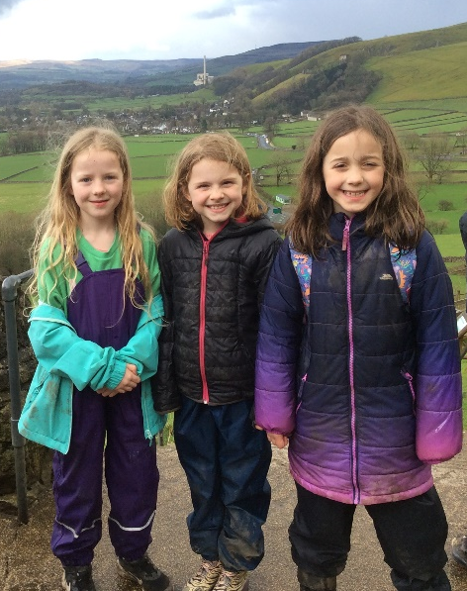
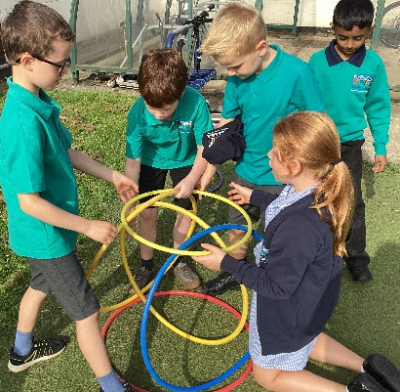
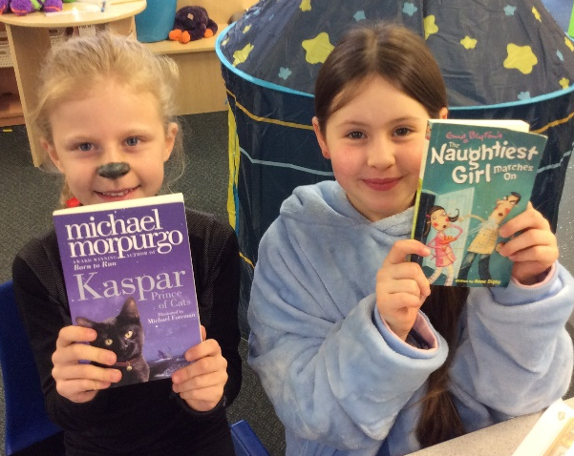
A Big Welcome to Our School

