Slide 1
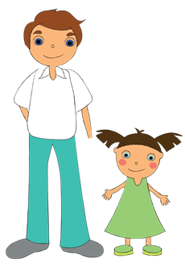
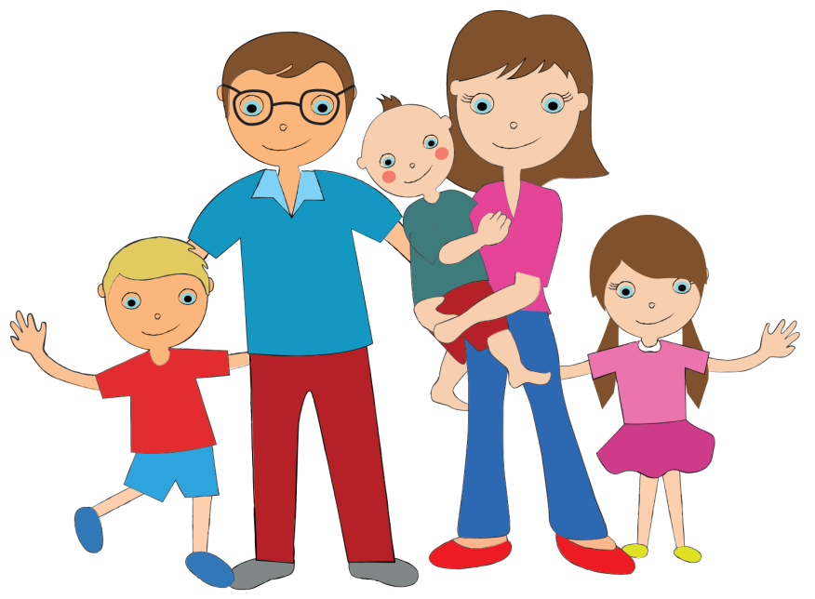

Feeling frightened at home?
A child’s guide to feeling safer in their own surroundings.
Notes:
This power-point is part of PDVI’s ‘The Lookout’ project education.

Slide 2
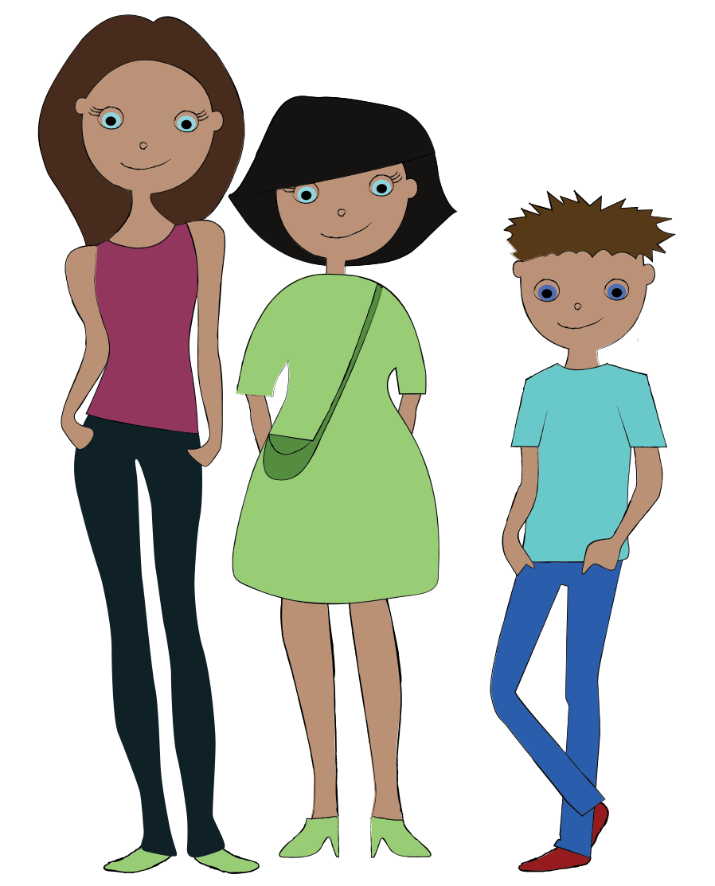
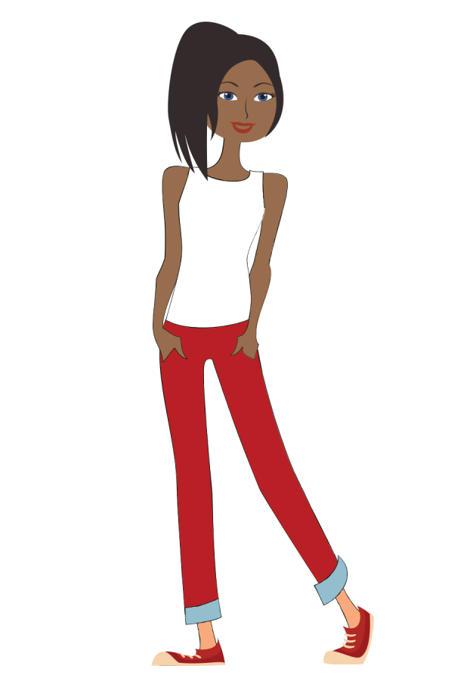
Hello, I’m here to talk with you about things that can happen at home that may make you feel frightened.
Notes:
Introduce yourself, giving a little background to who you are and your role. Share what your goal is in speaking to them today.

Slide 3

What are some words you could use to describe feeling frightened?
Scared
Unsettled
Funny in your tummy
Worried
Butterflies in stomach
Shaky (inside and out)
Goosebumps
Unsafe
Uneasy
Uncomfortable
Want to hide
Trembly
Nervous
Image source: clipart-library.com
Notes:
Give the child a few minutes to think of an answer. Then guide them through some other words they could use to describe being frightened, discussing examples for each one if needed.

Slide 4
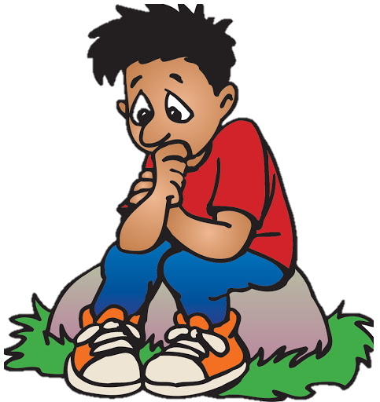
Sometimes people at home may do things which frighten you.
Can you think of things that people do that can be frightening?
Shouting aggressively (at you or others in your house)
Hitting (you or others in your house)
Throwing things about or breaking objects
Punching walls, doors etc
Being threatened
Hair pulling
Pushing
Touching private places of your body
Making you view things of an adult nature
Image source: clipart-library.com
How else might seeing or experiencing these things make you feel?
Notes:
After clicking the question, give time for the child to respond. If they are struggling, prompt them with the first one or two. At the end, give time to discus any other things that they may find distressing.
Open up a short discussion about other feelings they may experience from witnessing DV. (The next few slides will talk more about feelings.)

Slide 5
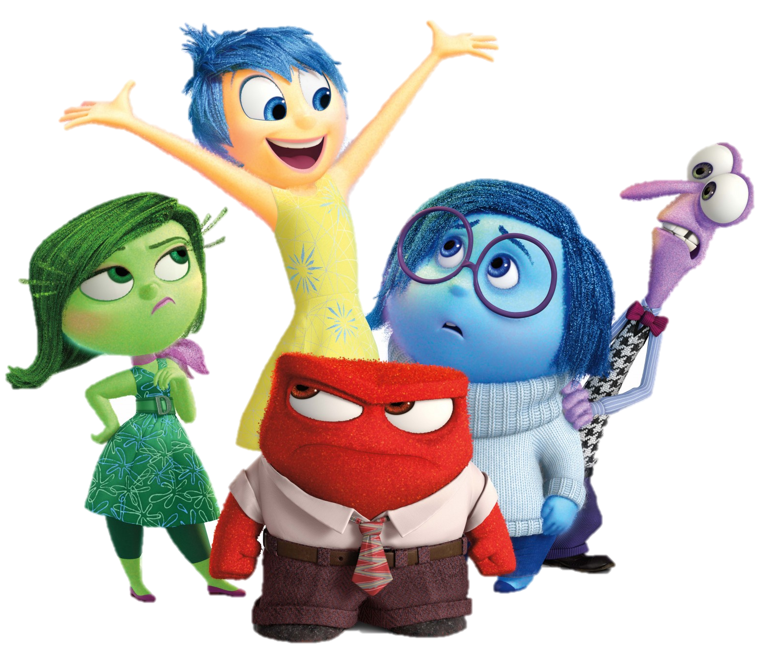
When you see people behave in ways that frighten you, or have things done to you that you don’t like, it can cause you to feel lots of different emotions inside.
These feelings are natural, they are trying to help you come to understand that what is happening is wrong.
Become aware of how you feel inside.
Quick fire: Set a 2 minute timer, take it in turns to name as many feelings as you can.
Image source: Disney

Slide 6
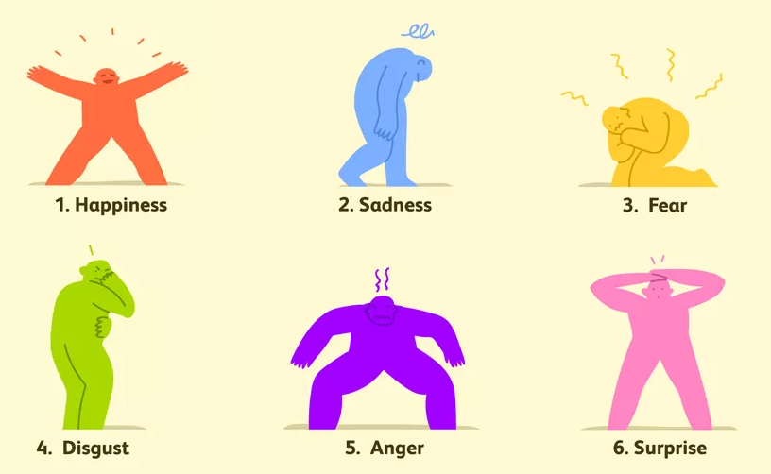
Feelings
Everyone feels these emotions.
It is important that when we feel negative emotions that you do something about it.
There are lots of people around you that you could talk to and ask for help when you feel any of the feelings we have looked at already.
Image source: verywellmind.com
What other feelings can you think of?
Notes:
Click through and then pause at the question.
Other emotions could be: Confused/confusion, worthless, low opinion of self.

Slide 7
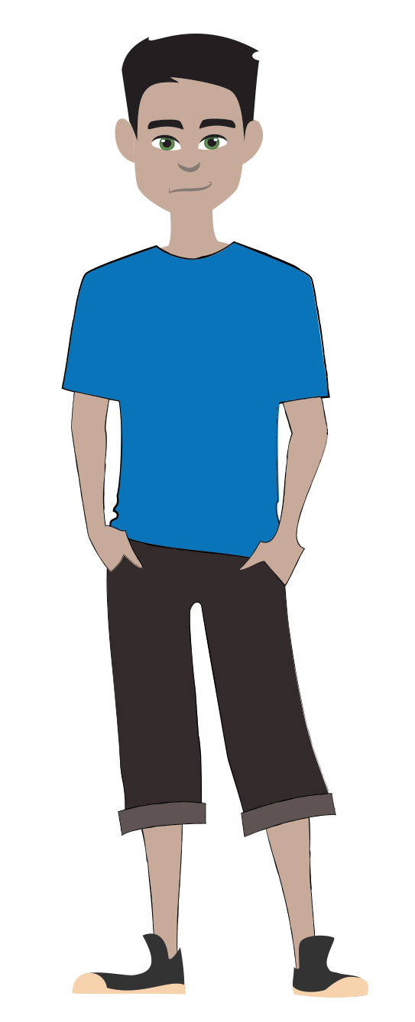
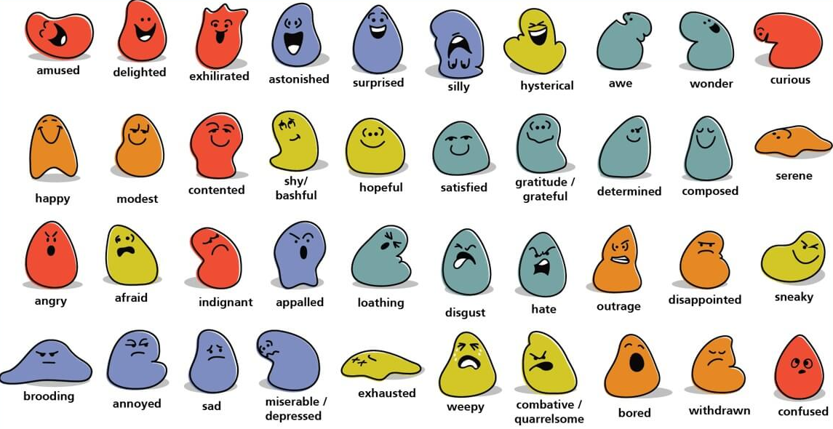
Which of these emotions do you think you have felt?
Image source: OysterEnglish.com
Notes:
Pause on this slide to allow time for the child to recognise any emotions they may be familiar with.

Slide 8
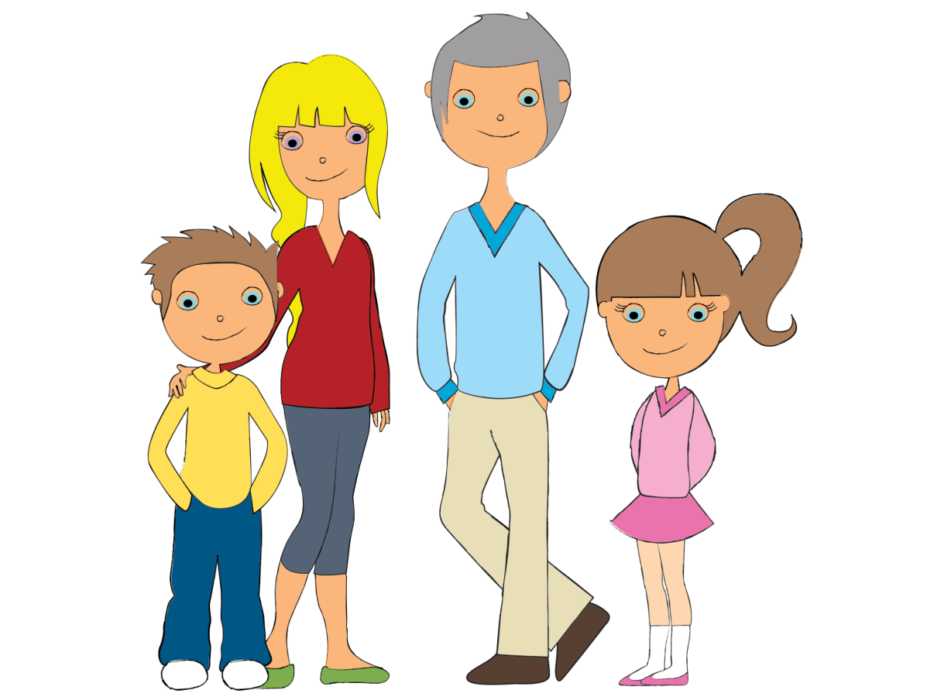

Let’s play a game…
Think of an emotion we have talked about today. Tell me a situation when you would feel that emotion.
How many examples can you think of?
Image source: clipartMax.com
Notes:
Have a quick fire game, taking time to explore why the child has felt the emotions they share. This gives opportunity for them to start identifying their feelings and associated experiences. This would be a good point to address any uneasy feelings they may experience; giving them permission to acknowledge their feelings and what may have caused them.

Slide 9
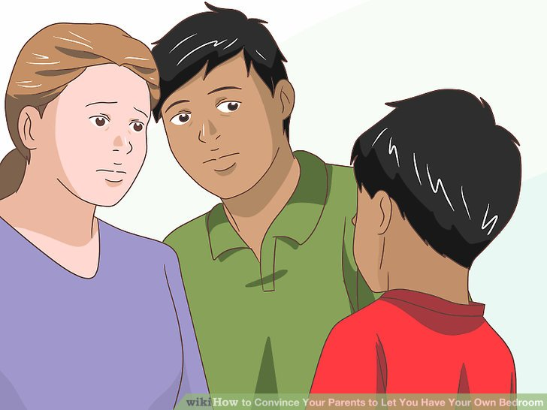

What you can do…
Talk to a trusted adult such as a parent, teacher or trusted family member (who is over 18)
Childline/NSPCC
A friend (who is over 18)
Talk to a member of ‘The Lookout’
If you feel any of those unpleasant feelings, what should you do?
Notes:
Give time to discuss the answer to the question before clicking through possible solutions.

Slide 10

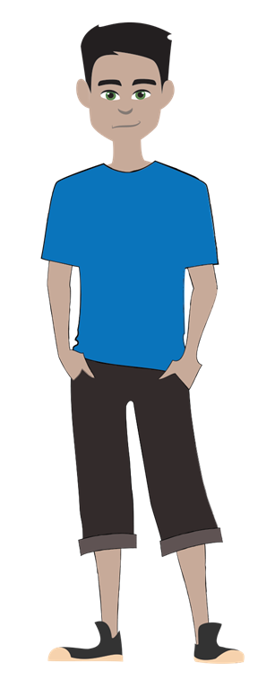
Let’s play a game…
Think about all the people whose job it is to keep you safe. Choose a square and see if you can identify who is underneath before all the squares run out.
Image source: clipartMax.com
Notes:
There are several job roles; you can go through them all or just skip to the roles you want to focus on by clicking anywhere other than the squares to move on to the next slide .
Order of roles: Fireman, Police officer, Lollipop man/woman, Parents/guardians, Doctor

Slide 11
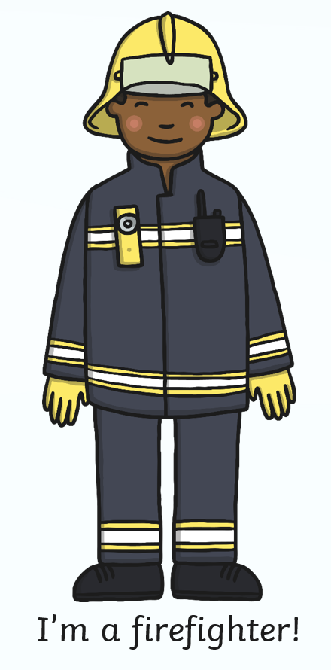
#1 I teach you about safety in your home.
Can you guess which one of the people who keep us safe is hiding behind the squares?
Pick a square to reveal who is underneath.
#2 I help when there are floods.
In what ways do they keep you safe?
#3 I help when there is a fire.
Image source: twinkl.co.uk
Notes:
Fireman
Click on a square to reveal the image underneath. There are ‘clues’ under the three squares on the right hand side of the screen.

Slide 12
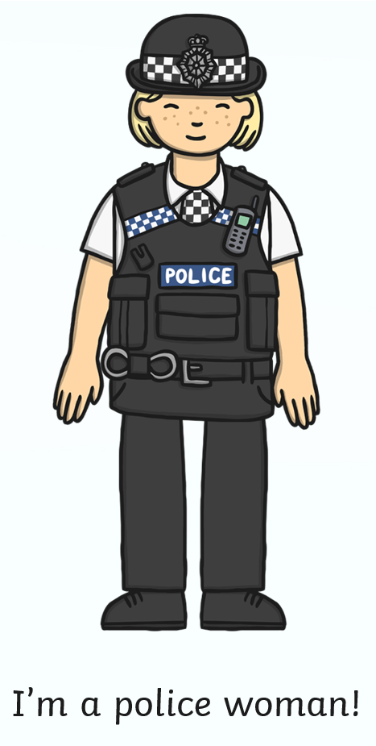
#1 I help protect you.
Can you guess which one of the people who keep us safe is hiding behind the squares?
Pick a square to reveal who is underneath.
#2 I help to catch criminals.
In what ways do they keep you safe?
#3 I walk the streets or drive a car with a siren.
Image source: twinkl.co.uk
Notes:
Police Officer
Click on a square to reveal the image underneath. There are ‘clues’ under the three squares on the right hand side of the screen.
You may want to emphases how the police (as well as community support officers) are helpful, dispelling misconceptions the child may have.

Slide 13
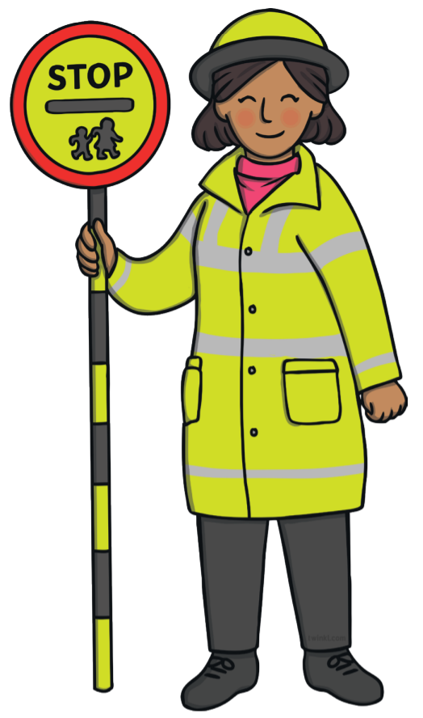
#1 I help you stay safe around traffic.
Can you guess which one of the people who keep us safe is hiding behind the squares?
Pick a square to reveal who is underneath.
#2 I help you cross the road.
In what ways do they keep you safe?
#3 I teach you to use the green cross code.
Image source: twinkl.co.uk
Notes:
Lollipop man/woman

Slide 14
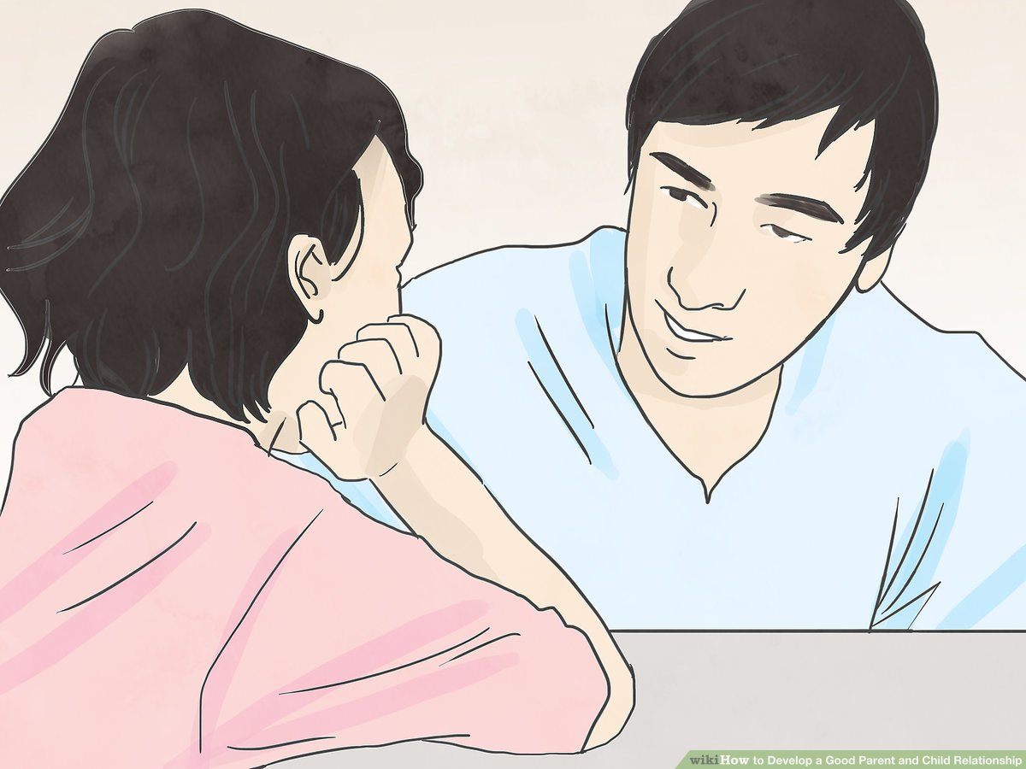
#1 I should help you stay safe.
Can you guess which one of the people who keep us safe is hiding behind the squares?
Pick a square to reveal who is underneath.
#2 I have responsibility for you.
In what ways do they keep you safe?
#3 You call me Mum or Dad
Parents or guardians
Image source: twinkl.co.uk
Notes:
Parents/guardians

Slide 15
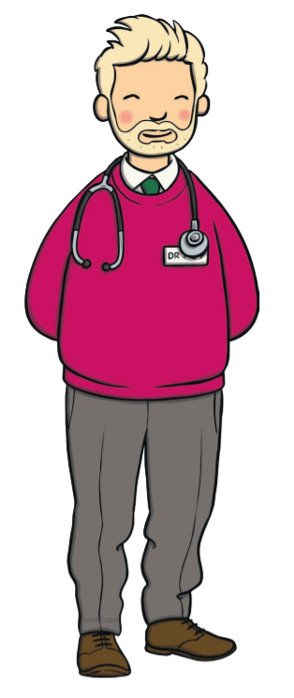
#1 I help you stay healthy.
Can you guess which one of the people who keep us safe is hiding behind the squares?
Pick a square to reveal who is underneath.
#2 I help you get better.
In what ways do they keep you safe?
#3 I teach people to look after themselves.
Image source: twinkl.co.uk
Notes:
Doctor

Slide 16

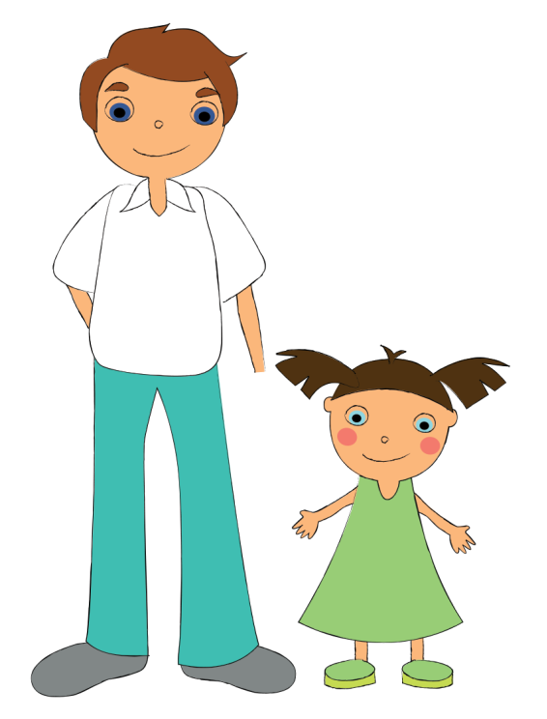
We have looked at a few people who can help keep you safe…
Who else can help keep you safe?
Notes:
This is an opportunity for the child to thing of anyone else they have in their life to help keep them safe (teachers/trusted adult family members/trusted neighbour etc). It could be an opportunity to discus your role with them too.

Slide 17

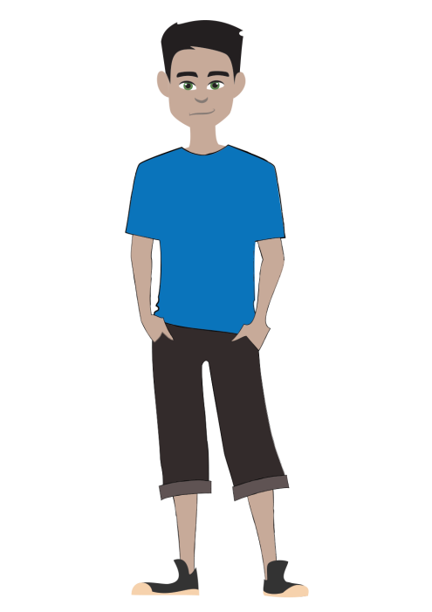
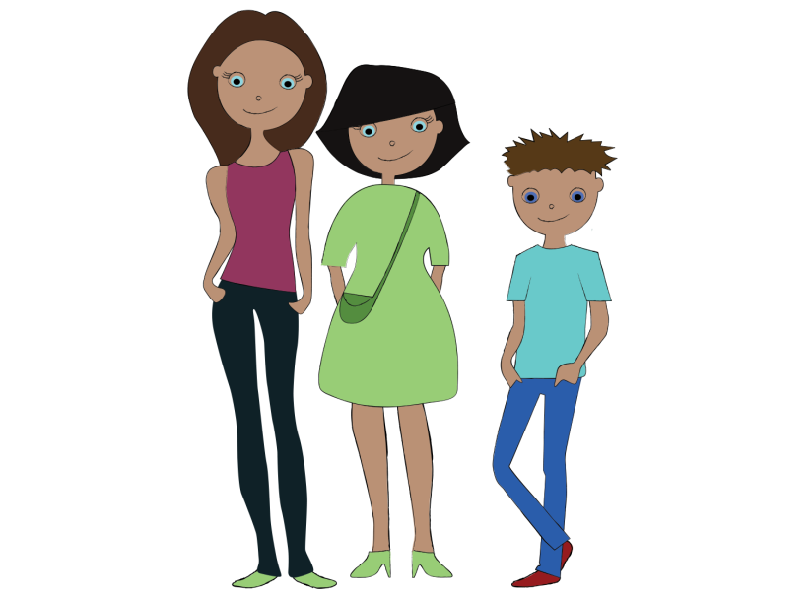

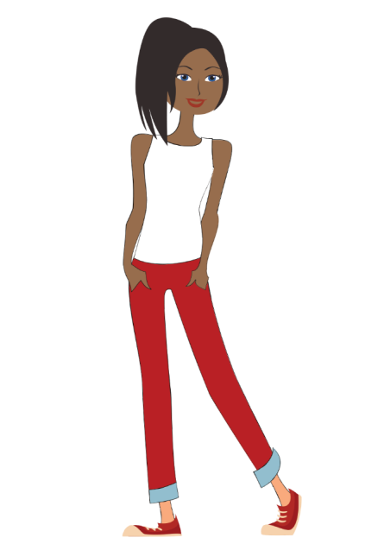



Remember…
Not all secrets are safe to keep!
You have people around you who want you to be safe and happy now and in the future.
If you are affected by any of the things we have talked about today you can speak to a member of ‘The Lookout’ team.
Notes:
Click though:
First paragraph- Emphasise the importance of speaking out and staying safe. There are many people all around them who want them to be safe.
Second paragraph- Emphasise the role of The Lookout and how to contact them.

