Slide 1

Thursday 9th January
KL: Digital Footprint

Slide 2


Aims
Slide 2
To understand that information put online leaves a digital footprint or trail.
To begin to think critically about the information we leave online.
To identify the steps that can be taken to keep personal data and hardware secure.
Need more support? Contact us:
Tel: +44(0)208 203 1781 | Email: support@2simple.com | Twitter: @2simplesoftware

Slide 3
Vocabulary Overview
Slide 3
Word encountered previous session
New in this lesson
Email: Messages distributed by electronic means from one computer user to one or more people.
Attachment: A computer file sent with an email.
Reply: When someone receives an email, they can send a reply using the reply button.
Personal information: This is information that is personal to someone. For example, their favourite food, their name and age.
Private information: This is personal information that should be kept secure. For example, their date of birth, their full address, credit card numbers.
Digital footprint: The information about a person that exists on the Internet as a result of their online activity.
Protection: Some places like schools, have systems in place that help to protect users from harmful content. However, it’s important that anyone using online services should always behave carefully to help protect themselves and others.
Identifying: It’s important that any information shared online doesn’t have details that can identify someone such as their name and address.
Secure: Users online should take steps to help keep their personal and private information secure.
Need more support? Contact us:
Tel: +44(0)208 203 1781 | Email: support@2simple.com | Twitter: @2simplesoftware

Slide 4


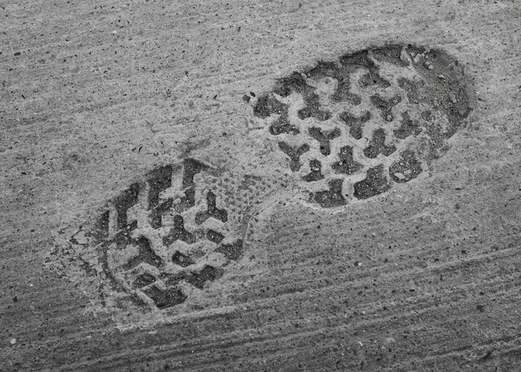
Footprints
Slide 4
What is a footprint?
Think about footprints on the beach or in the snow, what can they tell you about the owner of the feet?
What about walking through wet concrete and leaving it to dry, how is this different?
The wet concrete will dry with the footprints there for a very long time.
Need more support? Contact us:
Tel: +44(0)208 203 1781 | Email: support@2simple.com | Twitter: @2simplesoftware
Notes:
Think about footprints in the real world. They could be temporary or permanent.

Slide 5

Footprints
Slide 5
The trail that all people leave on digital technology is called a ‘Digital Footprint’.
Like the concrete footprints, a digital footprint lasts for a long time.
Once you start using digital technology to share on the Internet, you will start to make your own digital footprint.
Is this is a bad thing?
A digital footprint is only bad if it contains private things that you do not want to share or things about you that are not true and are hurtful.
In a moment, you are going to investigate a Purple Mash Digital footprint.
Sharing on Purple Mash is different from sharing on the Internet. Can you explain why?
What is a digital footprint | Online Safety for Kids | Digital Footprint for Kids | Online Safety
Watch the video about digital footprints.
Notes:
Click on the link to watch a video about digital footprints

Slide 6

Activity 1: Good Steps to Take
Slide 6
Which of these are good steps to use to keep personal data and hardware secure?
I should be careful about which photos I upload and think whether things in them could identify me to a stranger.
I will keep my password secret.
I mustn't leave my computer unlocked when I am not with it.
I should log out of sites when I finish using them.
It’s okay to give my brother my password to use.
If something upsets me or I’m worried that I have done something wrong, I should tell an adult.
I shouldn’t upload anything because I don’t want to get a digital footprint.
I can share funny photos I’ve made of my friends, they will never find out it was me!
Notes:
Activity 1: Decide which are the good steps and which are not.

Slide 7
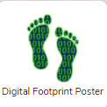
Activity 2: Digital Footprint Poster
Slide 7
Give examples of things that you would not want to be in your own digital footprint.
Think back to the slideshow and quiz and create a poster using the Digital Footprint Poster template telling others what should not be shared online.
Need more support? Contact us:
Tel: +44(0)208 203 1781 | Email: support@2simple.com | Twitter: @2simplesoftware
Notes:
Activity 2: Create a digital footprint poster

Slide 8
New Vocabulary Overview
Slide 8
Digital footprint
Secure
Digital footprint: The information about a person that exists on the Internet as a result of their online activity.
Secure: Users online should take steps to help keep their personal and private information secure.
Identifying
Protection: Some places like schools, have systems in place that help to protect users from harmful content. However, it’s important that anyone using online services should always behave carefully to help protect themselves and others.
Identifying: It’s important that any information shared online doesn’t have details that can identify someone such as their name and address.
Protection
Need more support? Contact us:
Tel: +44(0)208 203 1781 | Email: support@2simple.com | Twitter: @2simplesoftware
Notes:
Click on the words to reveal the definitions.

Slide 9
Review Success Criteria
Slide 9
I can explain what a digital footprint is.
I can give examples of things that I would not want to be in my digital footprint.
Need more support? Contact us:
Tel: +44(0)208 203 1781 | Email: support@2simple.com | Twitter: @2simplesoftware

