Slide 1

Thursday 18th January
Computing Scheme of Work
Unit 1.5 – Maze Explorers
KL: Challenges 1 and 2
Notes:
Unless otherwise stated, all resources can be found on the Lesson Materials: Lesson 1 page. From here, they can be set as 2Dos by clicking on the icon.
2Go: Lesson 1 Challenge 1
2Go: Lesson 1 Challenge 2
Additional extension activities for the 2Go challenges:
Extension Activity 1 – Lesson 1 Level 1
Extension Activity 2 – Lesson 1 Level 2
To make the most of this unit, it would be helpful if the children had had the opportunity to work with simple programmable toys to help develop directional language before engaging with this unit of work.

Slide 2


Vocabulary Overview
Slide 2
Words encountered previously*
New in this lesson and the unit.
Instruction: detailed information about how something should be done or operated.
Algorithm: a precise, step-by-step set of instructions used to solve a problem or achieve an objective.
Direction: The path that something travels. For example, a robot moving forwards or backwards.
Left and Right: A position which relates to something. For example, make the fish move left of the screen.
Challenge: A task to be completed.
Undo: If we make a mistake, we can press the undo button.
Route: A path an object or thing takes to get somewhere.
Delete: Removes something such as an instruction.
Command: An action such as left command.
Unit: A unit such as make the turtle move 2 units (squares).
*See unit 1.4
Need more support? Contact us:
Tel: +44(0)208 203 1781 | Email: support@2simple.com | Twitter: @2simplesoftware
Notes:
This slide can be used to see key vocabulary found within this lesson.
The vocabulary is repeated at the end of the lesson where it can be used to review new vocabulary.

Slide 3
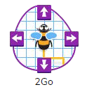
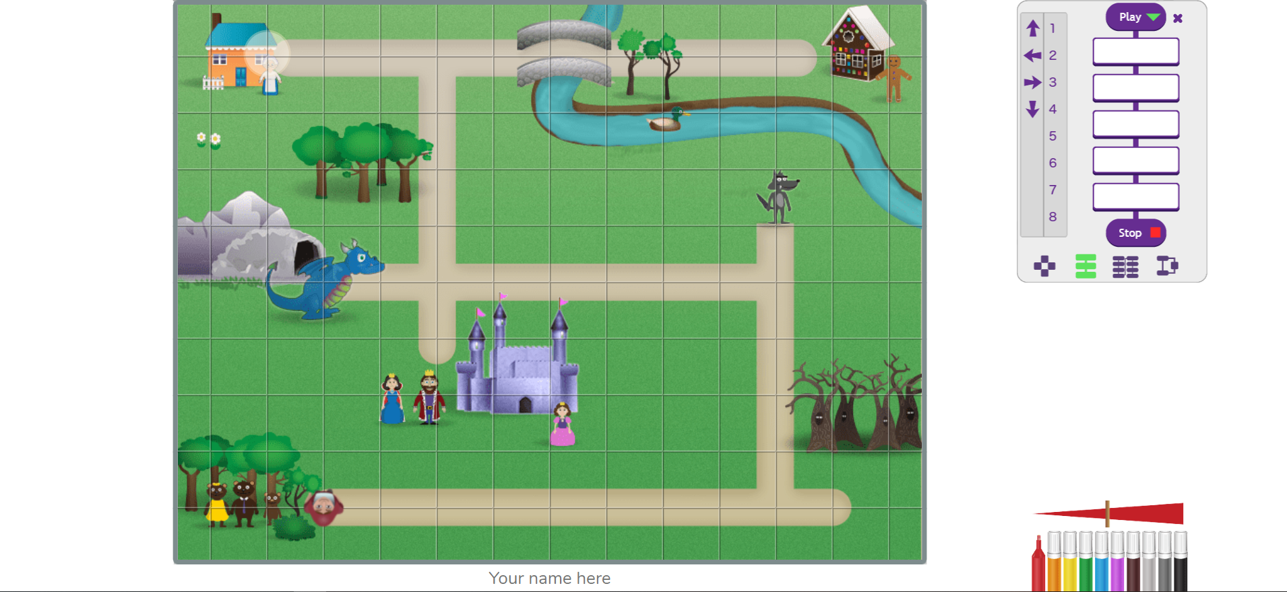
Introduction: 2Go
Slide 3
You are going to learn how to move things around on the computer using 2Go.
You will learn how...
2watch carefully
2listen carefully
2think brilliantly!
Then you can really make things happen!
Need more support? Contact us:
Tel: +44(0)208 203 1781 | Email: support@2simple.com | Twitter: @2simplesoftware
Notes:
Introduce the program 2Go from the tools section of Purple Mash.
Clicking reveals further information.

Slide 4
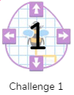
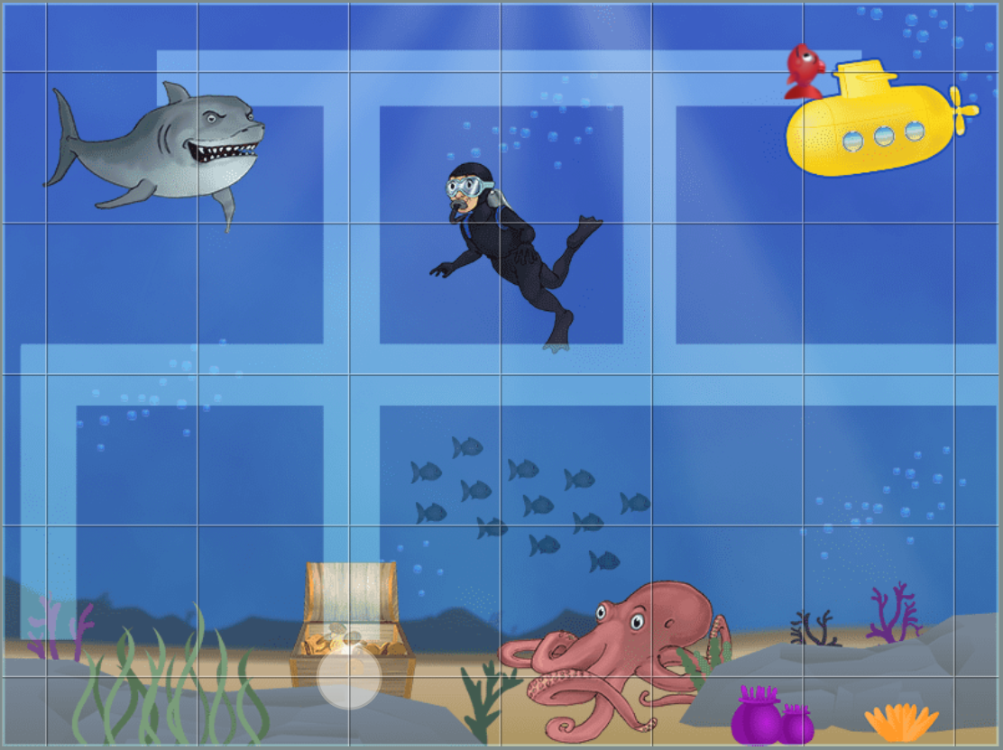

Activity 1: Challenge 1
Slide 4
Open up 2Go: Lesson 1 Challenge 1
Challenge: Guide the fish to the treasure chest using the direction keys.
direction keys
Need more support? Contact us:
Tel: +44(0)208 203 1781 | Email: support@2simple.com | Twitter: @2simplesoftware
Notes:
Introduce Challenge 1: Click on the link to open Challenge 1.
Demonstrate how to use the direction keys to move the fish around the screen.

Slide 5
Activity 1: Challenge 1
Slide 5
Suggested Questions:
Which way are we going to follow the path to the treasure?
Do you think there is a shortcut? Let’s draw the path with our finger first.
Which way do we need to make the fish go first?
Which command shall we press to make it go that way?
How far did the fish move?
Where shall we make the fish move to next?
Let’s count the squares; how many times do we need to press the command to make it move that way?
Make a mistake and let the children see how easy it is to undo it (undo button) or to send the fish back to the starting position and start again (rewind).
Challenge: Guide the fish to the treasure chest using the direction keys.
Now have a go at completing the challenge on your own device.
Need more support? Contact us:
Tel: +44(0)208 203 1781 | Email: support@2simple.com | Twitter: @2simplesoftware
Notes:
Check children understand the program and use the suggested questions to ensure children understand what the challenge is asking them to do.
When confident, allow them to have a go on their devices.
(Setting Challenge 1 as a 2Do enables quick access to this challenge from the 2Do area).

Slide 6
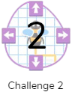
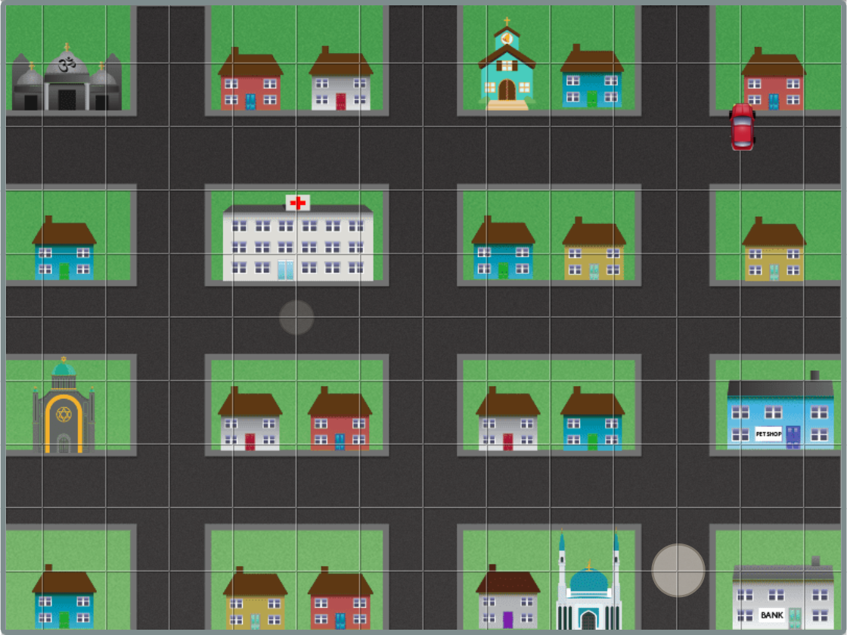

Slide 6
Activity 2: Challenge 2
Open up 2Go: Lesson 1 Challenge 2
Challenge: Drive the car to the bank and then to the hospital.
How does this challenge look different from challenge 1?
How are the direction keys different?
There is a number pad as well as direction keys.
You can now give a direction, e.g. forward 3.
The squares used in the grid are smaller than in the first activity.
Using the left and right commands, followed by a number, will move the car to the left or right by the number of squares you have chosen.
Need more support? Contact us:
Tel: +44(0)208 203 1781 | Email: support@2simple.com | Twitter: @2simplesoftware
Notes:
Introduce challenge 2. (Click on the link to open Challenge 2).
Discuss the questions first then click to reveal answers.

Slide 7
Activity 2: Challenge 2
Slide 7
Suggested Questions:
How many targets are there to meet?
Which route are you going to take to the bank first?
Map the route out with your finger.
The squares are much smaller on the grid. How many squares do you think the car should move to get to the bank?
Now you are at the bank, what command will you use to move towards the hospital?
Use the Undo button to try out your directions and delete them if they are wrong.
Challenge: Drive the car to the bank and then to the hospital.
Now have a go at completing the challenge on your own device.
Need more support? Contact us:
Tel: +44(0)208 203 1781 | Email: support@2simple.com | Twitter: @2simplesoftware
Notes:
Ensure children understand the program and use the suggested questions to ensure children understand what the challenge is asking them to do.
When confident, allow them to have a go on their devices. (Setting Challenge 2 as a 2Do enables quick access to this challenge from the 2Do area).

Slide 8
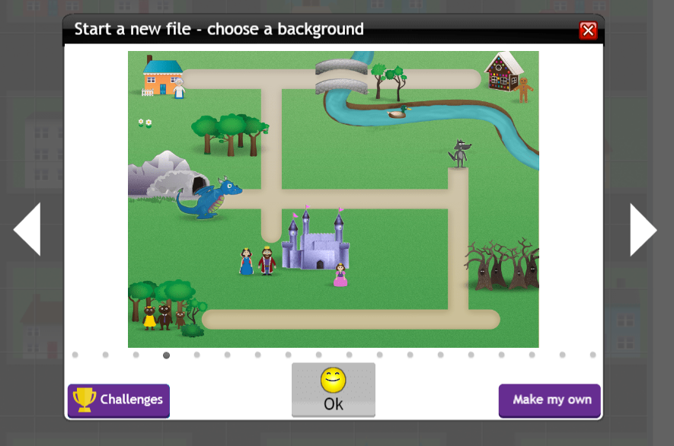
Slide 8
Activity 2: Challenge 2
Other things to try…
Once you have completed the task, set yourself another target. e.g., visit the pet shop, the temple and the church.
Can you make the car go around the village and create a big square shape?
Explore some of the other scenes by selecting a new background:
Need more support? Contact us:
Tel: +44(0)208 203 1781 | Email: support@2simple.com | Twitter: @2simplesoftware
Notes:
Suggest other things the children can try after they have reached the bank and hospital.
Children can explore another scene by clicking new, then using the white arrow keys to scroll through different backgrounds.

Slide 9
New Vocabulary Overview
Slide 9
Challenge: A task to be completed.
Direction: The path that something travels. For example, a robot moving forwards or backwards.
Left/Right: A position which relates to something. E.g. make the fish move left on the screen.
Challenge
Direction
Left/Right
Undo: If we make a mistake, we can press the undo button.
Route: A path an object or thing takes to get somewhere.
Delete: Removes something such as an instruction.
Undo
Route
Delete
Command: An action such as left command.
Command
Unit: A unit such as make the turtle move 2 units (Squares).
Unit
Need more support? Contact us:
Tel: +44(0)208 203 1781 | Email: support@2simple.com | Twitter: @2simplesoftware
Notes:
The slide can be used to review new vocabulary. Click on the words to reveal the definitions.

