Slide 1
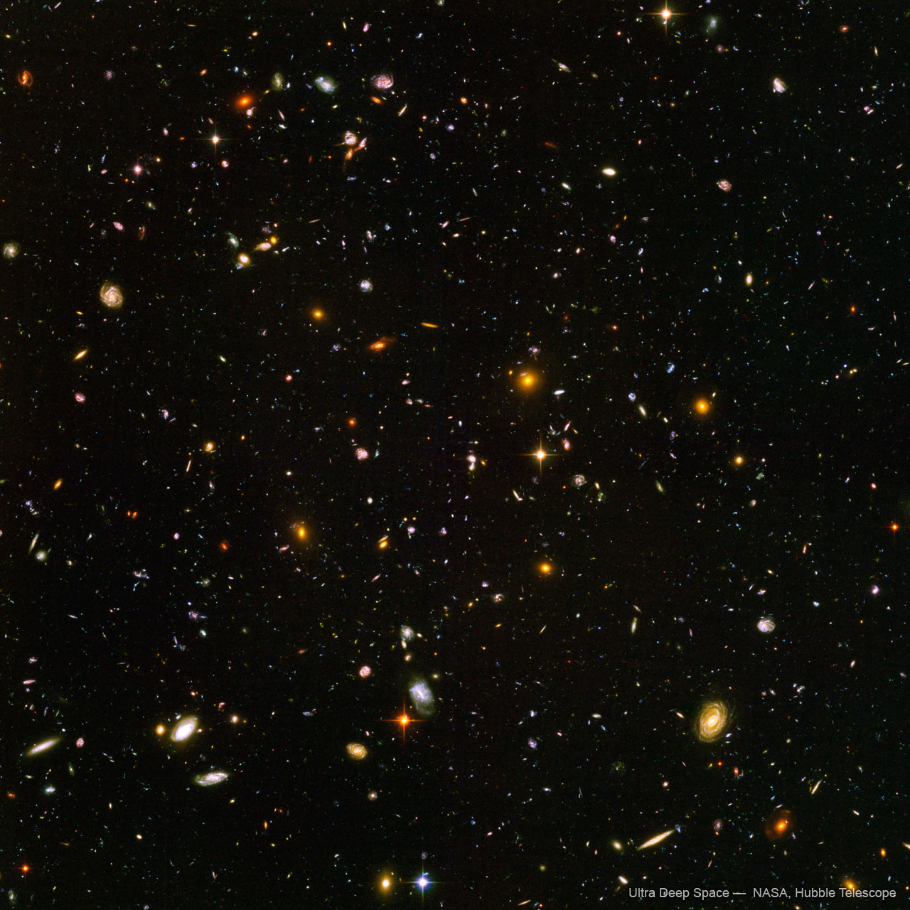
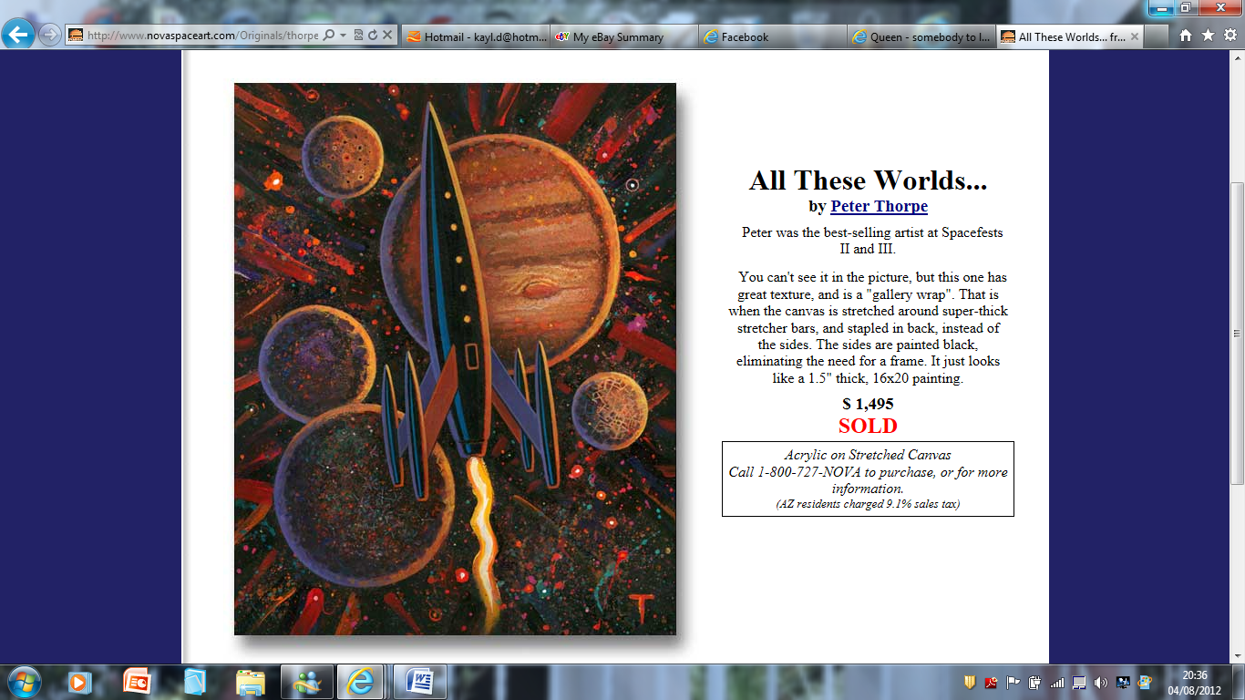
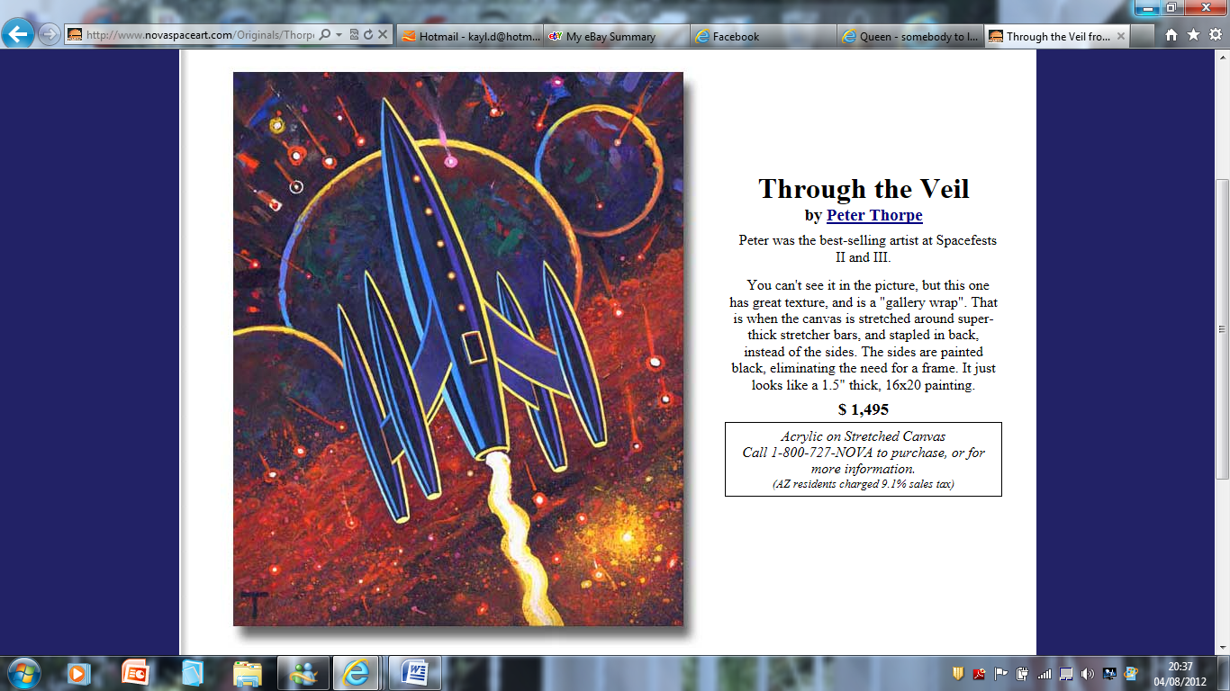
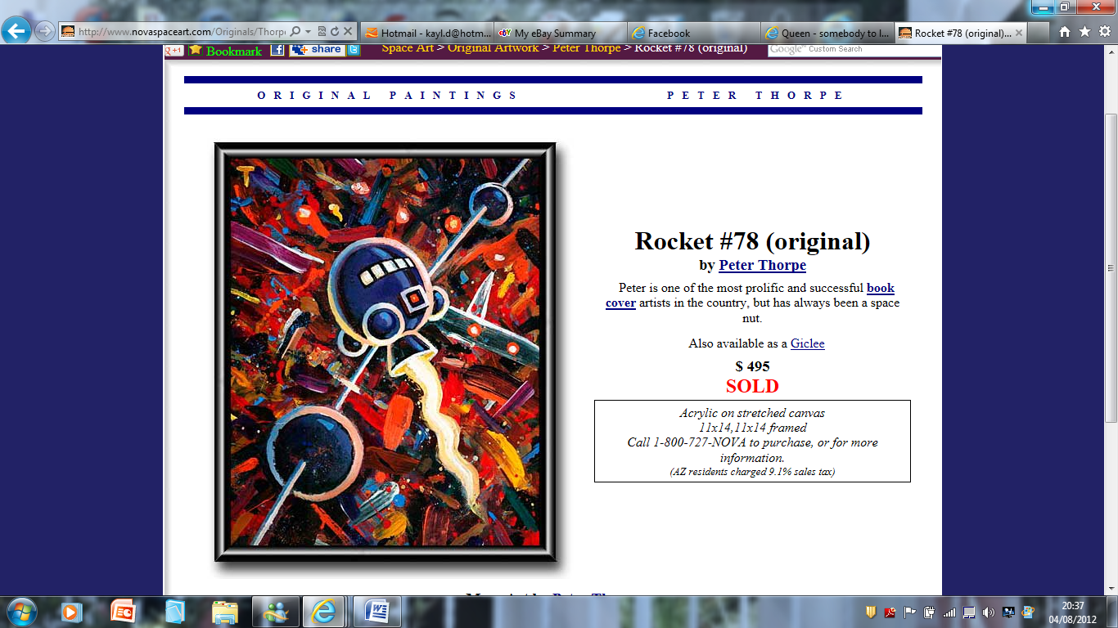
What is abstract art?
A painting or sculpture that does not represent a person, place or thing in the natural world.

Slide 2
LO: To investigate abstract painters and to research and examine surfaces of planets.

Slide 3
Jackson Pollock
Kandinsky
Peter Thorpe
Jean Miro
Mark Rothko

Slide 4
Let’s take a closer look at the planets…
http://www.windows2universe.org/our_solar_system/planets.html

Slide 5
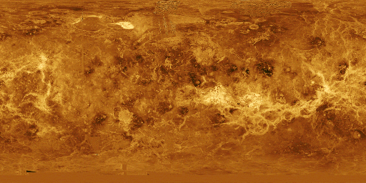
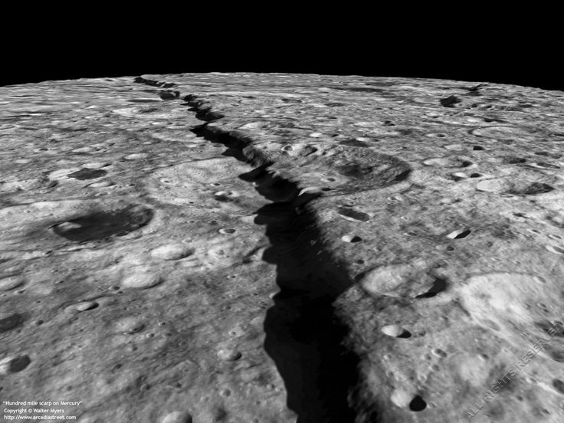
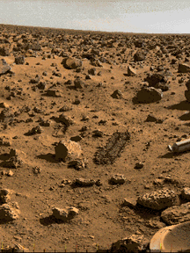
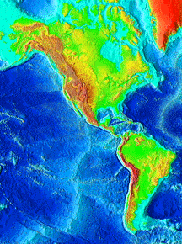
Venus
Mars
Mercury

Slide 6
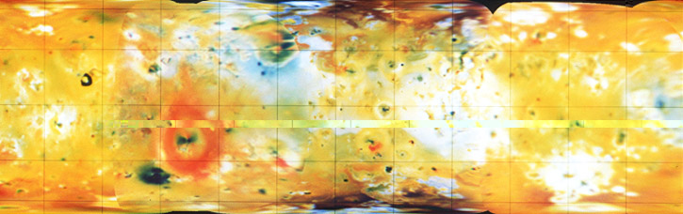
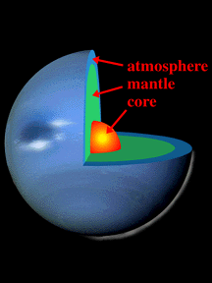
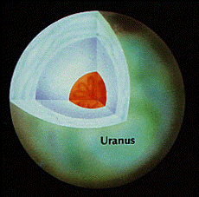
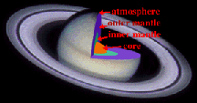
Jupiter
Saturn
Neptune

Slide 7
Plenary activity
1. What have I learnt?
2. How did the paintings make you feel?
3. Most useful activity?
4. Which artists work did you like best? Why?
5. Which planets surfaces did you sketch?
6. Describe the surface of one planet you sketched.

