Slide 1


Slide 3
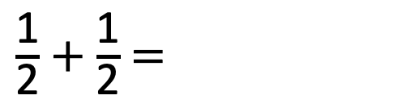
1)
2) A rectangle has an area of 26 m
The length of one of its sides is 1 m
How long are each of its longest sides?
3a) The side of a square is 12 cm
What is the square’s perimeter?
A regular hexagon has the same perimeter as the square in 3a).
What is the length of each of the hexagon’s sides?
$\frac{\text{1}}{\text{2}}$ + $\frac{\text{1}}{\text{2}}$ =
2

Slide 4
1)
2) A rectangle has an area of 26 m
The length of one of its sides is 1 m
How long are each of its longest sides?
3a) The side of a square is 12 cm
What is the square’s perimeter?
A regular hexagon has the same perimeter as the square in 3a).
What is the length of each of the hexagon’s sides?
$\frac{\text{1}}{\text{2}}$ + $\frac{\text{1}}{\text{2}}$ =
1
2
26 m
48 cm

Slide 5
A regular hexagon has the same perimeter as the square in 3a).
What is the length of each of the hexagon’s sides?
48 cm
48 cm ÷ 6 =
8 cm

Slide 7
1 cm
1 cm
1
2
3
4
5
6
9
7
8
Estimate the area of this shape.
What is the area of this shape?
2
9 cm

Slide 8

Have a think
1 cm
1 cm
3
2
1
4
Estimate the area of this shape.
2
4 cm

Slide 9
1 cm
1 cm
13
9
10
1
2
3
4
5
6
7
8
11
12
14
Estimate the area of this shape.
14 cm
2

Slide 10

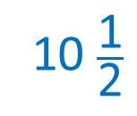

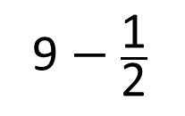
Estimate the area of these shapes.
1 cm
Have a think
1 cm
9
9 $−$ $\frac{\text{1}}{\text{2}}$
1
$\frac{\text{1}}{\text{2}}$
10
8 $\frac{\text{1}}{\text{2}}$
2
3
4
2
cm
5
6
7
8
1
2
3
8
7
10 $\frac{\text{1}}{\text{2}}$
2
4
5
6
9
cm
1 cm
1 cm

Slide 11
2
10 × 10 =
100 m
10 m
10 m
1
2
3
19
20
4
5
6
7
9
10
21
11
8
12
13
14
15
16
22
17
18
23
Estimate the area of this shape.
23
2
2,300 m

Slide 12
Have a go at the questions on the worksheet

