Slide 2
Aim
To identify and name some common trees.
Success Criteria
I can say what an evergreen tree is and what a deciduous tree is.
I can name and identify some evergreen trees.
I can name and identify some deciduous trees.
I can use leaves to identify and name trees.

Slide 3


Meet Quizby!
I will appear like this, click me to reveal a key question.
Can you spot me in the
Lesson Presentation?
Hi, I’m Quizby!
The questions that appear will help
you to think about the key learning throughout the lesson.

Slide 4







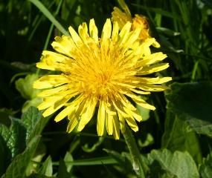
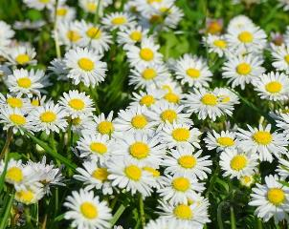
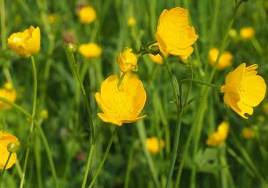
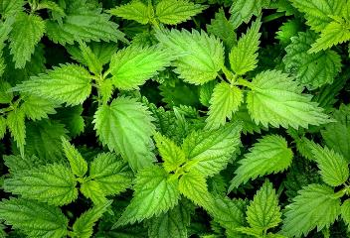
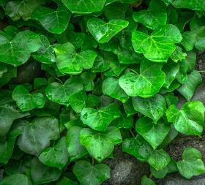
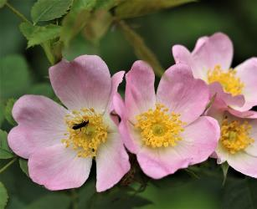
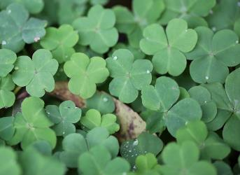
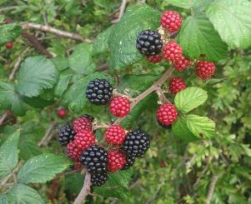
Remember It
Can you help to fill in the missing names of these plants from our Knowledge Organiser?
Wild Plants
dandelion
daisies
buttercups
nettles
x
ivy
dog rose
clover
bramble
Can you spot a plant that could also be a garden plant? Why can it be both?

Slide 5
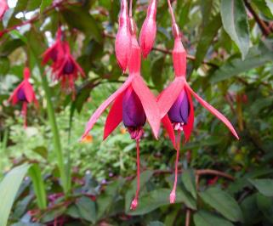
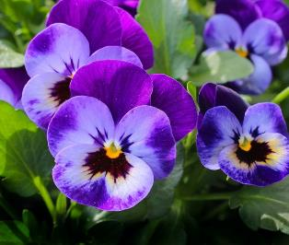
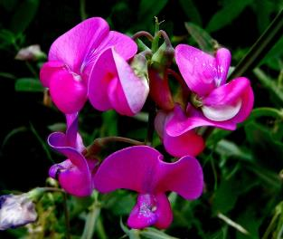
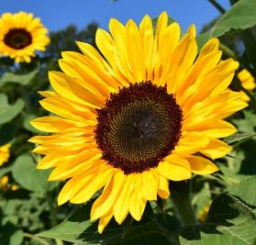
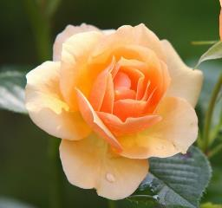
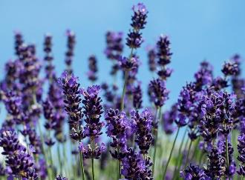
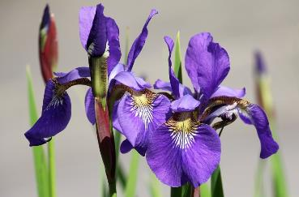
Remember It
Can you help to fill in the missing names of these plants from our Knowledge Organiser?
Garden Plants
fuchsia
pansies
sweet pea
sunflower
rose
lavender
iris
Have you seen any of these plants in real life? Can you tell me a fact about one of them?

Slide 6

Perfect Plants
Let’s find out all about trees in our Perfect Plants eBook.

Slide 7

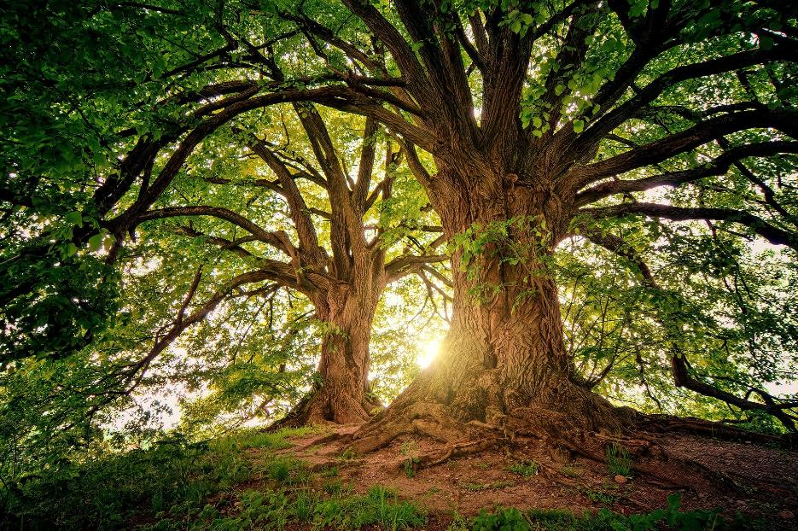
The Parts of a Tree
Tell your partner what you have learnt about trees from our eBook.
Which parts of this tree can you see?

Slide 8
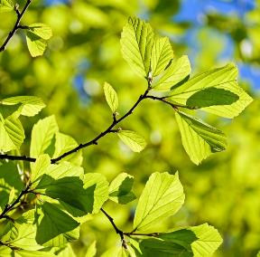
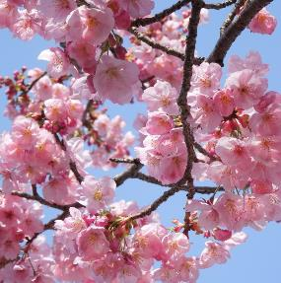
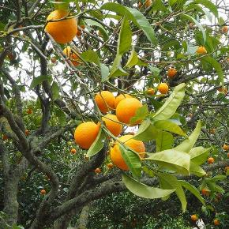
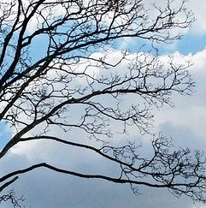
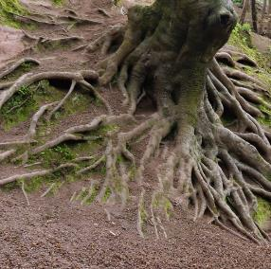
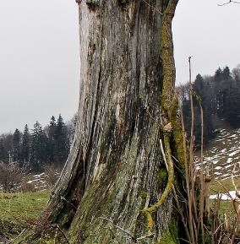

The Parts of a Tree
Can you name each part of the tree?
These are leaves.
This is blossom.
In spring some deciduous plants have lots of flowers. We call this blossom.
This is fruit.
These are branches.
These are roots. Tree roots grow underground, but can sometimes be seen above ground like this.
This is the trunk. The outside part of a trunk is called bark.

Slide 9
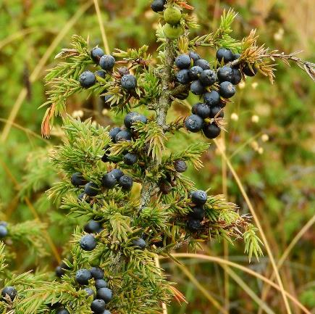
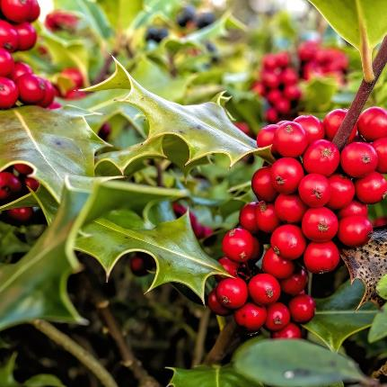
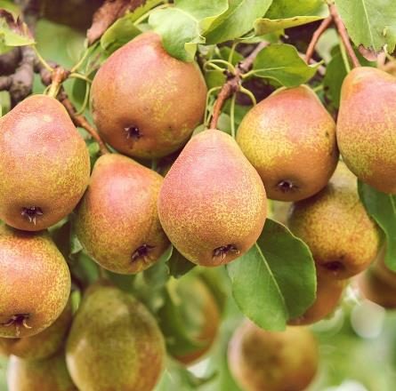
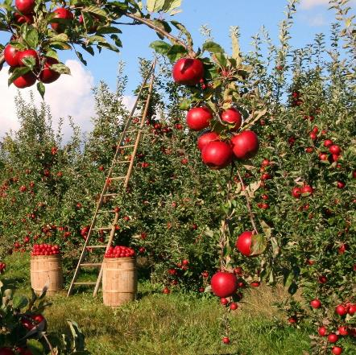
The Parts of a Tree
juniper berries
Tree Fruit
holly berries
Many trees have fruit. Some of the fruit can be eaten by people, such as oranges, apples and pears.
Some of the fruit is poisonous to people, but birds and other animals can eat them.
Holly berries are poisonous to people but robins love them!
pears
Poisonous definition
apples
Poisonous: Poisonous things can make us very ill if we eat (or sometimes even touch) them. That’s why it’s important to only touch plants or fruit that an adult says are safe.
X

Slide 10
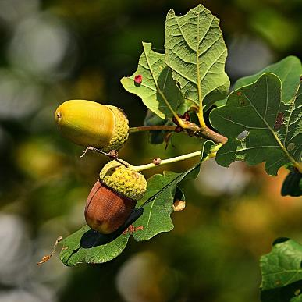
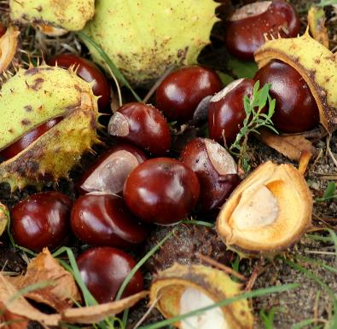
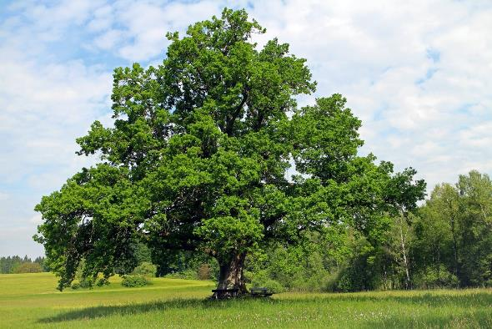
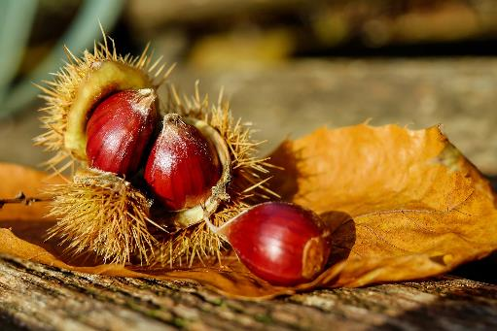
The Parts of a Tree
Some trees produce nuts. Some animals eat nuts, and some people eat them too.
Did You Know…?
sweet chestnuts
Some people are allergic to nuts (they can make them ill), so it’s important not to bring them into school if anybody has an allergy.
horse chestnuts (conkers)
Chestnuts are also nuts. Some chestnuts, such as sweet chestnuts, can be eaten by people. Some animals eat horse chestnuts (or conkers) but they shouldn't be eaten by people.
Acorns are nuts that grow on oak trees. People don’t tend to eat acorns, but woodland creatures love them!

Slide 11
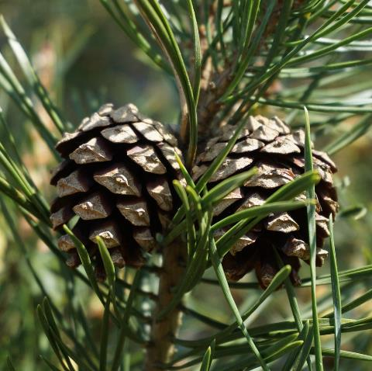
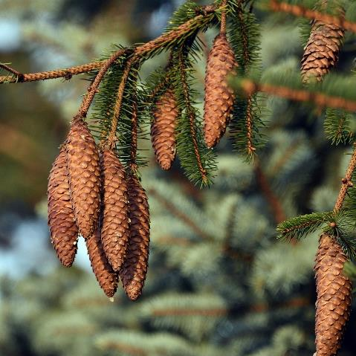
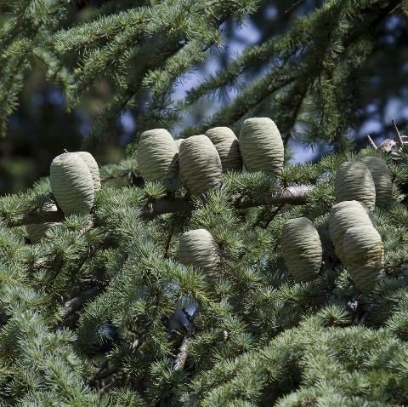

The Parts of a Tree
Some trees produce cones.
Scots pine cones
spruce cones
cedar cones
How are these cones similar? How are they different?
What job do you think cones do?
Cones contain seeds.

Slide 12

Deciduous Trees
In autumn, deciduous trees lose all of their leaves.
What happens to deciduous trees in autumn?
spring
winter
summer
X
Can you say what a deciduous tree is?
autumn

Slide 13
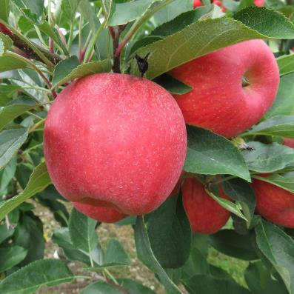
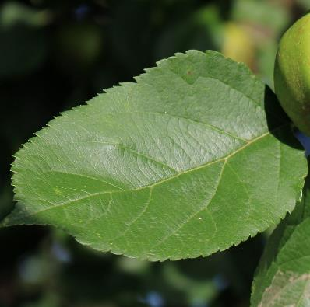
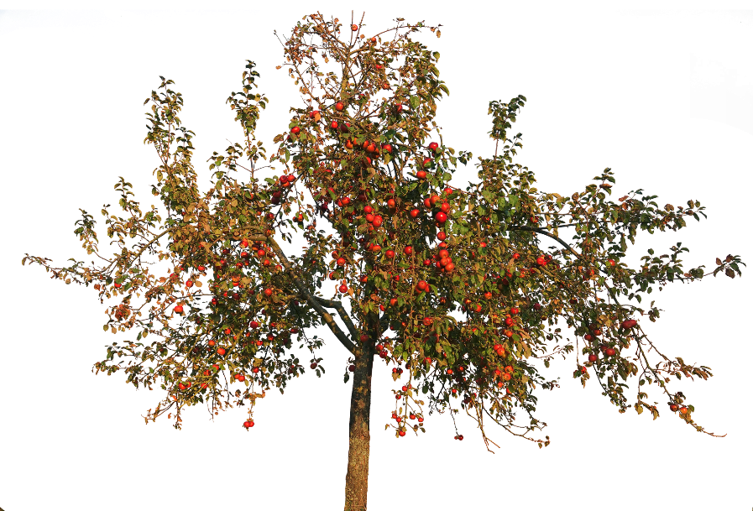
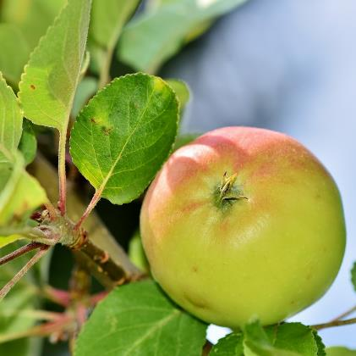
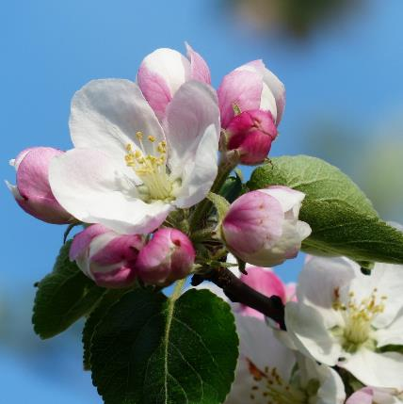
Deciduous Trees
Can you use the photo clues to help you to name the tree?
apple

Slide 14
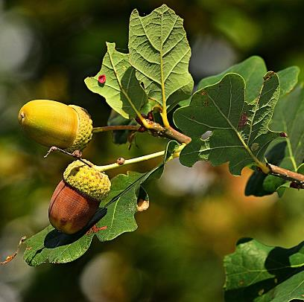
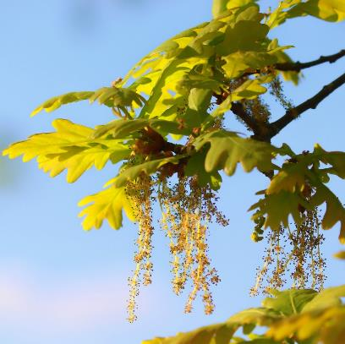
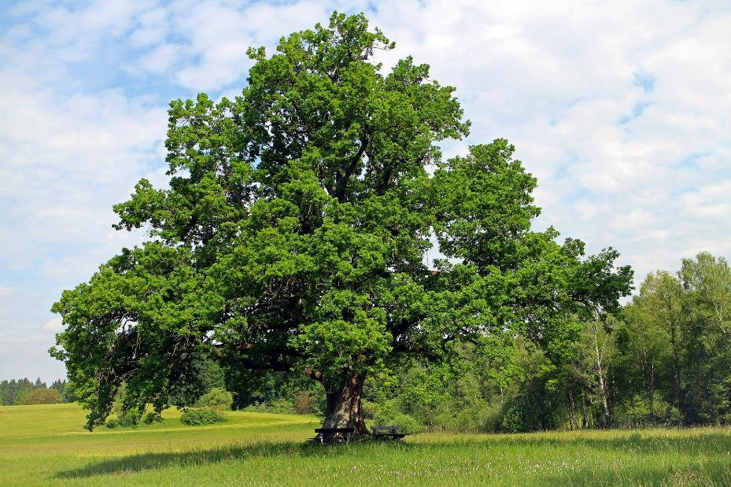
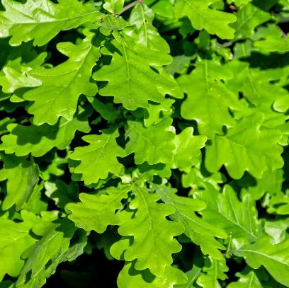
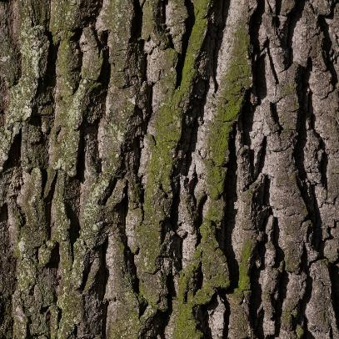
Deciduous Trees
Can you use the photo clues to help you to name the tree?
oak

Slide 15
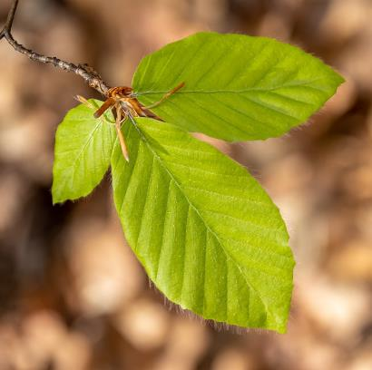
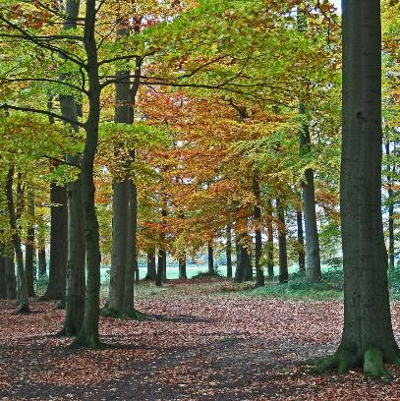
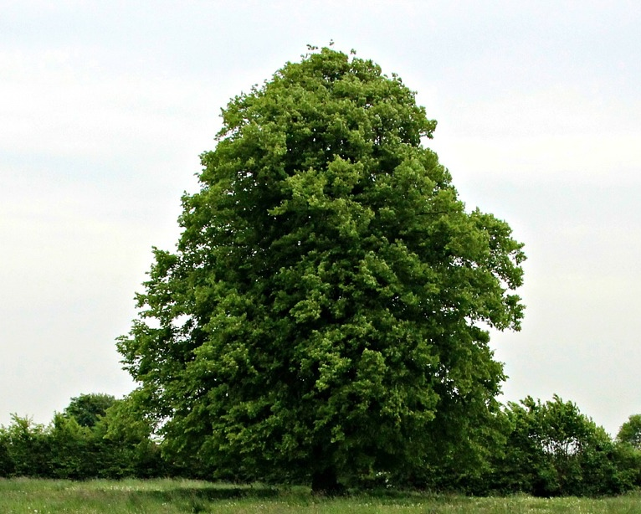
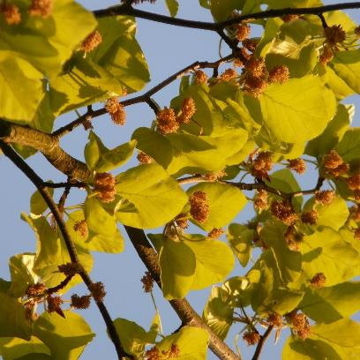
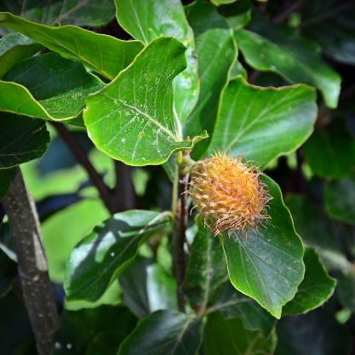
Deciduous Trees
Can you use the photo clues to help you to name the tree?
beech

Slide 16
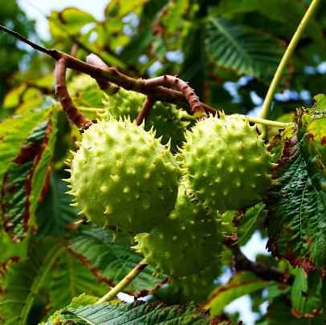
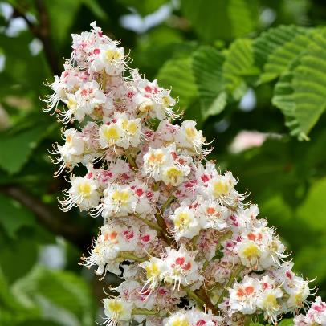



Deciduous Trees
Can you use the photo clues to help you to name the tree?
horse chestnut

Slide 17





Deciduous Trees
Can you use the photo clues to help you to name the tree?
maple

Slide 18





Deciduous Trees
Can you use the photo clues to help you to name the tree?
hawthorn

Slide 19




Deciduous Trees
Can you use the photo clues to help you to name the tree?
X
Can you name and identify deciduous trees?
sycamore

Slide 20

Evergreen Trees
Evergreen trees keep their leaves all year round.
How are evergreen trees different to deciduous trees?
Did You Know…?
Evergreen trees can grow flowers too.
Holly trees have very small white flowers.
spring
winter
summer
X
Can you say what an evergreen tree is?
autumn

Slide 21




Evergreen Trees
Can you use the photo clues to help you to name the tree?
cedar

Slide 22



Evergreen Trees
Can you use the photo clues to help you to name the tree?
holly
“Holly Tree” by Smabs Sputzer is licensed under CC BY 2.0

Slide 23




Evergreen Trees
Can you use the photo clues to help you to name the tree?
yew

Slide 24



Evergreen Trees
Can you use the photo clues to help you to name the tree?
spruce

Slide 25



Evergreen Trees
Can you use the photo clues to help you to name the tree?
cypress
X
Can you identify and name evergreen trees?

Slide 26






Tree Identification
There are so many different types of tree. How can we tell them apart?
How would you describe these leaves? Can you tell what trees they belong to?
We could look at different parts of the tree to help us. Which parts of the tree do you think we could look at?
Looking at the leaves of a tree is a good way to identify it!
chestnut tree leaves (deciduous)
oak tree leaves (deciduous)
maple tree leaves (deciduous)
pear tree leaves (deciduous)
spruce tree leaves (evergreen)
cedar tree leaves (evergreen)

Slide 27






Tree Identification
There are so many different types of tree. How would you describe these leaves? Can you tell what trees they belong to?
apple tree leaves (deciduous)
beech tree leaves (deciduous)
sycamore tree leaves (deciduous)
hazel tree leaves (deciduous)
yew tree leaves (evergreen)
holly leaves (evergreen)

Slide 28







Tree Leaf Sorting
Work with a partner to sort the leaves.
You could choose to sort them by their colour, into ‘evergreen’ or ‘deciduous’ groups, or any other way you choose. Make sure you can explain how you have sorted them!
1.
2.
3.
4.
5.
6.

Slide 29
Aim
To Identify and name some common trees.
Success Criteria
I can say what an evergreen tree is and what a deciduous tree is.
I can name and identify some evergreen trees.
I can name and identify some deciduous trees.
I can use leaves to identify and name trees.

Slide 31


Slide 32


Slide 33


Slide 34


