Slide 2


Meet Quizby!
I will appear like this, click me to reveal a key question.
Can you spot me in the
Lesson Presentation?
Hi, I’m Quizby!
The questions that appear will help
you to think about the key learning throughout the lesson.

Slide 3
Aim
To name and compare the parts of plants.
Success Criteria
I can name the parts of a plant.
I can find each part on a plant.
I can say what is similar and different when comparing parts of plants.

Slide 4







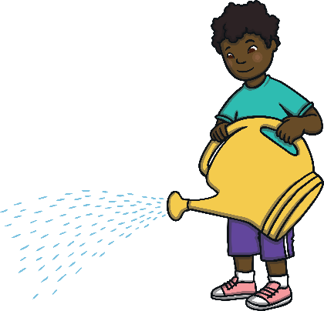
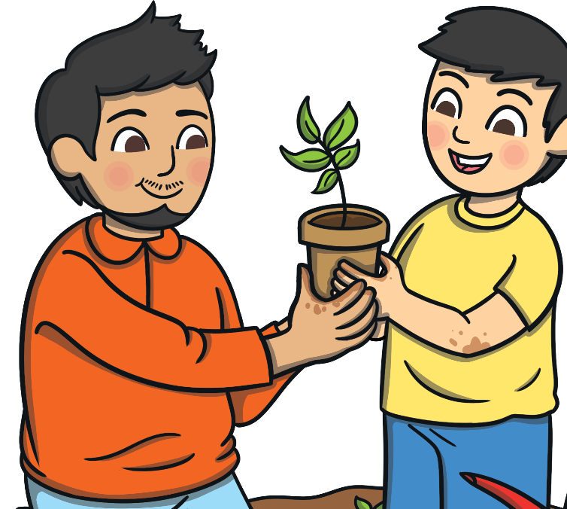

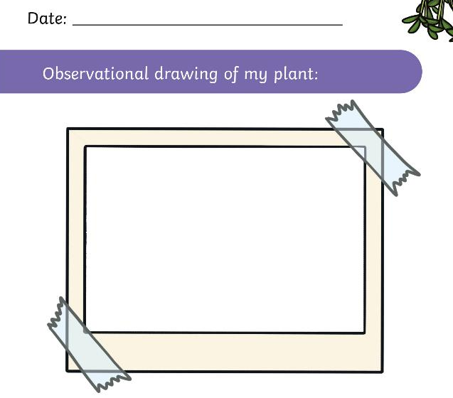
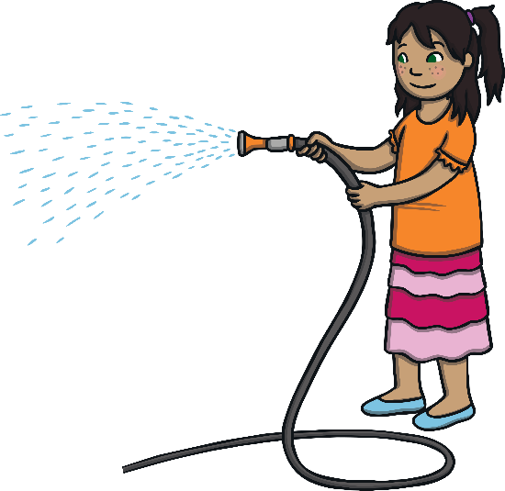
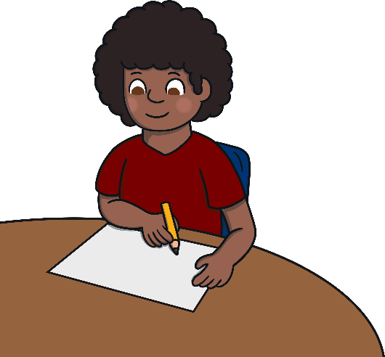
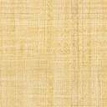
Remember It
Draw how your plant looks today on page 4 of your Plant Diary.
It’s time to look at the seeds or bulbs we have planted and see if they have started to grow!
It’s OK if our plants haven’t started to grow yet!
We can just draw exactly what we see.

Slide 5
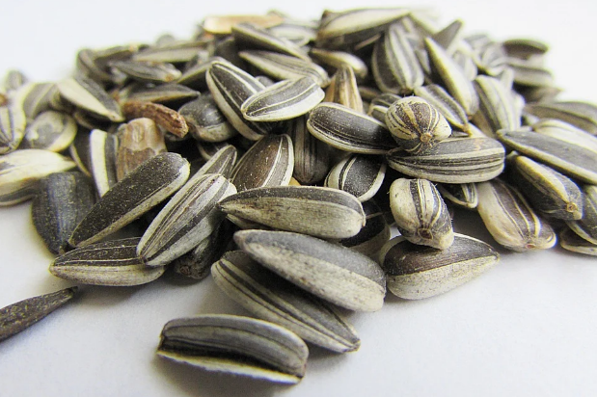
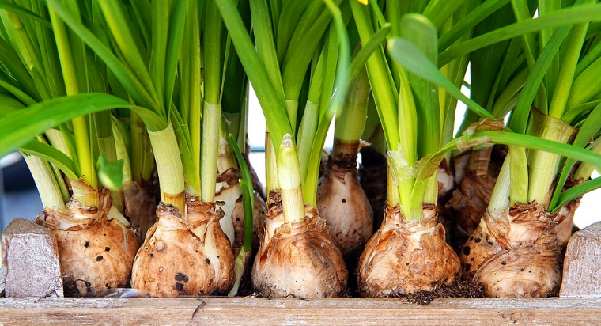
Remember It
Can you remember what these are called?
How are they similar and different?
seeds
bulbs

Slide 6
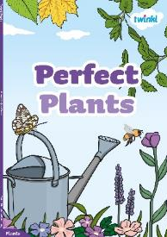
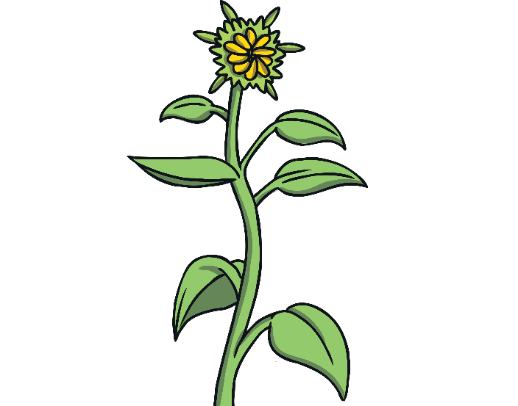
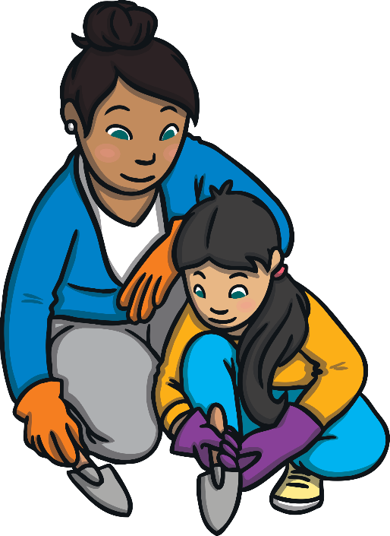
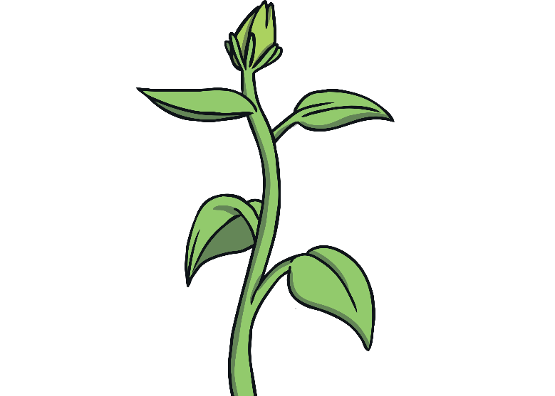
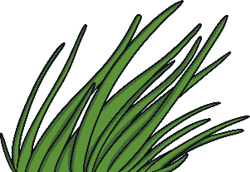
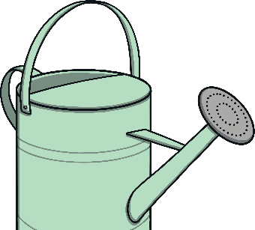
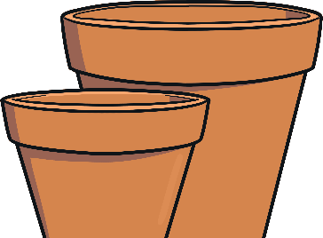

Perfect Plants
Let’s find out more about plants in our Perfect Plants eBook.

Slide 7

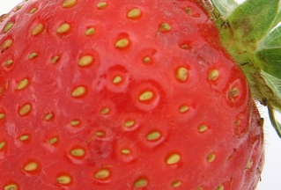
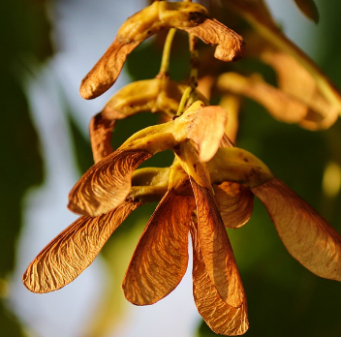

Perfect Plants
Look carefully at the seeds and bulbs.
Which plant do you think they will grow into?
Click on each picture to find out.
daffodil plant
strawberry
maple tree
sunflower
strawberry plant
daffodil
sunflower
maple tree

Slide 8

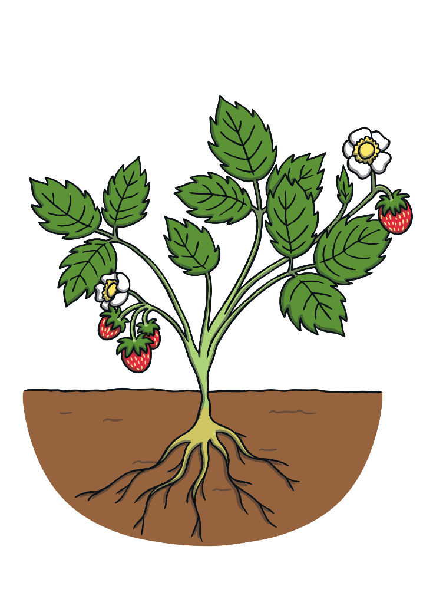



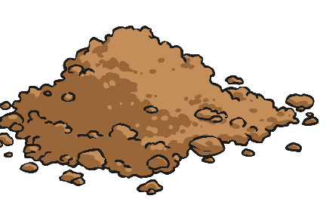

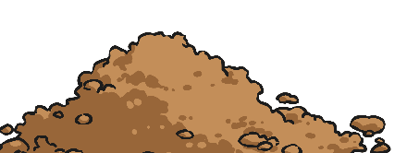
Parts of a Plant
Do you know what they are called?
Let’s look again closely at the parts of a plant.
leaves
flowers
stem
fruit
roots

Slide 9
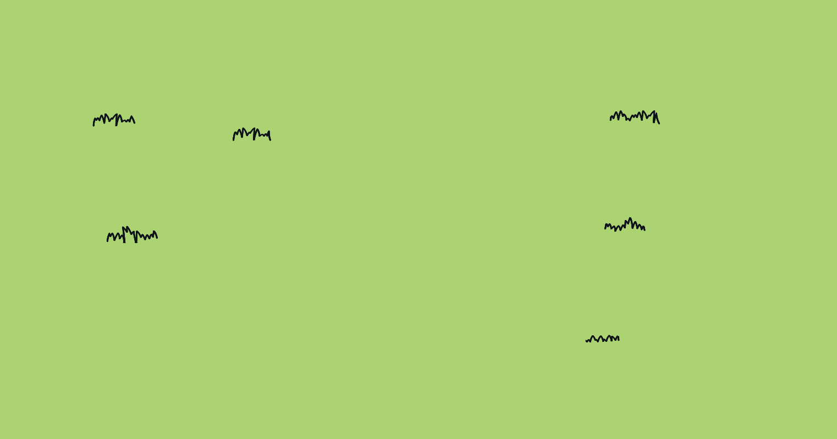
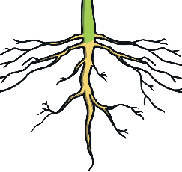

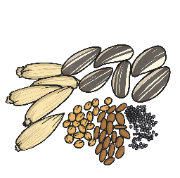



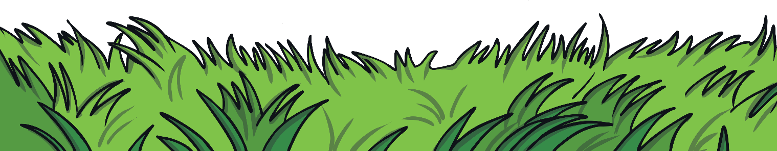
Parts of a Plant
Can you match the part of the plant to its name?
Click on each picture to find out.
stem
seeds
leaves
roots
fruit
flowers
seeds
roots
stem
leaves
fruit
flowers

Slide 10



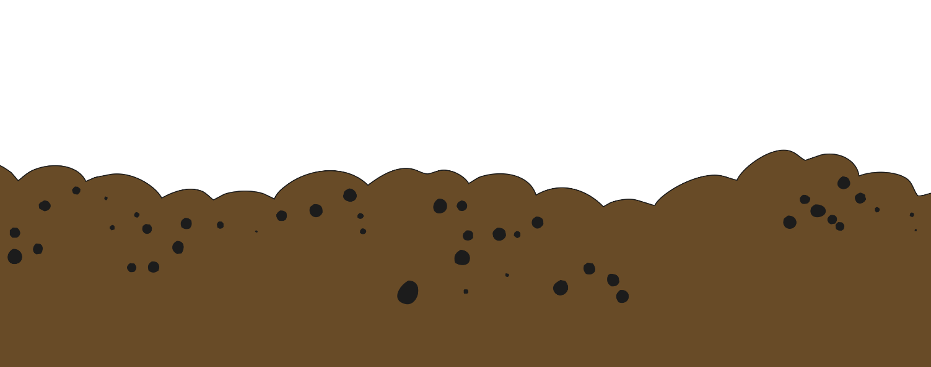



Parts of a Plant
Each part of a plant has a job to do.
Can you remember the job each part has?
The stem holds the plant up and carries the water and nutrients from the roots to the leaves and flowers.
Leaves catch sunlight to help the plant to make its own food.
Seeds grow into new plants.
Fruit contains the plant’s seeds.
Roots take in water and nutrients from the soil and keep the plant in the ground.
Flowers attract insects and birds.

Slide 11


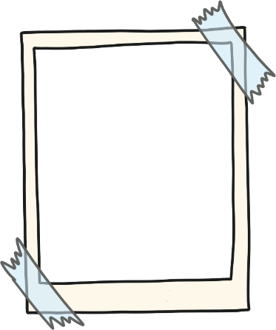

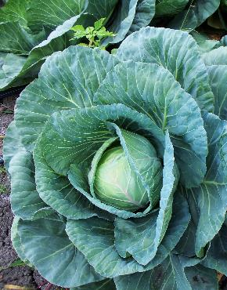
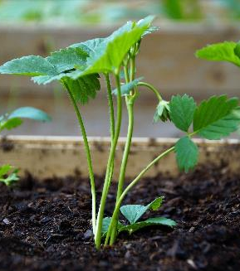
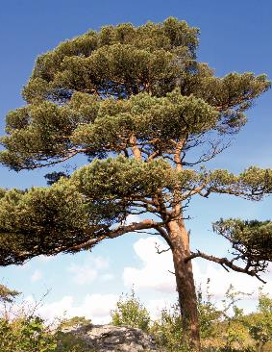


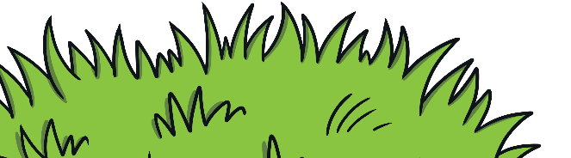
Looking Closely
Use these words to help you:
How are the roots similar for all the plants? How they are different?
How are the leaves similar for all the plants? How they are different?
We are going to look at the parts of a plant.
(Remember that real plants should be touched very carefully - they are living!).
Look at the other parts.
small
thin
round
long
short
bright
thick
straight
tall
curved
wonky
spiky
pointy
wide
smooth
Can you see each of the parts?
Are there any parts you can’t see? Why?
How are they similar and how are they different?
You could discuss their shape, size, colour or the job they do.

Slide 12
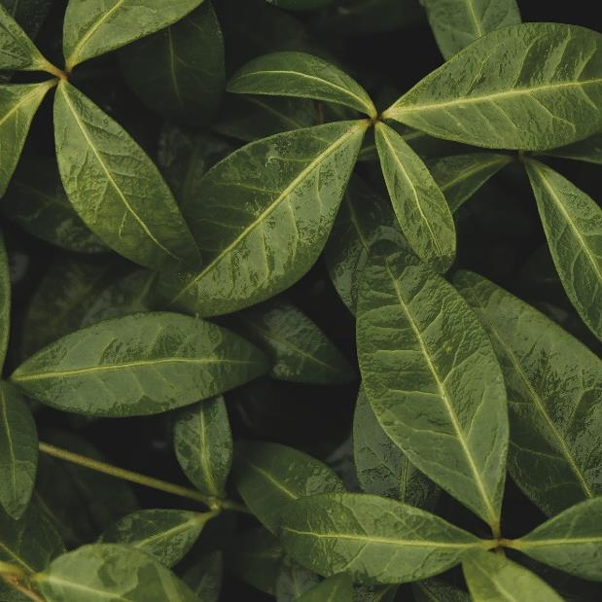
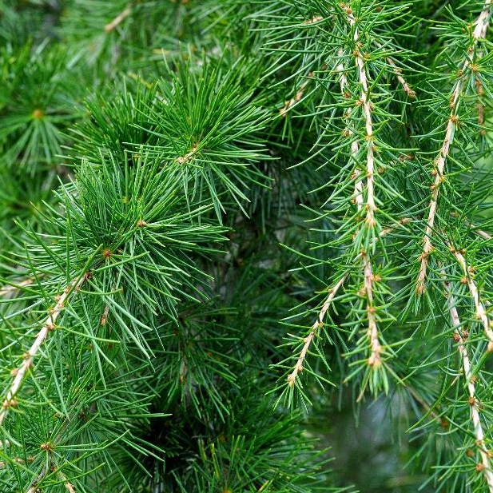
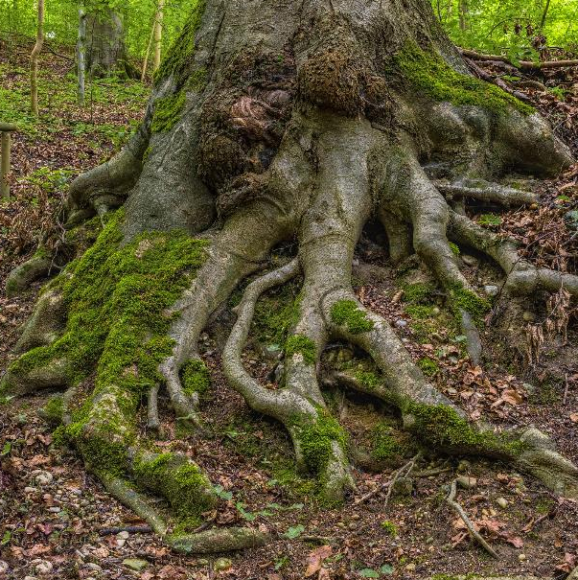
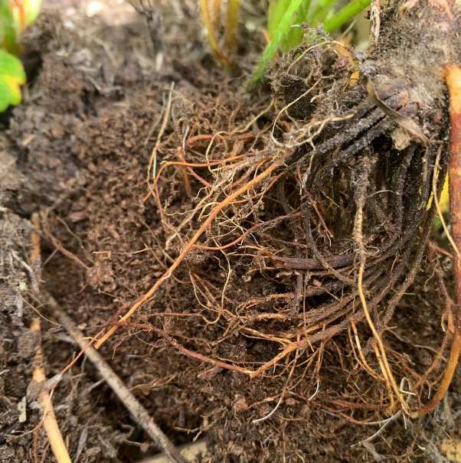
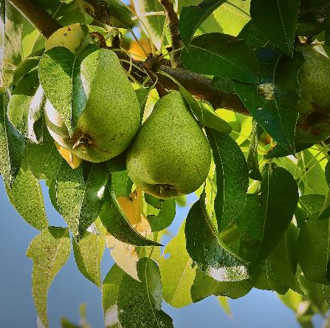
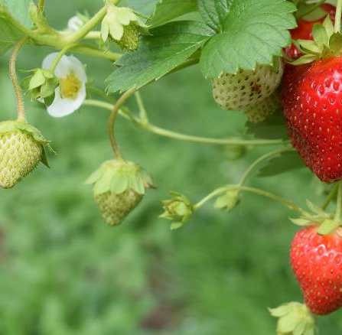
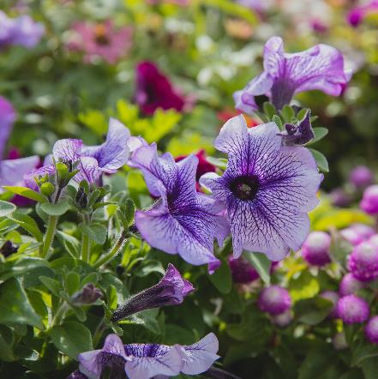
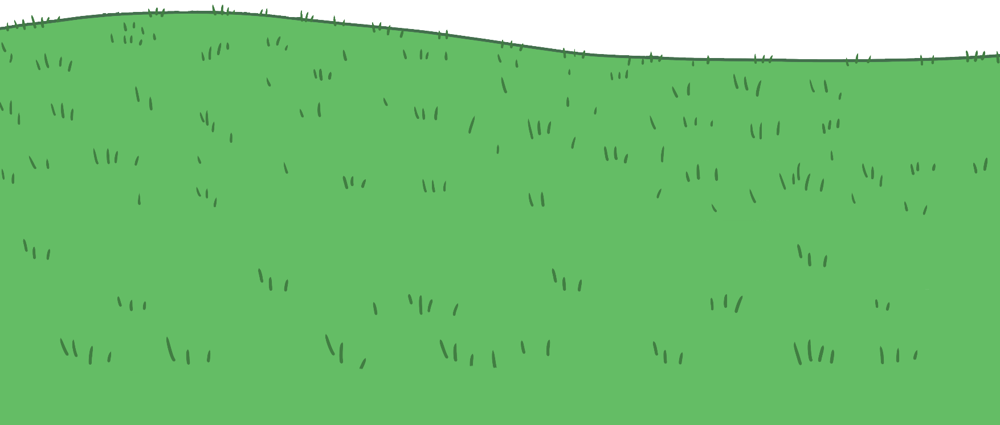

Sorting Plants
Plants have mainly the same parts but these parts can look very different from plant to plant.
Some plants have flowers.
Some plants have fruit.
Some have both!
Some leaves are smooth.
Some roots are thick.
Some roots are thin.
Some leaves are spiky.

Slide 13
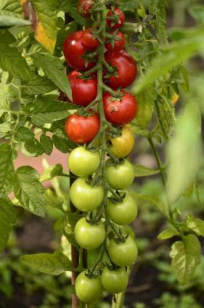
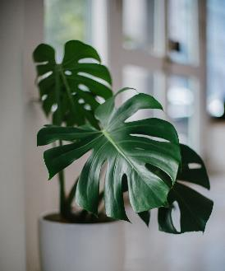
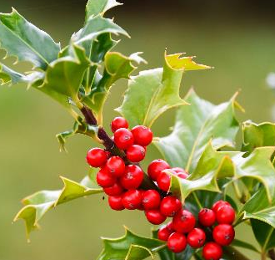
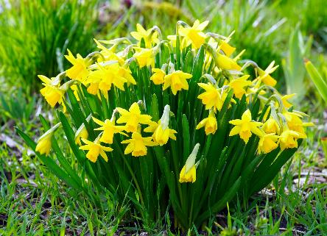
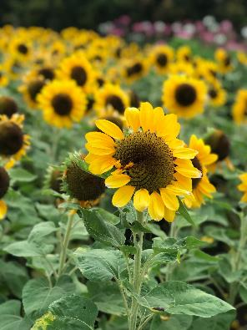
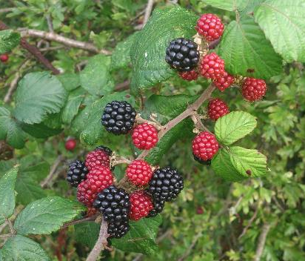
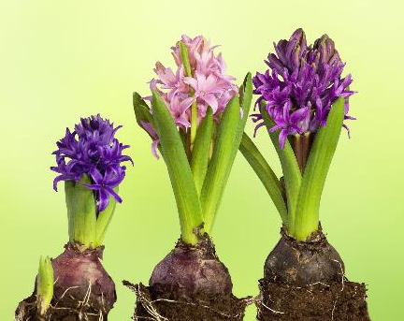
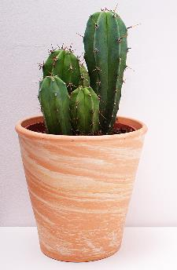
Sorting Plants
Draw two large circles on your whiteboard, like this.
How could we sort these plants? Write the number of each plant to sort it.
1
3
4
2
6
5
7
8

Slide 14
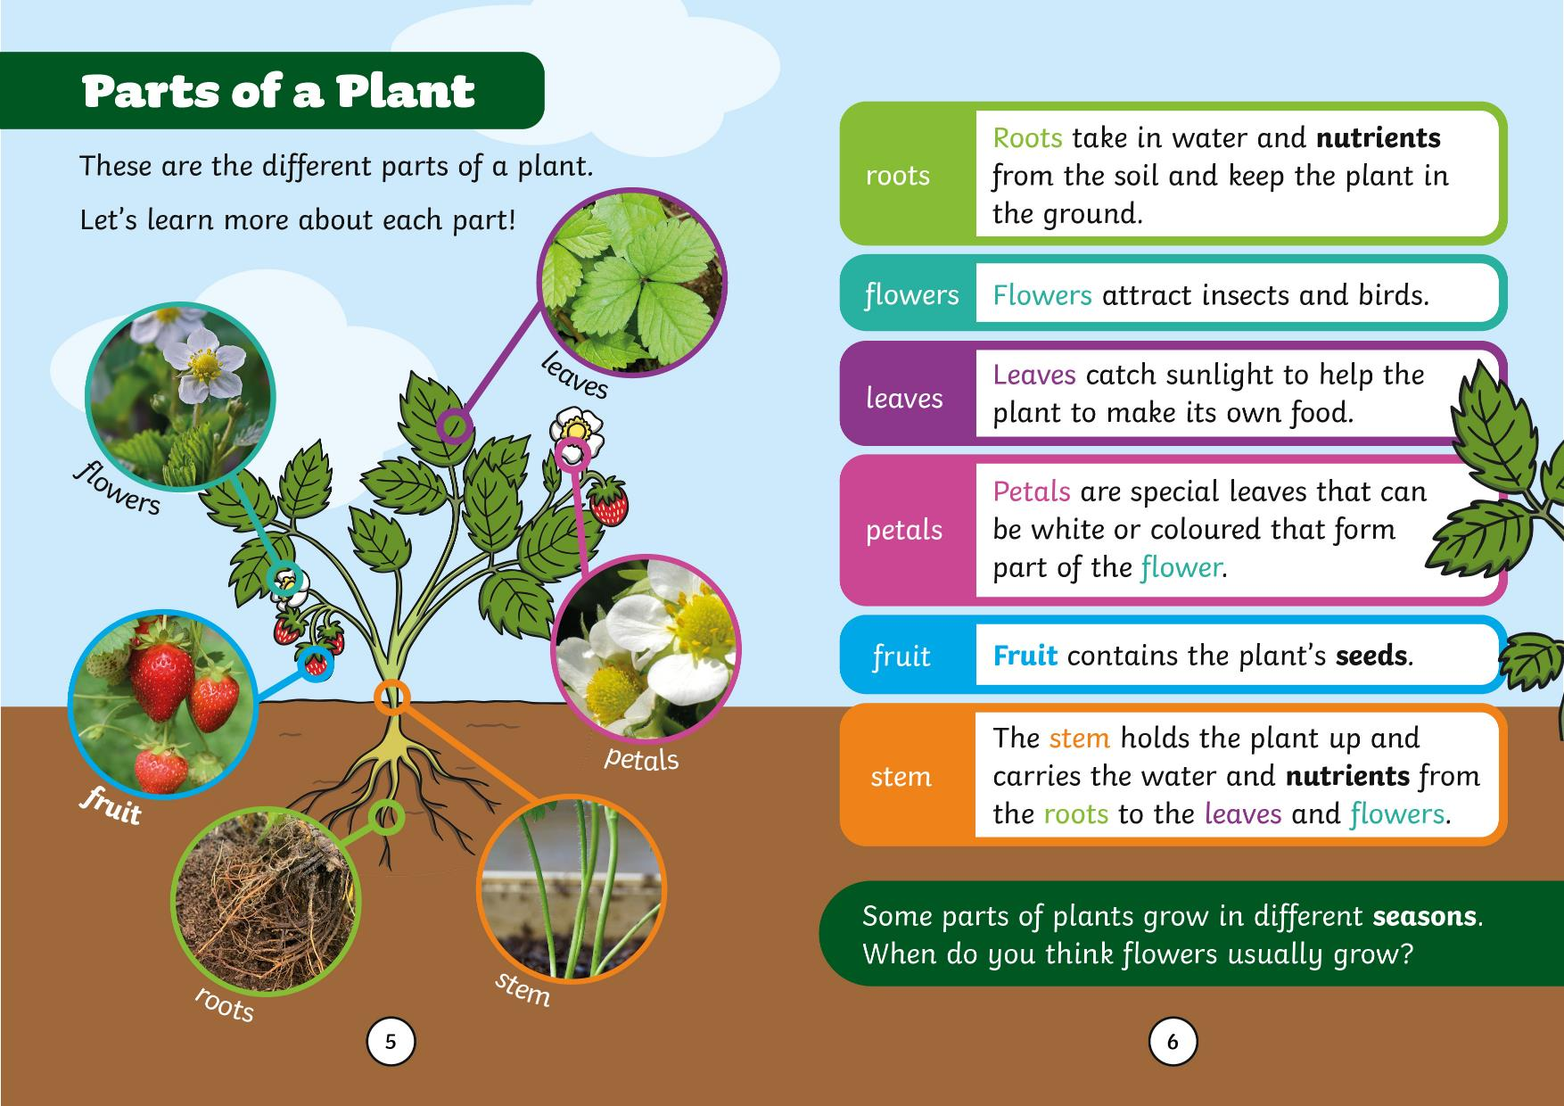

Slide 15
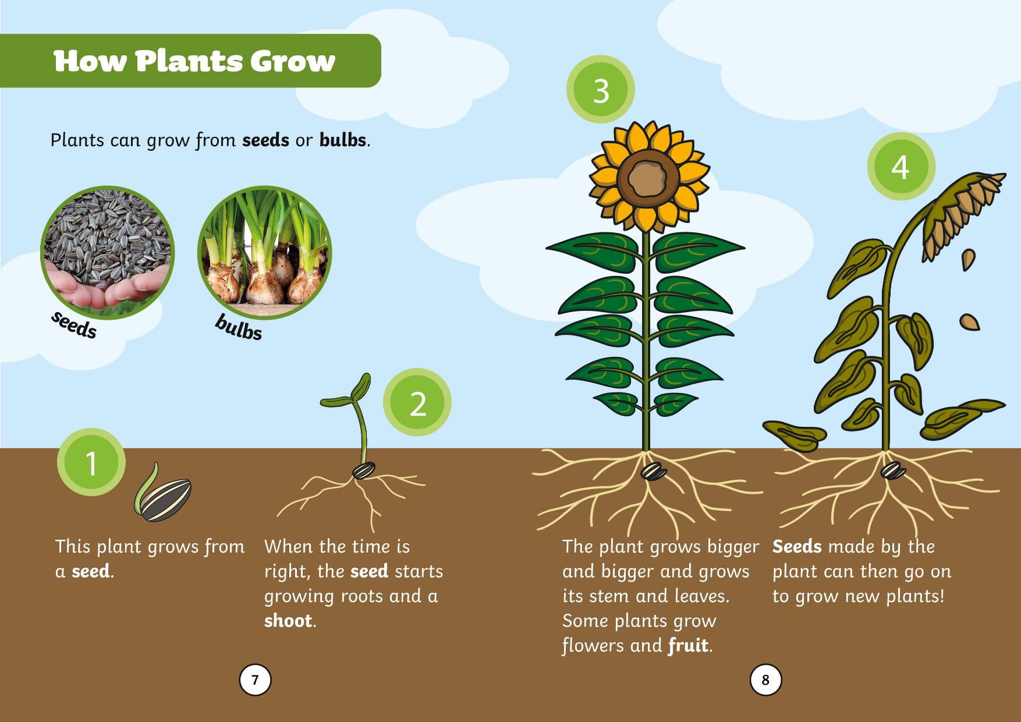

Slide 16
