Slide 1
People we can ask for help.
The following slides will support you to discuss with your child, the people that they can trust and ask for help. Share photographs of family members and friends as well as symbols of people at school and the wider community that they can ask for help.

Slide 2






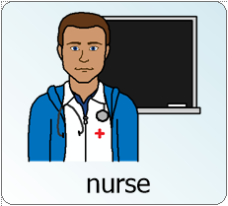
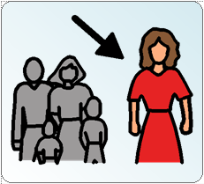



Ask for help if you are worried or feeling bad
You could telephone a friend
This could be a teacher or nurse
You could speak with a parent, carer or other family member.
You could message a friend
School number
0161 539 5322
Remember the rules to stay safe on the internet !

Slide 3

My Trust Hand
In the fingers write the names or stick images of 5 people you can
can talk to if you are
worried or upset.
Use photographs or symbols to talk about people you know and trust. See the word document in the resources section/PSE on the school website.
Childline on call anytime. Childline.org.uk Tel 0800 1111

Slide 4
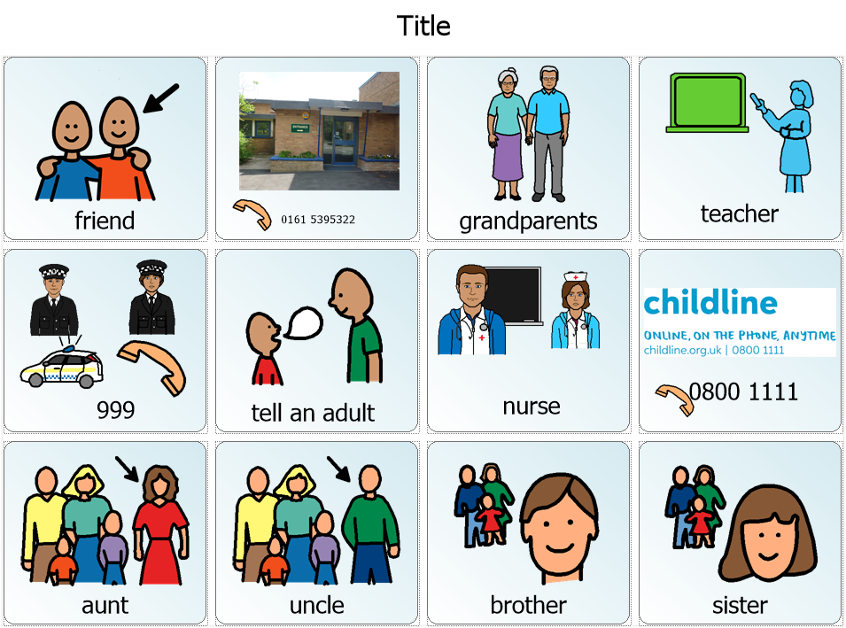

Slide 5

If a child you know asks you for help, you may find the following game helpful in relieving some of their worries
https://www.childline.org.uk/toolbox/games/balloon/

