Slide 2
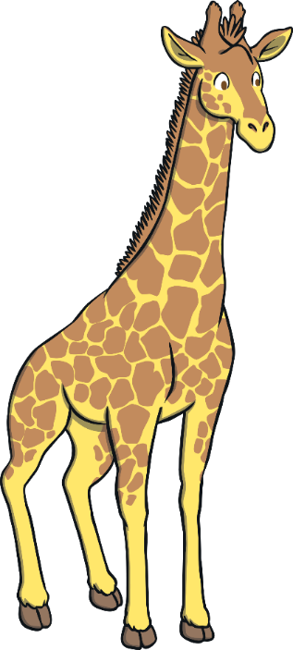


What Am I?
I sometimes have brown patches.
I eat leaves off trees.
I am a giraffe!
I have a long neck.
What am I?
Click on me to reveal the answer.
Start
Next

Slide 3
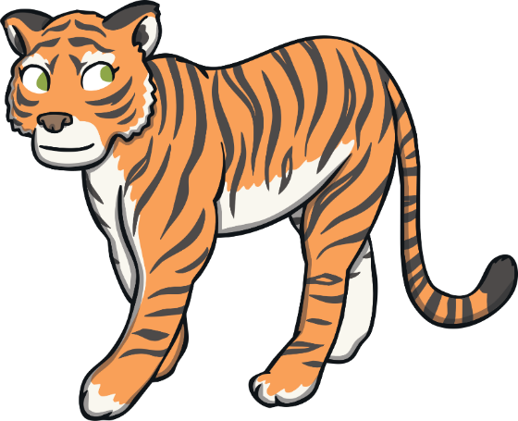
What Am I?
I am a tiger!
I am a type of big cat.
I have sharp claws.
I have stripes.
What am I?
Click on me to reveal the answer.
Previous
Next

Slide 4
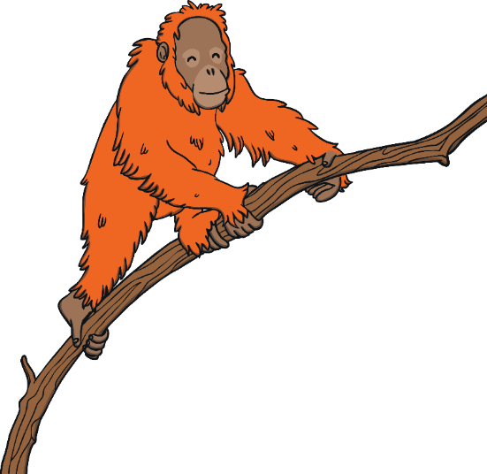
What Am I?
I live in the trees.
I have long arms.
I have orangey-brown hair.
What am I?
I am an orangutan!
Click on me to reveal the answer.
Previous
Next

Slide 5
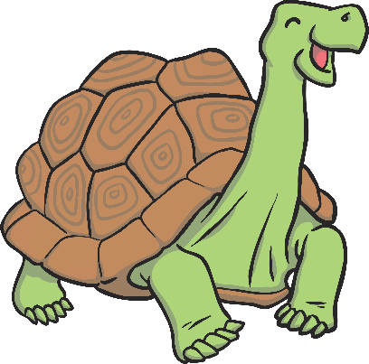
What Am I?
I am a tortoise!
I am very slow.
I can live for more than 200 years.
I have a hard shell.
What am I?
Click on me to reveal the answer.
Previous
Next

Slide 6
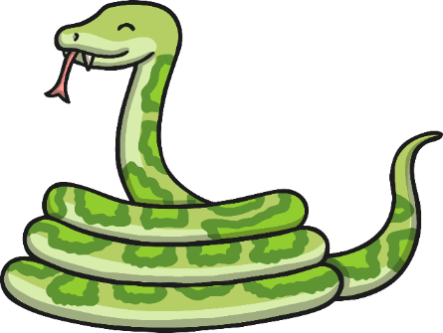
What Am I?
I am a snake!
I can be very long.
I have scales.
I don’t have any arms or legs.
What am I?
Click on me to reveal the answer.
Previous
Next

Slide 7
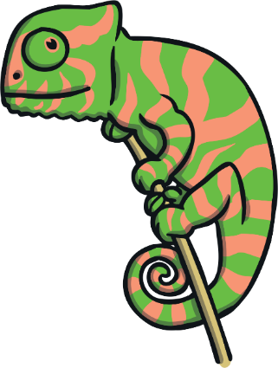
What Am I?
I am a chameleon!
I climb trees.
I am a type of lizard.
I can change colour.
What am I?
Click on me to reveal the answer.
Previous
Next

Slide 8
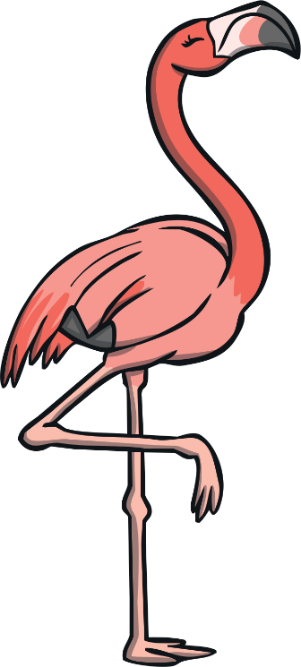
What Am I?
I have wings.
I am a flamingo!
I have long legs.
I am pink.
What am I?
Click on me to reveal the answer.
Previous
Next

Slide 9

What Am I?
I am an elephant!
I have big ears.
I am the largest animal you can find on land.
I have a very long nose.
What am I?
Click on me to reveal the answer.
Previous
Next

Slide 10
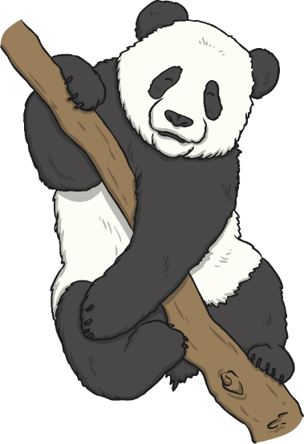
What Am I?
I am a panda!
I eat bamboo.
I am a type of bear.
I am black and white.
What am I?
Click on me to reveal the answer.
Previous
Next

Slide 11
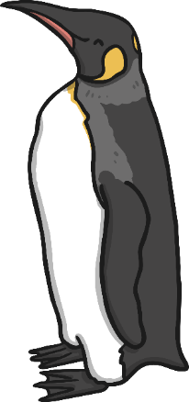
What Am I?
I am a penguin!
I have wings but can’t fly.
I usually live in cold places.
I am a very good swimmer.
What am I?
Click on me to reveal the answer.
Previous
End

