Slide 1
Understanding World Maps

Slide 2
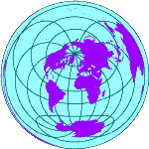

The globe is a sphere, when it is drawn onto a map it becomes distorted.

Slide 3
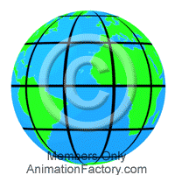
To help us pinpoint places on the globe there are a number of imaginary lines drawn onto the map

Slide 4
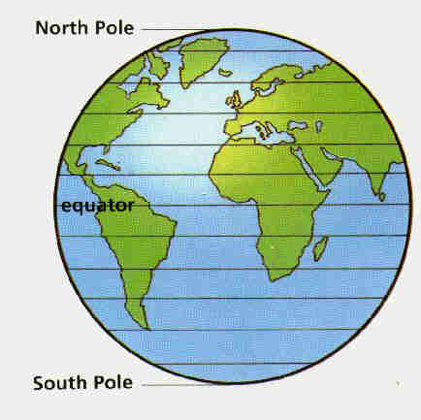
Lines which are drawn parallel around the globe are called:
Lines of Latitude
0 degrees latitude is called the equator.
Other lines of latitude are north or south of the equator.

Slide 5
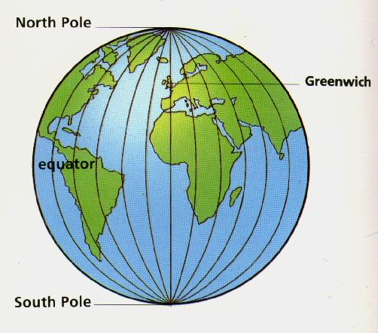
Lines which connect the North and South poles are called:
Lines of Longitude
0 degrees longitude is called the Greenwich Meridian.
Other lines of Longitude are West or East of the Greenwich Meridian.

Slide 6
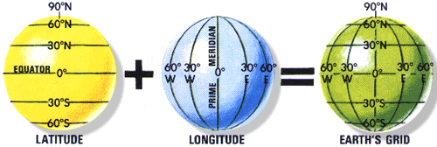
Latitude plus Longitude give us the earth’s grid.

Slide 7
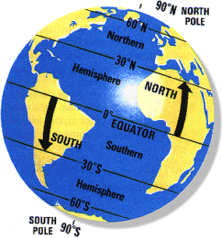
Using lines of Latitude the globe is divided into the Northern and Southern hemisphere.

Slide 8
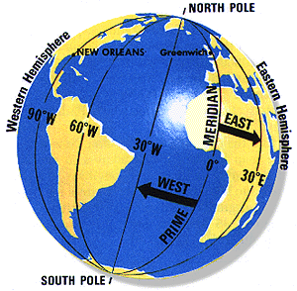
Using lines of Longitude the globe is divided into the Western and Eastern hemisphere.

Slide 9
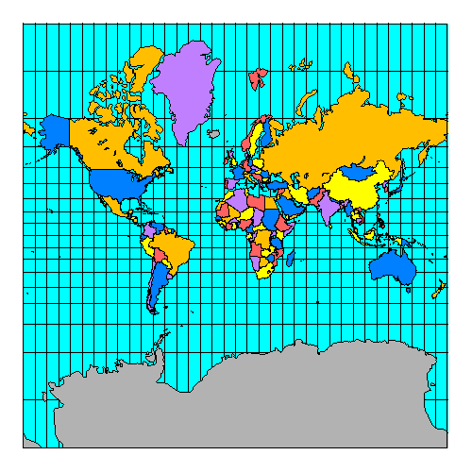
This is how the world map looks…
Here is the United Kingdom.

Slide 10
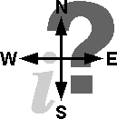

So how can we remember this
A song always helps us to remember…..

Slide 11
The lines of Latitude go round and round, round and round, round and round. The lines of Latitude go round and round they’re always North or South.

Slide 12
The lines of Longitude go up and down, up and down, up and down. The lines of Longitude go up and down they’re always East or West.

Slide 13
Wk beginning 8.6.20
Understand and use longitude and latitude
Latitude | Longitude | Place & Continent belongs to
30S | 140E
10S | 60W
60N | 120W
6ON | 10E
20S | 20E
52N | 1W
40N | 110W
50N | 100E
0 | 20E
Now plot some of your own for a family member/friend to find…

